Slide 1
Main CV scenarios

Slide 2
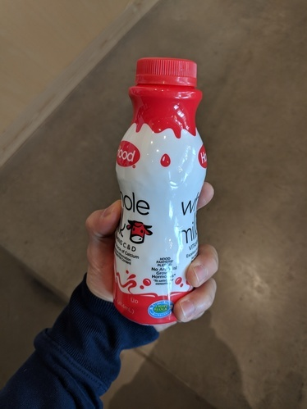
Airplane: no
Bottle: yes
Can: no
Input

Slide 3
Found 1 object:
Class: bottle Position: (100,50, 200, 80)
Input

Slide 4
Input
Segmentation mask

Slide 5
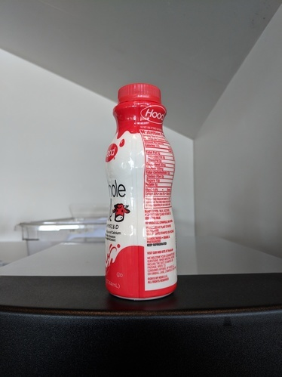
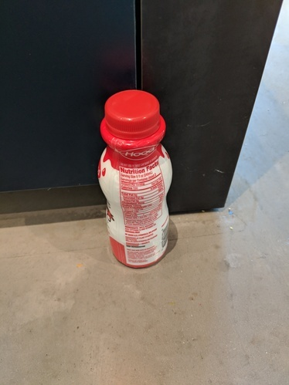
Input
Most similar images

