Slide 1
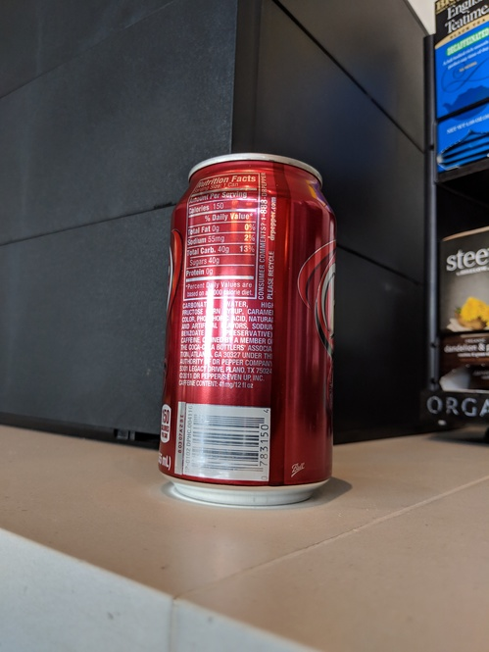
0.85
0.9
0.9
0.9
0.7
0.7

Slide 2
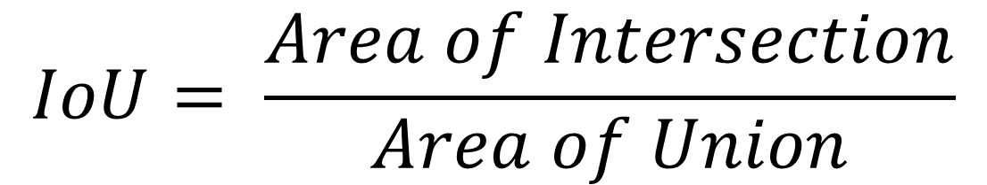
$$IoU= \frac{Area of Intersection}{Area of Union}$$
Intersection

