Slide 1
01
읽기 순서와 다단 레이아웃
Visual order should remain A → B → C even though the content is distributed across columns.
A
B
C
READING-A
READING-B
READING-C
첫 번째 단계 · 수요 신호 수집
두 번째 단계 · 메뉴 조합 최적화
세 번째 단계 · 승무원에게 배포
ORDER-SENTINEL-A-B-C
BENCHMARK · READING ORDER

Slide 2
02
병합 셀과 다단 헤더 표
The table tests merged headers, row spans, Korean labels, numeric values, and special symbols.
TABLE-REGION | 2026 상반기 |  | 2026 하반기
 | 식수 | 만족도 | 식수 | 만족도
ICN | 12,480 | 4.2 / 5 | 13,950 | 4.6 / 5
LAX | 8,120 | 3.9 / 5 | 9,330 | 4.3 / 5
CDG | 6,740 | 4.1 / 5 | 7,010 | 4.4 / 5
합계 Σ | 27,340 | — | 30,290 | Δ +10.8%
TABLE-CELL-LAX-9330
BENCHMARK · TABLE STRUCTURE

Slide 3
03
네이티브 차트와 데이터 레이블
A real PowerPoint chart should preserve series, categories, values, title, and visual trend.
91%
SIN regular meal share
TREND-CONCEPT: SIN highest, CDG lowest
BENCHMARK · NATIVE CHART

Slide 4
04
도형·연결선 기반 프로세스
Connectors are intentionally drawn before nodes so they remain behind the labels.
1
2
3
4
5
FLOW-01
FLOW-02
FLOW-03
FLOW-04
FLOW-05
Collect
Classify
Optimize
Approve
Serve
PROCESS-CONCEPT: Collect → Classify → Optimize → Approve → Serve
BENCHMARK · SHAPES AND CONNECTORS

Slide 5
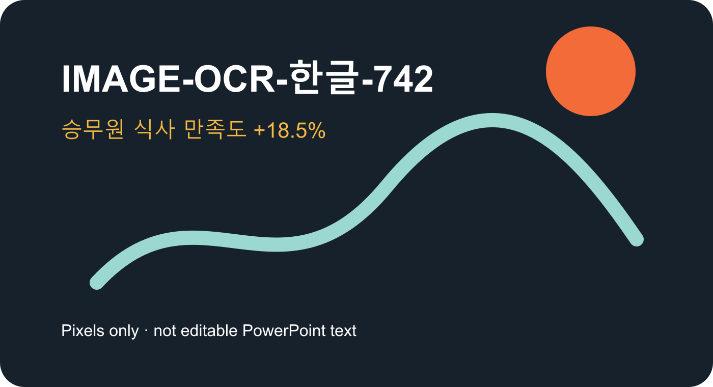
05
이미지 OCR, alt text, 외부 링크
The visible sentinel exists only in raster pixels; accessibility metadata should remain source-only.
LINK-SENTINEL
Open the official Azure Content Understanding overview
The link should survive PPTX and PDF conversion.
BENCHMARK · IMAGE OCR / ALT TEXT / HYPERLINK

Slide 6
06
혼합 언어, 특수기호, 중복 요소, 발표자 노트
Near-identical cards test deduplication while notes remain non-visual source metadata.
DUPLICATE-ALPHA
DUPLICATE-ALPHA-2
DUPLICATE-BETA
Meal #42 · 식사 #42
Meal #42 · 식사 #42
Meal #42 · 식사 #42
MIXED-UNICODE · 한글 English 日本語 · ± ∑ → € ₩ · 2026-07-15
NOTES-ARE-SOURCE-ONLY
BENCHMARK · UNICODE / DUPLICATES / NOTES
Notes:
SPEAKER-NOTE-SENTINEL-906 발표자 메모: PDF 본문에는 나타나지 않아야 하며 PPTX source manifest에서만 평가합니다.

