Slide 1
This is what our current team is imagining how the consent api (FHIR) would work. We are in discussions with the engineering team but none of this is final or official.

Slide 2
Consent App Ver. 1
Patient journey

Slide 3
What if there is a place where patients owns their own medical information
Bring our own health data to any physicians or providers we desire to see
Never needing to re-write all our medical history every time we make a new visit
Give and take away permissions from providers, in need basis.

Slide 4
Patient Flow

Slide 5
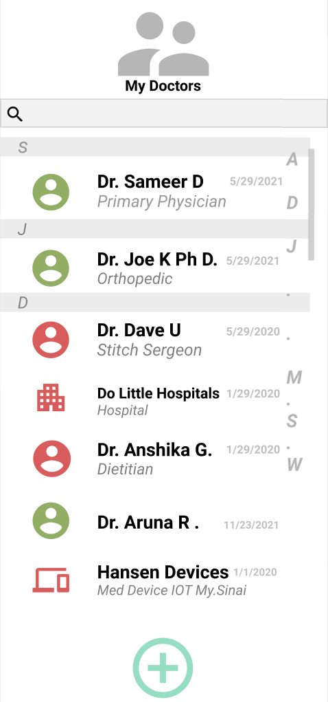
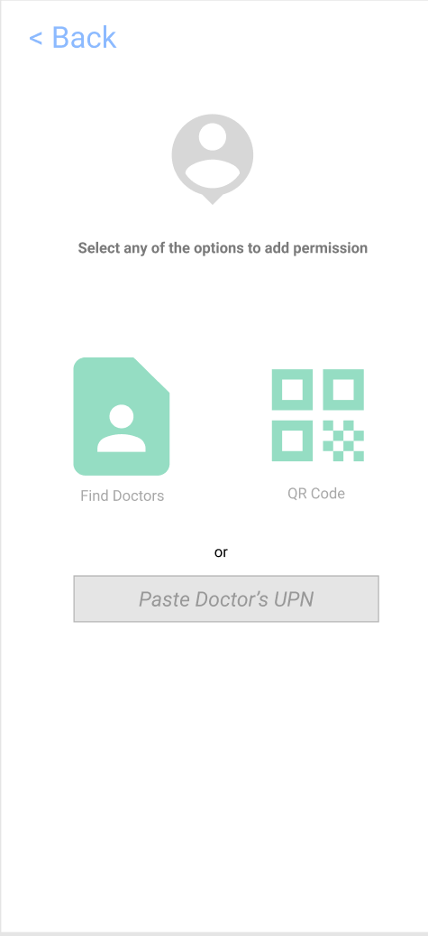
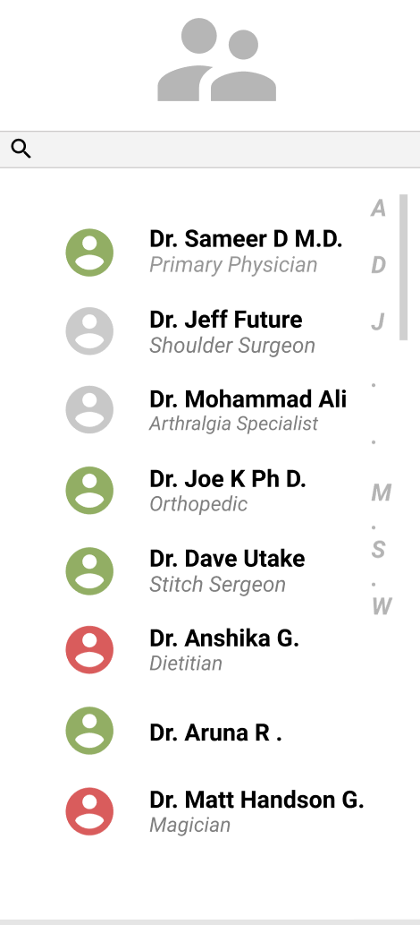
LIST
Doctors you have currently given your consent to.
Find doctors in your network
List of doctors in your network
Available
in-network
doctors
Active
Not added
Expired
Click to find doctors
Represents user click

Slide 6
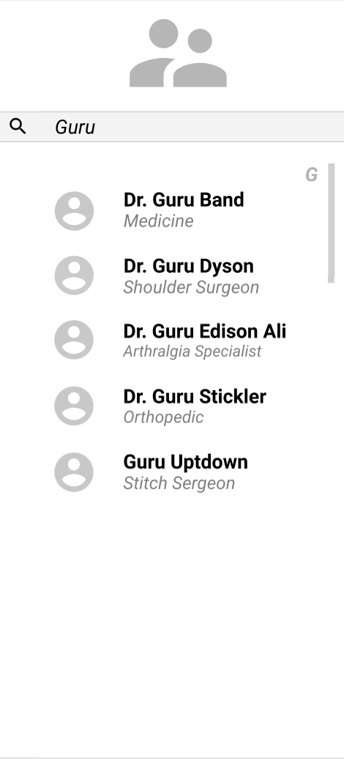
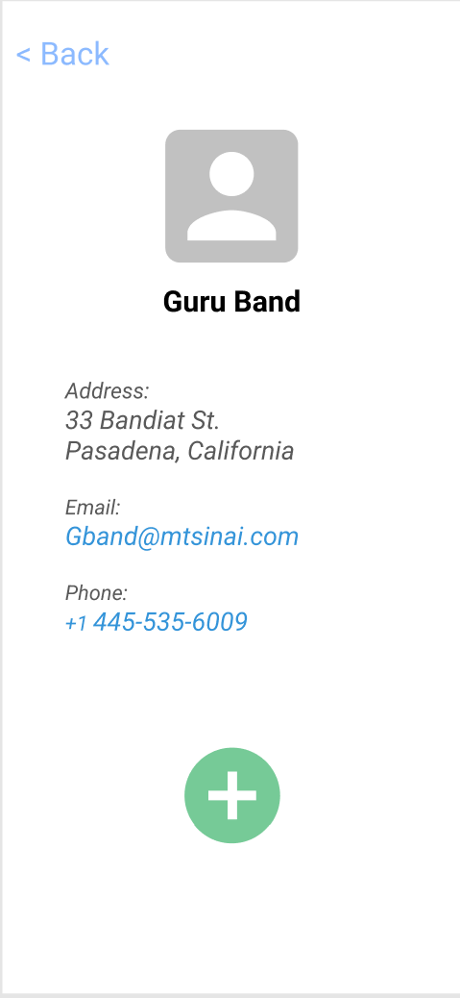
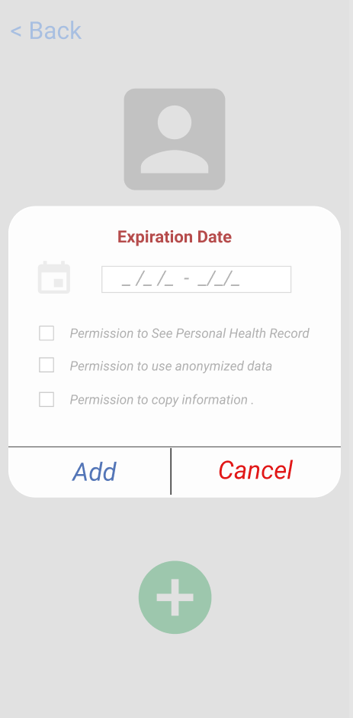
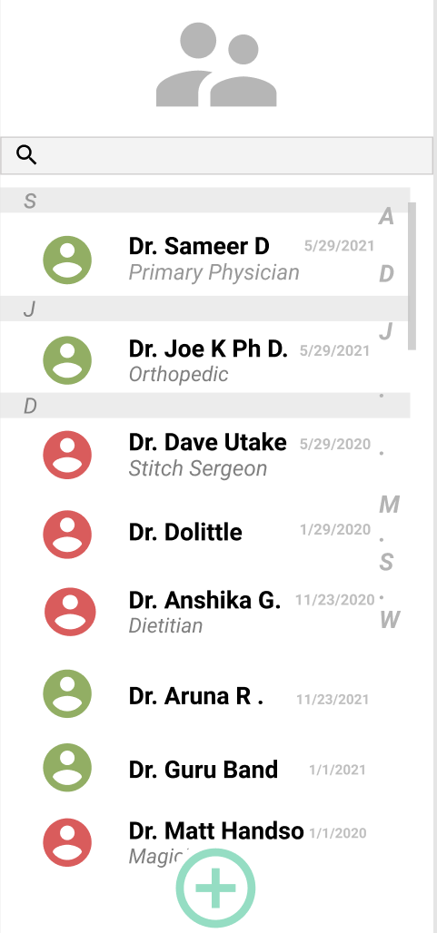
SEARCH & ADD
Set expiration date.
Give other permissions
Added

Slide 7
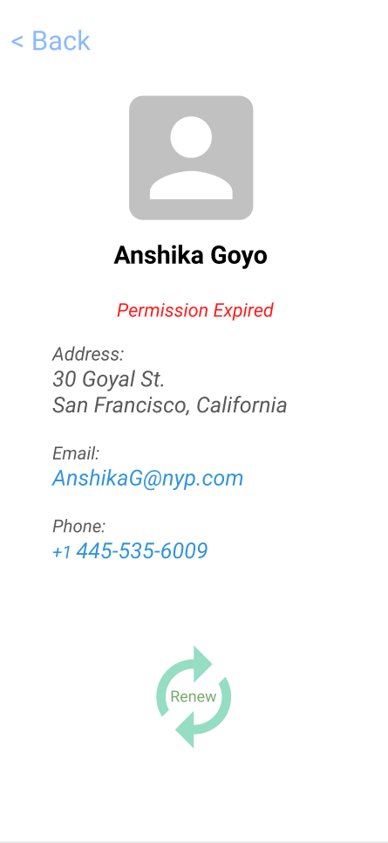
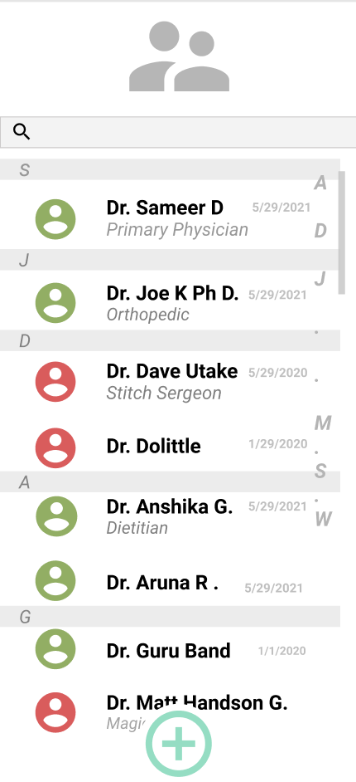
RE-ACTIVATE CONSENT
Reactivated!

Slide 8
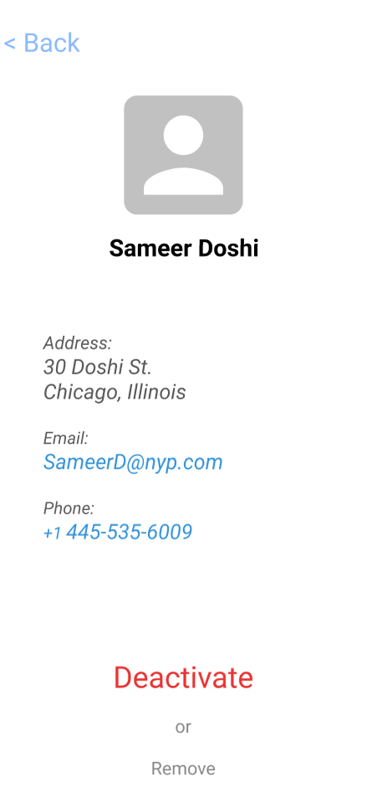
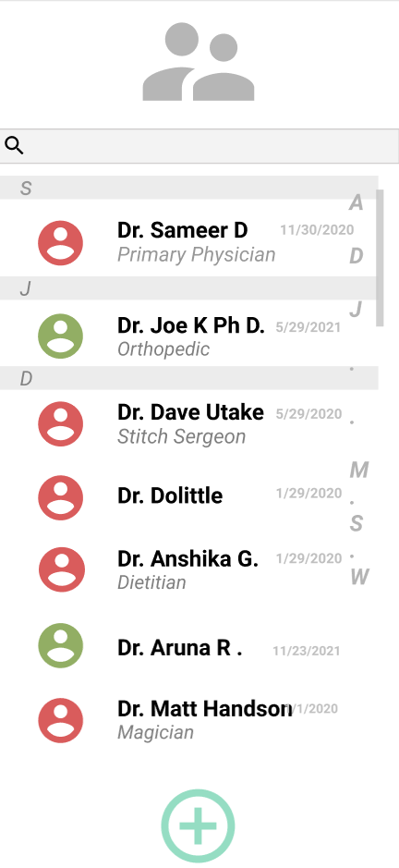
DEACTIVATE CONSENT
Deactivated

Slide 9
What if doctors/providers can request patient information before hand?
Better utilization of time slots
No mistakes from the patients.
No need to ask patients if they need critical information (if permissioned)

Slide 10
Provider Flow

Slide 11
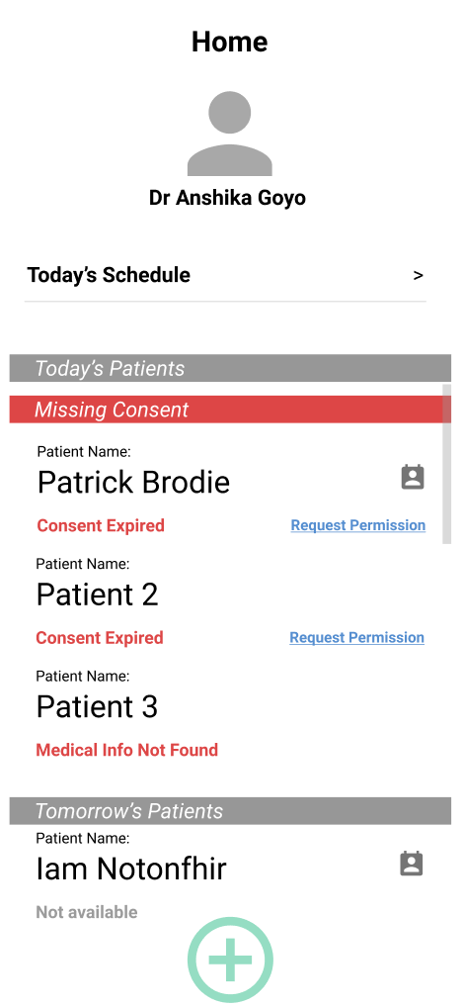
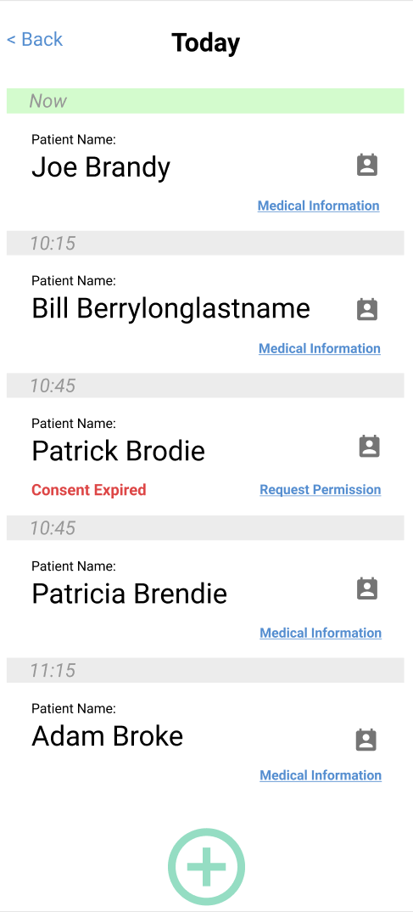
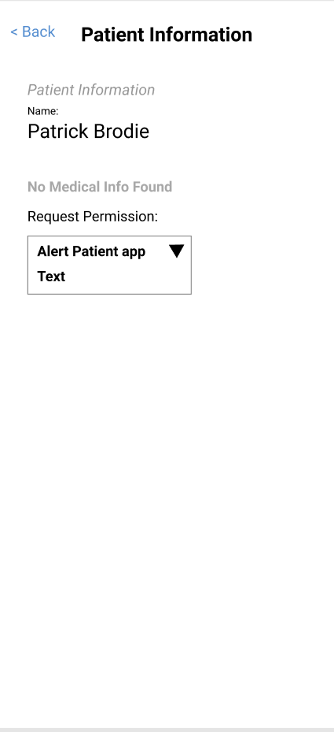
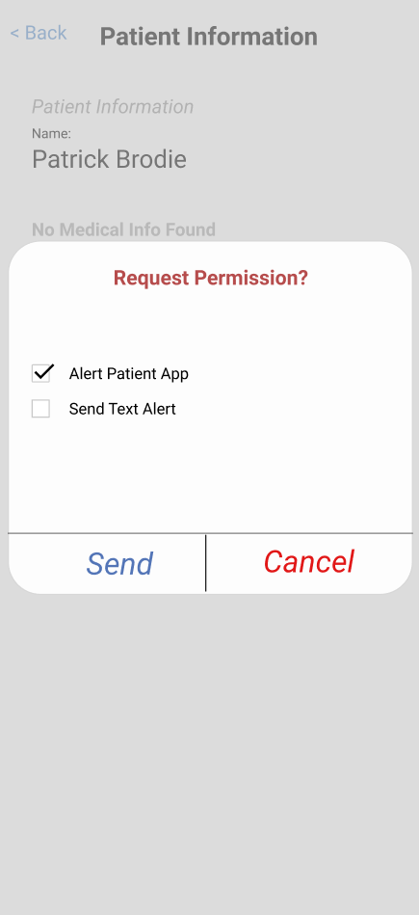
PATIENT LIST AND REQUEST FOR PERMISSION
List of Patients for today
Request permission
This will send notification to patient’s app

Slide 12
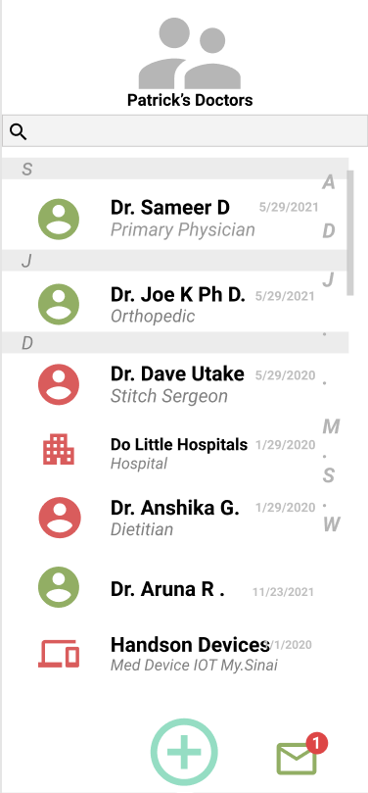
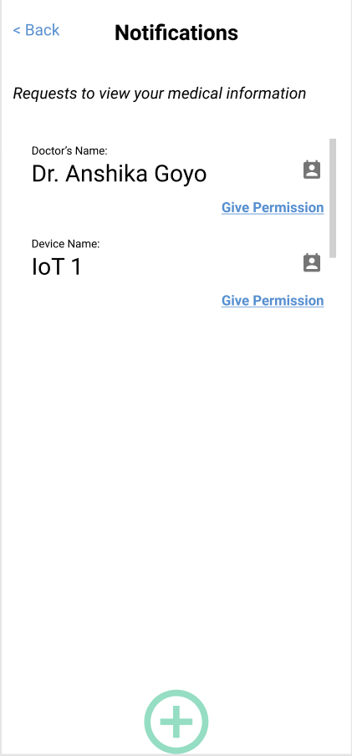
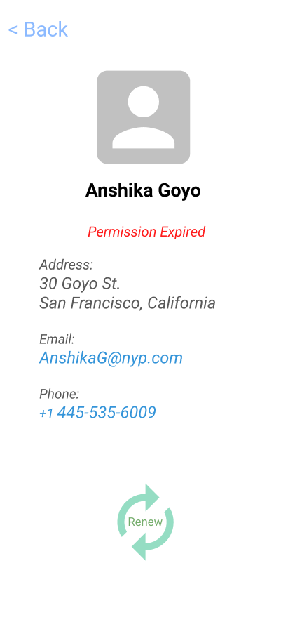
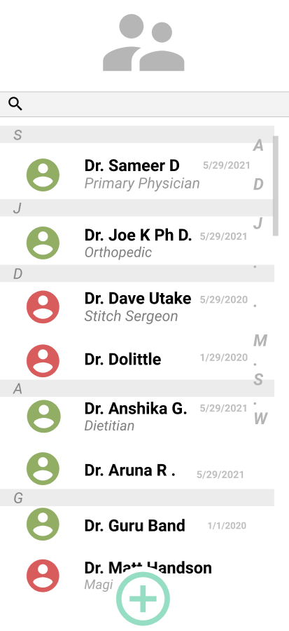
REACTIVATE CONSENT
Patient will get a notification
Reactivated!

Slide 13
Resources
Github: GitHub - microsoft/FHIR-Consent-Samples: Contains FHIR sample for Consent based authorization
Figma:
Provider flow: http://tiny.cc/f938tz
Patient flow: http://tiny.cc/c938tz

