Slide 1
Chapter 6 and pieces
Srikar Mylavarapu

Slide 2
Goals
Different types and members exist
Each one maps to a different thing in the CLR Type and member access/visibility
Keywords galore

Slide 3
Type Visibility
All of the types
Map the change to what we expect in ildasm → from the book

Slide 4
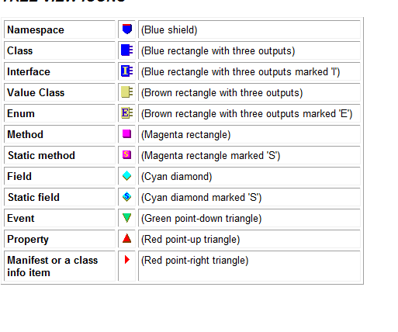
General type
public sealed class SomeType
{
}

Slide 5
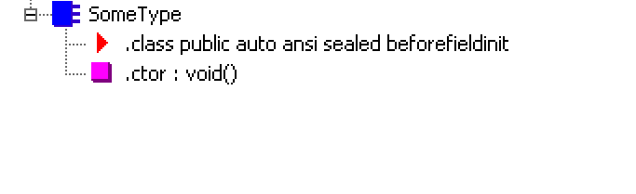
private const Int32 c_Const = 1;
private readonly String m_SomeReadOnly = "2";
private static Int32 s_ReadWrite = 3;

Slide 6
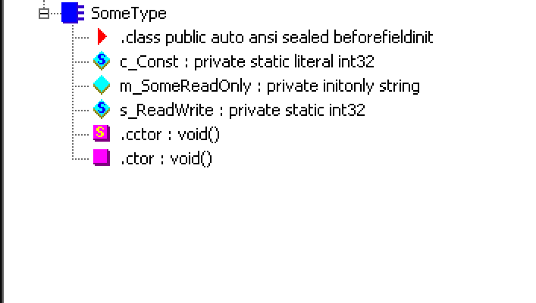
public SomeType(Int32 x) { }
public SomeType() { }
static SomeType() { }

Slide 7
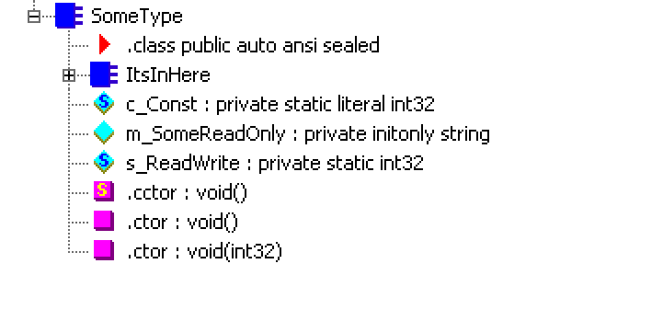
private String InstanceMethod()
{
return "What is weather > 100?";
}
public static void Main() { }

Slide 8
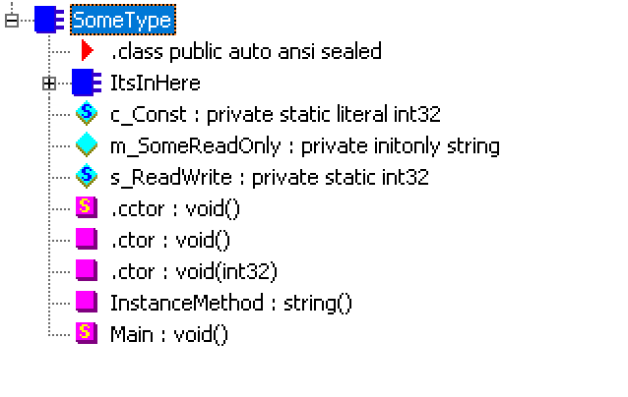
public Int32 SomeProp
{
get { return 0; }
set { }
}
public Int32 this[String s]
{
get { return 0; }
set { }
}

Slide 9
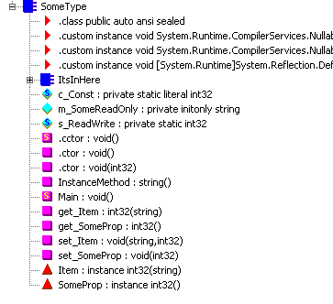
public event EventHandler SomeEvent;

Slide 10
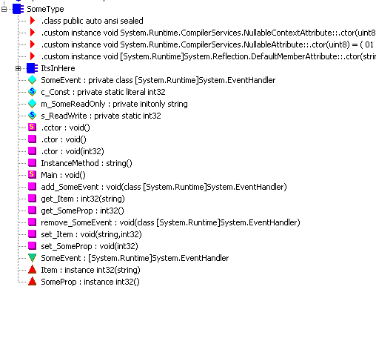

Slide 11
Member Accessibility
CLR Term | C# Keyword
private | Private | Accessible by class and nested classes
Family | Protected | Accessibly by defining types, nested, or derived (so can be different assembly)
Family and Assembly | DNE | Family and same assembly only
Assembly | Internal | Only in this assembly
Family or assembly | Protected internal | Superset of family and assembly
Public | Public | For anyone’s prying eyes

Slide 12

Static Classes via CLR
Just a way to bring common operations together
Common example is Math
In CLR, should be a single, noninstantiable type
Case in point, they don’t have constructors within the CLR

Slide 13
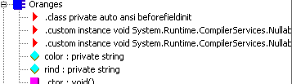
Partial
The source code maybe be in more than one file
Compiler reads it as “combine before making the additive class/struct/int

Slide 14
More KEywords
C# | Type | Method/Prop/Event | Constant/Field
Abstract | No instances can be constructed | Derived type must override/implmenet | Not allowed
Virtual | Not allowed | Can be overridden | ‘’
Override | ‘’ | Overrides base type | ‘’
Sealed | Cannot be used as a base type | Can’t be overridden | ‘’
New | When applied to something, , the member has no relationship to anything in the base/parent class

