Slide 1
Chapter 6 and 7
Srikar Mylavarapu

Slide 2
Goals
Different types and members exist
Each one maps to a different thing in the CLR Type and member access/visibility
Keywords galore

Slide 3
Type Visibility
All of the types
Map the change to what we expect in ildasm → from the book

Slide 4
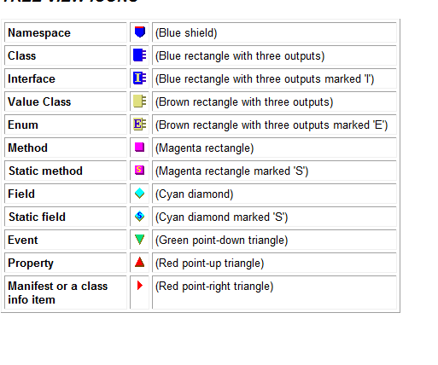
General type
public sealed class SomeType
{
}

Slide 5
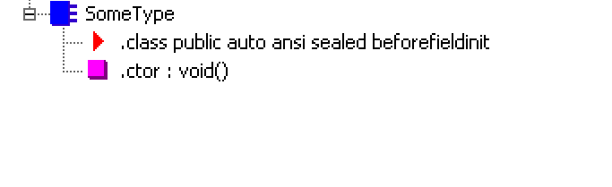
private const Int32 c_Const = 1;
private readonly String m_SomeReadOnly = "2";
private static Int32 s_ReadWrite = 3;

Slide 6
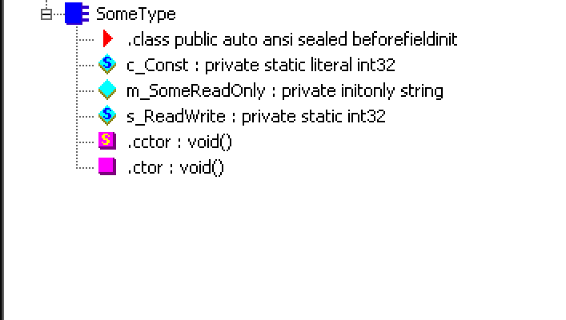
public SomeType(Int32 x) { }
public SomeType() { }
static SomeType() { }

Slide 7
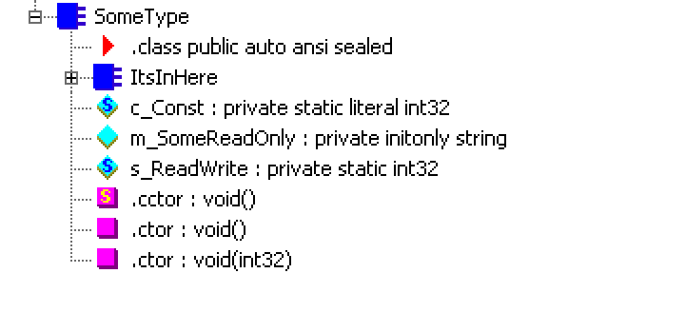
private String InstanceMethod()
{
return "What is weather > 100?";
}
public static void Main() { }

Slide 8
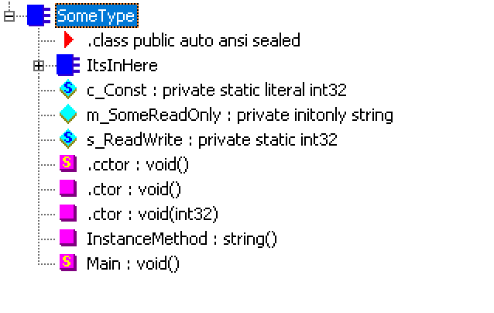
public Int32 SomeProp
{
get { return 0; }
set { }
}
public Int32 this[String s]
{
get { return 0; }
set { }
}

Slide 9
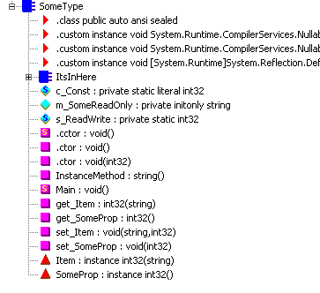
public event EventHandler SomeEvent;

Slide 10
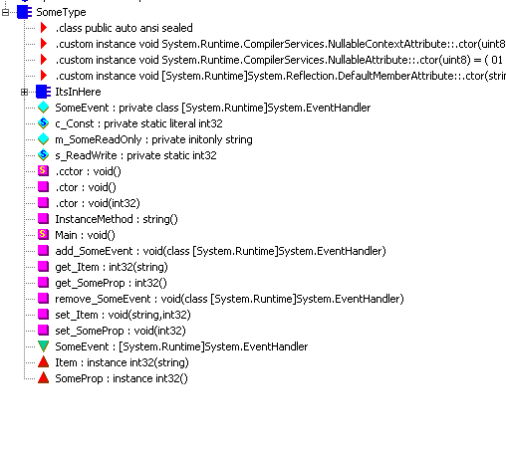

Slide 11
Member Accessibility
CLR Term | C# Keyword
private | Private | Accessible by class and nested classes
Family | Protected | Accessibly by defining types, nested, or derived (so can be different assembly)
Family and Assembly | DNE | Family and same assembly only
Assembly | Internal | Only in this assembly
Family or assembly | Protected internal | Superset of family and assembly
Public | Public | For anyone’s prying eyes

Slide 12

Static Classes via CLR
Just a way to bring common operations together
Common example is Math
In CLR, should be a single, noninstantiable type
Case in point, they don’t have constructors within the CLR

Slide 13
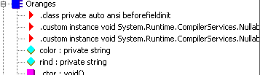
Partial
The source code maybe be in more than one file
Compiler reads it as “combine before making the additive class/struct/int

Slide 14
More Keywords
C# | Type | Method/Prop/Event | Constant/Field
Abstract | No instances can be constructed | Derived type must override/implement | Not allowed
Virtual | Not allowed | Can be overridden | ‘’
Override | ‘’ | Overrides base type | ‘’
Sealed | Cannot be used as a base type | Can’t be overridden | ‘’
New | When applied to something, , the member has no relationship to anything in the base/parent class

Slide 15
Jeff, IL, and virtual
There is a section dedicated to how call IL calls static, instance, and virtual methods with “call”
-- assumption that the value is not null
“callVirt” has to have an object, can’t be used on static variables. on the other hand. This has a tighter check and the value it’s being called on must not be null → perhaps something to think about at scale?

Slide 16
Jeff’s best practices for a safer typed world
Explictly make classes sealed unless it’s meant to be derived later
In CSharpChess, the class for piece could be sealed?
Make data fields explicitly private
Make methods, props, and events inside of a class explicitly private as well
When things are complicated “make more types”

Slide 17
Constants
Implicitly static already,
CLR | C# | Desc
Static | Static | Belongs to type’s state
Instance | Default | Belongs to instance of a type
Initonly | Readonly | Can only be written to in ctors
Volatile | Volatile | Not subject to thread unsafe optimizations

Slide 18
The safety of a constant
Example uses a max entries “public const”
If that is changes, and is not rebuilt, you’ll have problems
By switching it to read only, you’re forcing it to have to rebuild with the new value when calling it again

