Slide 1
Interfaces
Srikar Mylavarapu

Slide 2
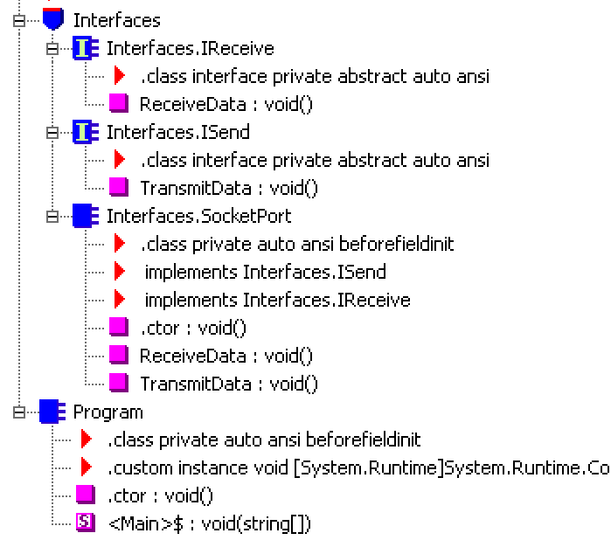
Inside of Ildasm, we have a ‘method table’

Slide 3
Looking at socket port, what do we get?
Virtual methods defined by Object
Implementations and signatures of the interfaces

