Slide 1
Methods
Srikar Mylavarapu

Slide 2
Questions from Last Time
Does order matter for how the compiler reads it (specifically properties)
Fields are initialized immediately before the constructor for the object instance is called. If the constructor assigns the value of a field, it will overwrite any value given during field declaration.
What instantiates the static constructor
Any time there’s a static value in the class, automatically created by compiler
Members are instantiated in order of class declaration
Static Constructors - C# Programming Guide | Microsoft Docs

Slide 3
Review of Value Types and Reference Types
Value types → have their values with them
Generally allocated on stack
‘keyword of struct’
Reference types → point/refer to their values
On heap
‘class’
Can contain references. Each instance is different

Slide 4
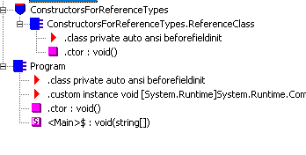
Instance Constructors and Classes
Fundamentally, every class has a default constructor codename ‘.ctor’

Slide 5
Ways to create a reference object without instance constructors
Memberwise clone (protected method of object)
Some Deserialization thing that looks like trivia (or to be talked about at ch 24)
NB – don’t call virtual methods within a ctor that can affect the object under construction as virtual method can be overridden

Slide 6
IL for our method
What happens if we have n constructors, all redoing this method? Code Explosion Fix is basically factor it out
.method public hidebysig specialname rtspecialname
instance void .ctor() cil managed
{
// Code size 15 (0xf)
.maxstack 8
IL_0000: ldarg.0
IL_0001: ldc.i4.6 Store 6
IL_0002: stfld int32 ConstructorsForReferenceTypes.RandomTypeToLookAtInIl::m_x set field m_x to that value
IL_0007: ldarg.0
IL_0008: call instance void [System.Runtime]System.Object::.ctor() call base class ctor
IL_000d: nop
IL_000e: ret
} // end of method RandomTypeToLookAtInIl::.ctor

Slide 7
Instance Constructors for Value Types
don’t necessarily need them
Automatically sets the values to 0/null
Cannot contain explicit parameterless constructors

Slide 8
Type constructors
AKA static constructors, class constructors, and type initializers
Applied to interfaces (not via c#), ref and value types
Never have parameters
Set the initial state of a type → ctors run first time type is accessed
Must be marked static
In generalization → I view these as “instantiating the type” in the CLR

Slide 9
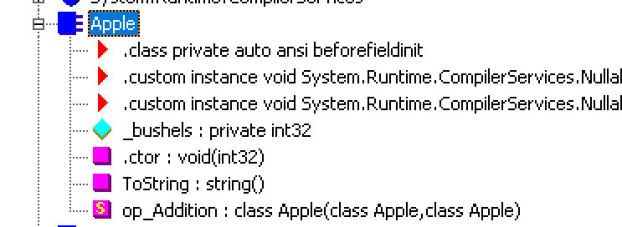
Operator Overloads
Fundamentally, you can “overwrite how even basic functions work”
Need to check if you can do it with primitive
Operator in C#
Overload CLR operator
Use overloaded operator

Slide 10
Oh Jeff
Rules for operator overloading are complicated
Honestly not worth delving into here
Jeff wishes that there were friendlier special names for the
op_special method names. Wishes we could overload them easier. Some people want climate change to be solved, jeff just wants Microsoft to make it easier to overload things.

Slide 11
Conversion Operator methods
Primitive types take care of this automatically
See the Byte to Int
What if it’s not a primitive type
At some level, all of this has to be defined.
Trying something new
Look at Microsoft docs example byte → digit
System.Decimal
Explicit vs implicit

Slide 12
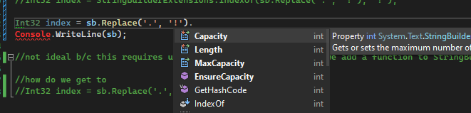
Extension Methods
Lets you “extend” methods or add methods to an existing type
Jeff says the best way to understanding it is via string builder, so lets see if I can get that written up before our session.
Basically, if the value exists in the class, compiler will use it, otherwise it will look for

Slide 13
Some rules
Only looks for it in static classes
Use it sparingly. Not every programmer is Jeff
Might cause versioning problems

Slide 14
Partial Methods
I like to think this is just “define method in two places and CLR combines em”
Look at Ildasm

