Slide 1
Methods
Srikar Mylavarapu

Slide 2
Questions from Last Time
Does order matter for how the compiler reads it (specifically properties)
//TODO get better answer
What instantiates the static constructor
Any time there’s a static value in the class, automatically created by compiler
Members are instantiated in order of class declaration
Static Constructors - C# Programming Guide | Microsoft Docs

Slide 3
Review of Value Types and Reference Types
Value types → have their values with them
Reference types → point/refer to their values

Slide 4
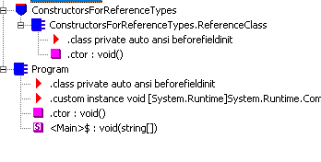
Instance Constructors and Classes
Fundamentally, every class has a default constructor codename ‘.ctor’

Slide 5
Ways to create a reference object without instance constructors
Memberwise clone (protected method of object)
Some Deserialization thing that looks like trivia (or to be talked about at ch 24)
NB – don’t call virtual methods within a ctor that can affect the object under construction as virtual method can be overridden

Slide 6
IL for our method
What happens if we have n constructors, all redoing this method? Code Explosion Fix is basically factor it out
.method public hidebysig specialname rtspecialname
instance void .ctor() cil managed
{
// Code size 15 (0xf)
.maxstack 8
IL_0000: ldarg.0
IL_0001: ldc.i4.6 Store 6
IL_0002: stfld int32 ConstructorsForReferenceTypes.RandomTypeToLookAtInIl::m_x set field m_x to that value
IL_0007: ldarg.0
IL_0008: call instance void [System.Runtime]System.Object::.ctor() call base class ctor
IL_000d: nop
IL_000e: ret
} // end of method RandomTypeToLookAtInIl::.ctor

Slide 7
Instance Constructors for Value Types
List rules here

Slide 8
Type constructors
AKA static constructors, class constructors, and type initializers
Applied to interfaces (not via c#), ref and value types
Never have parameters
Set the initial state of a type → ctors run first time type is accessed
Must be marked static
In generalization → I view these as “instantiating the type” in the CLR

