Slide 1
Why does the Common Language Runtime (CLR) exist
CLR via C#
Srikar Mylavarapu

Slide 2
Assumptions/PreReqs
I am assuming you know as much as I do– which is close to nothing
If you have time, please look over slides/repos before the meeting but not required
The first bit is going to be a lot of review/story telling.
It’s called CLR via C# so we might as well start with why CLR exists

Slide 3
Objectives
For the Course
For Today
Go through the practical parts/essence of CLR via C#
Make everything as tangible as possible
Github.com/rakirs2/…
A general idea of how we got here
How a basic C# program works
Making sure the code “deployment” pipeline works
Managed vs unmanaged code

Slide 4
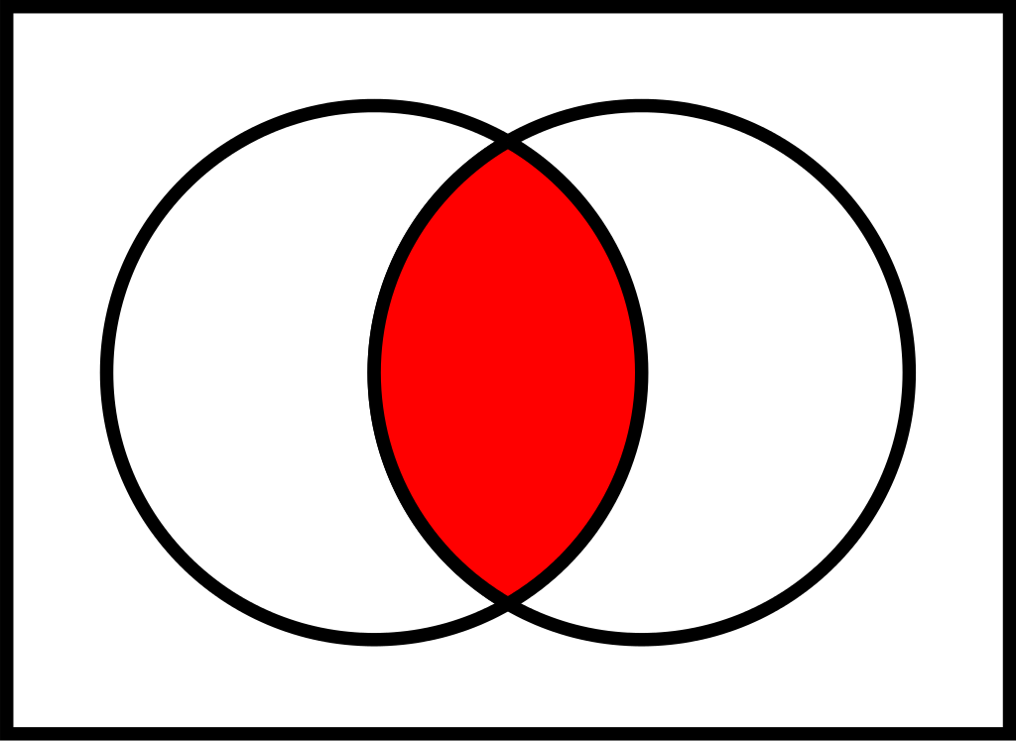
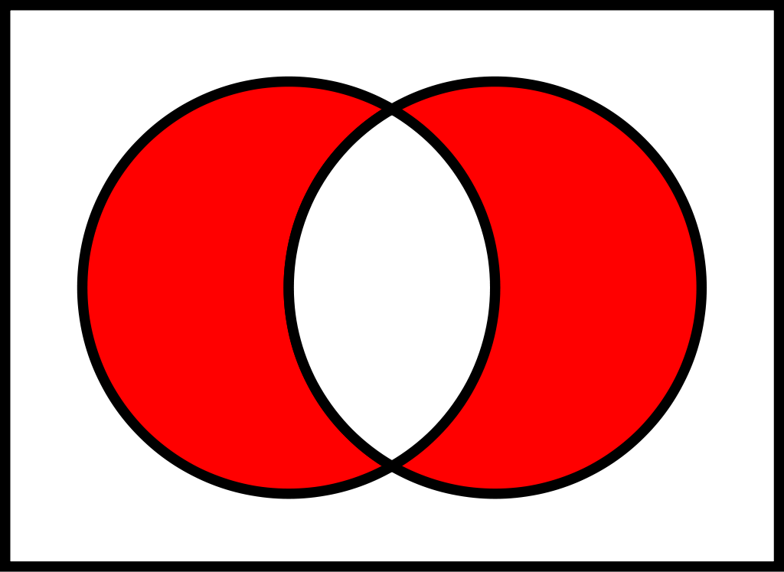
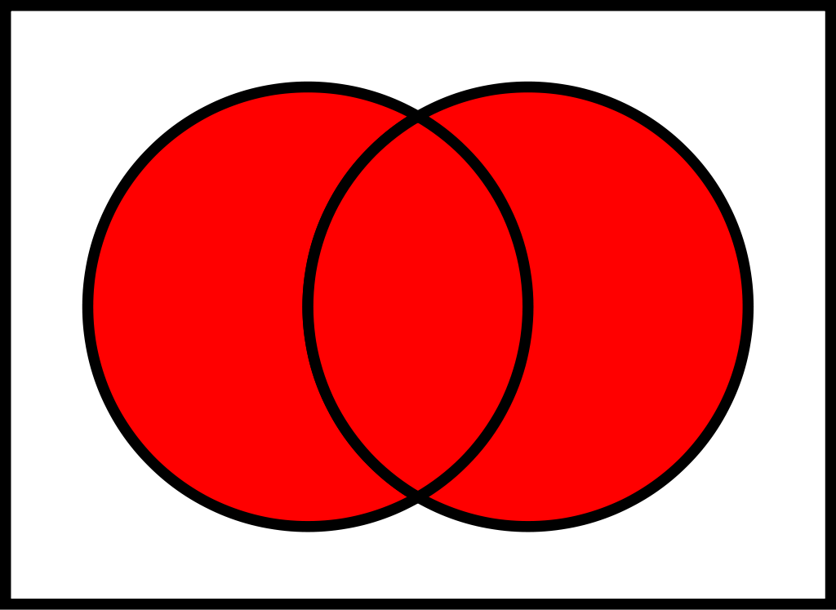
Boolean Algebra

Slide 6
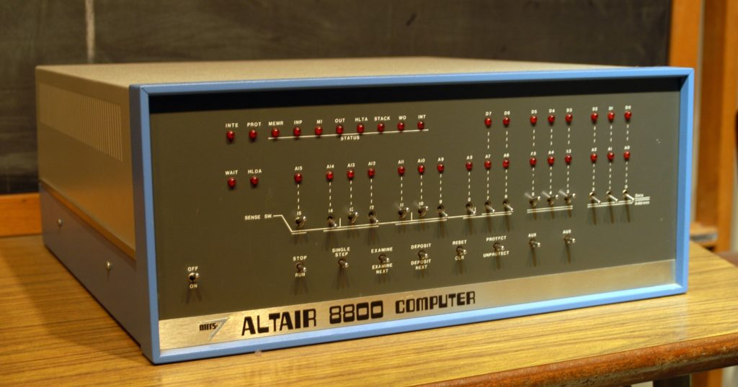
Computers are basically born
1948 First Computer
1956 they use transistors at MIT
1975 Altair BASIC– Microsoft’s first product
--That’s insanely fast
Lithium discovered in 1800s, used for bipolar in 1970s
Number Theory; first real use is probably cryptography

Slide 7
How do computers work
At the deepest level, there’s a bunch of 0’s and 1s that are just bit manipulations
01101000 01100101 01101100 01101100 01101111 00100000 01110111 01101111 01110010 01101100 01100100

Slide 8
Classic Problem
We have a computer that speaks a language of 1s and 0s (binary or machine code)
We have humans who do not understand that language easily
https://youtu.be/rIUj1zk2XkM?t=230

Slide 9
Assembly
We take something like binary and put something that’s occasionally readable on top of it
Basically telling computer exactly what to do
It is assembled into machine code before it runs
global _main
extern _printf
section .text
_main:
push message
call _printf
add esp, 4
ret
message:
db 'Hello, World', 10, 0

Slide 10
Ok, but I want something that looks readable
1972-C
Debatably easy for a Human to read. Much harder for a computer to understand
How do we run this on a computer?
#include <stdio.h>
int main()
{
printf("Hello World");
return 0;
}

Slide 11
What if I want more complicated Functions
Not everything can be described by functions
Sometimes usecases need properties/objects etc.
C++
Superset of C
“Now we have classes”

Slide 12
Why don’t we use C++ for everything?
int main() {
int * q = new int;
}
It works right?

Slide 13
People have different types of computers
What if I have customers running Linux, Windows and Macintosh?
Kind of the same problem
Create something that can take in the

Slide 14
Java (1990)
Sun Microsystems (Acquired by Oracle)
James Gosling
JRE
Garbage collection
null
Java Code
Compile
Bytecode
JRE
Run on System in machine code

Slide 15

Microsoft in the early 90s/2000s
Was not exactly the biggest supporter of Open Source
Anders Hejlsberg
In a sense, C++ and Java
Garbage Collection
Run anywhere you can run a CLR

Slide 16
How a C# program executes
C#
Compile
Bytecode
JRE
Run on System in machine code

Slide 17
Starting with Hello World

