Slide 1
Chapter 6 and pieces
Srikar Mylavarapu

Slide 2
Goals
Different types and members exist
Each one maps to a different thing in the CLR Type and member access/visibility
Keywords galore
Some stuff that’s popped up
GAC

Slide 3
Type Visibility
All of the types
Map the change to what we expect in ildasm → from the book

Slide 4
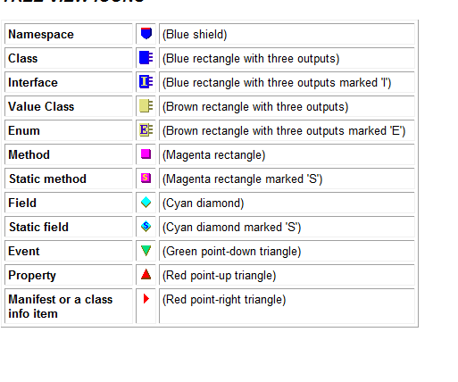
General type
public sealed class SomeType
{
}

Slide 5
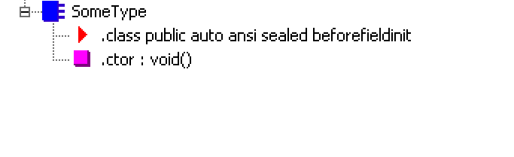
private const Int32 c_Const = 1;
private readonly String m_SomeReadOnly = "2";
private static Int32 s_ReadWrite = 3;

Slide 6
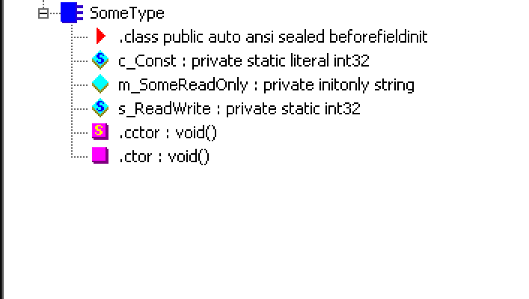
public SomeType(Int32 x) { }
public SomeType() { }
static SomeType() { }

Slide 7
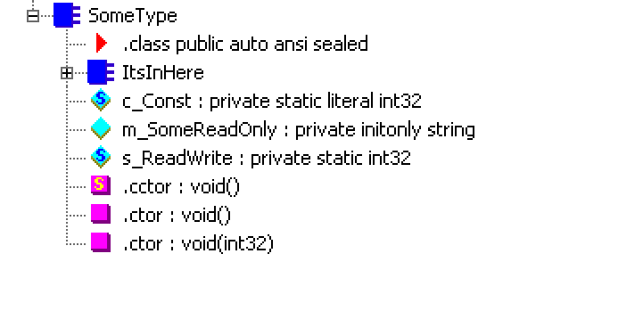
private String InstanceMethod()
{
return "What is weather > 100?";
}
public static void Main() { }

Slide 8
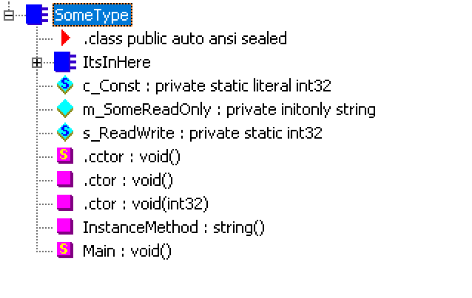
public Int32 SomeProp
{
get { return 0; }
set { }
}
public Int32 this[String s]
{
get { return 0; }
set { }
}

Slide 9
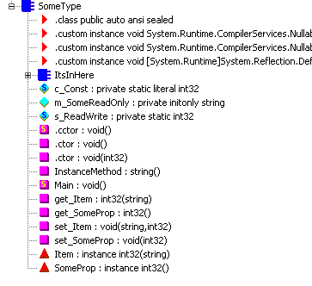
public event EventHandler SomeEvent;

Slide 10
