Slide 1
Telcommunications Accelerator
Packaging & Layering
Telco Sales Apps
Telco Plant Maintenance Apps
Telco Sales CDM
Telco Plant Maintenance CDM
Telco Apps
Dynamics 365 Sales
Telco Common CDM
Microsoft Dataverse
Telco Specific Solutions
Existing Microsoft Business Applications Solutions

Slide 2
Telco Common CDM -> Primary Entities
Entity Name
Account
Contact
External System
Geographic Address
Geographic Location
Geographic Place
Geographic Point
Geographic Sub-Address
Local Place
Network
Network Operating Center
Network Resource
Network Resource Type
Network Zone
Place
Service Area
Service Area Geographical Place
Service Area Technology
Telco Sales Apps
Telco Plant Maintenance Apps
Telco Sales CDM
Telco Plant Maintenance CDM
Telco Apps
Dynamics 365 Sales
Telco Common CDM
Microsoft Dataverse

Slide 3
Telco Apps -> Enriched Entities
Telco Sales Apps
Entity Name
Geographic Address
Geographic Location
Local Place
Network Resource
Network Zone
Service Area
Telco Plant Maintenance Apps
Telco Sales CDM
Telco Plant Maintenance CDM
Telco Apps
Dynamics 365 Sales
Telco Common CDM
Microsoft Dataverse

Slide 4
Telco Apps -> Apps
Telco Sales Apps
Telco Plant Maintenance Apps
Telco Sales CDM
App Name | Type
Find Geo Address | Canvas
Place Management | Model-driven
Telco Plant Maintenance CDM
Telco Apps
Dynamics 365 Sales
Telco Common CDM
Microsoft Dataverse

Slide 5
Telco Sales CDM -> Enriched Entities
Telco Sales Apps
Entity Name
Lead
Place
Service Area Technology
Opportunity
Quote
Order
Telco Plant Maintenance Apps
Telco Sales CDM
Telco Plant Maintenance CDM
Telco Apps
Dynamics 365 Sales
Telco Common CDM
Microsoft Dataverse

Slide 6
Telco Sales Apps -> Enriched Entities
Entity Name
Lead
Lead Serviceability Flow
Telco Sales Apps
Telco Plant Maintenance Apps
Telco Sales CDM
Telco Plant Maintenance CDM
Telco Apps
Dynamics 365 Sales
Telco Common CDM
Microsoft Dataverse

Slide 7
Telco Sales Apps -> Apps
Telco Sales Apps
App Name | Type
Lead Serviceability Check | Canvas
Telco Sales | Model-driven
Telco Plant Maintenance Apps
Telco Sales CDM
Telco Plant Maintenance CDM
Telco Apps
Dynamics 365 Sales
Telco Common CDM
Microsoft Dataverse

Slide 8
Telco Plant Maintenance CDM -> Primary Entities
Telco Sales Apps
Entity Name
Maintenance Activity
Maintenance Plan
Maintenance Plan Network Resource
Maintenance Type
Telco Plant Maintenance Apps
Telco Sales CDM
Telco Plant Maintenance CDM
Telco Apps
Dynamics 365 Sales
Telco Common CDM
Microsoft Dataverse

Slide 9
Telco Plant Maintenance CDM -> Enriched Entities
Telco Sales Apps
Telco Plant Maintenance Apps
Telco Sales CDM
Entity Name
Network Resource
Telco Plant Maintenance CDM
Telco Apps
Dynamics 365 Sales
Telco Common CDM
Microsoft Dataverse

Slide 10
Telco Plant Maintenance Apps -> Enriched Entities
Telco Sales Apps
Entity Name
Geographic Address
Geographic Location
Local Place
Maintenance Activity
Network Resource
Service Area
Telco Plant Maintenance Apps
Telco Sales CDM
Telco Plant Maintenance CDM
Telco Apps
Dynamics 365 Sales
Telco Common CDM
Microsoft Dataverse

Slide 11
Telco Plant Maintenance Apps -> Apps
Telco Sales Apps
App Name | Type
Plant Maintenance | Model-driven
Telco Plant Maintenance Apps
Telco Sales CDM
Telco Plant Maintenance CDM
Telco Apps
Dynamics 365 Sales
Telco Common CDM
Microsoft Dataverse

Slide 12
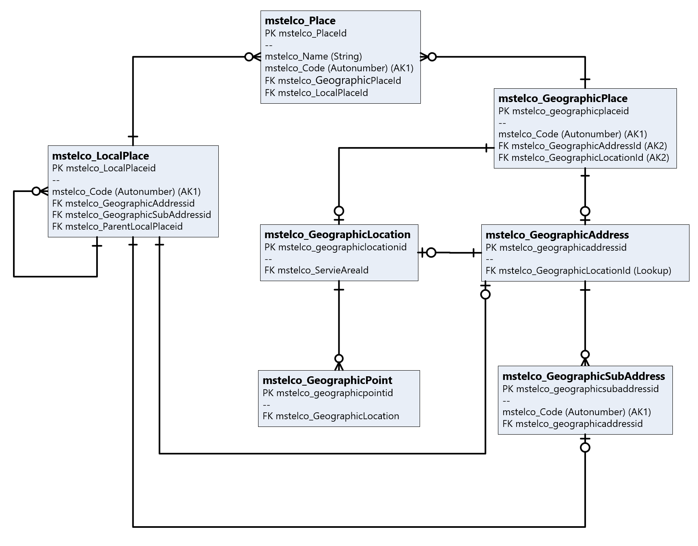
Telecommunications CDM – Place Management - ERD

Slide 13
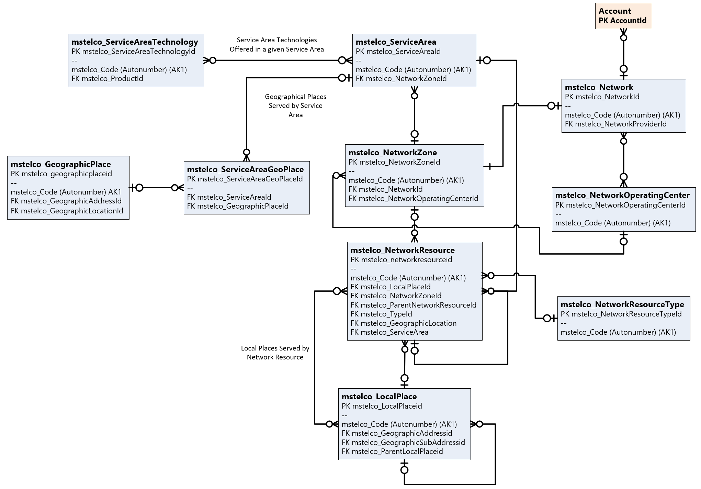
Telecommunications CDM – Network Management - ERD

Slide 14
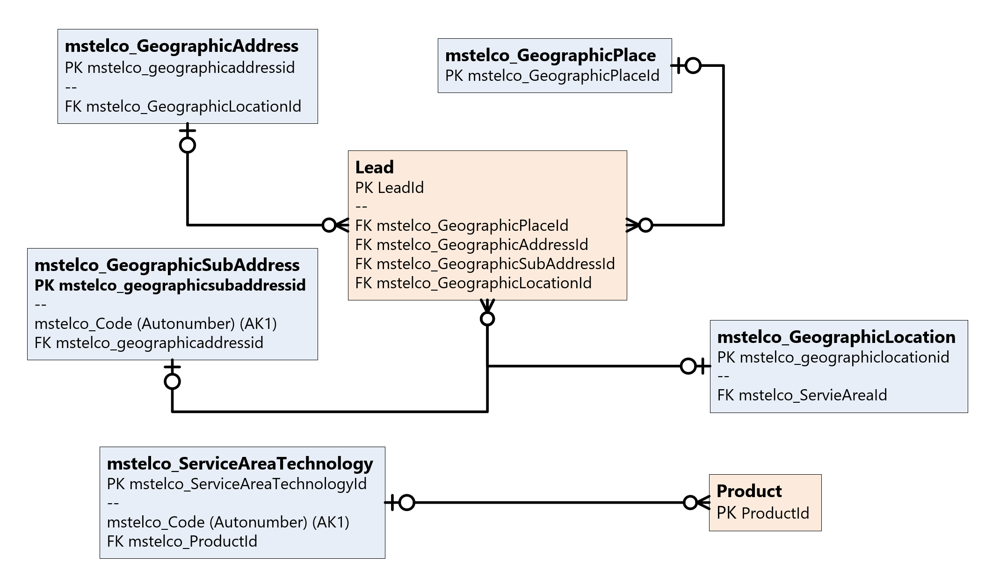
Telecommunications CDM – Telco Sales - ERD

Slide 15
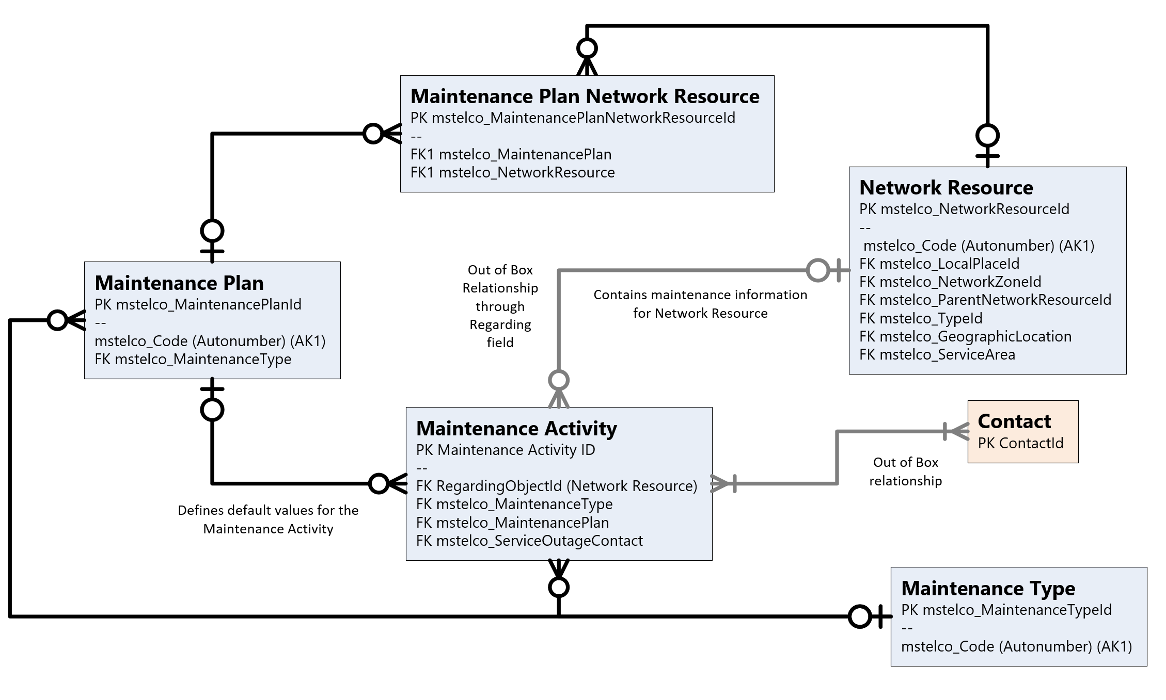
Telecommunications CDM
Plant Maintenance - ERD

