Slide 1

CFC Briefing
Last updated December 15, 2022 | aka.ms/Microsoft-QnA-GitHub

Slide 2
Hey you!
Thank you for taking time to find out more about this program.
Before we talk about Microsoft Q&A program and its upcoming CFC, you may view the recording along with this deck here

Slide 3
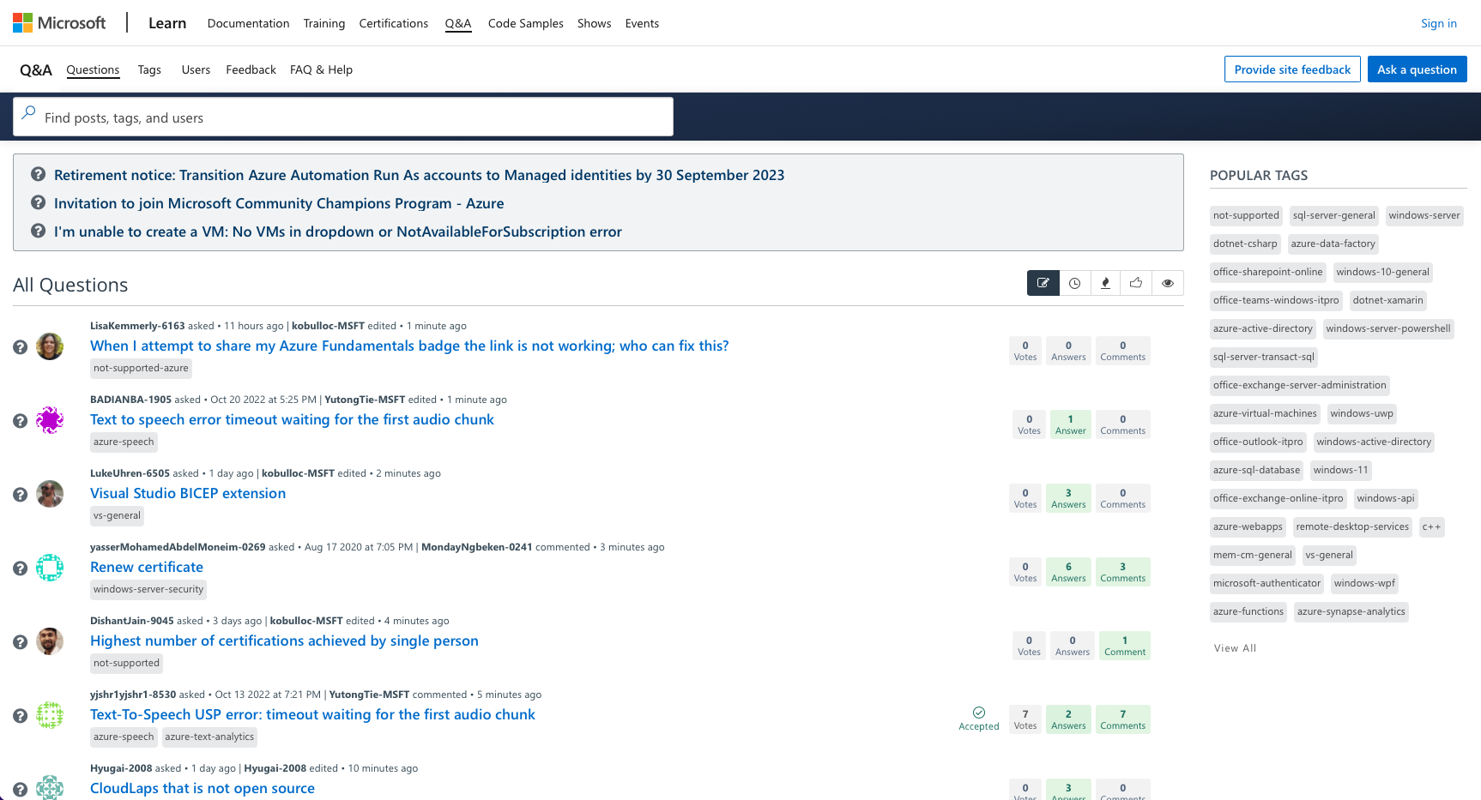
Have you experienced asking a question on Microsoft Q&A?
Visit https://aka.ms/Microsoft-QnA
to experience finding a solution on the forum

Slide 4
Why we do this?
According to MSFT Community Champion Program, Community experts are answering 500 questions a month.
Answers are written, instructional – often telling, rather than showing.
There is an opportunity for us to engage our community better.
Short sizzles with more Show and less Tell addressing frequently asked questions on Microsoft Q&A can engage and help our community learn better

Slide 5
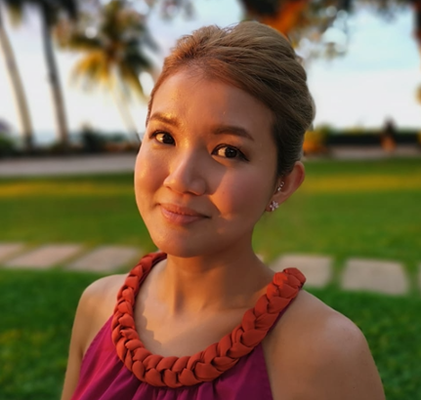
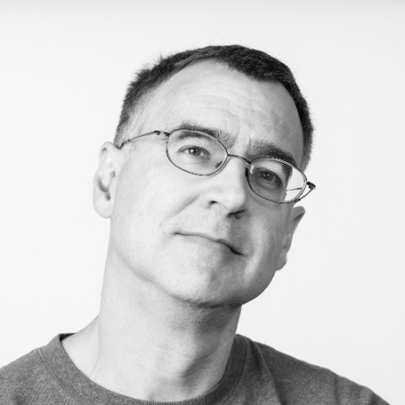
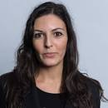
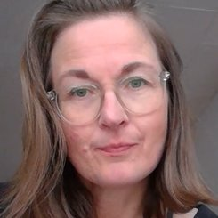
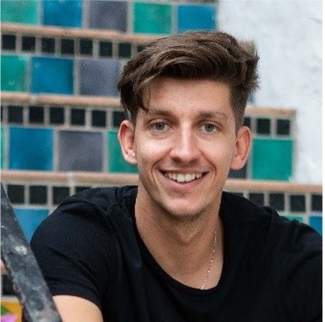

Microsoft Q&A Short Video Content V-team
Frank Boucher
Cloud Advocate
Suzanne Chen
Program Manager
Program Management (All-up)
Ross Heise
Senior Video Producer
Alice Piras
Community Program Manager
..and your region’s CPM
Tina Stenderup-Larsen
Community Program Manager
Martin Tatar
Community Program Manager
Priya Agrawal
Senior Program Manager
Azure Community Champions Program

Slide 6
How do we do this?
We encourage and would love for you and the tech community to partnering us in creating a piece of video content in addressing the most frequently asked questions on Microsoft Q&A
We want to show, not just tell. Let’s encourage collaboration and dialogues.
The deliverable
No longer than a 2-minute bite sized video, addressing exactly a HOW-TO a question (Watch sample on Github page)
Placed on Microsoft YouTube Channels, Microsoft Q&A and other forums

Slide 7
What’s in it for me?
Monthly Recognitions | @AzureSupport / Twitter + LinkedIn Recognition* [Criteria: Top 3 contributors]
 | @AzureHeroes / Twitter Badges for social media* [Criteria: Top 3 contributors]
 | MSFT Q&A Monthly Leaderboard* [Criteria: Top 10 contributors across Az service areas]
 | Community Expert Badges
 | Gift cards $50 to 20+ top contributors monthly
All-time Top member Privileges [Criteria: 100+ answers] | MVP Award: Assistance with Nominations | Renewals
 | MSFT NDA via Azure Connections Program
 | Photo/ mention in MSFT Q&A Leaderboard
 | Q&A Moderator privileges
Networking: Be a part of like-minded thriving community of technology experts and leaders
*accurate as of December 14, we are still improving these benefits and hence, this is subjected to revision without prior notice

Slide 8
CFC Process
Content Creator looks through briefing notes and recording, attends optional Office Hours to have any questions answered
Content creator completes CFC submission
Submitted content is reviewed
Successful submissions will be announced via GitHub and email
Video is produced
Content Creator places video on forums and other platforms
Content Creator's recognition is added on Leaderboard
Q&A Program and CFC launches
By December 30
8 weeks
Check weekly for updates on the questions that have been submitted and approved.
Possible back and forth iterations will likely take place during these two phases so that we get information as accurate as possible

Slide 9
Creators’ Resources
One-stop "shop"
GitHub - https://aka.ms/Microsoft-QnA-GitHub
Briefing notes
Sample script, videos screen captures, still images
Sample final output
Template script to complete
How to write quality answer
Approved questions and contributors
Contributors ranking and emojis (All-Contributors)
CFC Form to complete
When submission is approved, refer to Tech Community Champion Guidelines before posting
We will also be updating the page with Frequently Asked Questions.

Slide 10
Amplification on other channels
Apart from Microsoft Q&A
Microsoft Learn
Microsoft Developer YouTube Channels
https://stackoverflow.microsoft.com/questions

Slide 11
Frequently Asked Questions
How do I know that I would not be answering a question that has been answered?
Approved submissions to the CFC and their respective questions will be displayed on GitHub. This information will be provided for at the beginning of every week.
Before submitting a CFC, all content creators should check that they do not submit a repeat question.
Could I produce the content in other languages other than English?
We are currently only accepting content in English; however, we are in the process of creating various platforms to allow hosting of non-English content. To ensure that our content is up-to-date and the latest, the CFC for non-English video take place when the platforms are ready and available.

Slide 12
Thank you
More questions? Please feel free to reach out to us.
Include all of us in your query:
Frank Boucher frank.boucher@microsoft.com
Suzanne Chen suzanne.chen@microsoft.com
Alice Piras alice.piras@microsoft.com
Martin Tatar martin.tatar@microsoft.com

