Slide 1
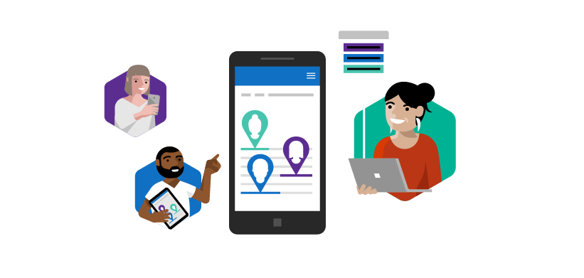
Microsoft Rapid Screening Solution V3 (1.0.0.120) Deployment Guide
April 26, 2021

Slide 2
VERSION 3 (1.0.0.120)
This release we are continuing our work on the backlog. It is now easier to push reminders, cancel appointments and re-attest. On the facility management side, we added a time zone configuration and a screening view.
Of course, there is so much more, so read on!

Slide 3
Version 3 (1.0.0.120) - Features
Employee App
HSO App
Facility App
Re-attestation
Cancellation of bookings
Presumptive positive email to others – VIP
Move time zone to Facility App
Screening view - showing screening results
Environment Variable
Power BI
Re-attestation config
Admin email address
Send as email
New UX

Slide 4
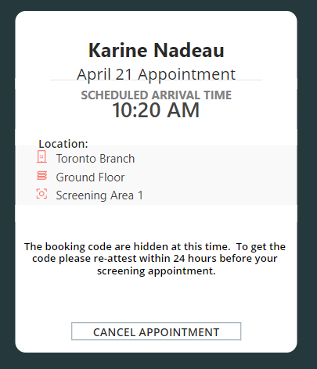
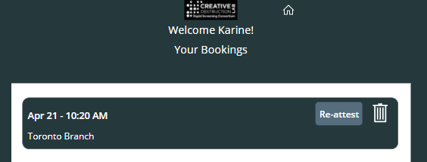
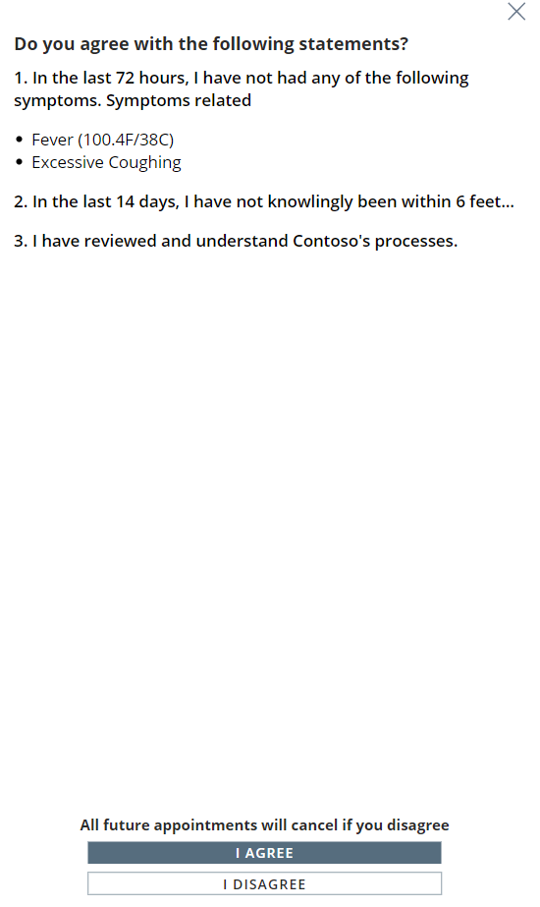
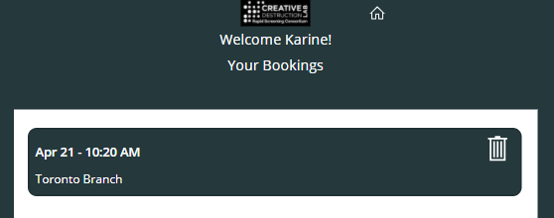
Employee App
1.Booking a screening for the next day
2. Re-attesting
Re-attestation
When a screening is booked in the future the employee will need to re-attest on the day of the booking. This is to ensure that employee's attestation happens on the same day of the screening.

Slide 5
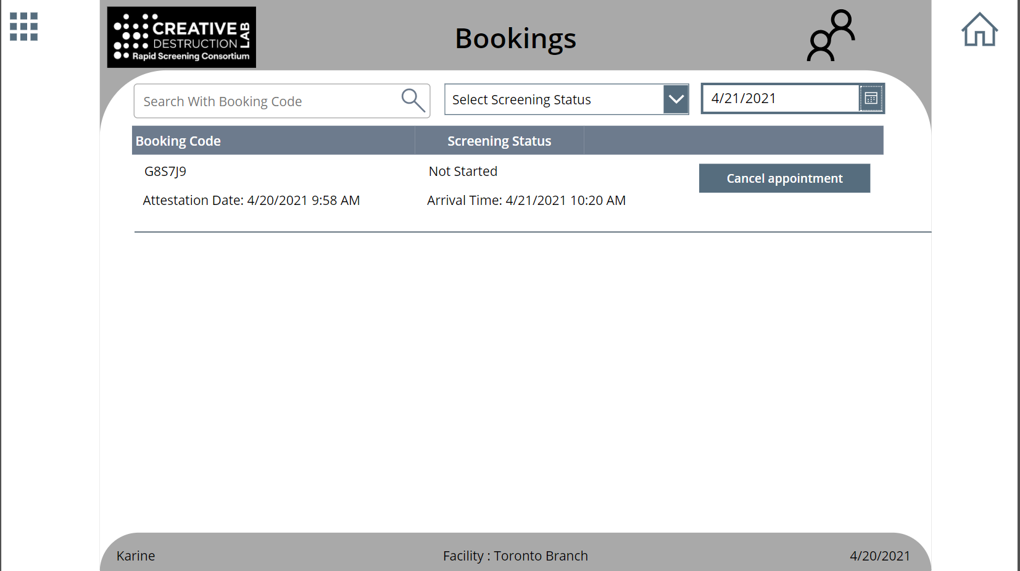
HSO App
Cancellation of bookings
The HSO is able to cancel an appointment on behalf of the employee.

Slide 6
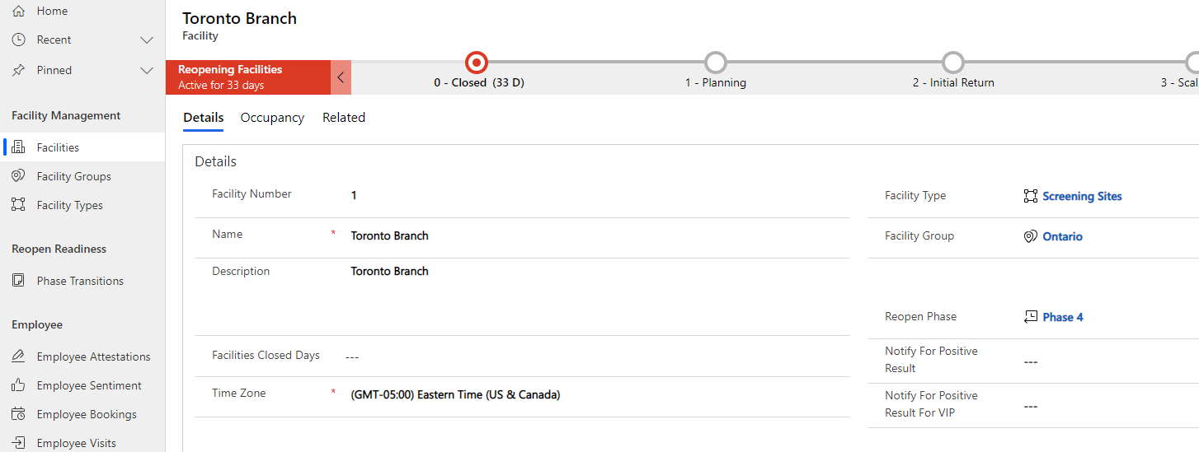
Facility App
Presumptive positive email to others – VIP
When an employee’s test result is presumptive positive send an email to a specific mail box.

Slide 7
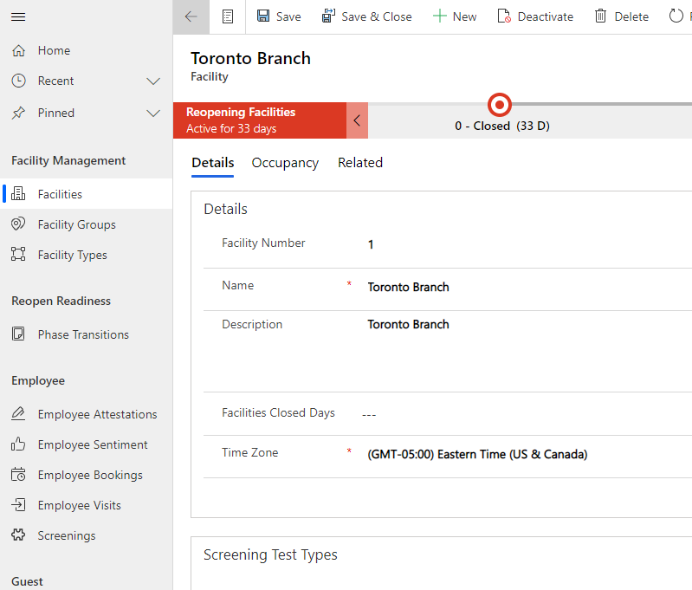
Facility App
Move time zone to Facility App
Time zone is now part of the Facility App. This will allow for flexibility in organizations where employees are crossing time zones.

Slide 8
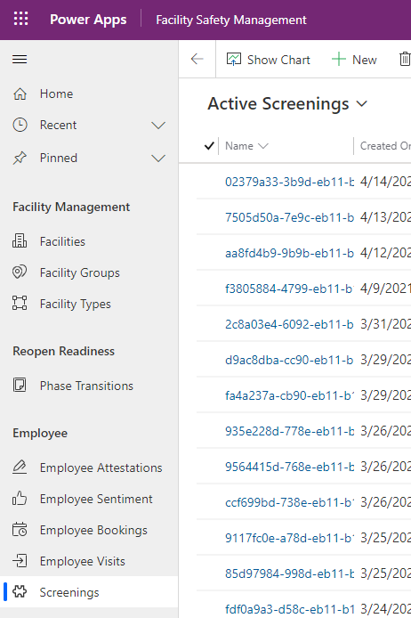
Facility App
Screening view - showing screening results
Details for the screenings can be viewed in the Facility App.

Slide 9
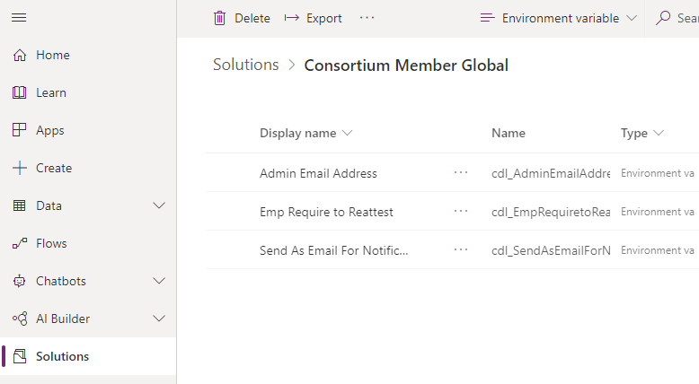
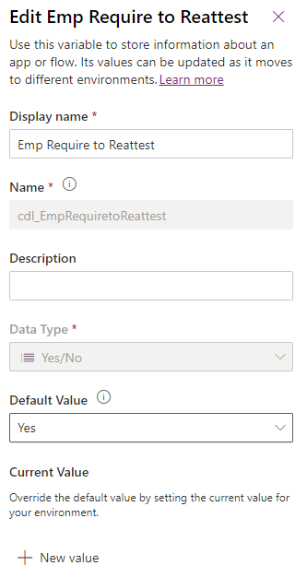
Environment Variable
Re-attestation configuration
Enable or disable re-attestation on the day of the screening when the appointment was booked in the future.
CDL’s guidance is to keep re-attestation enabled.

Slide 10
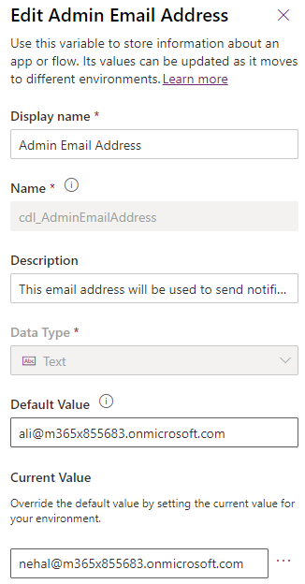
Environment Variable
Admin email address
Email address used to send a notification in case the result flow* fails.
*Result flow: flow used to notify result of employee’s screening.

Slide 11
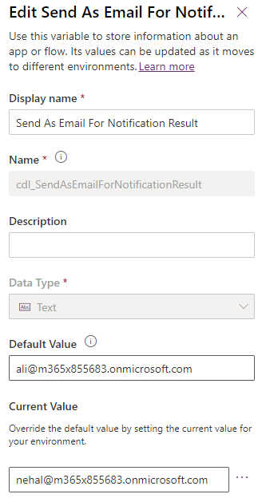
Environment Variable
Send as email
Email address used to send the screening result notification.

Slide 12
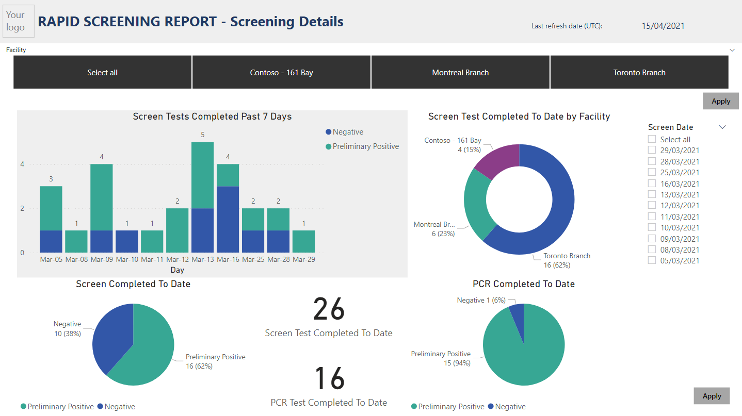
Power BI
New UX
Overall user experience has been enhanced with new visuals and color changes.

Slide 13
Feedback
We are always looking to improve our documentation. If you have feedback and/or suggestions, please email us at: RapidScreeningSolution@service.microsoft.com

