Slide 1

SPRING AI / MODULE 02
Prompt engineering with Spring AI
Apply five foundational prompting techniques.
Explore eight working prompt patterns.
Connect templates, memory, reasoning effort, and streaming.
SPRING AI FOR BEGINNERS / 02 Prompt Engineering
01 / 25
Notes:
Position this as an extension of Module 01. The shared deployment remains gpt-5.6-luna, while the input structure and per-request reasoning settings change. The eight application patterns include focused, autonomous, task, code, analyze, chat, reason, and constrained. This is a programming workshop about making requests intentional and measuring the resulting behavior. Repository sources: 02-prompt-engineering/README.md 02-prompt-engineering/src/main/java/com/example/springai/prompts/service/Gpt5PromptService.java

Slide 2
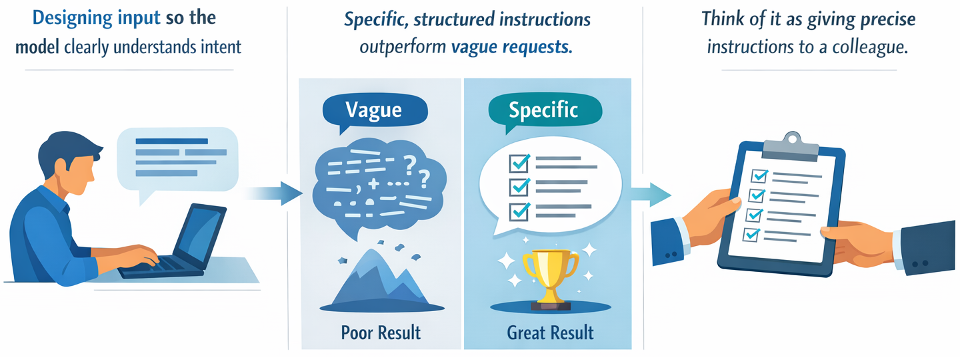
MODULE 02 / Why prompts matter
Specific instructions give you a testable target
SPRING AI FOR BEGINNERS / 02 Prompt Engineering
02 / 25
Notes:
Contrast a vague instruction such as Fix the bug with a request that identifies the failing behavior, relevant code, and expected outcome. Prompt engineering is not a guarantee of correctness. Its value is making the task unambiguous enough that the answer can be evaluated. The existing illustration is conceptual; the working patterns and code are examined in the following slides. Repository sources: 02-prompt-engineering/README.md

Slide 3
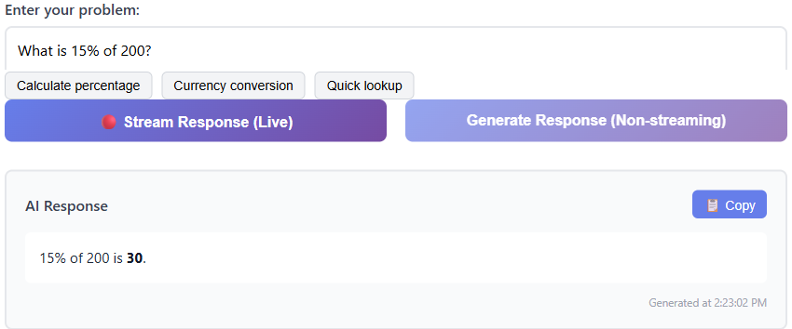
MODULE 02 / The working example
A focused prompt produces a checkable answer
Submitted question
What is 15% of 200?
Observed answer
The existing capture returns 30.
Two display modes
Stream output or wait for the full response.
SPRING AI FOR BEGINNERS / 02 Prompt Engineering
03 / 25
Notes:
The existing Low Eagerness screenshot shows a submitted question and completed answer. The crop keeps the question, the two response actions, and the result without the unused form area. Fifteen percent of 200 equals 30, so this simple result can be independently checked. Do not infer which API effort setting or latency was measured from the screenshot. Each pattern page has synchronous and streaming actions; the implementation distinctions follow later in the deck. The dashboard remains available in the running application, but actual request/output evidence is more useful on this slide. Repository sources: 02-prompt-engineering/README.md 02-prompt-engineering/src/main/java/com/example/springai/prompts/controller/Gpt5PromptController.java

Slide 4
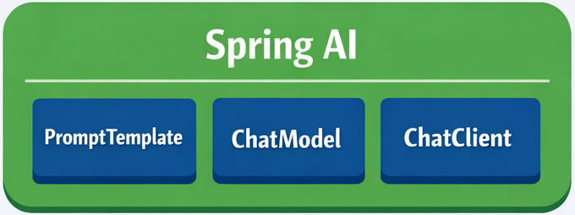
MODULE 02 / Spring AI architecture
Spring AI connects a template to a model call
Generated response back to the application
Java application
Model provider
Template values, prompt, and configuration
Processes the request and generates output
Model response
Request: PromptTemplate -> Prompt -> ChatClient -> ChatModel
SPRING AI FOR BEGINNERS / 02 Prompt Engineering
04 / 25
Notes:
The existing Spring AI component artwork is retained, with explicit request and return connectors. PromptTemplate creates a Prompt from the application values; ChatClient sends it through ChatModel to the provider. The provider response travels back through Spring AI and is returned to the application. The root POM supplies the OpenAI starter and ChatClient, and Spring Boot auto-configures the model and builder. The component group is a set of abstractions, not left-to-right ordering of its three labels. This does not guarantee validated structured output. Repository sources: 02-prompt-engineering/README.md 02-prompt-engineering/src/main/java/com/example/springai/prompts/config/SpringAiConfig.java pom.xml

Slide 5
MODULE 02 / Foundation 1 / Zero-shot
Zero-shot: state the task directly
JAVA
No examples
String prompt =
"Classify this sentiment: " +
"'I absolutely loved the movie!'";
String response = chatClient
.prompt(prompt)
.call()
.content();
Let the instruction define the task.
Good starting point
Use for familiar classifications or direct questions.
Check the result
Test ambiguous inputs before adding complexity.
SPRING AI FOR BEGINNERS / 02 Prompt Engineering
05 / 25
Notes:
This teaching example comes from the zero-shot section of the README. The Java string is wrapped for legibility. A typical answer is Positive, but the current snippet does not enforce an enum or validate the answer. Ask the audience how they would handle mixed sentiment or an irrelevant input, then connect that uncertainty to the next technique. Repository sources: 02-prompt-engineering/README.md

Slide 6

MODULE 02 / Foundation 2 / Few-shot
Few-shot: teach the response pattern with examples
One request: classify sentiment
Examples:
Great product! -> Positive
Nothing special -> Neutral
Terrible -> Negative
New input: The service was slow.
Generated sentiment
Negative
The instruction, examples, and new input all enter the model before it responds.
SPRING AI FOR BEGINNERS / 02 Prompt Engineering
06 / 25
Notes:
Use the repository sentiment examples to explain few-shot prompting. The instruction, examples, and new input are all sent within one prompt through ChatClient. Select examples that cover the expected range instead of repeating easy cases. Keep a separate set of evaluation inputs so that apparent success is not just reproduction of examples placed in the request. Repository sources: 02-prompt-engineering/README.md

Slide 7
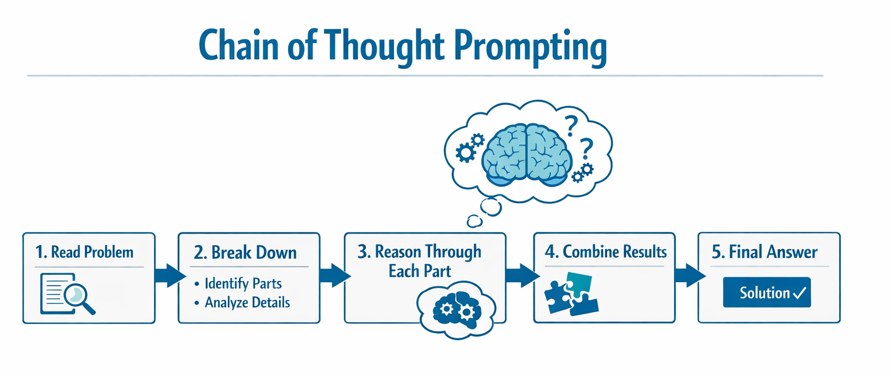
MODULE 02 / Foundation 3 / Chain of thought
Stepwise explanations make answers easier to check
SPRING AI FOR BEGINNERS / 02 Prompt Engineering
07 / 25
Notes:
The README calls this chain-of-thought prompting and illustrates a multi-step calculation. Explain the public solution steps rather than suggesting the application can inspect hidden model reasoning. For the apples example, 15 minus 8 plus 12 equals 19. A plausible explanation can still contain an error; validate results with ordinary code or tests where possible. Repository sources: 02-prompt-engineering/README.md

Slide 8
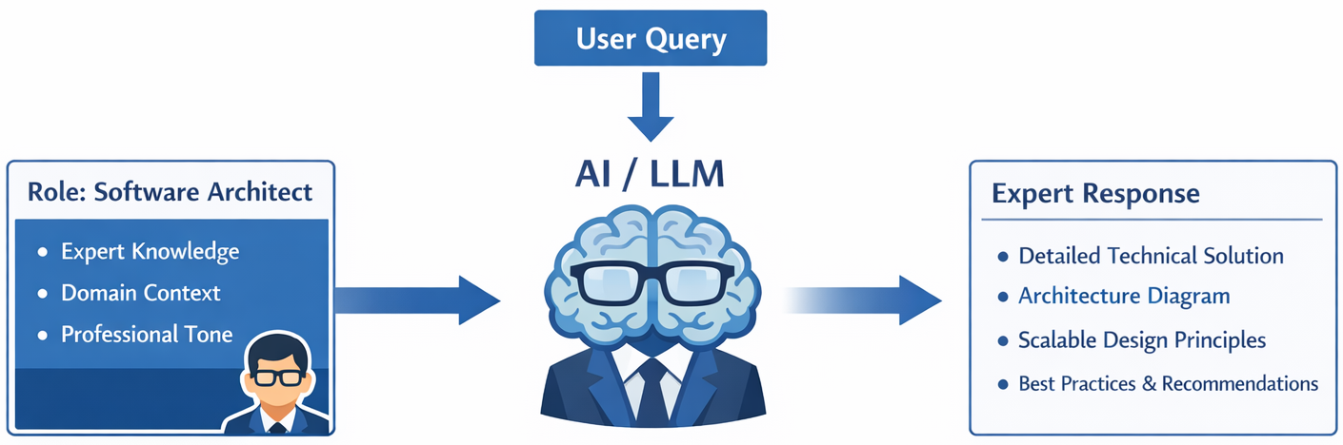
MODULE 02 / Foundation 4 / Role-based
Role-based prompts set the review perspective
SPRING AI FOR BEGINNERS / 02 Prompt Engineering
08 / 25
Notes:
Use the software-architect code-review example in the README. Role text changes the framing and priorities of an answer. It should be paired with a concrete task and criteria, such as correctness or maintainability. The example puts the role in the prompt text; distinguish that from an actual SystemMessage or ChatClient system instruction when discussing message roles. Repository sources: 02-prompt-engineering/README.md

Slide 9
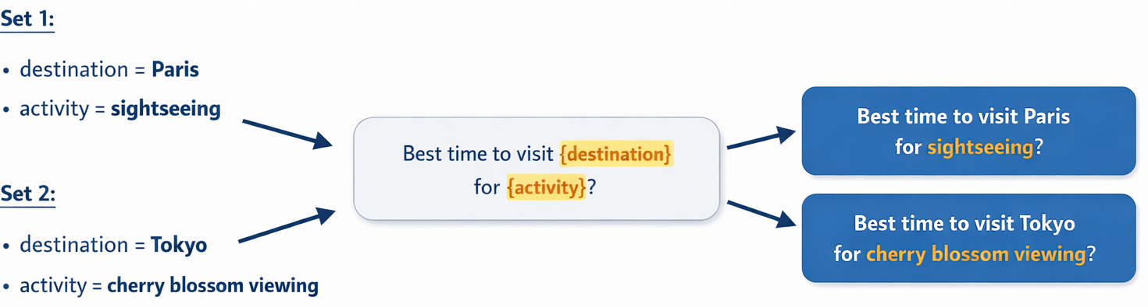
MODULE 02 / Foundation 5 / Prompt templates
Reuse the structure and change the input data
SPRING AI FOR BEGINNERS / 02 Prompt Engineering
09 / 25
Notes:
Point out the destination and activity variables in the existing graphic. The visible examples are Paris sightseeing and Tokyo cherry-blossom viewing. One reusable template accepts different values without rewriting the instructions. The following code slide uses the Paris example. Template substitution is not sanitization, authorization, or protection against prompt injection; untrusted data still needs appropriate treatment. Repository sources: 02-prompt-engineering/README.md

Slide 10
MODULE 02 / Spring AI API
Create a Prompt from named template variables
JAVA
PromptTemplate
PromptTemplate template = new PromptTemplate(
"Best time to visit {destination} " +
"for {activity}?");
Prompt prompt = template.create(Map.of(
"destination", "Paris",
"activity", "sightseeing"));
String answer = chatClient.prompt(prompt)
.call().content();
Owns the reusable instruction text.
Map.of(...)
Supplies values for each named variable.
ChatClient
Sends the resulting Prompt to the model.
SPRING AI FOR BEGINNERS / 02 Prompt Engineering
10 / 25
Notes:
This is an abbreviated version of the README template example; the API calls and variable names are unchanged. PromptTemplate.create returns a Spring AI Prompt that ChatClient accepts. The running Gpt5PromptService often formats Java text blocks instead, so do not claim every endpoint is implemented using PromptTemplate. Both approaches express reusable request structure. Repository sources: 02-prompt-engineering/README.md 02-prompt-engineering/src/main/java/com/example/springai/prompts/service/Gpt5PromptService.java

Slide 11
MODULE 02 / Request anatomy
Prompt structure and reasoning effort are separate
API OPTIONS + PROMPT TEXT / SCHEMATIC
API parameter
{"reasoning": {"effort": "low"}}
Prompt text:
<instructions>
Review this Java method.
</instructions>
<context>Spring Boot REST API</context>
<constraints>
List issues by severity.
</constraints>
reasoning.effort sets the model's reasoning budget.
Prompt content
Instructions, context, user input, and output constraints.
Message roles
Text tags do not create privileged system messages.
SPRING AI FOR BEGINNERS / 02 Prompt Engineering
11 / 25
Notes:
This is a schematic of two separate request ingredients, not one complete JSON document or Java program. The first line is the reasoning options object used by the Responses API. The remaining lines illustrate the structured prompt text, which is supplied separately as input. Context, instructions, and constraints are ordinary text sections, not privileged API message roles. Gpt5PromptService sends effort through ResponseCreateParams using Reasoning.builder().effort(...). Changing an XML-like prompt tag does not set that parameter. The original small bitmap has been replaced here so these distinctions are legible on screen. Repository sources: 02-prompt-engineering/README.md 02-prompt-engineering/src/main/java/com/example/springai/prompts/service/Gpt5PromptService.java

Slide 12
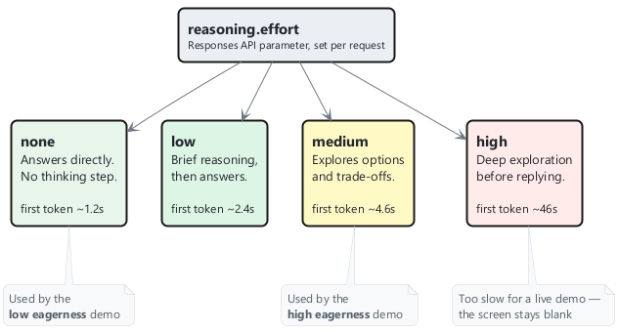
MODULE 02 / Reasoning control
Match the reasoning budget to the task
SPRING AI FOR BEGINNERS / 02 Prompt Engineering
12 / 25
Notes:
The original image lists repository observations for none, low, medium, and high. Its removed legend incorrectly claimed that only the thinking budget changes. In this application, focused and autonomous also use different prompt wording; comparing those routes is a combined-pattern comparison, not a controlled effort-only benchmark. The plotted observations were not remeasured for the presentation and are not latency or quality guarantees. To isolate effort, keep the full rendered input, endpoint, output constraints, deployment, and test procedure constant and vary only the effort field. Repository sources: 02-prompt-engineering/README.md 02-prompt-engineering/src/main/java/com/example/springai/prompts/service/Gpt5PromptService.java

Slide 13
MODULE 02 / Implementation choices
Two client paths share the Spring Boot application
Spring AI ChatClient
OpenAI Responses API
Short synchronous calls
Streaming and effort
Fluent prompt(...).call().content().
OpenAIClientAsync plus ResponseCreateParams.
Spring AI memory
Long synchronous demos
Typed UserMessage and AssistantMessage history.
Collect the stream for autonomous and reason.
SPRING AI FOR BEGINNERS / 02 Prompt Engineering
13 / 25
Notes:
This is a deliberate repository-specific split. In this Spring AI 2.0.1 configuration, ChatClient has no Responses API surface. SpringAiConfig creates a separate async client for the OpenAI-compatible /openai/v1 endpoint, with a 180-second timeout and one retry. Most short non-streaming calls use ChatClient; autonomous and reason collect a Responses stream to avoid the documented client timeout. Do not imply every endpoint uses the same effort setting. Repository sources: 02-prompt-engineering/src/main/java/com/example/springai/prompts/config/SpringAiConfig.java 02-prompt-engineering/src/main/java/com/example/springai/prompts/service/Gpt5PromptService.java 02-prompt-engineering/pom.xml

Slide 14
MODULE 02 / Pattern 1 / Focused
Low eagerness: keep the request focused
PROMPT EXCERPT + JAVA STREAMING CALL
Narrow task
<context_gathering>
- Search depth: very low
- Answer as quickly as possible
- At most 2 reasoning steps
</context_gathering>
Problem: What is 15% of 200?
return streamResponse(
prompt, ReasoningEffort.NONE);
Use for quick calculations and direct questions.
Streaming effort
The /focused/stream route requests NONE.
Expected check
15% of 200 is 30.
SPRING AI FOR BEGINNERS / 02 Prompt Engineering
14 / 25
Notes:
The panel combines a shortened prompt excerpt and the actual streaming call; it is not one complete Java source block. solveFocusedStreaming sets ReasoningEffort.NONE. solveFocused uses ChatClient without passing that effort setting. The streaming routes expose the explicit field, but focused and autonomous still use different prompt text. Their comparison evaluates the combined patterns, not the independent effect of effort. Repository sources: 02-prompt-engineering/src/main/java/com/example/springai/prompts/service/Gpt5PromptService.java 02-prompt-engineering/src/main/java/com/example/springai/prompts/controller/Gpt5PromptController.java

Slide 15
MODULE 02 / Pattern 2 / Autonomous
High eagerness: explore approaches and trade-offs
PROMPT EXCERPT + JAVA STREAMING CALL
Broader task
Analyze this problem thoroughly.
Consider multiple approaches,
trade-offs, and important details.
Problem: Design a caching strategy
for a high-traffic REST API.
return streamResponse(
prompt, ReasoningEffort.MEDIUM);
Use for design choices with competing constraints.
More exploration
Ask for alternatives and their consequences.
Explicit budget
The demo selects MEDIUM, not HIGH.
SPRING AI FOR BEGINNERS / 02 Prompt Engineering
15 / 25
Notes:
The prompt is shortened for the slide. Both solveAutonomous and solveAutonomousStreaming use the Responses API with MEDIUM reasoning effort; the synchronous version collects the stream. Submit the same caching problem to focused and autonomous to compare the combined patterns, evaluating missing constraints, unsupported claims, first text, and total time. This holds the user task constant but not the full prompt. An effort-only experiment must also hold the service prompt text constant. Repository sources: 02-prompt-engineering/src/main/java/com/example/springai/prompts/service/Gpt5PromptService.java 02-prompt-engineering/src/main/java/com/example/springai/prompts/controller/Gpt5PromptController.java

Slide 16
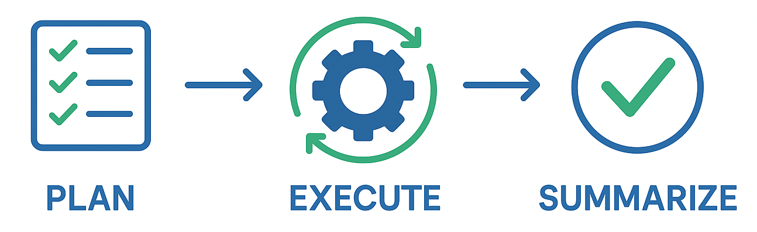
MODULE 02 / Pattern 3 / Task
Task execution: plan, explain progress, summarize
SPRING AI FOR BEGINNERS / 02 Prompt Engineering
16 / 25
Notes:
The task_execution and tool_preambles sections request a goal restatement, plan, visible progress, and summary. Use the user-registration endpoint example. Although the pattern name mentions tools, Gpt5PromptService does not register tool callbacks for this route. The model writes a proposed implementation and explanation; it does not edit the repository or deploy the endpoint. Actual Spring AI tool calling appears in Module 04. Repository sources: 02-prompt-engineering/src/main/java/com/example/springai/prompts/service/Gpt5PromptService.java 02-prompt-engineering/README.md

Slide 17
MODULE 02 / Pattern 4 / Self-reflecting code
Code generation: make quality requirements explicit
JAVA
Concrete requirement
String prompt = """
Generate Java code with
production-quality standards: %s
Keep it simple and include
basic error handling.
""".formatted(requirement);
return chatClient.prompt(prompt)
.call().content();
Try an email-validation service.
Quality guidance
Request simple code and error handling.
Independent checks
Compile, test, and review the generated code.
SPRING AI FOR BEGINNERS / 02 Prompt Engineering
17 / 25
Notes:
The application labels this Self-Reflecting Code. Its actual implementation makes a single model call with a short quality-oriented instruction. Do not claim that a coded evaluator repeatedly improves the result or that it certifies production quality. The repository self-reflection-cycle image is conceptual, so this slide instead shows the implementation. Module 06 supplies an actual evaluator-optimizer control loop. Repository sources: 02-prompt-engineering/src/main/java/com/example/springai/prompts/service/Gpt5PromptService.java 02-prompt-engineering/README.md

Slide 18
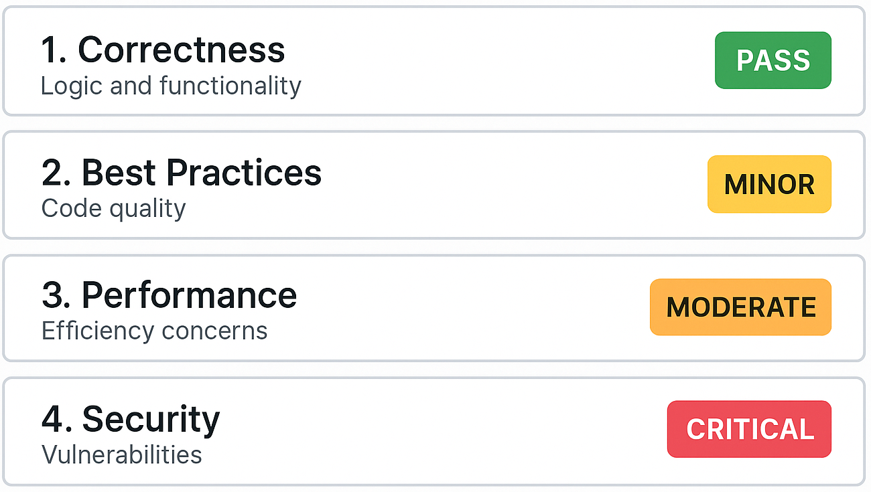
MODULE 02 / Pattern 5 / Analyze
Structured analysis: review with a fixed rubric
SPRING AI FOR BEGINNERS / 02 Prompt Engineering
18 / 25
Notes:
The analysis_framework prompt asks for five review dimensions, then a summary, strengths, severity-ranked issues, and recommendations. The output is generated text, not an automatically validated analysis object. Show a short code snippet and ask whether each reported defect is actually supported by it. A consistent rubric improves comparability but does not eliminate false positives. Repository sources: 02-prompt-engineering/src/main/java/com/example/springai/prompts/service/Gpt5PromptService.java 02-prompt-engineering/README.md

Slide 19
MODULE 02 / Pattern 6 / Chat
Multi-turn chat: manage Spring AI messages directly
JAVA
MessageWindowChatMemory
chatMemory.add(sessionId,
new UserMessage(userMessage));
String responseText = chatClient.prompt()
.messages(chatMemory.get(sessionId))
.call()
.content();
chatMemory.add(sessionId,
new AssistantMessage(responseText));
A separate 10-message window per session ID.
Explicit lifecycle
The service adds user and assistant messages.
System context
A SystemMessage is added on the first turn.
SPRING AI FOR BEGINNERS / 02 Prompt Engineering
19 / 25
Notes:
The displayed excerpt is the core of continueConversation. The service uses Spring AI ChatMemory and typed messages directly so synchronous and streaming flows can share memory. It adds a session system message on the first interaction, then the current user message, calls the model with history, and stores the assistant response. Ten messages is not an assured token budget. The active session set supports clearing sessions. Repository sources: 02-prompt-engineering/src/main/java/com/example/springai/prompts/service/Gpt5PromptService.java

Slide 20
MODULE 02 / Shared conversation state
Streaming chat stores accumulated assistant text
JAVA
Reuse the session
StringBuilder assistantResponse =
new StringBuilder();
return streamResponse(fullPrompt.toString())
.doOnNext(assistantResponse::append)
.doOnComplete(() -> {
String responseText =
assistantResponse.toString();
if (!responseText.isBlank()) {
chatMemory.add(sessionId,
new AssistantMessage(responseText));
}
});
Streaming and non-streaming turns share that session's history.
Accumulate output
Append arriving text chunks, called deltas, into one response.
On normal Flux completion
Store nonblank text, even if the API marked it incomplete.
SPRING AI FOR BEGINNERS / 02 Prompt Engineering
20 / 25
Notes:
The method builds role-labelled input text, appends output deltas, and stores a nonblank AssistantMessage when the Flux completes normally. The helper logs Responses API incomplete events without failing the Flux, so truncated output can reach doOnComplete and be stored. Transport failure or cancellation is different. A stronger application would track API-level completion and choose how incomplete history is represented. Structured API message input would also preserve role semantics more explicitly than textual role labels. Repository sources: 02-prompt-engineering/src/main/java/com/example/springai/prompts/service/Gpt5PromptService.java

Slide 21
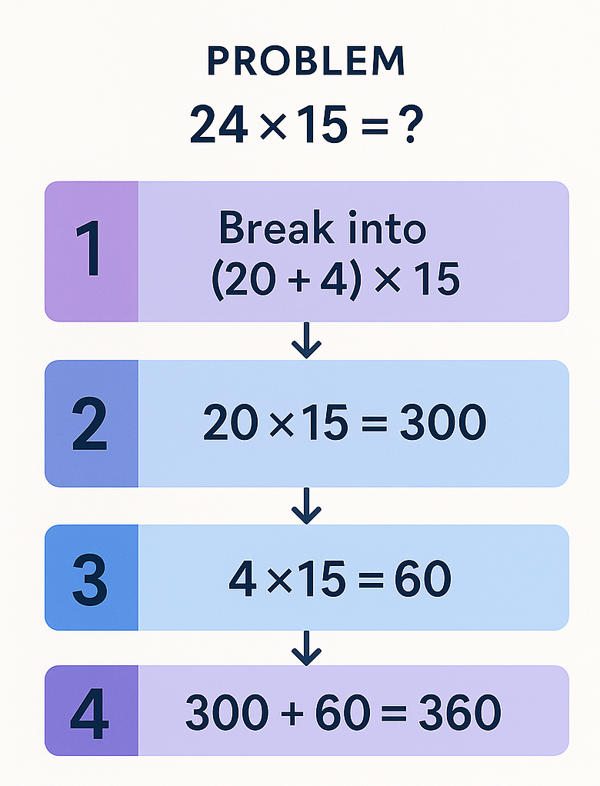
MODULE 02 / Pattern 7 / Reason
Reasoning: request a solution you can verify
SPRING AI FOR BEGINNERS / 02 Prompt Engineering
21 / 25
Notes:
The visible image illustrates 24 times 15: split 24 into 20 plus 4, calculate 20 times 15 equals 300 and 4 times 15 equals 60, then add to obtain 360. Check those displayed steps independently; they are not access to private internal reasoning. As a separate live example from the README, the 210-km journey including a stop lasts four hours, giving 52.5 km/h. Introduce that explicitly as a different problem. The synchronous reason method collects a LOW-effort Responses stream. Repository sources: 02-prompt-engineering/README.md 02-prompt-engineering/src/main/java/com/example/springai/prompts/service/Gpt5PromptService.java

Slide 22
MODULE 02 / Pattern 8 / Constrained
Constrained output: request limits, then validate
REQUEST + PROMPT EXCERPT
Actual input
{
"topic": "machine learning",
"format": "bullet points",
"maxWords": 100
}
<strict_constraints>
- Topic: %s
- Format: %s
- Maximum words: %d
</strict_constraints>
The endpoint accepts topic, format, and maxWords.
Upper bound
The current prompt requests a maximum, not exactly 100.
Application checks
Count words and validate the required structure.
SPRING AI FOR BEGINNERS / 02 Prompt Engineering
22 / 25
Notes:
The README includes an exactly-100-words teaching example, but generateConstrained uses Maximum words and a maxWords request field. Teach the running implementation accurately. The service does not count words or reject violations afterward. A production workflow should validate output and decide how to handle failures, rather than treating a strongly worded prompt as a hard constraint. Repository sources: 02-prompt-engineering/src/main/java/com/example/springai/prompts/service/Gpt5PromptService.java 02-prompt-engineering/src/main/java/com/example/springai/prompts/controller/Gpt5PromptController.java 02-prompt-engineering/README.md

Slide 23
MODULE 02 / Streaming implementation
Stream Responses API text through Reactor Flux
OPENAI SDK / JAVA EXCERPTS
Actual text events
ResponseCreateParams params =
ResponseCreateParams.builder()
.model(deploymentName)
.input(prompt)
.reasoning(Reasoning.builder()
.effort(effort).build())
.build();
openAIClientAsync.responses()
.createStreaming(params);
event.outputTextDelta().ifPresent(
delta -> emit(sink, delta.delta()));
Emit non-empty outputTextDelta values.
Lifecycle handling
Close the HTTP stream when Flux is disposed.
Browser transport
The controller returns text/event-stream.
SPRING AI FOR BEGINNERS / 02 Prompt Engineering
23 / 25
Notes:
The excerpts show request construction, SDK streaming, and text-event handling from the helper. The helper also handles refusal deltas, API errors, failed responses, incomplete responses, and completion. sink.onDispose closes the underlying stream when the subscriber leaves. Spring Web MVC endpoints expose Flux<String> as SSE. First network frames can be metadata rather than text, so timing must measure the first non-empty visible delta. Repository sources: 02-prompt-engineering/src/main/java/com/example/springai/prompts/service/Gpt5PromptService.java 02-prompt-engineering/src/main/java/com/example/springai/prompts/controller/Gpt5PromptController.java 02-prompt-engineering/src/main/java/com/example/springai/prompts/config/SpringAiConfig.java 02-prompt-engineering/README.md

Slide 24
MODULE 02 / Workshop demonstration
Compare patterns using the same user task
1
Start from 02-prompt-engineering
PowerShell: .\start.ps1 | Bash: ./start.sh | http://localhost:8083
2
Compare the same input
Use focused and autonomous streaming; note first text, total time, and answer quality.
3
Test the remaining behaviors
Follow up in chat, review a code snippet, and count the constrained output words.
SPRING AI FOR BEGINNERS / 02 Prompt Engineering
24 / 25
Notes:
Reuse the Module 01 environment in an external browser. Hold the user task constant when comparing the patterns, while explaining that their internal prompt wording and effort both differ. Do not attribute the entire difference to effort. For an effort-only benchmark, send the same full input through the same Responses helper with only the effort field changed. Each /api/gpt5 route has a /stream counterpart. Payload keys include requirement for code, topic/format/maxWords for constraints, and message/sessionId for chat. Use the matching stop script after the demo. Repository sources: 02-prompt-engineering/README.md 02-prompt-engineering/src/main/java/com/example/springai/prompts/controller/Gpt5PromptController.java

Slide 25

SPRING AI / MODULE 02
Demo
http://aka.ms/Spring-AI-for-Beginners
SPRING AI FOR BEGINNERS / 02 Prompt Engineering
25 / 25
Notes:
Use a small Spring Boot test with the existing ChatClient bean and the request construction shown on slides 5, 6, and 10. Prepare five held-out sentiment inputs with positive, negative, or neutral expected labels; do not reuse the few-shot examples as evaluation inputs. Keep deployment and options constant, compare the three prompt forms, and record the returned label, format compliance, and elapsed wall-clock time. Report sample size and variability. Cost is an optional extension: the current application endpoints return no token-usage data, so it requires capturing provider usage metadata and documenting the applicable prices. Do not estimate cost from character count or the displayed timestamp. The next module adds missing source information through retrieval. Repository sources: 02-prompt-engineering/README.md 02-prompt-engineering/src/main/java/com/example/springai/prompts/service/Gpt5PromptService.java

