Slide 1
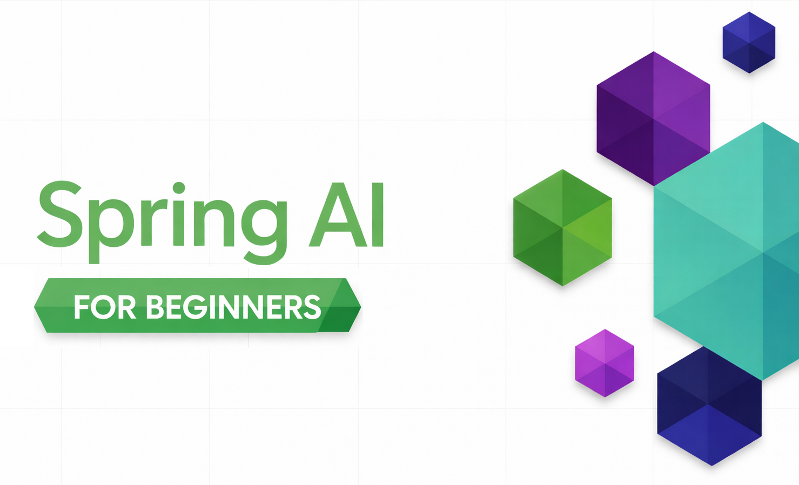
SPRING AI / MODULE 03
RAG with Spring AI
Answer questions using your own documents.
Build ingestion and semantic retrieval.
Compare native and advisor-based generation.
SPRING AI FOR BEGINNERS / 03 RAG
01 / 22
Notes:
Introduce retrieval-augmented generation as a way to supply relevant external information at request time. It is not retraining the model. This module implements an upload-to-answer workflow with Spring AI, a separate embedding deployment, and a shared in-memory vector store. Both native and advisor-based query paths use the same ingested documents. Repository sources: 03-rag/README.md 03-rag/src/main/java/com/example/springai/rag/config/SpringAiRagConfig.java

Slide 2

MODULE 03 / Why retrieval matters
A better prompt cannot supply missing private data
Application retrieval
ChatModel.call
Question
VectorStore
Prompt
Answer
What is in our company policy?
Embed query; retrieve relevant passages
Question + retrieved passages + instructions
Generated from the supplied context
Previously ingested documents supply the passages. The chat model generates the answer.
SPRING AI FOR BEGINNERS / 03 RAG
02 / 22
Notes:
The flow uses the existing model illustration with corrected native connectors. The application embeds the question through VectorStore, retrieves document passages, and assembles the original question plus context before calling the chat model. Retrieved content flows toward the model, not back toward Document Search. The displayed path assumes matches exist; the native no-match branch is taught later. Missing, stale, or misused evidence can still produce a bad answer. Authorization must be applied before private text is retrieved. Repository sources: 03-rag/README.md 03-rag/src/main/java/com/example/springai/rag/service/RagService.java

Slide 3
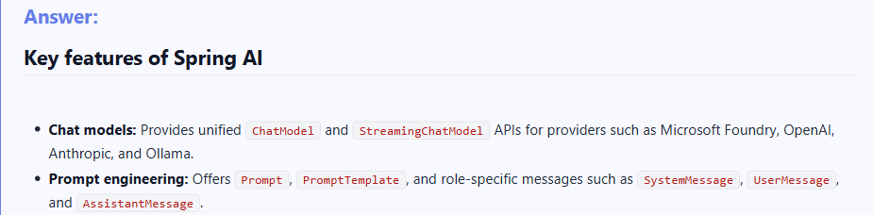
MODULE 03 / The working example
The app answers from the uploaded document
SPRING AI FOR BEGINNERS / 03 RAG
03 / 22
Notes:
This focused crop of the existing repository results screenshot establishes the working application before implementation details. The source-reference experience is enlarged later in the deck. This is an older capture: the full image shows one-segment ingestion and legacy configuration advice, so do not treat its settings or generated class names as the current configuration. The current code uses 150-token chunking and a 0.35 threshold. The following slides explain the current APIs. Repository sources: 03-rag/src/main/java/com/example/springai/rag/service/RagService.java 03-rag/README.md

Slide 4
MODULE 03 / Spring AI abstractions
Shared ingestion supports two query approaches
Native querying
Advisor-based querying
RagService
AdvisorRagService
Search explicitly, assemble context, and call ChatModel.
Attach QuestionAnswerAdvisor to a ChatClient request.
More direct control
Less query plumbing
Each query stage is visible in application code.
The advisor retrieves and inserts context.
SPRING AI FOR BEGINNERS / 03 RAG
04 / 22
Notes:
Extract-transform-load, or ETL, is the shared ingestion path: parse uploaded text or PDFs in DocumentService, wrap content in Document with metadata, split with TokenTextSplitter, then embed and store using VectorStore. Native and advisor-based RAG are two querying choices over that same index. ETL plus advisor querying is the third combination discussed in the README, not a third independent store or parser in this application. The slide keeps the full pipeline readable instead of squeezing long Java class names into the original three-column bitmap. Advisors alone do not establish production readiness. Repository sources: 03-rag/README.md 03-rag/src/main/java/com/example/springai/rag/service/DocumentService.java 03-rag/src/main/java/com/example/springai/rag/service/RagService.java 03-rag/src/main/java/com/example/springai/rag/service/AdvisorRagService.java

Slide 5
MODULE 03 / Dependencies and configuration
Add the Spring AI vector-store modules
MAVEN ARTIFACTS / SPRING BEANS
Separate models
Inherited from the root POM:
spring-ai-starter-model-openai
spring-ai-client-chat
Added by Module 03:
spring-ai-vector-store
spring-ai-vector-store-advisor
Beans used by the services:
EmbeddingModel + VectorStore + ChatClient
Chat generates text; embeddings represent meaning.
Shared configuration
Module 01 provisions both deployments.
PDF support
Apache PDFBox extracts uploaded PDF text.
SPRING AI FOR BEGINNERS / 03 RAG
05 / 22
Notes:
The root POM provides the OpenAI model starter and ChatClient. This module adds the in-memory vector store and QuestionAnswerAdvisor dependency, plus PDFBox and Thymeleaf. application.yaml configures AZURE_OPENAI_FAST_DEPLOYMENT for chat and AZURE_OPENAI_EMBEDDING_DEPLOYMENT for the text-embedding-3-small embedding deployment. Keep actual environment values out of the presentation. Repository sources: 03-rag/pom.xml pom.xml 03-rag/src/main/resources/application.yaml 03-rag/src/main/java/com/example/springai/rag/config/SpringAiRagConfig.java

Slide 6
MODULE 03 / Ingestion / Parse
Wrap uploaded content in a Spring AI Document
JAVA
Read the content
String documentId =
UUID.randomUUID().toString();
Document document = new Document(
content, Map.of(
"filename", filename,
"documentId", documentId));
List<Document> segments =
splitter.split(document);
PDFBox for PDF; UTF-8 text for TXT uploads.
Preserve metadata
Filename and document ID travel with the content.
Reject empty input
Blank extracted content fails processing.
SPRING AI FOR BEGINNERS / 03 RAG
06 / 22
Notes:
Show processDocument in DocumentService. It generates a document ID, branches on the filename extension, extracts content, rejects empty text, and constructs a Spring AI Document. The code uses PDFBox and BufferedReader rather than a configured DocumentReader bean. The HTTP multipart limit is 10 MB. A PDF without extractable text would need an additional OCR path, which this module does not implement. Repository sources: 03-rag/src/main/java/com/example/springai/rag/service/DocumentService.java 03-rag/src/main/resources/application.yaml

Slide 7
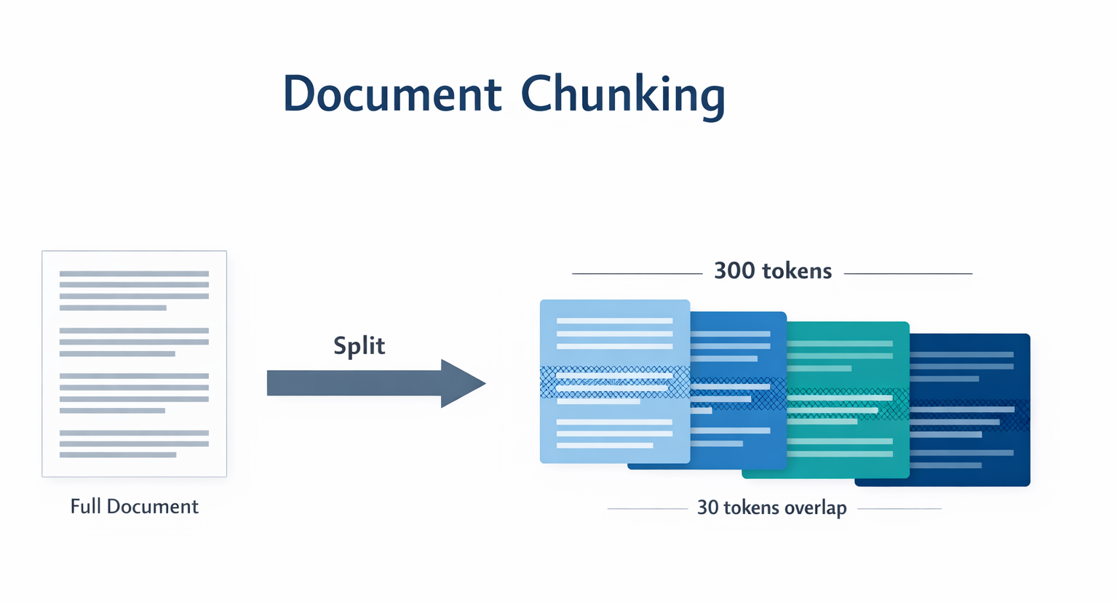
MODULE 03 / Ingestion / Split
Chunking shapes what one embedding represents
SPRING AI FOR BEGINNERS / 03 RAG
07 / 22
Notes:
Use the graphic to explain boundaries and the general reason overlapping chunks are sometimes useful. State explicitly that the TokenTextSplitter implementation in this module does not add overlap. Its configured chunk size is 150 tokens. Very large chunks can mix unrelated topics; very small chunks can lose the context needed to interpret a sentence. Chunking choices must be evaluated against real questions. Repository sources: 03-rag/src/main/java/com/example/springai/rag/service/DocumentService.java 03-rag/README.md 03-rag/src/main/resources/application.yaml

Slide 8
MODULE 03 / Spring AI TokenTextSplitter
Configure the actual chunk size: 150 tokens
JAVA + CONFIGURATION VALUE
Corpus-specific choice
TokenTextSplitter splitter =
TokenTextSplitter.builder()
.withChunkSize(chunkSize)
.build();
List<Document> segments =
splitter.split(document);
app.rag.chunking.chunk-size: 150
The small sample needs focused chunks.
Tune and re-ingest
Changing the size affects newly processed documents.
Not a universal rule
Different documents may need different boundaries.
SPRING AI FOR BEGINNERS / 03 RAG
08 / 22
Notes:
The constructor reads app.rag.chunking.chunk-size and validates that it is positive. Spring AI has a larger default, but the repository configures 150 so specific topics in the sample are not averaged into one broad embedding. The final line is the dotted form of the YAML setting, not Java. Re-ingest after changing the setting; existing vectors do not change themselves. Repository sources: 03-rag/src/main/java/com/example/springai/rag/service/DocumentService.java 03-rag/src/main/resources/application.yaml

Slide 9
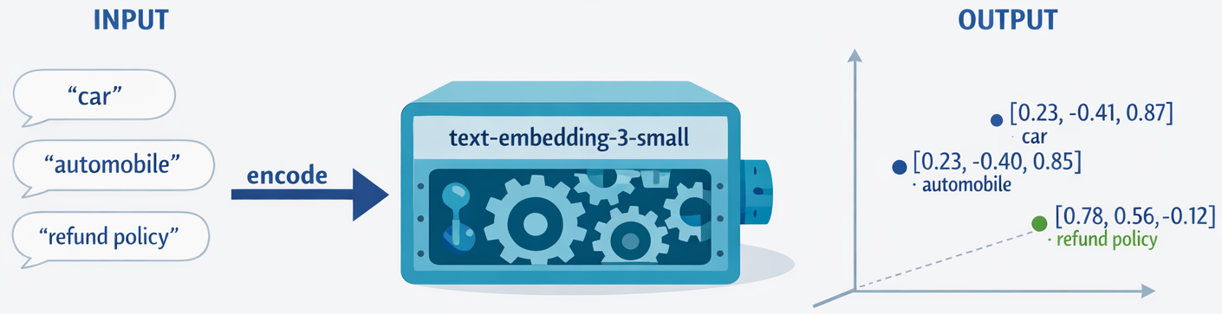
MODULE 03 / Ingestion / Embed
EmbeddingModel turns text into comparable vectors
SPRING AI FOR BEGINNERS / 03 RAG
09 / 22
Notes:
Distinguish the two model roles. text-embedding-3-small maps text to numerical vectors; the chat model uses retrieved text to compose an answer. Related meanings tend to map nearby, even when wording differs. The visual representation is a simplified projection, not the actual high-dimensional embedding. Documents and queries need a compatible embedding model and vector dimension. Repository sources: 03-rag/README.md 03-rag/src/main/java/com/example/springai/rag/config/SpringAiRagConfig.java 03-rag/src/main/resources/application.yaml

Slide 10
MODULE 03 / Spring AI storage
Store chunks through the VectorStore abstraction
JAVA
Automatic embedding
@Bean
VectorStore vectorStore(
EmbeddingModel embeddingModel) {
return SimpleVectorStore
.builder(embeddingModel)
.build();
}
vectorStore.add(segments);
The store uses EmbeddingModel when adding chunks.
One shared store
Both query paths use the same indexed content.
In-memory demo
Restarting the process discards the index.
SPRING AI FOR BEGINNERS / 03 RAG
10 / 22
Notes:
The bean excerpt comes from SpringAiRagConfig, while the add operation belongs to the ingestion flow. They are displayed together to show the contract, not as one source method. SimpleVectorStore handles embedding and keeps vectors in memory. A production replacement must be configured and tested, and may have different filtering, similarity, scaling, and persistence behavior. Repository sources: 03-rag/src/main/java/com/example/springai/rag/config/SpringAiRagConfig.java 03-rag/src/main/java/com/example/springai/rag/service/EmbeddingService.java 03-rag/README.md

Slide 11




MODULE 03 / Retrieval / Meaning
Semantic search can match different wording
0.92
Vector similarity
Compare the query with stored vectors
0.85
0.78
Matching passage: "Retrieve source passages, then include them in the model prompt."
SPRING AI FOR BEGINNERS / 03 RAG
11 / 22
Notes:
The existing question and document artwork is reused, but each result now has exactly one associated score. The 0.92, 0.85, and 0.78 values are illustrative values from the original graphic, not a measured result for the added paraphrased passage. How does RAG work? can match a passage about retrieving source text and adding it to a model prompt without requiring every query word. This slide illustrates semantic retrieval, not a side-by-side lexical comparison. IDs and exact strings may still need filters, keyword search, or hybrid retrieval. Repository sources: 03-rag/README.md 03-rag/src/main/java/com/example/springai/rag/service/RagService.java

Slide 12
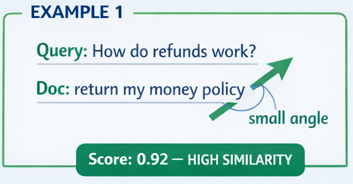
MODULE 03 / Retrieval / Scoring
Cosine similarity ranks vector alignment
Raw cosine
Ranges from -1 to 1 for nonzero vectors.
Alignment
Aligned is positive; perpendicular is zero; opposite is negative.
Store conventions
Interpret returned scores using the vector store's metric.
SPRING AI FOR BEGINNERS / 03 RAG
12 / 22
Notes:
Cosine similarity is the dot product divided by the product of vector magnitudes. For nonzero vectors it ranges from minus one to one; an obtuse angle gives a negative cosine. The cropped image retains only the aligned example because other portions of the original graphic contain an incorrect positive label for an obtuse angle and a misleading universal zero-to-one range. Do not interpret the illustrative 0.92 as a calibrated probability. Store scoring conventions, embedding models, and corpora affect threshold interpretation. Repository sources: 03-rag/README.md 03-rag/src/main/java/com/example/springai/rag/service/RagService.java

Slide 13
MODULE 03 / Spring AI search API
Use SearchRequest to bound retrieval
JAVA
topK(5)
SearchRequest searchRequest =
SearchRequest.builder()
.query(request.question())
.topK(5)
.similarityThreshold(0.35)
.build();
List<Document> matches =
vectorStore.similaritySearch(searchRequest);
Return at most five matching chunks.
Threshold 0.35
Filter weak matches for this sample corpus.
Typed results
Read Document text, metadata, and score.
SPRING AI FOR BEGINNERS / 03 RAG
13 / 22
Notes:
This is the expanded SearchRequest teaching example from the README. In current code, both services build the request through RagSearchProperties, using max-results 5 and similarity-threshold 0.35 from YAML. Raising the threshold can lose useful context; lowering it can include noise. topK limits the number of results, not the exact token count or factual quality of the prompt. Repository sources: 03-rag/README.md 03-rag/src/main/java/com/example/springai/rag/service/RagService.java 03-rag/src/main/java/com/example/springai/rag/service/AdvisorRagService.java 03-rag/src/main/resources/application.yaml 03-rag/src/main/java/com/example/springai/rag/config/RagSearchProperties.java

Slide 14
MODULE 03 / Native RAG / Generation and attribution
Assemble context and preserve source metadata
ChatModel.call
Matched Documents
Assembled Prompt
Text, filename, and score
Question + chunk text + grounding instruction
Application code builds sources
Generated
answer
SourceReference list
RagResponse
Filename, chunk text, score
answer + sources[]
SPRING AI FOR BEGINNERS / 03 RAG
14 / 22
Notes:
RagService joins matched Document text into a context string and adds the original question and grounding instruction. It calls OpenAiChatModel to generate the answer. Separately, application code maps the same matches to SourceReference records and returns them alongside the answer in RagResponse. The original context-assembly image showed inline numbered citations that this implementation does not construct; this corrected flow retains the model artwork but separates the two data paths. Grounding instructions do not enforce truth or protect against malicious document instructions. Repository sources: 03-rag/src/main/java/com/example/springai/rag/service/RagService.java 03-rag/README.md

Slide 15
MODULE 03 / RagService implementation
Native RAG makes every query stage explicit
JAVA
Before this call
String context = matches.stream()
.map(Document::getText)
.collect(Collectors.joining("\n\n"));
String answer = chatModel
.call(new Prompt(promptText))
.getResult()
.getOutput()
.getText();
Search, check for no matches, and build the prompt.
Direct model API
Calls OpenAiChatModel directly.
After this call
Return the answer with source references.
SPRING AI FOR BEGINNERS / 03 RAG
15 / 22
Notes:
The excerpts come from RagService after retrieval and before source mapping. promptText is the context-and-question template shown conceptually on the prior slide. An empty result list produces a deterministic cannot-answer response with an empty sources list. When matches exist, generation still needs evaluation. The response carries conversationId, but this RAG service does not add conversation memory. Repository sources: 03-rag/src/main/java/com/example/springai/rag/service/RagService.java

Slide 16
MODULE 03 / Spring AI advisor-based RAG
QuestionAnswerAdvisor handles retrieval and context
JAVA
Attach the advisor
QuestionAnswerAdvisor qaAdvisor =
QuestionAnswerAdvisor.builder(vectorStore)
.searchRequest(
searchProperties.buildSearchRequest())
.build();
ChatResponse response = chatClient.prompt()
.advisors(qaAdvisor)
.user(request.question())
.call()
.chatResponse();
Use the configured VectorStore and search policy.
Ask normally
ChatClient sends the user question.
Retrieve and augment
The advisor adds matching context to the call.
SPRING AI FOR BEGINNERS / 03 RAG
16 / 22
Notes:
This excerpt follows AdvisorRagService. The advisor builds the query context inside the ChatClient call, avoiding manual context assembly in that service. The application still owns ingestion, storage configuration, permissions, evaluation, and error behavior. The actual service also performs a separate similarity search after generation to construct the source references returned to the UI. Repository sources: 03-rag/src/main/java/com/example/springai/rag/service/AdvisorRagService.java 03-rag/src/main/java/com/example/springai/rag/config/SpringAiRagConfig.java

Slide 17
MODULE 03 / Control versus convenience
Compare the two query endpoints
POST /api/rag/ask
POST /api/rag/advisor/ask
Native query
Advisor query
Search, no-match branch, prompt, model call.
QuestionAnswerAdvisor augments ChatClient.
Source attribution
Source attribution
Uses the same matches used in the prompt.
This demo runs a second search for UI sources.
SPRING AI FOR BEGINNERS / 03 RAG
17 / 22
Notes:
Both routes accept the same RagRequest shape and return RagResponse. They are not operationally identical: the native path exits early on empty retrieval, while the advisor owns its generation behavior. The advisor service searches again for displayed sources; if the index changes between searches, those sources are not guaranteed to be exactly the documents used in generation. This is a useful implementation trade-off to discuss, not a reason to mislabel the two paths as identical. Repository sources: 03-rag/src/main/java/com/example/springai/rag/service/RagService.java 03-rag/src/main/java/com/example/springai/rag/service/AdvisorRagService.java 03-rag/src/main/java/com/example/springai/rag/app/RagController.java

Slide 18
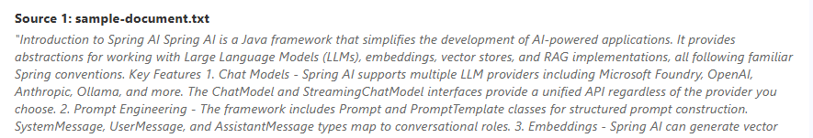
MODULE 03 / The working example
Inspect the sources behind the answer
The source names SystemMessage, UserMessage, and AssistantMessage as conversation-role types.
Recorded relevance score, not answer confidence.
SPRING AI FOR BEGINNERS / 03 RAG
18 / 22
Notes:
The two crops come from Source 1 of the existing screenshot: its heading and opening passage, followed separately by its 69.3 percent relevance label. The passage explicitly names SystemMessage, UserMessage, and AssistantMessage, allowing the audience to verify the earlier answer claim rather than infer support from an unrelated excerpt. The native callout is a summary of that visible source sentence. This older screenshot uses different retrieval settings from the current code. Its score describes retrieval alignment, not answer confidence or support for every generated claim. Repository sources: 03-rag/README.md 03-rag/src/main/java/com/example/springai/rag/service/RagService.java 03-rag/src/main/java/com/example/springai/rag/model/dto/SourceReference.java

Slide 19
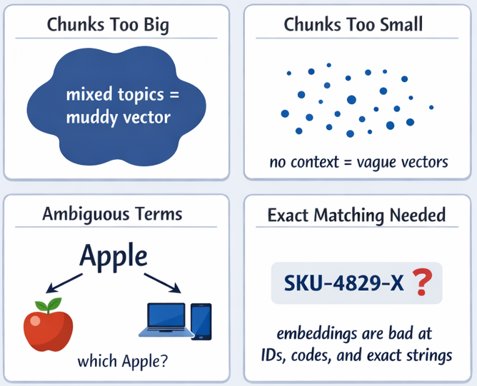
MODULE 03 / Evaluation and tuning
Recognize retrieval failure modes
Chunking
Large chunks mix topics; very small chunks lose context.
Ambiguity
Add enough domain context to disambiguate the query.
Exact identifiers
Use lexical search or filters for codes and IDs.
SPRING AI FOR BEGINNERS / 03 RAG
19 / 22
Notes:
Discuss the four cases in the existing image: overly large chunks, overly small chunks, ambiguous vocabulary, and exact-match identifiers. The diagram uses strong shorthand; embeddings are not categorically incapable of matching identifiers, but they are often the wrong sole mechanism for that task. Build a small evaluation set with facts, paraphrases, ambiguous queries, and questions deliberately absent from the corpus. Repository sources: 03-rag/README.md 03-rag/src/main/java/com/example/springai/rag/service/DocumentService.java 03-rag/src/main/resources/application.yaml

Slide 20
MODULE 03 / Operational limits
Manage the retrieval budget and storage lifetime
Context budget
Storage lifetime
150-token chunk target
SimpleVectorStore
Keep each vector focused on a useful passage.
Uploaded content is temporary in this app.
At most five matches
Production extension
Leave room for instructions, question, and output.
Add persistence, access filters, and evaluation.
SPRING AI FOR BEGINNERS / 03 RAG
20 / 22
Notes:
Reiterate the actual local settings, not a universal best-practice prescription. The combined request includes instructions, retrieved text, the question, and output budget, so result count alone is not a hard context-window guarantee. Restarting this workshop application clears its in-memory vector store. Persistent stores, tenant filtering, deletion policies, and document-version management are further engineering work. Repository sources: 03-rag/src/main/java/com/example/springai/rag/config/SpringAiRagConfig.java 03-rag/src/main/resources/application.yaml 03-rag/README.md

Slide 21
MODULE 03 / Workshop demonstration
Upload, ask, inspect, and compare
1
Start from 03-rag
PowerShell: .\start.ps1 | Bash: ./start.sh | http://localhost:8081
2
Upload sample-document.txt
Ask: What is Spring AI? The UI uses advisor RAG; inspect the passage and score.
3
Compare the two POST routes
Send {"question":"What is Spring AI?"} to /api/rag/ask and /api/rag/advisor/ask.
SPRING AI FOR BEGINNERS / 03 RAG
21 / 22
Notes:
Use the sample document shipped in 03-rag. The upload endpoint is POST /api/documents/upload with multipart field file. The native and advisor question endpoints accept a question property. The UI is useful for upload and source inspection; use the endpoints when comparing query implementations. Do not project credentials. Re-upload after a restart, because the index is in memory. Repository sources: 03-rag/README.md 03-rag/sample-document.txt 03-rag/src/main/java/com/example/springai/rag/app/DocumentController.java

Slide 22

SPRING AI / MODULE 03
Demo
http://aka.ms/Spring-AI-for-Beginners
SPRING AI FOR BEGINNERS / 03 RAG
22 / 22
Notes:
Close with a decision and an experiment. RAG is useful when relevant information is private, changing, or too large to include in every prompt. It can be unnecessary when a small relevant source already fits. Ask participants to create a labelled query set, inspect retrieval separately from answer quality, and choose a threshold based on their own corpus. Before production, add persistent storage, access controls, provenance, and output evaluation. Repository sources: 03-rag/README.md 03-rag/src/main/resources/application.yaml

