Slide 1
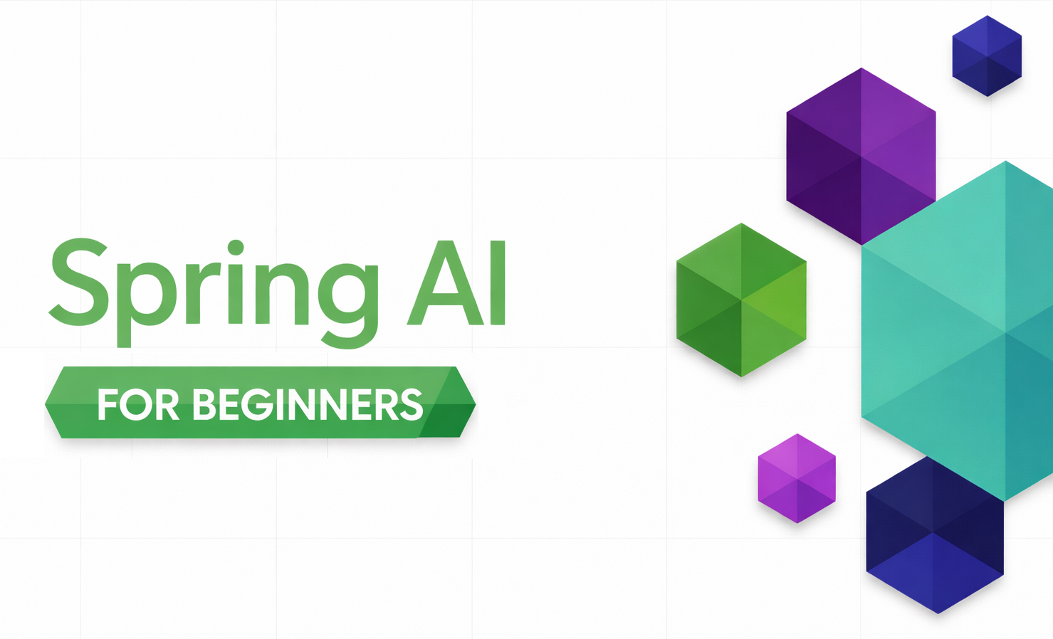
SPRING AI / MODULE 04
Tool calling with Spring AI
Expose Java capabilities with @Tool.
Let ChatClient manage the tool-call loop.
Inspect real calls, chained results, and session context.
SPRING AI FOR BEGINNERS / 04 Tool Calling
01 / 20
Notes:
Frame this module around connecting an LLM to application capabilities. The workshop uses weather and temperature conversion tools with Spring AI ChatClient. Weather data is synthetic; conversion math runs in Java. The term agent here means a tool-enabled assistant. Module 06 explores explicit multi-stage orchestration patterns, which are a different control layer. Repository sources: 04-tools/README.md 04-tools/src/main/java/com/example/springai/tools/service/AgentService.java 04-tools/src/main/java/com/example/springai/tools/tools/WeatherTool.java 04-tools/src/main/java/com/example/springai/tools/tools/TemperatureTool.java

Slide 2

MODULE 04 / Why tools matter
Text generation is not the same as taking action
Model chooses a tool
User asks
Application executes WeatherTool
Weather in Seattle?
getCurrentWeather("Seattle")
Tool result goes back to the model: 22 C, cloudy
Generated reply to the user
The tool reports 22 C and cloudy.
SPRING AI FOR BEGINNERS / 04 Tool Calling
02 / 20
Notes:
The diagram reuses the existing LLM artwork but reconnects request, execution, result, and generated answer. The model chooses getCurrentWeather; Spring AI invokes it in the application. The tool result returns to the model, which then produces the user-facing text. The 22 C example is illustrative; the workshop tool randomizes weather and does not query a real weather API. Exposed tool capabilities remain application-controlled, not arbitrary model execution. Repository sources: 04-tools/README.md 04-tools/src/main/java/com/example/springai/tools/tools/WeatherTool.java 04-tools/src/main/java/com/example/springai/tools/tools/TemperatureTool.java

Slide 3
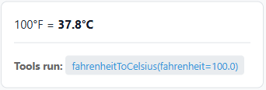
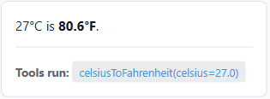
MODULE 04 / The working example
The demo shows which Java methods actually ran
Direct conversion request
Follow-up after Seattle was 27 C
Recorded input: fahrenheit=100.0
Follow-up: convert that value to Fahrenheit.
SPRING AI FOR BEGINNERS / 04 Tool Calling
03 / 20
Notes:
The left excerpt is a request to convert 100 Fahrenheit. The right excerpt follows a separate Seattle weather response of 27 Celsius and the user request Now convert that temperature to Fahrenheit. This antecedent explains celsius=27.0; it does not come from the earlier 100-Fahrenheit conversion. ToolExecutionInfo records actual method names and arguments, not raw return values. Generated prose is not invocation evidence, and the randomized weather changes between runs. Repository sources: 04-tools/README.md 04-tools/src/main/java/com/example/springai/tools/model/dto/ToolExecutionInfo.java 04-tools/src/main/java/com/example/springai/tools/service/AgentService.java

Slide 4

MODULE 04 / ReAct pattern
The loop alternates decisions and tool results
Spring AI client
Foundry model
Java tool
Question needing a capability
Messages + available tool schemas
Chosen tool name and arguments
Invoke the registered Java method
Actual tool result
Supply the tool result in the next request
Choose another tool or answer
Final answer when ready
Return the answer
SPRING AI FOR BEGINNERS / 04 Tool Calling
04 / 20
Notes:
Trace one complete tool cycle and the decision to continue or answer. The model chooses a capability, Spring AI dispatches it, and the real output returns to the model before its next decision. If another tool is needed, repeat the four tool-request/execution/result messages rather than inventing a result. The final natural-language answer originates from the model after observations. This illustrates externally visible tool behavior, not private model reasoning. Repository sources: 04-tools/README.md 04-tools/src/main/java/com/example/springai/tools/service/AgentService.java

Slide 5
MODULE 04 / Execution flow
Follow a complete temperature-conversion request
Spring AI client
Foundry model
Java tool
"Convert 100 F to Celsius"
Message + TemperatureTool schemas
fahrenheitToCelsius(fahrenheit=100)
Call fahrenheitToCelsius(100.0)
Formatted conversion: 100.0 F = 37.8 C
Return that tool output
Final answer using the conversion
37.8 C; invocation metadata
SPRING AI FOR BEGINNERS / 04 Tool Calling
05 / 20
Notes:
This scenario uses the actual TemperatureTool method and parameter names, avoiding the incorrect temp parameter in the old generated flow illustration. The tool calculates (100 minus 32) times five-ninths and displays one decimal, 37.8 Celsius. Spring AI returns the formatted method result to the model before the final answer. Tool metadata is supplied separately by the application recorder. The user artwork comes from an existing repository diagram; all arrows now have explicit source and destination. Repository sources: 04-tools/README.md 04-tools/src/main/java/com/example/springai/tools/service/AgentService.java

Slide 6
MODULE 04 / Spring AI integration
Spring Boot wires the client; the service adds tools
JAVA
Inherited starter
this.chatClient = chatClientBuilder.build();
this.toolExecutionRecorder =
new ToolExecutionInfo.Recorder();
this.weatherTool =
new WeatherTool(toolExecutionRecorder);
this.temperatureTool =
new TemperatureTool(toolExecutionRecorder);
The root POM provides the OpenAI starter and client.
No extra AI library
Tool calling is already available through ChatClient.
Actual construction
AgentService creates these two tool instances.
SPRING AI FOR BEGINNERS / 04 Tool Calling
06 / 20
Notes:
The root POM provides spring-ai-starter-model-openai and spring-ai-client-chat; Module 04 adds Thymeleaf, not another Spring AI tool artifact. Spring Boot injects ChatClient.Builder. AgentService constructs the tool objects and recorder itself. Do not claim the tools are automatically component-scanned and globally available just because their methods have annotations. Repository sources: 04-tools/src/main/java/com/example/springai/tools/service/AgentService.java 04-tools/pom.xml pom.xml

Slide 7
MODULE 04 / Tool definitions
Define tools with @Tool and @ToolParam
JAVA / METHOD SIGNATURE, BODY OMITTED
@Tool
@Tool(description =
"Convert temperature from Celsius to Fahrenheit")
public String celsiusToFahrenheit(
@ToolParam(description =
"Temperature in Celsius")
double celsius)
Names the capability and when it is useful.
@ToolParam
Explains the argument, including its unit.
Java types
Describe the callable method contract.
SPRING AI FOR BEGINNERS / 04 Tool Calling
07 / 20
Notes:
This is the actual annotation and signature from TemperatureTool, with the body omitted. The correct Spring AI annotation syntax uses description attributes. Spring AI inspects registered annotated instances to construct tool definitions and parameter schemas. Descriptions are guidance to the model, not runtime validation or authorization. Validate arguments inside the tool when correctness or safety requires it. Repository sources: 04-tools/src/main/java/com/example/springai/tools/tools/TemperatureTool.java 04-tools/src/main/java/com/example/springai/tools/tools/WeatherTool.java

Slide 8
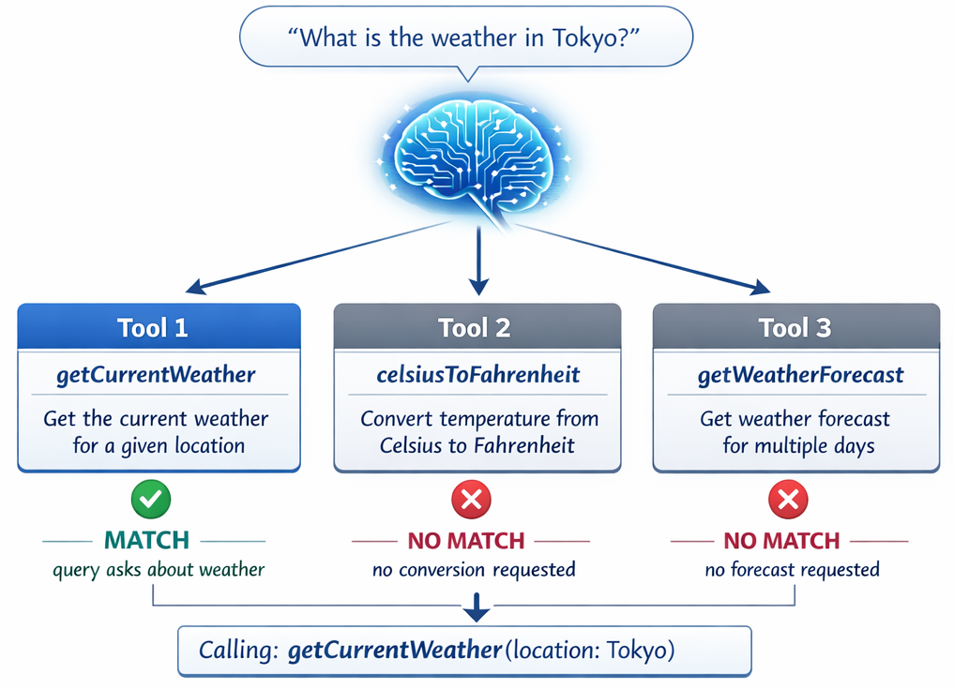
MODULE 04 / Model decisions
Tool descriptions guide selection and arguments
SPRING AI FOR BEGINNERS / 04 Tool Calling
08 / 20
Notes:
The diagram illustrates matching a user need to a capability. Do not claim the application computes an explicit relevance score for every tool or guarantees the most specific tool will always be selected. The model sees tool names, descriptions, and parameter definitions and generates a call. Test ambiguous phrasing, wrong units, and requests that should not trigger any tool. Repository sources: 04-tools/README.md 04-tools/src/main/java/com/example/springai/tools/tools/WeatherTool.java 04-tools/src/main/java/com/example/springai/tools/tools/TemperatureTool.java

Slide 9
MODULE 04 / Spring AI API
Register tools on the ChatClient request
JAVA
Conversation input
String answer = chatClient.prompt()
.messages(messages)
.tools(weatherTool, temperatureTool)
.call()
.content();
messages(...) supplies the current session history.
Allowed capabilities
tools(...) exposes these instances for this call.
Automatic loop
Spring AI dispatches calls and returns results.
SPRING AI FOR BEGINNERS / 04 Tool Calling
09 / 20
Notes:
Show the core of executeTask. It loads messages from ChatMemory and supplies the two tool instances with .tools. Spring AI handles the model request, argument conversion, tool invocation, and subsequent model response. Restricting available tools is an application responsibility. This flow does not implement authorization checks or human approval for side-effecting actions. Repository sources: 04-tools/src/main/java/com/example/springai/tools/service/AgentService.java

Slide 10
MODULE 04 / Workshop capabilities
Eight methods form the available tool set
TOOL METHODS
Two weather calls
WeatherTool
getCurrentWeather(location)
getWeatherForecast(location, days)
TemperatureTool
celsiusToFahrenheit(celsius)
fahrenheitToCelsius(fahrenheit)
celsiusToKelvin(celsius)
kelvinToCelsius(kelvin)
fahrenheitToKelvin(fahrenheit)
kelvinToFahrenheit(kelvin)
Current conditions and a 1-7 day forecast.
Six conversions
Both directions between Celsius, Fahrenheit, and Kelvin.
Small contracts
Each tool has one clear responsibility.
SPRING AI FOR BEGINNERS / 04 Tool Calling
10 / 20
Notes:
Read the actual available-tool list from AgentService. The two weather methods return mock data, and the six temperature methods implement conversions in Java. Splitting conversion directions into separate tools gives each method clear units. The generic ecosystem image in the README shows possibilities beyond this set; this module does not implement email, payment, or database tools. Repository sources: 04-tools/src/main/java/com/example/springai/tools/service/AgentService.java 04-tools/src/main/java/com/example/springai/tools/tools/WeatherTool.java 04-tools/src/main/java/com/example/springai/tools/tools/TemperatureTool.java

Slide 11
MODULE 04 / Implementation boundaries
WeatherTool is a mock, not a live weather API
JAVA / MOCK DATA EXCERPT
Synthetic readings
int temperature = 15 + random.nextInt(20);
String[] conditions = {
"sunny", "cloudy", "partly cloudy", "rainy"
};
String condition = conditions[
random.nextInt(conditions.length)];
Generated values range from 15 to 34 Celsius.
No city lookup
Any location string can receive mock conditions.
Forecast limit
The days parameter is checked against 1-7.
SPRING AI FOR BEGINNERS / 04 Tool Calling
11 / 20
Notes:
The code uses Random, not a fixed city database or remote weather provider. nextInt(20) returns zero through nineteen, making the temperature range 15 through 34 despite a broader source comment. An unknown-city example will not trigger a lookup failure in this implementation. A real provider integration would require credentials, timeouts, rate handling, validation, and tests. Repository sources: 04-tools/src/main/java/com/example/springai/tools/tools/WeatherTool.java

Slide 12
MODULE 04 / Deterministic tools
Run temperature calculations in ordinary Java
JAVA / CALCULATION EXCERPTS
Known formulas
double fahrenheit =
(celsius * 9.0 / 5.0) + 32.0;
double celsius =
(fahrenheit - 32.0) * 5.0 / 9.0;
double kelvin = celsius + 273.15;
The tool computes instead of asking the model to guess.
Simple test cases
0 Celsius = 32 Fahrenheit = 273.15 Kelvin.
Display precision
Celsius/Fahrenheit use one decimal; Kelvin uses two.
SPRING AI FOR BEGINNERS / 04 Tool Calling
12 / 20
Notes:
These are independent calculation excerpts from different conversion methods, not one method with duplicate local variables. The formulas are deterministic and can be unit-tested without any model calls. Tool selection can still be wrong, so both the math and orchestration need checks. Kelvin-input methods reject negative Kelvin; validation is not uniform across every conversion direction in the current code. Repository sources: 04-tools/src/main/java/com/example/springai/tools/tools/TemperatureTool.java

Slide 13
MODULE 04 / Multiple tool calls
Chain a lookup into a conversion
Spring AI client
Foundry model
Java tool
"Seattle weather in Fahrenheit?"
Question + weather/conversion schemas
getCurrentWeather(location="Seattle")
getCurrentWeather("Seattle")
Example mock result: 22 C, cloudy
Return actual weather result
celsiusToFahrenheit(celsius=22)
celsiusToFahrenheit(22.0)
22.0 C = 71.6 F
Return actual conversion result
Final combined weather answer
Weather + converted temperature
SPRING AI FOR BEGINNERS / 04 Tool Calling
13 / 20
Notes:
Trace a specific two-tool sequence: getCurrentWeather, its real return to the model, celsiusToFahrenheit with that Celsius value, then the conversion return and final answer. The example 22 Celsius produces 71.6 Fahrenheit; live weather is randomized, so the values vary. Spring AI executes each selected method. To verify result reuse, compare a captured raw weather output with the subsequent conversion argument; the invocation recorder alone does not store the weather return. Repository sources: 04-tools/README.md 04-tools/src/main/java/com/example/springai/tools/service/AgentService.java 04-tools/src/main/java/com/example/springai/tools/tools/WeatherTool.java 04-tools/src/main/java/com/example/springai/tools/tools/TemperatureTool.java

Slide 14
MODULE 04 / Observability
Record invocations independently of model text
JAVA
Real method calls
toolExecutionRecorder.start();
String answer = chatClient.prompt()
.messages(messages)
.tools(weatherTool, temperatureTool)
.call().content();
List<ToolExecutionInfo> executions =
toolExecutionRecorder.stop();
Tools wrap their execution with Recorder.record(...).
Useful fields
toolName, arguments, and completed/failed status.
UI evidence
The response supplies the Tools run list.
SPRING AI FOR BEGINNERS / 04 Tool Calling
14 / 20
Notes:
The recorder uses a ThreadLocal list scoped to the current synchronous agent request. It records completion or failure around a Supplier invocation and removes the list on stop. It does not currently provide a duration, result payload, or distributed trace in its primary record, despite a legacy constructor with older metadata. For asynchronous execution, recorder context propagation would need explicit design. Repository sources: 04-tools/src/main/java/com/example/springai/tools/model/dto/ToolExecutionInfo.java 04-tools/src/main/java/com/example/springai/tools/service/AgentService.java

Slide 15
MODULE 04 / Spring AI conversation memory
Keep a 20-message window per session
JAVA
Explicit management
this.chatMemory =
MessageWindowChatMemory.builder()
.maxMessages(20)
.build();
chatMemory.add(sessionId,
new UserMessage(request.message()));
List<Message> messages =
chatMemory.get(sessionId);
The service adds user and final assistant messages.
Follow-up context
A later request can reference the prior temperature.
Session isolation
Different IDs select separate message histories.
SPRING AI FOR BEGINNERS / 04 Tool Calling
15 / 20
Notes:
AgentService creates a UUID when no session ID is supplied. It adds a UserMessage, calls ChatClient with the retained history, and adds the final AssistantMessage. Intermediate tool exchanges are managed inside the call; this code does not separately archive them into the long-term ChatMemory window. Twenty messages is not twenty turns or a token cap. Session IDs are not access-control checks, and memory is not durable. Repository sources: 04-tools/src/main/java/com/example/springai/tools/service/AgentService.java

Slide 16
MODULE 04 / Error handling
Distinguish domain limits from execution failures
JAVA
Domain response
if (days < 1 || days > 7) {
return "Forecast is available for " +
"1 to 7 days only.";
}
if (kelvin < 0) {
throw new IllegalArgumentException(
"Temperature cannot be below " +
"absolute zero (0 K)");
}
Invalid forecast length returns explanatory text.
Java exception
Negative Kelvin throws and is recorded as failed.
Service fallback
The service catches failures and returns a failed response.
SPRING AI FOR BEGINNERS / 04 Tool Calling
16 / 20
Notes:
These are separate validation excerpts from WeatherTool and TemperatureTool, wrapped for legibility. A returned domain message is still a completed Java invocation. A RuntimeException causes the recorder to mark failure and rethrow. Spring AI exception policy determines what can be sent back to the model; AgentService also has a catch block that returns a failed AgentResponse. Error handling, bounded retries, and user-safe messages need deliberate production design. Repository sources: 04-tools/src/main/java/com/example/springai/tools/tools/WeatherTool.java 04-tools/src/main/java/com/example/springai/tools/tools/TemperatureTool.java 04-tools/src/main/java/com/example/springai/tools/model/dto/ToolExecutionInfo.java 04-tools/src/main/java/com/example/springai/tools/service/AgentService.java

Slide 17
MODULE 04 / Choosing the right pattern
RAG supplies evidence; tools execute capabilities
RAG: retrieve before generation
Question
Retrieve + build prompt
Generated answer
Final reply after tool results
Tools: select and observe
Question
Execute Java tool
Generated answer
Tool result via Spring AI
SPRING AI FOR BEGINNERS / 04 Tool Calling
17 / 20
Notes:
Both initiating questions are now explicitly connected. RAG retrieves passages and assembles context before generation. Tool calling first asks the model to select a capability, executes it in application code, and feeds the result back before the model returns a final answer. The existing model artwork is reused with corrected connectors. The distinction is not strictly static versus dynamic or read-only versus write: corpora can be refreshed and tools can be read-only. Applications often combine both patterns. Repository sources: 04-tools/README.md

Slide 18
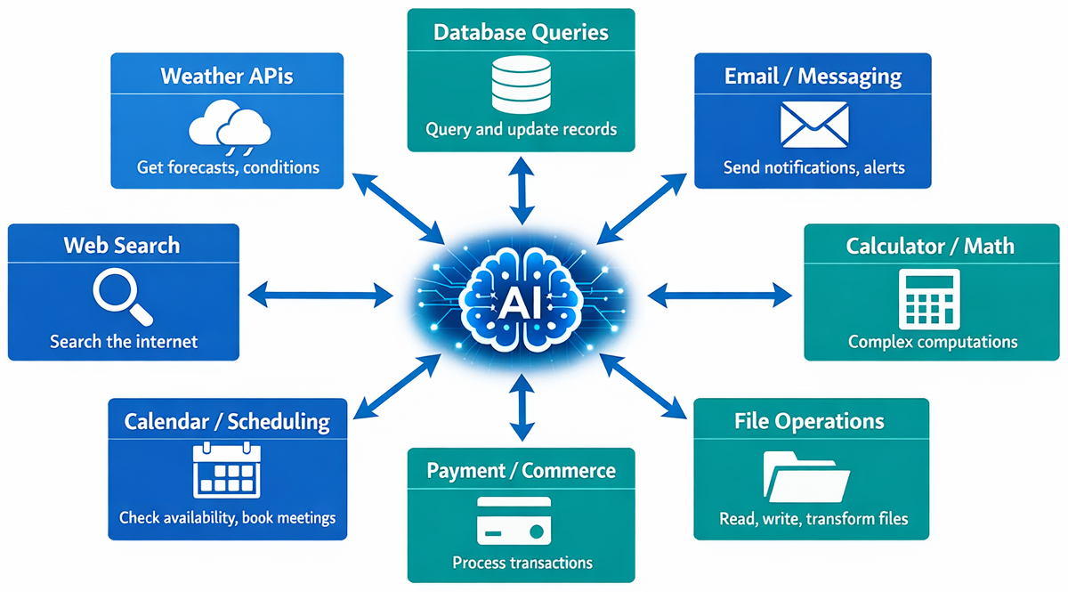
MODULE 04 / Beyond the workshop
Expose only the capabilities the task needs
Read-only first
Start with lookup and calculation functions.
Validate and authorize
Check inputs and the caller in application code.
Control side effects
Use approval and idempotency for consequential actions.
SPRING AI FOR BEGINNERS / 04 Tool Calling
18 / 20
Notes:
The ecosystem graphic illustrates potential integrations, not tools implemented here. Weather lookups, calculations, database access, email, and payments have different risk profiles. The model should receive only the capabilities appropriate for the request. The current demo does not implement approval workflows, payment operations, or production authorization. General text generation does not need tools merely because tools are available. Repository sources: 04-tools/README.md 04-tools/src/main/java/com/example/springai/tools/service/AgentService.java

Slide 19
MODULE 04 / Workshop demonstration
Demonstrate a single call, a chain, and a follow-up
1
Start from 04-tools
PowerShell: .\start.ps1 | Bash: ./start.sh | http://localhost:8084
2
Check a conversion
Ask: Convert 100 degrees Fahrenheit to Celsius. Inspect Tools run and the arguments.
3
Chain and continue
Ask for Seattle weather in Fahrenheit, then request the same temperature in Kelvin.
SPRING AI FOR BEGINNERS / 04 Tool Calling
19 / 20
Notes:
Use the shared Module 01 environment. A single Fahrenheit conversion should display the fahrenheitToCelsius invocation. The weather-plus-conversion request can demonstrate multiple tool calls; inspect the actual generated sequence rather than requiring a fixed count for every model run. Continue within the same session to use prior context. For limits, test a forecast beyond seven days or a negative Kelvin input; an unknown city is not a failure case for this mock. Repository sources: 04-tools/README.md 04-tools/src/main/java/com/example/springai/tools/service/AgentService.java 04-tools/src/main/java/com/example/springai/tools/tools/WeatherTool.java 04-tools/src/main/java/com/example/springai/tools/tools/TemperatureTool.java

Slide 20

SPRING AI / MODULE 04
Demo
http://aka.ms/Spring-AI-for-Beginners
SPRING AI FOR BEGINNERS / 04 Tool Calling
20 / 20
Notes:
The lab should extend the existing pattern without broad new infrastructure. A small unit conversion or a controlled application lookup is sufficient. Write direct Java tests for the operation and validation, then test model selection with clear, ambiguous, and irrelevant prompts. Inspect the recorder to distinguish tool use from generated claims. The next module moves tool contracts out of process while retaining application control over execution. Repository sources: 04-tools/src/main/java/com/example/springai/tools/service/AgentService.java 04-tools/src/main/java/com/example/springai/tools/tools/TemperatureTool.java 04-tools/src/main/java/com/example/springai/tools/model/dto/ToolExecutionInfo.java 04-tools/README.md

