Slide 1
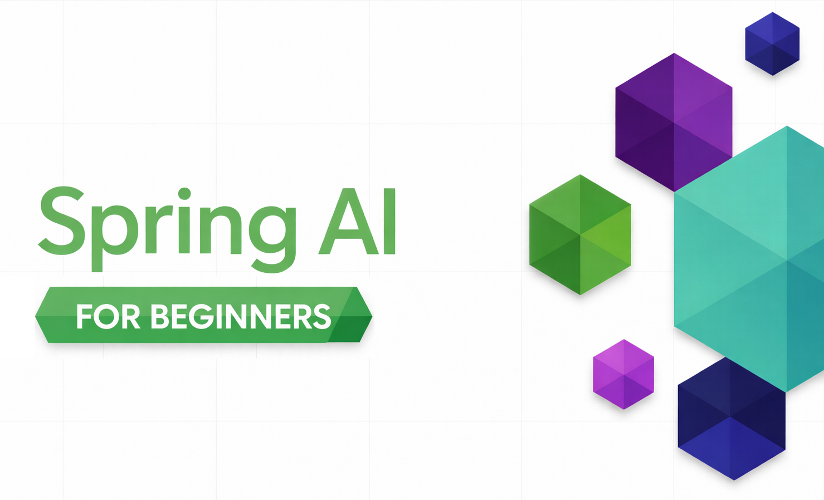
SPRING AI / MODULE 05
MCP with Spring AI
Publish tools from a separate Spring Boot server.
Discover remote tools through Spring AI callbacks.
Drive one game with board actions and natural-language chat.
SPRING AI FOR BEGINNERS / 05 MCP
01 / 24
Notes:
Introduce Model Context Protocol through the working tic-tac-toe application. The human plays X and the server AI plays O. Both board clicks and the chat panel use server-hosted MCP tools. The server owns the game engine and an internal ChatClient for AI moves; the client has both a deterministic invocation path and an LLM-orchestrated path. Repository sources: 05-mcp/README.md 05-mcp/mcp-client/src/main/java/com/example/springai/mcp/client/GameService.java 05-mcp/mcp-client/src/main/java/com/example/springai/mcp/client/AgentService.java 05-mcp/mcp-server/src/main/java/com/example/springai/mcp/server/TicTacToeTools.java

Slide 2
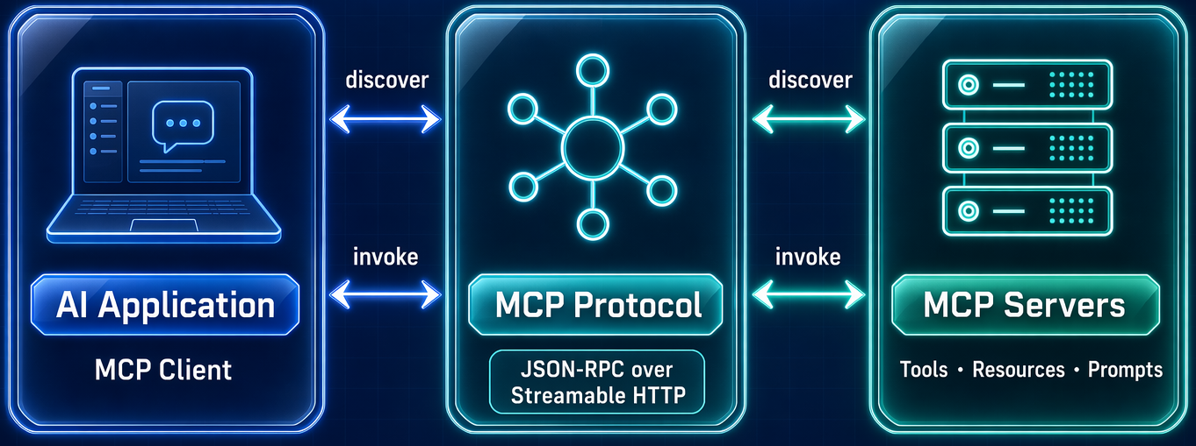
MODULE 05 / Why MCP matters
Share capabilities across application boundaries
SPRING AI FOR BEGINNERS / 05 MCP
02 / 24
Notes:
Module 04 registered Java objects inside one process. MCP makes it possible to publish a tool contract from an independently running service and reuse it from multiple clients. An AI application discovers available capabilities instead of hard-coding every network API integration. The protocol does not eliminate authentication, authorization, versioning, or trust decisions. Repository sources: 05-mcp/README.md

Slide 3
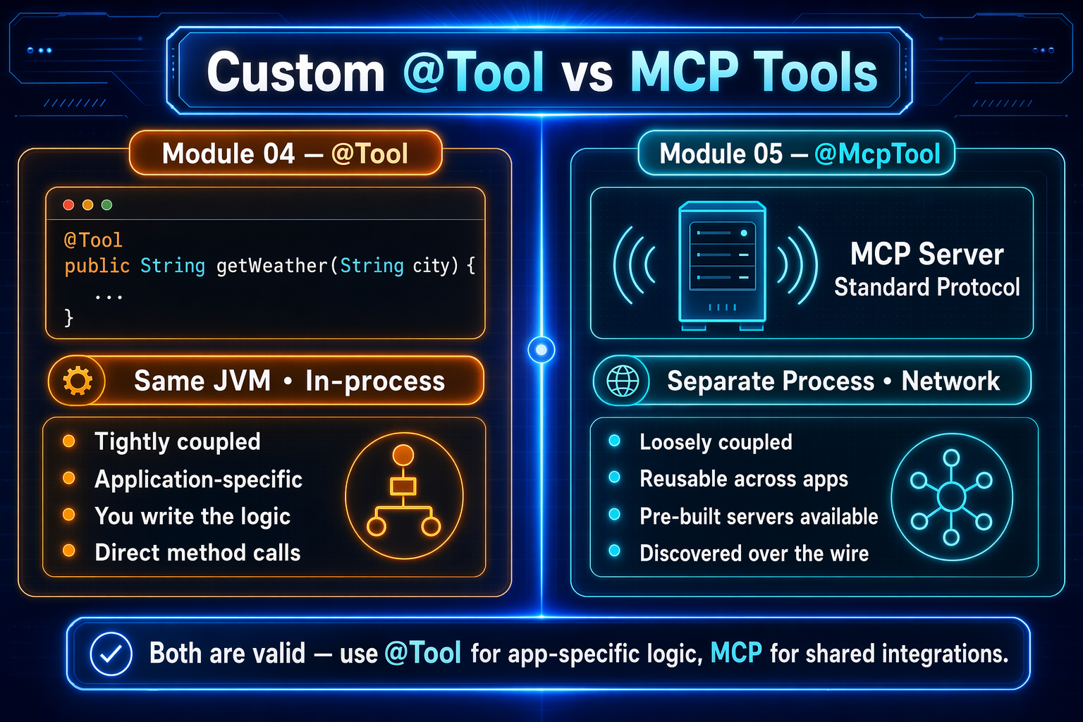
MODULE 05 / Module 04 to Module 05
Local tools and MCP tools use different boundaries
SPRING AI FOR BEGINNERS / 05 MCP
03 / 24
Notes:
Explain the process boundary rather than implying one option is universally better. Module 04 explicitly registers WeatherTool and TemperatureTool using ChatClient.tools; they are not made globally available by component scan alone. Module 05 publishes annotated server methods and discovers them through MCP. Remote use adds transport latency, connection lifecycle, and server trust considerations. Repository sources: 05-mcp/README.md 05-mcp/mcp-server/src/main/java/com/example/springai/mcp/server/TicTacToeTools.java 05-mcp/mcp-client/src/main/java/com/example/springai/mcp/client/GameService.java 04-tools/src/main/java/com/example/springai/tools/service/AgentService.java

Slide 4
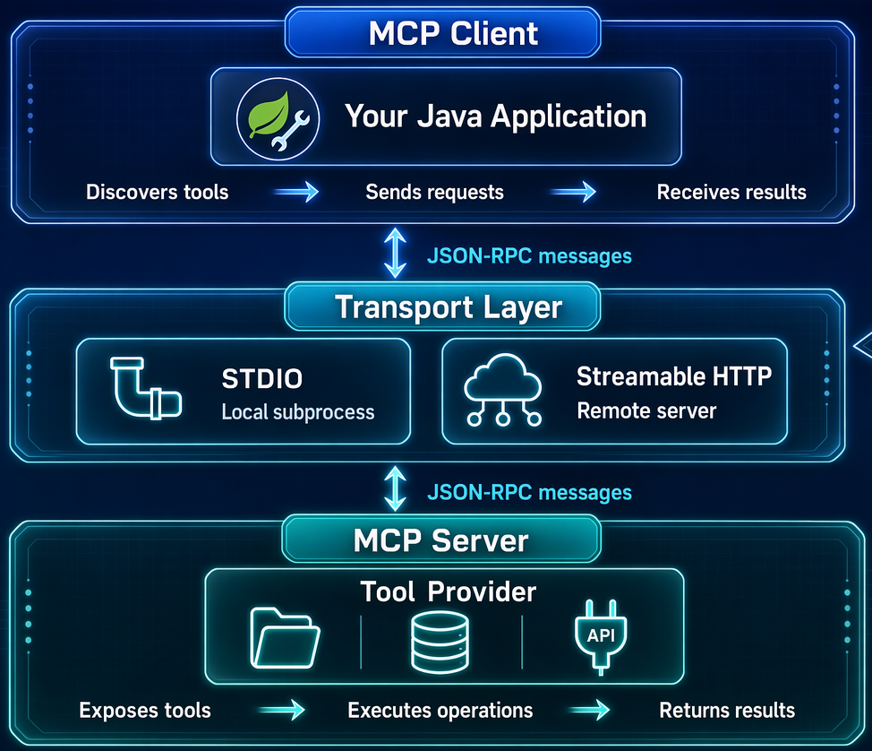
MODULE 05 / Protocol fundamentals
MCP carries discovery and calls over a transport
SPRING AI FOR BEGINNERS / 05 MCP
04 / 24
Notes:
Identify the protocol messages separately from their transport. Clients initialize a session, discover tool definitions, and send named tool calls with arguments. Streamable HTTP is the configured network transport in this module, rather than the legacy HTTP+SSE transport. Streamable HTTP can itself use event streams, so do not describe it as universally having no SSE. stdio is the alternative for a local subprocess. Repository sources: 05-mcp/README.md

Slide 5
MODULE 05 / Transport choices
Protocol sessions are different from game state
Stateful transport
Stateless transport
STREAMABLE in this demo
STATELESS option
Supports session-oriented exchange and server callbacks.
Independent request/response tool calls.
Deployment consideration
Application state remains
Session routing matters when scaling servers.
GameEngine still needs durable, coordinated storage.
SPRING AI FOR BEGINNERS / 05 MCP
05 / 24
Notes:
The README describes STREAMABLE and STATELESS Spring AI server modes. Stateful operation supports the session and callback features discussed later. Stateless transport reduces session coupling, but this application still holds boards and chat state in process memory. A production deployment must design persistence, concurrency, routing, and identity independently of the transport setting. Repository sources: 05-mcp/README.md 05-mcp/mcp-server/src/main/java/com/example/springai/mcp/server/GameEngine.java 05-mcp/mcp-client/src/main/java/com/example/springai/mcp/client/AgentService.java 05-mcp/mcp-server/src/main/resources/application.yaml

Slide 6
MODULE 05 / Connection lifecycle
Discover tool contracts before invoking them
01
02
03
Connect
Discover
Invoke
Initialize the configured MCP server connection.
Obtain tool names, descriptions, and input schemas.
Send a named call and parse the returned content.
SPRING AI FOR BEGINNERS / 05 MCP
06 / 24
Notes:
The conceptual wire flow includes initialization, tools/list discovery, and tools/call invocation. The Spring AI MCP client starter handles the protocol connection and provides a ToolCallbackProvider. GameService indexes those callbacks by tool definition name. The server must be available when the client initializes; a missing callback is reported as an application error rather than magically resolved by the model. Repository sources: 05-mcp/README.md 05-mcp/mcp-client/src/main/java/com/example/springai/mcp/client/GameService.java

Slide 7
MODULE 05 / Dependencies
Use matching Spring AI server and client starters
MAVEN ARTIFACTS
Server model use
MCP server:
spring-ai-starter-mcp-server-webmvc
MCP client:
spring-ai-starter-mcp-client-webflux
Inherited by both applications:
spring-ai-starter-model-openai
spring-ai-client-chat
aiMove calls ChatClient inside the tool.
Client model use
The agent chat path lets an LLM choose tools.
Direct path
GameService itself does not need a client-side LLM.
SPRING AI FOR BEGINNERS / 05 MCP
07 / 24
Notes:
The server adds the Web MVC MCP server starter. The client adds the WebFlux MCP client starter and Thymeleaf for its UI, while the repository still supplies the shared application baseline. Both inherit the OpenAI starter and ChatClient. A direct aiMove invocation avoids a client-side model decision, but the server tool still calls its own model; do not describe the whole move as model-free. Repository sources: 05-mcp/mcp-server/pom.xml 05-mcp/mcp-client/pom.xml pom.xml 05-mcp/mcp-server/src/main/java/com/example/springai/mcp/server/TicTacToeTools.java 05-mcp/mcp-client/src/main/java/com/example/springai/mcp/client/GameService.java 05-mcp/mcp-client/src/main/java/com/example/springai/mcp/client/AgentService.java

Slide 8
MODULE 05 / Spring Boot properties
Connect the client to the server configuration
YAML / TWO APPLICATION EXCERPTS
Server: 8085
spring.ai.mcp.server:
name: tictactoe-server
protocol: STREAMABLE
spring.ai.mcp.client:
streamable-http:
connections:
tictactoe-server:
url: http://localhost:8085
Publishes the tool catalog and executes game methods.
Client: 8082
Hosts the browser UI and the two invocation paths.
Shared environment
Both use the Module 01 model configuration.
SPRING AI FOR BEGINNERS / 05 MCP
08 / 24
Notes:
These excerpts belong to separate application.yaml files and use dotted YAML keys to fit on the slide. The full files also configure names, ports, and the OpenAI deployment. The connection URL is the server base address. The MCP server is not the browser application; a root-page 404 on port 8085 is not proof that MCP is broken. Open the client at port 8082. Repository sources: 05-mcp/README.md 05-mcp/mcp-server/src/main/resources/application.yaml 05-mcp/mcp-client/src/main/resources/application.yaml

Slide 9
MODULE 05 / Remote capabilities
Five server tools define the game contract
MCP TOOL CATALOG
Create
startNewGame()
makeMove(gameId, position, player)
aiMove(gameId)
getBoardState(gameId)
getAvailableMoves(gameId)
Board positions: 0 through 8
Players: X = human, O = AI
States: IN_PROGRESS, WON, DRAW
A new game returns an ID and an empty board.
Mutate
makeMove and aiMove update server-owned state.
Inspect
Read board state and empty positions.
SPRING AI FOR BEGINNERS / 05 MCP
09 / 24
Notes:
Read the exact tool names from TicTacToeTools. GameEngine returns JSON strings including gameId, board, status, winner, and currentPlayer; terminal states have no current player. makeMove accepts a position and player; aiMove selects and executes the server AI move as O. The interface is sufficient for both the board and chat interaction patterns. Repository sources: 05-mcp/mcp-server/src/main/java/com/example/springai/mcp/server/TicTacToeTools.java 05-mcp/mcp-server/src/main/java/com/example/springai/mcp/server/GameEngine.java

Slide 10
MODULE 05 / Spring AI server API
Publish a method with @McpTool
JAVA
@McpTool
@McpTool(description =
"Get the current board state for a game. " +
"Returns the board array, game status, " +
"current player, and winner if any.")
public String getBoardState(
@McpToolParam(description = "The game ID")
String gameId) {
return gameEngine.getBoardState(gameId);
}
Publishes the operation and return contract.
@McpToolParam
Describes required input for discovery.
Spring service
The server starter scans the annotated service.
SPRING AI FOR BEGINNERS / 05 MCP
10 / 24
Notes:
This is the getBoardState method from the Spring-managed TicTacToeTools service, with string wrapping adjusted for legibility. The annotations are org.springframework.ai.mcp.annotation.McpTool and McpToolParam. GameEngine contains the ordinary Java rules and has no MCP imports. Publishing a method still requires deliberate authorization and trustworthy return data in a production service. Repository sources: 05-mcp/mcp-server/src/main/java/com/example/springai/mcp/server/TicTacToeTools.java 05-mcp/mcp-server/src/main/java/com/example/springai/mcp/server/GameEngine.java

Slide 11
MODULE 05 / Application-owned rules
Keep move validation in the game engine
01
02
03
04
Game
Position
Turn
Outcome
Require an existing game that is still in progress.
Accept only an empty cell from 0 through 8.
Require the expected player, then apply the move.
Resolve a win or draw, or change turns.
SPRING AI FOR BEGINNERS / 05 MCP
11 / 24
Notes:
GameEngine validates game existence, status, position range, occupancy, and turn order before mutating a board. It checks the eight winning lines and then a full-board draw. The data structures are in-memory maps; this does not establish transactional safety across concurrent operations or persistent games. A production game service would need explicit concurrency and lifecycle design. Repository sources: 05-mcp/mcp-server/src/main/java/com/example/springai/mcp/server/GameEngine.java 05-mcp/mcp-server/src/main/java/com/example/springai/mcp/server/TicTacToeTools.java

Slide 12
MODULE 05 / Server-side model integration
The aiMove tool calls Spring AI on the server
JAVA
Server context
String aiResponse = chatClient.prompt()
.system(AI_STRATEGY_PROMPT)
.user("Current board state: " + boardState
+ "\nAvailable positions: " + available
+ "\nChoose your position:")
.call().content();
int position = selectMove(aiResponse, available);
return gameEngine.makeMove(gameId, position, "O");
Read the board and available positions first.
Strategy prompt
Ask for one digit using win/block/position priorities.
Apply safely
Validate the selection before calling makeMove.
SPRING AI FOR BEGINNERS / 05 MCP
12 / 24
Notes:
The actual tool reads getBoardState and getAvailableMoves before this excerpt. It asks ChatClient for a single digit and then routes the result through selectMove. The strategy lives on the server, so any MCP-compatible client can request the same AI move. The strategy prompt does not make the model unbeatable or guarantee a legal answer by itself. Repository sources: 05-mcp/mcp-server/src/main/java/com/example/springai/mcp/server/TicTacToeTools.java 05-mcp/mcp-client/src/main/java/com/example/springai/mcp/client/GameService.java

Slide 13
MODULE 05 / Guardrails
Prompt strategy and Java fallback are not identical
Requested strategy
Validated fallback
Win, then block
Check the response
The prompt prioritizes immediate tactical moves.
Accept an extracted 0-8 digit only if available.
Then position
Otherwise select
Prefer center, corners, and finally edges.
Choose center, corners, then edges from legal cells.
SPRING AI FOR BEGINNERS / 05 MCP
13 / 24
Notes:
AI_STRATEGY_PROMPT requests win, block, center, corners, edges. selectMove extracts the first digit in the range zero through eight and checks membership in available moves. Invalid or occupied choices trigger the constant fallback order 4,0,2,6,8,1,3,5,7. That fallback does not calculate winning or blocking moves. Empty available moves cause aiMove to fail before the model call, and transport/model failures are not covered by this selection fallback. Repository sources: 05-mcp/mcp-server/src/main/java/com/example/springai/mcp/server/TicTacToeTools.java

Slide 14
MODULE 05 / Spring AI client discovery
ToolCallbackProvider exposes discovered tools
JAVA
Injected provider
this.mcpTools = new HashMap<>();
for (ToolCallback callback :
toolCallbackProvider.getToolCallbacks()) {
mcpTools.put(
callback.getToolDefinition().name(),
callback);
}
The MCP starter supplies remote callbacks.
ToolDefinition
Read each discovered tool name.
Shared catalog
GameService and AgentService use the same provider.
SPRING AI FOR BEGINNERS / 05 MCP
14 / 24
Notes:
This is the GameService constructor loop with the local variable renamed for readability. Spring AI exposes the remote tool contract through ToolCallback and ToolDefinition. GameService stores the callbacks in a name-keyed map. AgentService receives the same provider and wraps callbacks to capture returned game IDs. Neither path needs to implement MCP message framing manually. Repository sources: 05-mcp/mcp-client/src/main/java/com/example/springai/mcp/client/GameService.java 05-mcp/mcp-client/src/main/java/com/example/springai/mcp/client/AgentService.java

Slide 15
MODULE 05 / Board interaction path
Invoke a remote tool directly from Java
JAVA / CALL EXCERPT + INPUT SHAPE
Code chooses
ToolCallback tool = mcpTools.get(name);
String raw = tool.call(input);
return extractText(raw);
makeMove input:
{
"gameId": "the-active-game-id",
"position": 4,
"player": "X"
}
A board click already identifies the intended action.
Remote invocation
ToolCallback sends the MCP request.
Parse the result
Unwrap TextContent to obtain the game JSON.
SPRING AI FOR BEGINNERS / 05 MCP
15 / 24
Notes:
GameService has a missing-tool check before the excerpt and uses a Jackson parser to unwrap the MCP TextContent array. The JSON is an illustrative input shape, not a current game ID. For a board move, the controller invokes makeMove as X and then aiMove when the game is still active. A direct startNewGame or makeMove selection needs no client model call. Repository sources: 05-mcp/mcp-client/src/main/java/com/example/springai/mcp/client/GameService.java 05-mcp/mcp-client/src/main/java/com/example/springai/mcp/client/GameController.java

Slide 16

MODULE 05 / Request walkthrough
A board click takes the direct MCP path
Browser :8082
MCP client
MCP server
Foundry model
Click empty cell
POST /api/game/move
makeMove(gameId, position, "X")
Board and status
If IN_PROGRESS: aiMove(gameId)
If invoked: choose legal O move
Index; validate + apply
Board after O (if invoked)
Current state: board, status, ...
Render board
SPRING AI FOR BEGINNERS / 05 MCP
16 / 24
Notes:
The browser posts gameId and position. GameController invokes makeMove as X and inspects the returned status. Only IN_PROGRESS triggers aiMove; a win or draw returns the terminal state directly without the four AI-exchange messages. Inside aiMove the server calls its own ChatClient, validates the proposed index, and applies O. The diagram reuses the original user artwork with editable, source-checked messages. Direct invocation avoids a client-side model decision, not the model call inside the server tool. Repository sources: 05-mcp/README.md 05-mcp/mcp-client/src/main/java/com/example/springai/mcp/client/GameController.java 05-mcp/mcp-client/src/main/java/com/example/springai/mcp/client/GameService.java 05-mcp/mcp-server/src/main/java/com/example/springai/mcp/server/TicTacToeTools.java

Slide 17
MODULE 05 / Agent interaction path
Let ChatClient choose from the discovered callbacks
JAVA
Same capabilities
this.chatClient = chatClientBuilder
.defaultSystem(SYSTEM_PROMPT)
.defaultTools((Object[]) capturingCallbacks)
.defaultAdvisors(
MessageChatMemoryAdvisor
.builder(chatMemory).build())
.build();
Pass the MCP callbacks into the client.
Model selection
The model chooses tools from their descriptions.
Conversation memory
The advisor retains context by conversation ID.
SPRING AI FOR BEGINNERS / 05 MCP
17 / 24
Notes:
This matches the AgentService constructor. It wraps each callback with a game-ID capture decorator, then attaches those callbacks and MessageChatMemoryAdvisor. The system prompt describes the game behavior without hard-coding individual tool names, allowing discovery descriptions to guide selection. A request can involve several model and tool round-trips, not necessarily one model call. Repository sources: 05-mcp/mcp-client/src/main/java/com/example/springai/mcp/client/AgentService.java

Slide 18
MODULE 05 / Spring AI request context
Pass conversation identity to memory and tools
JAVA
Advisor parameter
String reply = chatClient.prompt()
.user(userMessage)
.toolContext(Map.of(
"conversationId", conversationId))
.advisors(advisor -> advisor.param(
ChatMemory.CONVERSATION_ID,
conversationId))
.call()
.content();
Selects the right conversation history.
ToolContext
Lets the callback decorator attribute returned game IDs.
Structured capture
Read gameId from tool JSON, not generated prose.
SPRING AI FOR BEGINNERS / 05 MCP
18 / 24
Notes:
The request carries the conversation identifier twice for distinct reasons. The advisor parameter scopes memory. ToolContext carries the identifier to the callback wrapper, which parses the returned game JSON and updates conversationGameIds. This avoids scraping a game ID from the model natural-language answer. Neither identifier mechanism is an authentication or authorization system. Repository sources: 05-mcp/mcp-client/src/main/java/com/example/springai/mcp/client/AgentService.java

Slide 19
MODULE 05 / Cross-path state
Synchronize chat with the current visual board
01
02
03
04
Read
Snapshot
Capture
Refresh
Fetch getBoardState when the UI supplies a game ID.
Add fresh positions and status to chat memory.
Read gameId from remote tool results using ToolContext.
Return the active game so the board can update.
SPRING AI FOR BEGINNERS / 05 MCP
19 / 24
Notes:
The three-argument chat method accepts boardGameId. seedGameContext obtains real server state and adds a labelled AssistantMessage snapshot with JSON, explicit positions, and a readable grid. The system prompt prioritizes the latest snapshot. The reverse path captures game IDs from tool results so a game started in chat can update the board. Fetch errors are logged; this approach improves grounding but does not make model descriptions infallible. Repository sources: 05-mcp/mcp-client/src/main/java/com/example/springai/mcp/client/AgentService.java 05-mcp/mcp-client/src/main/java/com/example/springai/mcp/client/GameController.java

Slide 20
MODULE 05 / Agent request walkthrough
Chat sequence 1/2: request and human move
Browser :8082
MCP client
MCP server
Foundry model
"Play X at position 4"
POST /api/agent/chat
getBoardState(gameId)
X next; position 4 empty
ChatMemory: add snapshot
Message + memory + tool schemas
Tool request: makeMove(gameId, 4, "X")
makeMove(gameId, 4, "X")
Updated board; still IN_PROGRESS
Tool result: updated board; O next
SPRING AI FOR BEGINNERS / 05 MCP
20 / 24
Notes:
This example assumes an existing game, X to move, empty position 4, and a human move that does not finish the game. The user explicitly requests a human position; an ambiguous your-turn message would not justify inventing one. GameController requires message and conversationId, and optionally receives gameId from the visual board. AgentService fetches a fresh snapshot, passes it with memory and discovered tools to ChatClient, and executes the selected remote move. Its result goes back to the client-side model before the next decision. The following slide continues that same request; the exact model-selected tool sequence can vary. Repository sources: 05-mcp/README.md 05-mcp/mcp-client/src/main/java/com/example/springai/mcp/client/GameController.java 05-mcp/mcp-client/src/main/java/com/example/springai/mcp/client/AgentService.java 05-mcp/mcp-server/src/main/java/com/example/springai/mcp/server/TicTacToeTools.java

Slide 21
MODULE 05 / Same request, continued
Chat sequence 2/2: AI move and final reply
Browser :8082
MCP client
MCP server
Foundry model
Next tool request: aiMove(gameId)
aiMove(gameId)
Server model call: O move
Index; validate and apply O
Tool result: board after O
Return aiMove result to client model
Final natural-language reply
getBoardState(gameId)
Fresh gameState for browser
{reply, gameId, gameState}
Reply + updated board
SPRING AI FOR BEGINNERS / 05 MCP
21 / 24
Notes:
Continue the nonterminal human-move example from the prior slide. The client-side model asks for aiMove after receiving the human move result. The server tool makes a separate ChatClient call using its current board, validates the selected cell, and applies O. Spring AI then sends the returned tool result to the client-side model, which generates the final reply. GameController fetches the latest board independently and returns reply, gameId, and gameState to the browser. A transport error or a terminal human move follows a different path; this slide is a specific successful scenario, not a mandatory sequence for every chat prompt. Repository sources: 05-mcp/mcp-client/src/main/java/com/example/springai/mcp/client/GameController.java 05-mcp/mcp-client/src/main/java/com/example/springai/mcp/client/AgentService.java 05-mcp/mcp-server/src/main/java/com/example/springai/mcp/server/TicTacToeTools.java

Slide 22
MODULE 05 / Other protocol primitives
MCP supports more than callable tools
SPRING AI MCP ANNOTATIONS
This module
Server
@McpTool callable operations
@McpResource read-only data by URI
@McpPrompt named prompt templates
Client
@McpSampling server requests model output
@McpElicitation structured user input
@McpProgress progress notifications
@McpLogging structured log events
Implements tools, not every listed primitive.
Callback features
Require client support and suitable session handling.
Trust boundary
Treat server requests as capabilities to authorize.
SPRING AI FOR BEGINNERS / 05 MCP
22 / 24
Notes:
The README introduces the wider annotation set. Sampling means a server asks a client to use its model, whereas this demo aiMove directly uses the server own ChatClient. Elicitation requests user input. Resources and prompts have different contracts from tools. Client support, negotiated capabilities, and transport/session mode matter; listing an annotation does not make the demo implement the feature. Repository sources: 05-mcp/README.md 05-mcp/mcp-server/src/main/java/com/example/springai/mcp/server/TicTacToeTools.java

Slide 23
MODULE 05 / Workshop demonstration
Run both processes and exercise both paths
1
Start the server from 05-mcp
PowerShell: .\start-server.ps1 | Bash: ./start-server.sh | port 8085
2
Start the client from 05-mcp
PowerShell: .\start-client.ps1 | Bash: ./start-client.sh | localhost:8082
3
Compare board and chat actions
Click New Game and a cell; ask chat to place X in an empty cell. Verify the board, then continue by clicking.
SPRING AI FOR BEGINNERS / 05 MCP
23 / 24
Notes:
Start the server, then the client. Open port 8082, create a game, make one human move, and wait for O. Inspect an empty cell and explicitly ask Agent Chat to place X at that position, provided the game is in progress and X is next. Verify the changed board and O response, then continue with a board click. A question about available cells can be answered from a fresh injected snapshot without model-selected tool use, so it is insufficient alone to demonstrate that path. Reset Chat, New Game, and Reset Scores respectively affect conversation, server game, and browser scores. Server games are temporary. Repository sources: 05-mcp/README.md 05-mcp/mcp-client/src/main/java/com/example/springai/mcp/client/GameService.java 05-mcp/mcp-client/src/main/java/com/example/springai/mcp/client/AgentService.java 05-mcp/mcp-server/src/main/java/com/example/springai/mcp/server/GameEngine.java

Slide 24

SPRING AI / MODULE 05
Demo
http://aka.ms/Spring-AI-for-Beginners
SPRING AI FOR BEGINNERS / 05 MCP
24 / 24
Notes:
The lab can add a read-only game-summary or validation operation. Define a clear input and return contract, restart the server and client as required for discovery, and test direct invocation before model-driven selection. For deployment beyond localhost, add trusted connections, authentication, authorization, timeouts, persistence, and concurrency control. The next module focuses on deciding and observing multi-stage application workflows. Repository sources: 05-mcp/mcp-server/src/main/java/com/example/springai/mcp/server/TicTacToeTools.java 05-mcp/mcp-client/src/main/java/com/example/springai/mcp/client/GameService.java 05-mcp/mcp-client/src/main/java/com/example/springai/mcp/client/AgentService.java 05-mcp/README.md

