Slide 1

Introduction to Learn Cloud VS Code Extension
[Speaker Name]
Notes:
Speaker & session introduction

Slide 2

Inclusive Guidelines
Code of Conduct
Audience Guidance
Be welcoming and respectful
Be aware of others
Be open to all questions & viewpoints
Be understanding of differences
Be friendly and patient
Be kind and considerate to others
Use raise hand to ask a question
Questions in chat to be prefaced with Q:
@mention to respond to an individual
Return to mute when not talking
Use alt-text for images and gifs
Immersive reader can be found by clicking on … in the meeting chat
Visit the full Microsoft Learn Student Ambassador Code of Conduct or report an issue by visiting aka.ms/SACoC

Slide 3

Learn Cloud​ ​ Guiding first-time cloud users to deploy to Azure PaaS ​ ​
Pre-requisites​ ​ Visual Studio Code 1.83.0 or newer. ​
Notes:
Definition
This extension helps you deploy your app to Azure, whether you’re a first-time cloud user or want a closer look at the development cycle. Step-by-step instructions, useful tips, and starter templates get you started using Azure’s Platform as a service (PaaS).

Slide 4

Problem Have you ever wanted to deploy your code to the cloud, but felt overwhelmed by the complexity and options?​
With Learn Cloud:​
Use ready-made templates to create a simple web app or use your own code.
Choose the best Azure PaaS for your app.
Follow step-by-step tutorials on the deployment process, based on your operating system and language stack.
Learn the key concepts and terms of cloud computing.
Notes:
Problem-Solution Fit
Features
Step-by-step walkthrough to deploy to Azure PaaS
Starter template apps

Slide 5
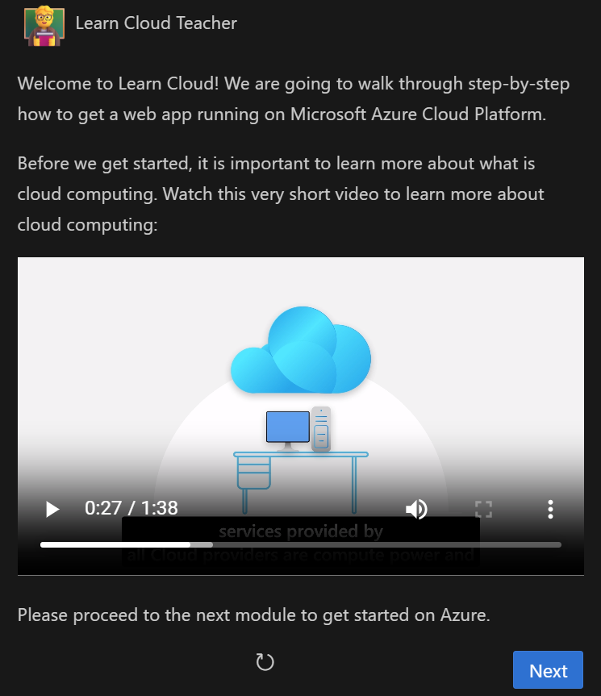
Learn Cloud Roadmap
0. Introduction
In this part of the roadmap, you will learn the basics of cloud computing and how it can benefit you as a developer or a learner.

Slide 6
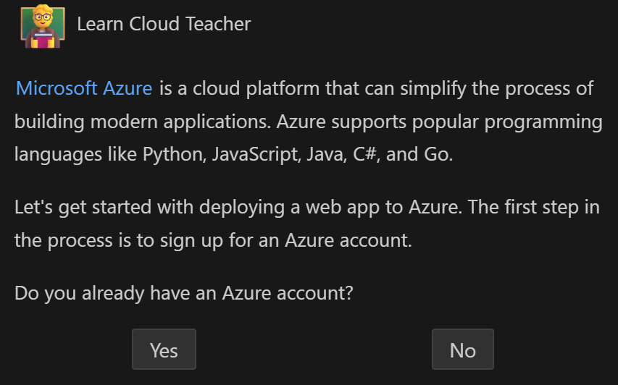
Learn Cloud Roadmap
1. Setup Azure Account
Option 1: Free Azure account ($200 Azure credits to explore and experiment with Azure for 30 days, at no cost to you.)
Option 2: Free Azure for Students subscription ($100 Azure credits every year while you are a student)
Introduction to core cloud computing terminologies

Slide 7
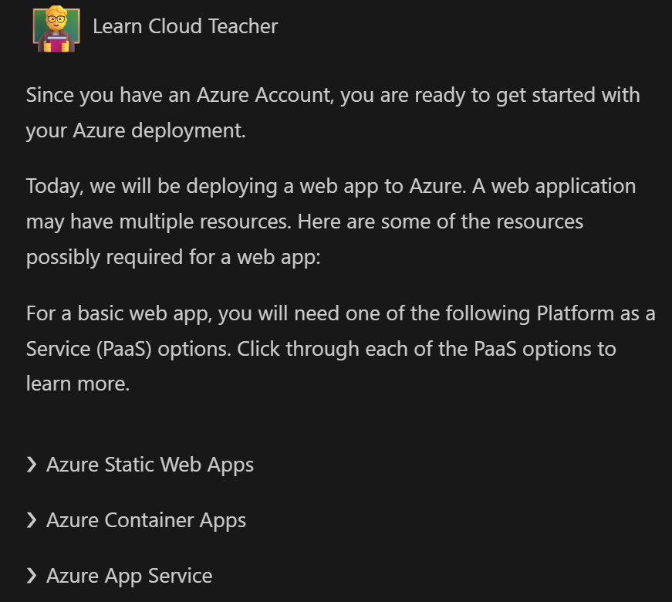
Learn Cloud Roadmap
2. Introduction to PaaS
Learn how to deploy your web app, explore the different Platform as a Service (PaaS) options that Azure offers and learn how to choose the best one for your app.

Slide 8
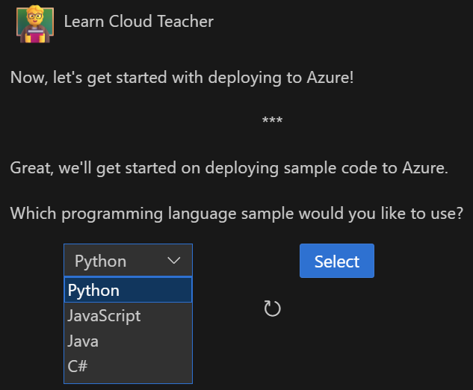
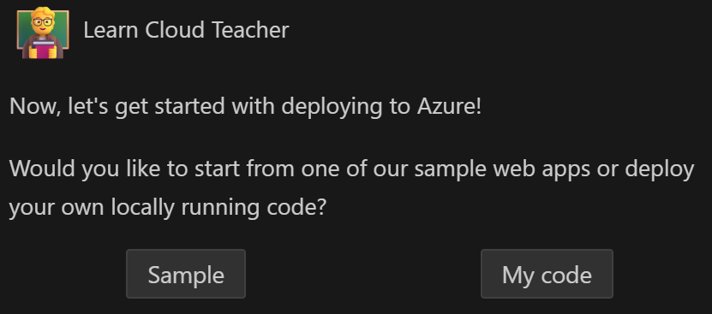
Learn Cloud Roadmap
3. Deploy to Azure
Deploy from, sample or own code.

Slide 9
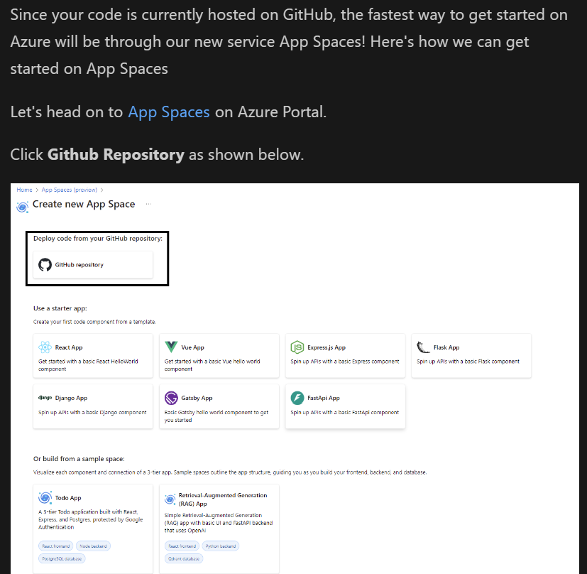
Learn Cloud Roadmap
3. Deploy to Azure
Deploy from, sample or own code.

Slide 10
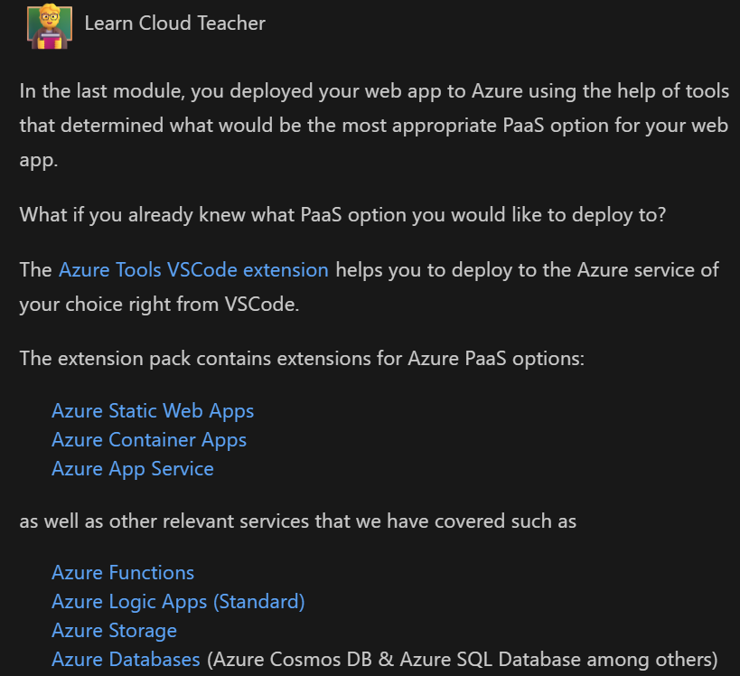
Learn Cloud Roadmap
4. Azure Tools
The final module of this course will blow your mind with the amazing tools that Azure offers to take your code to cloud journey to the next level.
You'll learn how to use other relevant services on Azure that can supercharge your web application's performance, security, scalability, and functionality.

Slide 11
Demo Time
Learn Cloud Walk-through
Notes:
Touch on installation > cover roadmap

Slide 12
Demo Time
Scenario : I’m new to Cloud Computing and want a project-based learning experience
Notes:
Deployment using a sample.

Slide 13
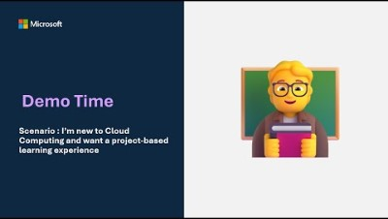
Notes:
Problem-Solution Fit
Features
Step-by-step walkthrough to deploy to Azure PaaS
Starter template apps

Slide 14

Azure Developer CLI (azd) and Deployment to Azure
Deploying Applications to Azure using AZD

Slide 15
Azure Developer CLI (azd) is an open-source tool that automates your entire deployment process from source-control (local development environment) to Azure.
Developer-friendly commands that map to key stages in your workflow
Interaction in the terminal, your editor/ IDE, or CI/CD
Blueprint templates with reusable infrastructure as code assets
azd init
azd up
azd deploy
azd provision
azd down
Notes:
Azd init – Initialize the project
Azd up – Package, provision, deploy
Azd deploy – continue iterating on your application code and deploying changes as needed
Azd provision – Update azure resources by modifying the template’s IaC

Slide 17
Demo Time
Scenario : I want a quick way to deploy my project sitting on GitHub
Notes:
Deployment through app spaces

Slide 18
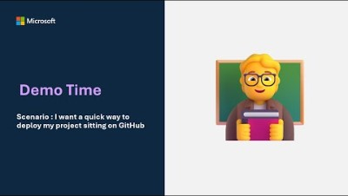

Slide 19
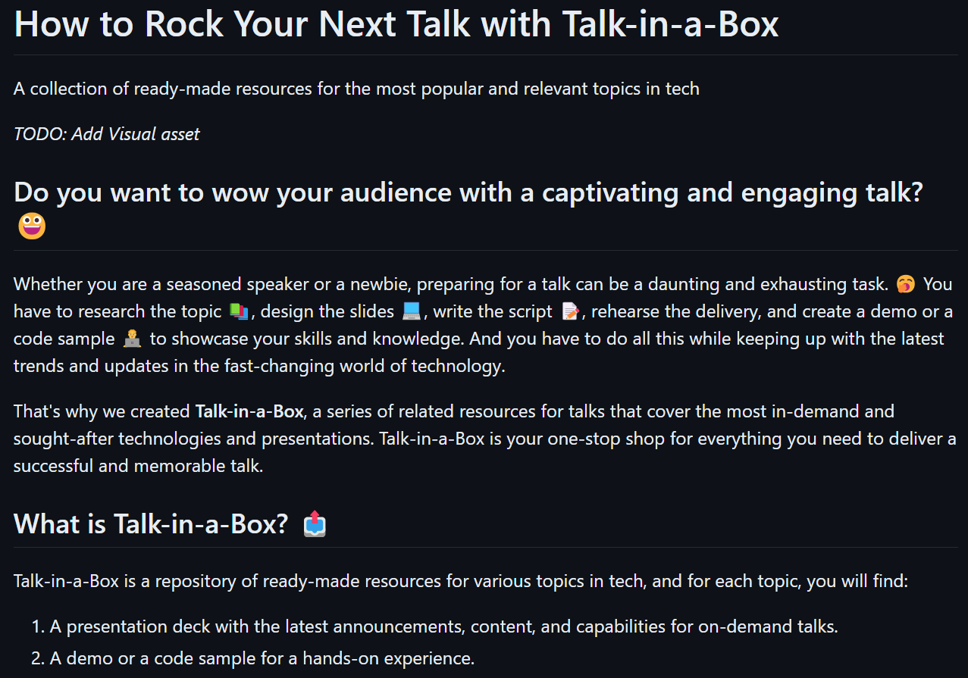
Next Steps
Leverage Learn Cloud on your next ‘Introduction to Cloud Computing’ Event.
Visit aka.ms/Talk-in-a-Box for a set of resources to help you prepare your presentation.

Slide 20
Event Survey​ ​ Thank you for attending please complete this event survey before leaving! ​ ​
Notes:
Feedback

