Slide 1
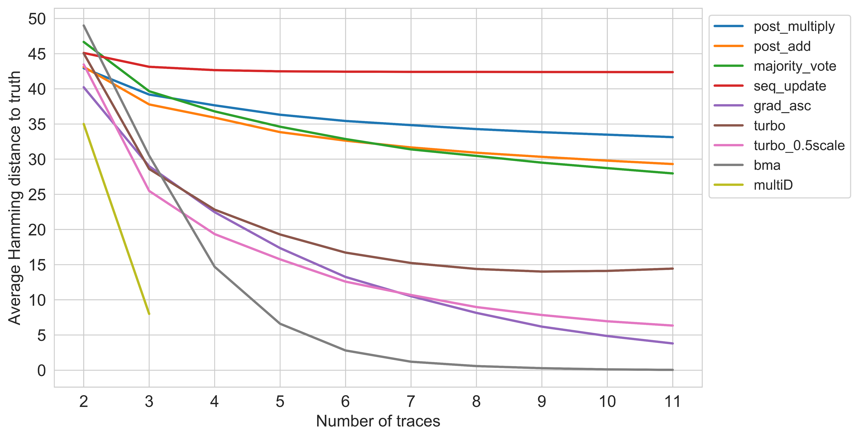
Simulated data error rates
Randomly insert or delete symbols in the traces to accommodate a drift = 4
Only consider data points where traces have a max drift of 4

Slide 2
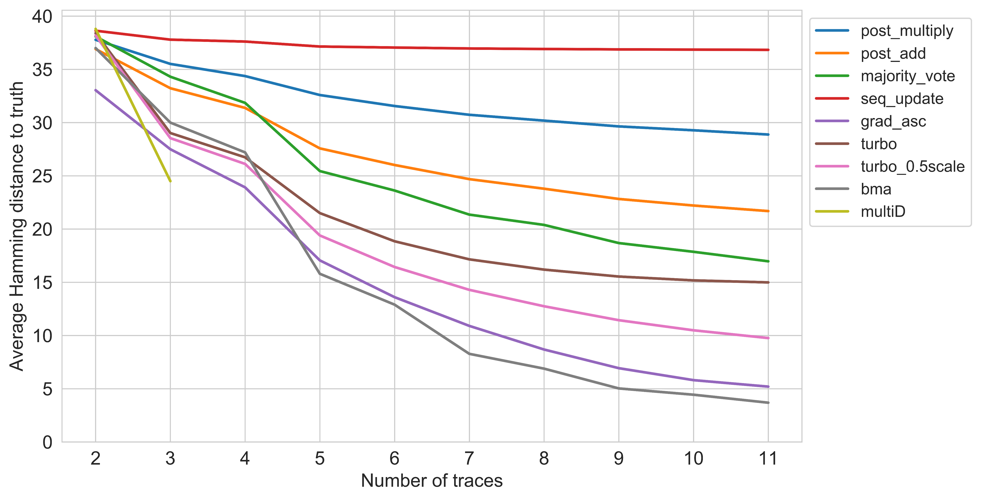
Real data error rates
Drift of 4

