Slide 1
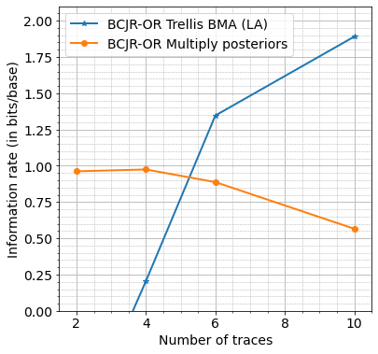
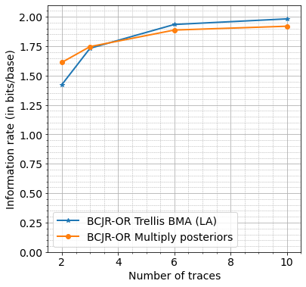
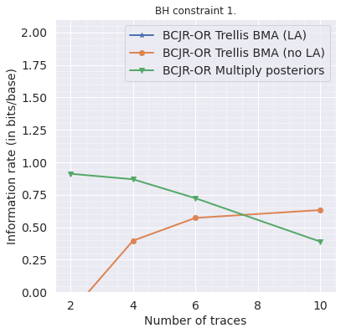
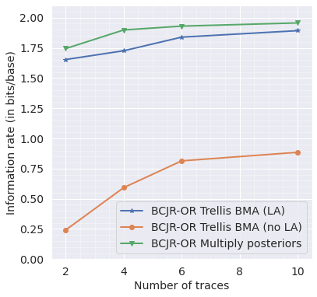
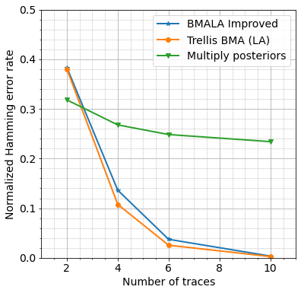
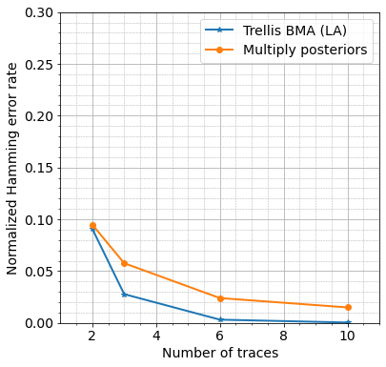
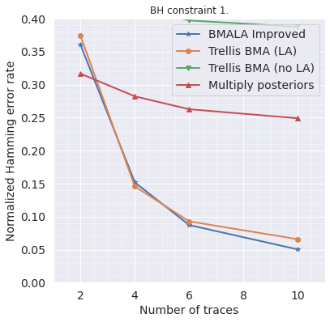
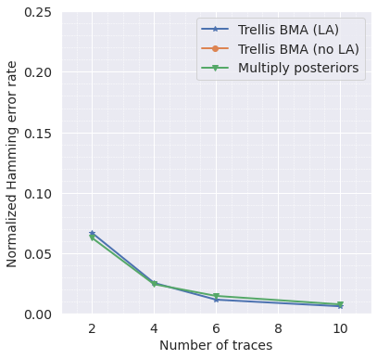
Simulated data, no coding, new algorithm epsilon = 1.0
Simulated data, 10% coding, new algorithm epsilon = 1.0
Real data, no coding, new algorithm epsilon = 1.0
Real data, 10% coding, new algorithm epsilon = 1.0

Slide 2
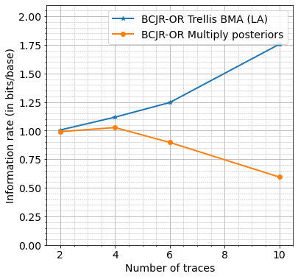
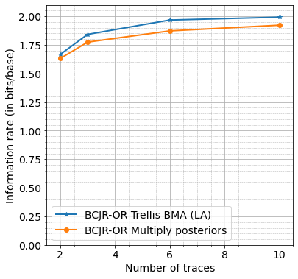
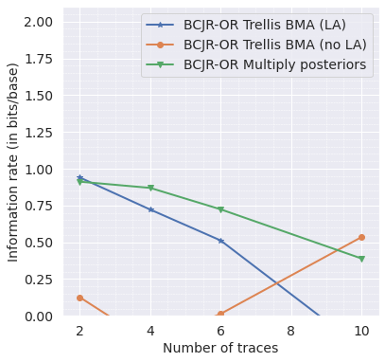
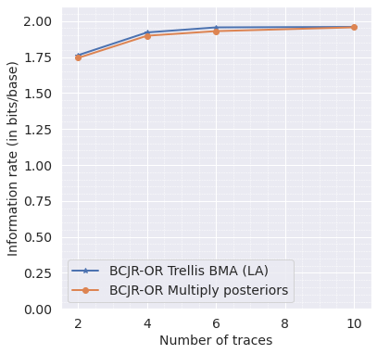
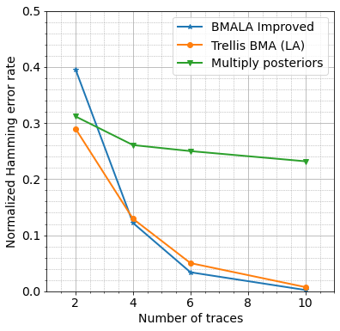
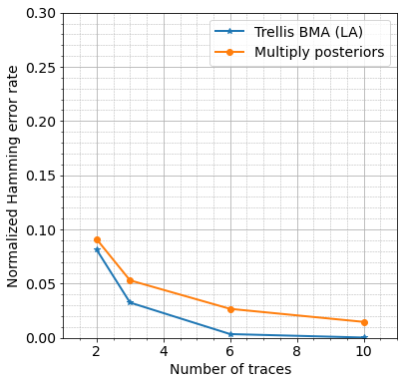
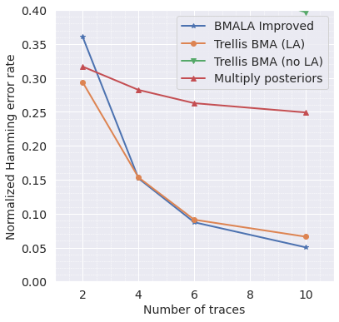
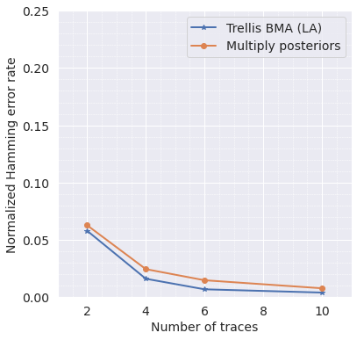
Simulated data, no coding, new algorithm epsilon = 0.1
Simulated data, 10% coding, new algorithm epsilon = 0.1
Real data, no coding, new algorithm epsilon = 0.1
Real data, 10% coding, new algorithm epsilon = 0.1

Slide 3
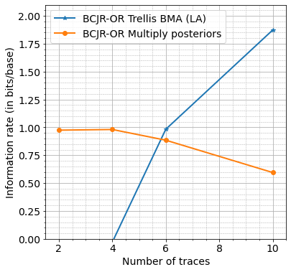
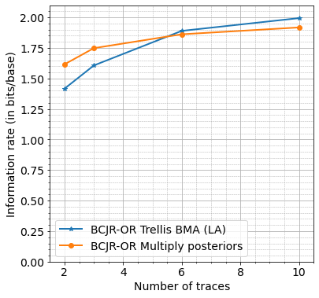
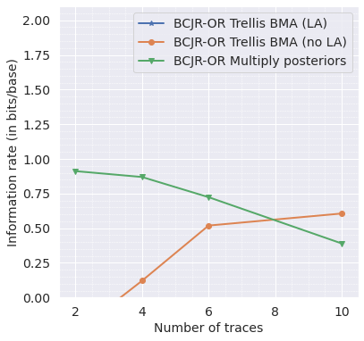
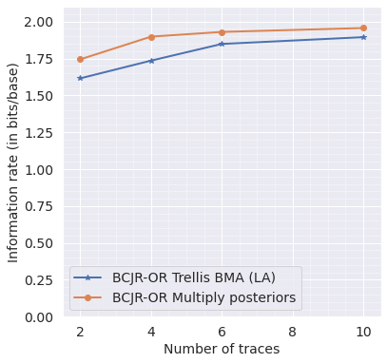
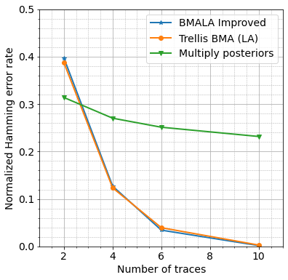

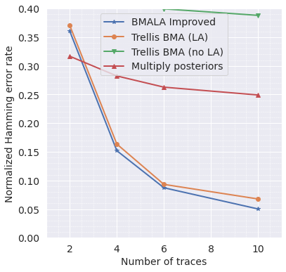
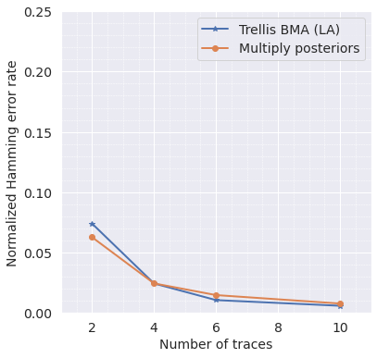
Simulated data, no coding, new algorithm epsilon = 5.0
Simulated data, 10% coding, new algorithm epsilon = 5.0
Real data, no coding, new algorithm epsilon = 5.0
Real data, 10% coding, new algorithm epsilon = 5.0

Slide 4
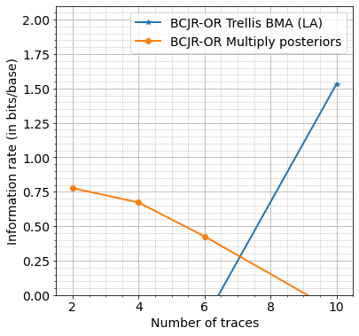
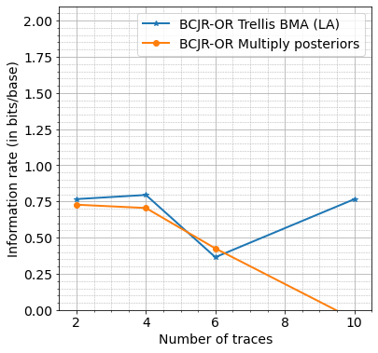
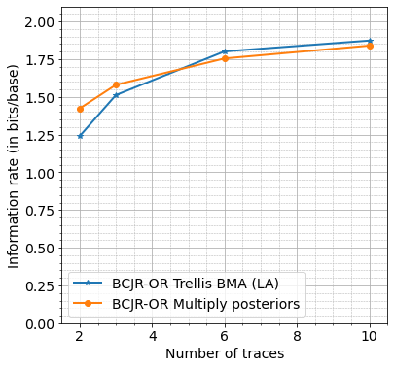
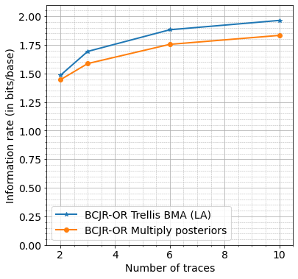
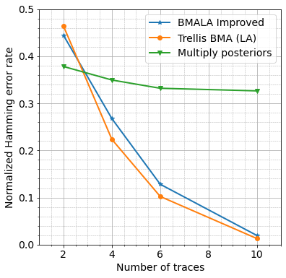
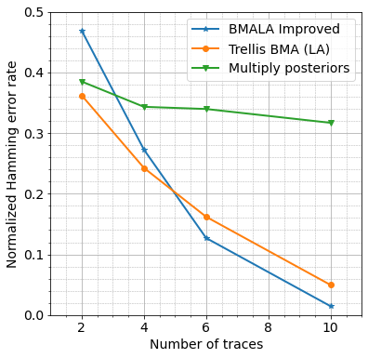
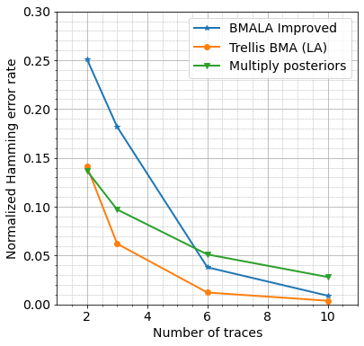
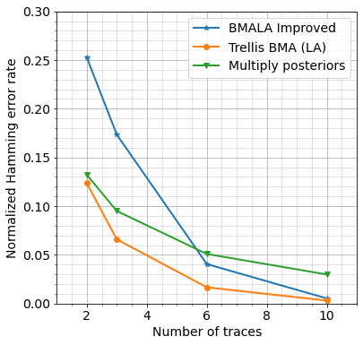
Simulated data (9% error rates), no coding, new algorithm epsilon = 1.0
Simulated data (9% error rates), no coding, new algorithm epsilon = 0.1
Simulated data (9% error rates), 10% coding, new algorithm epsilon = 1.0
Simulated data (9% error rates), 10% coding, new algorithm epsilon = 0.1

Slide 5
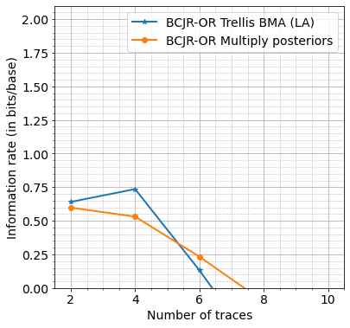
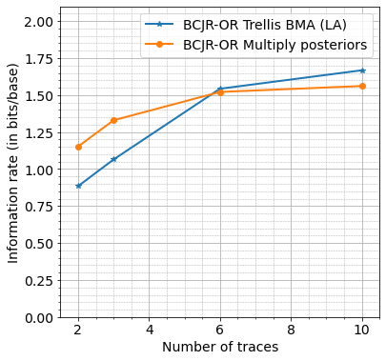
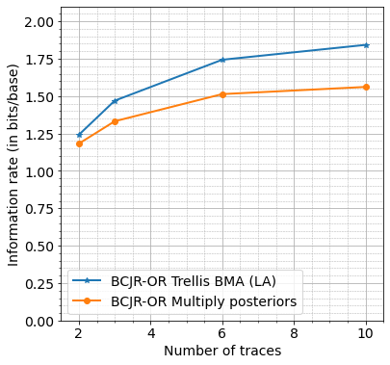
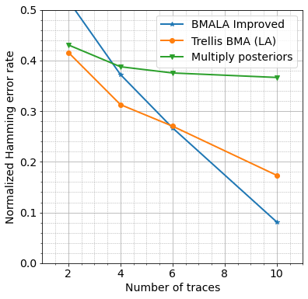
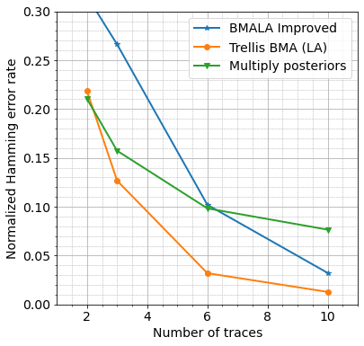
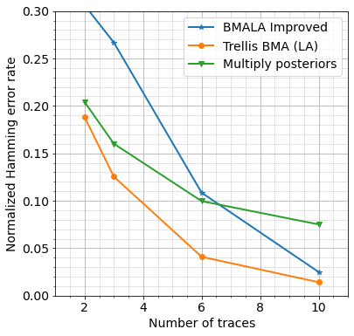
Simulated data (12% error rates), no coding, new algorithm epsilon = 1.0
Simulated data (12% error rates), no coding, new algorithm epsilon = 0.1
Simulated data (12% error rates), 10% coding, new algorithm epsilon = 1.0
Simulated data (12% error rates), 10% coding, new algorithm epsilon = 0.1

