Slide 1
AI Agent Architecture & Observability
Microsoft Agent Framework, OpenTelemetry,
New Relic, Quality Assurance and AI Security & Trust
Notes:
This deck is a template for What The Hack lectures.
It is recommended that Coaches deliver mini-lectures ahead of each Challenge that set context for the challenge and introduce & explain any key technologies.
At a minimum, it is handy to have a slide with the key goals of each challenge to display on the screen when running the hack in-person.

Slide 2
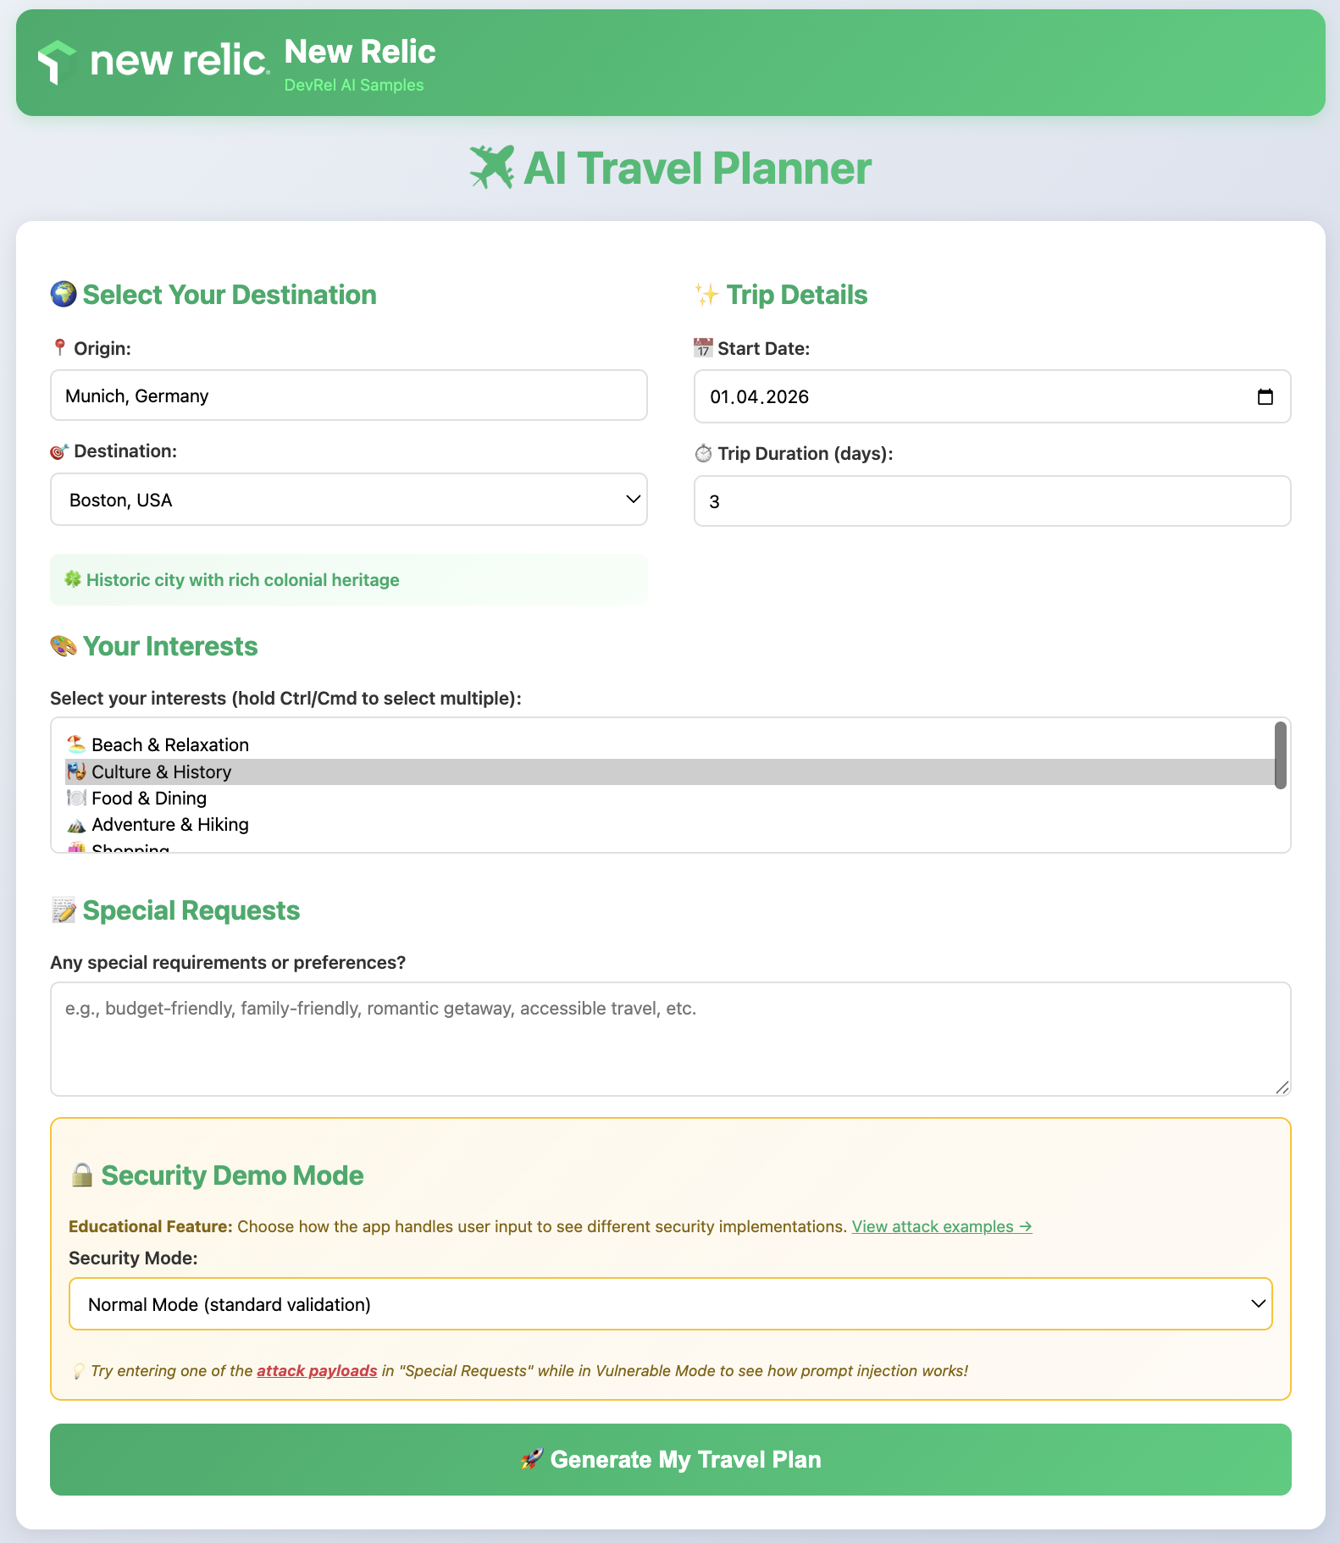
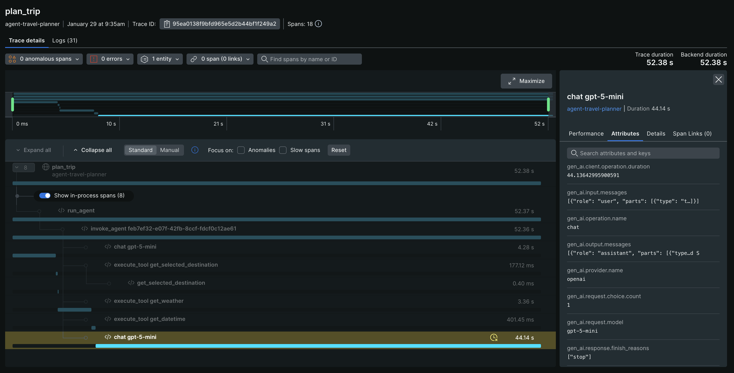
The End Goal
Running, fully functional travel planner app
Observable, safe and secure environment
Notes:
Modify this slide and add the pre-reqs specific to your hack here.
Each challenge slide should list the key goals for the challenge.

Slide 3

🚀 WanderAI - Your Travel Planning Startup
Welcome & Intros
Harry Kimpel
Peter Laudati
DevRel @ New Relic
Jemiah Sius
Cloud SA @ MSFT
Spence Taylor
DevRel @ New Relic
Andy Huang
DevRel @ New Relic
Cloud SA @ MSFT
Notes:
Coaches/Presenters for THIS hack/lecture event should be listed on this slide.
Original contributors to the hack content & these slides include:
Please list original contributors to this hack here in the speaker notes and give them credit when delivering this content.
<Original Author 1>
<Original Author 2>
…
<Original Author N>

Slide 4
Challenge Zero
Get your machines ready!
Deploy Microsoft Foundry (incl. base LLM model)
Deploy Azure Native New Relic Service
Notes:
Modify this slide and add the pre-reqs specific to your hack here.
Each challenge slide should list the key goals for the challenge.

Slide 5
Challenge 1
- Master the Foundations
What makes an AI agent tick?

Slide 6
Challenge #1
Master the Foundations – What makes an AI agent tick?
Before you start building WanderAI's AI agents, you need to understand the core concepts that power them. This challenge focuses on building your foundational knowledge of AI agents, the Microsoft Agent Framework, and observability concepts.
An AI agent is different from a simple LLM API call. While a direct API call just sends a prompt and receives a response, an agent can reason about problems, decide when to use external tools, and orchestrate multiple steps to accomplish complex tasks. Understanding this distinction is crucial for building effective AI-powered applications.
In this challenge, you will study the Microsoft Agent Framework documentation and learn about tool calling, agent lifecycles, and why observability matters for AI systems.
Notes:
Template for a lecture slide with bullets (if you need them).
Try to NOT use bullet lists in your presentation.
Diagrams, puppy pictures, etc are always better. ☺

Slide 7
Challenge #1
Master the Foundations – What makes an AI agent tick?
Your goal is to gain a solid understanding of the following concepts:
AI Agents vs. Simple LLM Calls
  Understand what differentiates an agent from a basic chat completion API call
Tool Calling
  Learn why agents need tools and how they decide when to call them
Agent-Tool Lifecycle
  Understand the flow from user request through agent reasoning to tool execution and response
OpenTelemetry Basics
  Learn about traces, metrics, and logs and why they matter for AI systems
Application Architecture
  Understand how a Flask web app integrates with the Microsoft Agent Framework
Notes:
For each challenge, list out the key high-level goals.
If there are important specifications, list them here, or remind students to “read the student guide!”

Slide 8
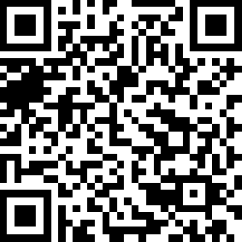
Challenge #1
Master the Foundations – What makes an AI agent tick?
Notes:
For each challenge, list out the key high-level goals.
If there are important specifications, list them here, or remind students to “read the student guide!”

Slide 9
Challenge 2
- Build Your MVP
Ship the first version of WanderAI!

Slide 10
Challenge #2
Build Your MVP - Ship the first version of WanderAI!
It's time to build the first version of WanderAI's Travel Planner service! In this challenge, you will create a Flask web application that leverages the Microsoft Agent Framework to generate personalized travel itineraries.
Your application will accept user travel preferences through a web form and use an AI agent to create beautiful, customized trip plans. The agent will have access to tools that provide real-time information like weather data and current date/time.
Notes:
Template for a lecture slide with bullets (if you need them).
Try to NOT use bullet lists in your presentation.
Diagrams, puppy pictures, etc are always better. ☺

Slide 11
Challenge #2
Build Your MVP - Ship the first version of WanderAI!
You need to build a Flask web application with the following components:
User Interface
  A form where users enter their travel preferences (travel date, trip duration, interests, special requests)
Backend
  Flask web server with appropriate routes
  AI agent that creates travel plans using the Microsoft Agent Framework
  Tool functions for getting data (weather, random destinations, current time)
Output
  Formatted HTML page with travel itinerary
  Beautiful presentation of the AI's recommendations
Notes:
For each challenge, list out the key high-level goals.
If there are important specifications, list them here, or remind students to “read the student guide!”

Slide 12
Challenge 3
- Add Observability
Can you see what's happening?

Slide 13
Challenge #3
Add Observability - Can you see what's happening?
Now that you have a working MVP, it's time to add observability to your WanderAI agents using OpenTelemetry. Right now, if something goes wrong with your agent, you have no visibility into which tool was called, how long operations take, or how to correlate logs to specific requests.
OpenTelemetry is the industry standard for observability in modern applications. By instrumenting your application, you'll be able to see traces showing the full journey of each request, capture timing information, and add structured context to your logs.
Microsoft Agent Framework already integrates with OpenTelemetry out of the box, and more specifically Agent Framework emits traces, logs, and metrics according to the OpenTelemetry GenAI Semantic Conventions.
In this challenge, you will initialize OpenTelemetry, verify telemetry in the console, and then confirm the same telemetry in New Relic before moving on to custom instrumentation in the next challenge.
Notes:
Template for a lecture slide with bullets (if you need them).
Try to NOT use bullet lists in your presentation.
Diagrams, puppy pictures, etc are always better. ☺

Slide 14
Challenge #3
Add Observability - Can you see what's happening?
Your goal is to add basic OpenTelemetry instrumentation to your travel planning application and validate the results:
Initialize OpenTelemetry
  Set up the tracer provider and configure resource attributes to identify your service
Verify Console Telemetry
  Confirm traces and metrics show up in your terminal
Send Telemetry to New Relic
  Switch exporters to OTLP and confirm the same signals in New Relic
Notes:
For each challenge, list out the key high-level goals.
If there are important specifications, list them here, or remind students to “read the student guide!”

Slide 15
Challenge 4
- Custom Telemetry
Add your own signals

Slide 16
Challenge #4
Custom Telemetry - Add your own signals
In Challenge 03, you verified that the Agent Framework automatically generates traces and metrics for your AI agent operations. Now it's time to add custom instrumentation to capture application-specific insights.
Custom instrumentation allows you to:
Create spans for specific business operations (e.g., "plan_trip", "validate_itinerary")
Record custom metrics (e.g., number of destinations, planning duration)
Add structured logging context for better debugging
Correlate application events with AI agent activities
By the end of this challenge, you'll have visibility into both the automatic Agent Framework telemetry and your custom business logic, all flowing to New Relic.
Notes:
Template for a lecture slide with bullets (if you need them).
Try to NOT use bullet lists in your presentation.
Diagrams, puppy pictures, etc are always better. ☺

Slide 17
Challenge #4
Custom Telemetry - Add your own signals
Your goal is to add custom spans, metrics, and structured logging to your travel planning application:
Add Custom Spans
  Instrument tool calls and business logic with manual spans
Add Custom Metrics
  Record meaningful measurements (trip planning duration, destination counts, etc.)
Add Structured Logging
  Correlate logs with spans using trace context
Verify in New Relic
  Confirm custom telemetry appears alongside auto-generated signals
Notes:
For each challenge, list out the key high-level goals.
If there are important specifications, list them here, or remind students to “read the student guide!”

Slide 18
Challenge 5
- Optimize for Production
Make it fast, reliable, insightful.

Slide 19
Challenge #5
Optimize for Production - Make it fast, reliable, insightful.
You're now sending telemetry to New Relic, but raw data alone isn't enough. Without dashboards and alerts, you're manually checking traces all the time, you won't notice problems until customers complain, and you can't track performance trends over time.
In this challenge, you'll learn industry best practices for monitoring AI-driven applications by creating custom dashboards, setting up alerts, and tracking key metrics that matter for your travel planning service.
Notes:
Template for a lecture slide with bullets (if you need them).
Try to NOT use bullet lists in your presentation.
Diagrams, puppy pictures, etc are always better. ☺

Slide 20
Challenge #5
Optimize for Production - Make it fast, reliable, insightful.
Your goal is to build a comprehensive monitoring solution for WanderAI that includes dashboards, alerts, and meaningful metrics collection.
Enhanced Metrics Collection
  Add custom metrics to your application using the OpenTelemetry meter
  Emit these metrics from your application code at appropriate points (request handlers, error handlers, tool functions).
Create a New Relic Dashboard
  Build a dashboard in New Relic called "WanderAI Agent Performance”
  Use NRQL queries to power your dashboard widgets.
Set Up Alerts
  Configure alerts in New Relic to notify your team
Notes:
For each challenge, list out the key high-level goals.
If there are important specifications, list them here, or remind students to “read the student guide!”

Slide 21
Challenge 6
- AI Quality Assurance
Prove your agents are trustworthy

Slide 22
Challenge #6
AI Quality Assurance - Prove your agents are trustworthy
You can't just ship AI without testing. What if the agent returns a non-existent destination? What if the itinerary is way too long or short? What if recommendations are unsafe (war zones, extreme weather)? What if the response includes toxicity or negativity?
In this challenge, you'll build an automated quality gate for your AI agents using New Relic's AI Monitoring platform. Quality gates ensure that only high-quality travel plans reach your customers.
Notes:
Template for a lecture slide with bullets (if you need them).
Try to NOT use bullet lists in your presentation.
Diagrams, puppy pictures, etc are always better. ☺

Slide 23
Challenge #6
AI Quality Assurance - Prove your agents are trustworthy
Your goal is to implement a comprehensive evaluation & quality assurance system for your AI-generated travel plans. Several layers of evaluation working together.
Layer 1: Custom Events for New Relic AI Monitoring
  Enterprise AI evaluation by capturing AI interactions as structured events
Layer 2: Rule-Based Evaluation
  Implement deterministic checks against business rules
Layer 3: Integration into Your Application
  Integrate the evaluation system into your Flask application
Layer 4: User Feedback Collection
  Capture real user feedback to measure actual satisfaction with AI-generated travel plans
Layer 5: LLM-Based Quality Evaluation (Optional)
  Use another LLM to evaluate responses
Notes:
For each challenge, list out the key high-level goals.
If there are important specifications, list them here, or remind students to “read the student guide!”

Slide 24
Challenge 7
- Secure Against Prompt Injection
Keep your agents safe.

Slide 25
Challenge #7
Secure Against Prompt Injection - Keep your agents safe.
Congratulations! WanderAI's travel planning agent is now production-ready with comprehensive observability and quality gates. However, as the platform gains popularity, the security team has identified a critical concern: prompt injection attacks.
Prompt injection is a security vulnerability where malicious users manipulate AI agent behavior by injecting carefully crafted prompts that override the agent's original instructions. This can lead to:
  Data leakage (exposing system prompts or sensitive information)
  Unauthorized actions (bypassing safety controls)
  Reputation damage (generating inappropriate content)
  Business logic bypass (circumventing rules and policies)
In this challenge, you'll learn to detect and prevent prompt injection attacks using a layered defense strategy. You'll start by leveraging platform-level protections provided by Microsoft Foundry Guardrails, then gradually add more granular application-level controls while maintaining comprehensive observability through New Relic.
Notes:
Template for a lecture slide with bullets (if you need them).
Try to NOT use bullet lists in your presentation.
Diagrams, puppy pictures, etc are always better. ☺

Slide 26
Challenge #7
Secure Against Prompt Injection - Keep your agents safe.
Your security team at WanderAI has discovered several attempted prompt injection attacks in production logs. Your goal is to implement layered security defenses starting with platform-level protections and then adding application-specific controls.
Platform-Level Security (Foundry Guardrails)
  Enable Microsoft Foundry Guardrails for baseline protection
  Verify platform-level defenses against common attacks
  Track Foundry Guardrail decisions in your observability
Application-Level Security (Custom Controls)
  Learn about travel-planning-specific injection patterns
  Implement domain-specific detectors as middleware in the web app
  Create custom safeguards for travel planning context
  Track all security events in New Relic with custom metrics
  Strengthen the agent's instructions to resist injection
  Verify your combined defenses against various attack vectors
Notes:
For each challenge, list out the key high-level goals.
If there are important specifications, list them here, or remind students to “read the student guide!”

Slide 27
Thank You for Attending!
https://aka.ms/wth
Notes:
Thank students for attending and share the link to the What The Hack website with them.

