Slide 1

Bronze Silver Gold Using Synapse and Databricks Together with Delta Lake

Slide 2

What Is What The Hack ?
“What the Hack” is a challenge-based hackathon format
Challenges describe high-level tasks and goals to be accomplished
Challenges are not step-by-step labs.
By having to “figure it out”, attendee knowledge retention is greater
Attendees work in squads of 3 to 5 people to solve the challenges
Attendees “learn from” and “share with” each other.
Coaches provide technical guidance, but not answers to the squads
Coaches may provide lectures & demos to setup challenges & review solutions
What the Hack can be hosted in-person or virtually via Microsoft Teams
Notes:
Quick overview of the format….
Share this if you’re doing a Train The Trainer, or else keep hidden

Slide 3
Community Driven
Anyone can contribute a new hack
All content is available for sharing broadly to enable cloud architects and partners to re-deliver to their customers
Built from the ground up to be delivered virtually with Microsoft Teams
Notes:
Show this slide if training the trainer. Else, keep it hidden. What The Hack is a community driven collection of challenge-based hacks on the Microsoft platform.
We have a collection of over 40+ hacks to choose from.
We’ll share the content details with you after today’s hack.
If you enjoy this event, please share the content with your peers and of course…
Deliver it to your CUSTOMERS!!!

Slide 4
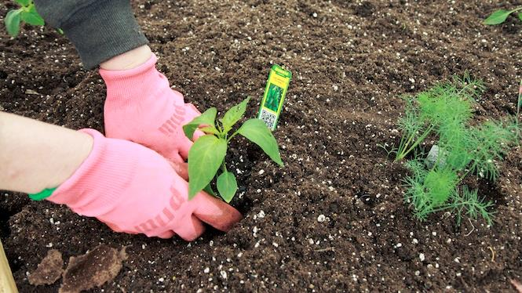
You will get your hands dirty
Notes:
This is a “hands-on” exercise where you will work in groups of 4-5 people to solve technical challenges.
You only get out what you put in, don't be lazy.
Knowledge Retention is achieved through Pain and Discomfort

Slide 5
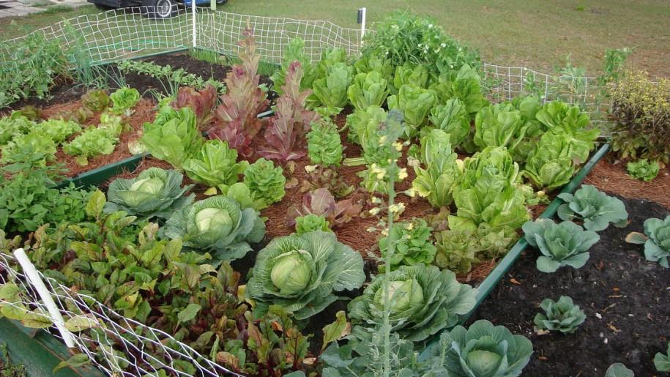
*results may vary
Notes:
You might not grow a garden like this… but at least you can learn while trying.

Slide 6

Logistics
Notes:
And now we’ll cover logistics…

Slide 7
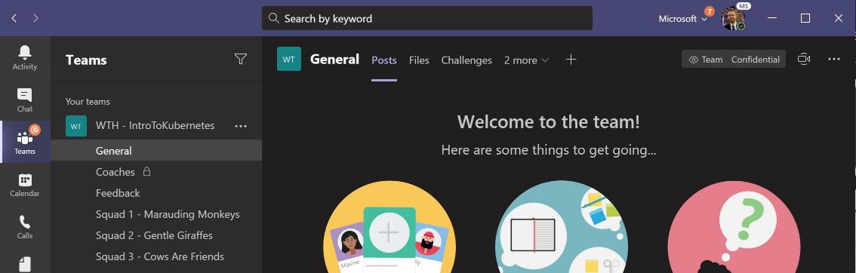
Collaboration We’re going to use Microsoft Teams in a different way…
Central gathering place. Kick-off & stand-up meetings take place HERE

Slide 8
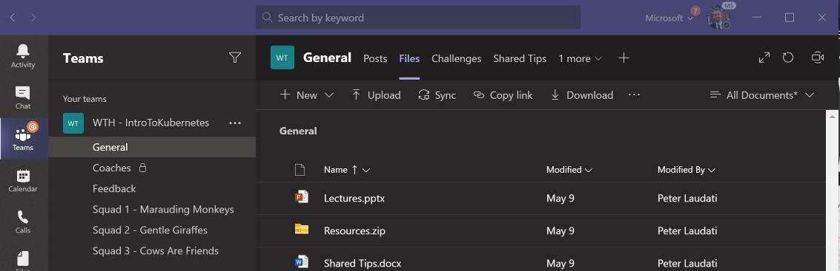
Collaboration We’re going to use Microsoft Teams in a different way…
Find any files, resources, or code samples needed for the hack, and THIS presentation HERE

Slide 9
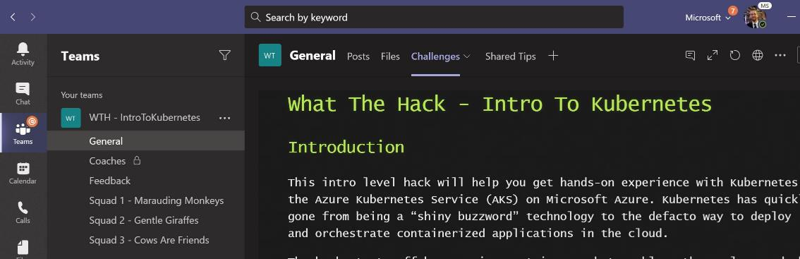
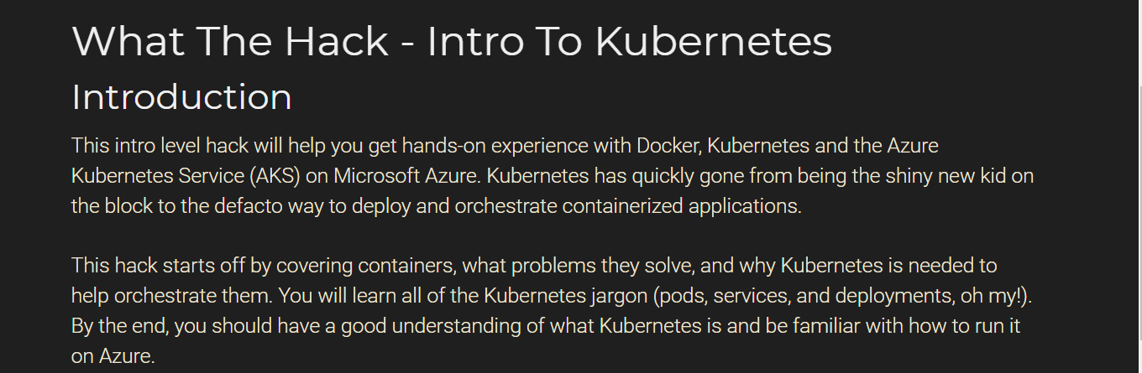
Collaboration We’re going to use Microsoft Teams in a different way…
Student Guide and Challenges are posted HERE

Slide 10
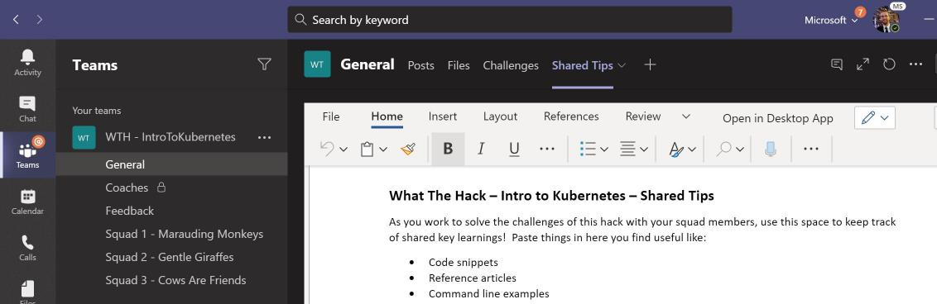
Collaboration We’re going to use Microsoft Teams in a different way…
Share tips, tricks, gotchas (how you solved them), code snippets, and links you learn along the way HERE with everyone
Notes:
Demo: Show an already created event Teams site inside of the Teams client

Slide 11
Collaboration We’re going to use Microsoft Teams in a different way…
Private channel for coaches to discuss event logistics
(students won’t see this ☺)

Slide 12
Collaboration We’re going to use Microsoft Teams in a different way…
DURING & after the event, share feedback with the coaches in the Feedback channel. This will help them improve the event as it progresses and make the next one even better

Slide 13
Collaboration We’re going to use Microsoft Teams in a different way…
Hang out, communicate, talk, and screenshare with squad members in your squad’s channel.

Slide 14
Hacking Remotely
Expectations, Tips, & Tricks
Everyone expected to be joined to their squad’s “party line” throughout the event
Mics on at all time (kids, significant others, & pet noises okay, but please mute the toilet flushes ☺)
Coaches should keep cameras on. Students optional, but preferred
Coaches & Squads will designate a “driver” for each challenge to lead by sharing their screen. Students should take turns driving (or backseat driving)!
Coaches & Squads will set break times throughout the day. Use them and walk away from your screen!
Notes:
Only show this slide if you’re hosting a virtual event or have remote attendees

Slide 15


Challenge Format
Challenges are cumulative, building upon each other.
Establish Confidence – start small and simple (think hello world)
Build Competence – by having successively more complex challenges
Challenges are NOT step-by-step hands-on labs!
No “clicking here” or “copy n pasting there”
Challenge definitions are short. A couple of sentences or bullet points stating the end goal(s) and perhaps a hint at the skill(s) needed.
You MUST work together as a team to figure out how to complete them!

Slide 16

Challenge Format
For each challenge we will deliver a ”mini-lecture” explaining concepts in it.
Coaches will review results for each challenge when all squad members have completed the challenge
Don’t be beholden by the clock!
Move quickly or take it slow.
But stay together with your squad!
Your coach is there to help.
There WILL be more challenges than you can complete in our allotted time!
These are takeaways for follow up at home or with customers!

Slide 17
Coaches
Each team will have a coach through-out the whole hack.
Use them! But don’t expect them to give you all the answers.
Get to know your coach, their likes and dislikes...
All the better to find a bribe that works!
Notes:
Keep the teams working as teams!
Encourage all to “learn from” and “share with” each other!
If you observe individuals racing ahead, encourage them to help those who are behind.
Encourage attendees to use their team’s channel on MS Teams to collaborate/share info!
Unblock teams who get stuck
Encourage team members to unblock each other first!
Provide hints, but not answers
If you observe individuals stuck for a while, help them get moving so they don’t lose interest.
Provide hints/pointers to the teams on how to solve problems & where to find information.
Use the answers/solutions in the proctor’s guide, but don’t share with the attendees
Proctor’s guide won’t be comprehensive. As SMEs, proctors should use their knowledge to help with solution hints/ideas.
Notify the emcee of unexpected blockers that arise during the event so they can be communicated to all, and recorded for future reference.

Slide 18
Tooling
During the Hackathon you will be immersed in the following technologies so plan accordingly:
-- Azure Portal
-- Synapse Workspace
-- Databricks Workspace
-- Azure Storage Accounts / Delta Lake
-- Key Vault
-- Databricks CLI
-- Power BI Desktop

Slide 19
Finding Answers
Search engines are your friend! Azure is a hot technology and much ink has been spilled on it.
The Azure docs are your best bet.
Many of the related open source projects used here have top notch documentation!

Slide 20

And now death by Power Point…

Slide 21
And now death by Power Point… (just kidding!)

Slide 22
Bronze Silver Gold Using Synapse and Databricks
Scenario
Be able to setup an environment to utilize a three-tiered data lake architecture
Copy and Merge data from the AdventureWorks and WideWorldImporters databases.
Use Delta Lake Technology in at least one tier of the data lake architecture.
Be able to showcase how both Synapse and Databricks can interact with the data at each tier. Compare and contrast the technologies.
Utilize System Managed Identities and Key Vault for all connections so no usernames/passwords are exposed in your CI/CD Pipeline.
Visualize the results in Power BI.

Slide 23
Bronze Silver Gold Using Synapse and Databricks
Overview
Challenge 1: Building out the Bronze
Standup and configure the Synapse and Databricks Environments.
Agree on and begin to implement the three-tiered architecture.
Hydrate the Bronze Data Lake.
Ensure no connection details are stored on the Linked Service or in Notebooks.
Challenge 2: Striving for Silver
Move the data from the Bronze Layer to the Silver Layer
Apply Delta Format to the Silver Layer
Perform consolidation and standardization of data
Challenge 3: Go for the Gold
Take data from the Silver Layer and make it business analyst ready.
Understand the basics of data models.
Challenge 4: Visualize the Results
Create Power BI Assets to showcase your results.

Slide 24
Bronze Silver Gold Using Synapse and Databricks
Suggested Agenda
Day 1
Challenge 1 - Building Out the Bronze
Challenge 2 - Standardizing on Silver
Day 2
Challenge 2 - Standardizing on Silver
Challenge 3 - Go for the Gold
Day 3
Challenge 3 - Go for the Gold
Challenge 4 - Visualize the Results

Slide 25
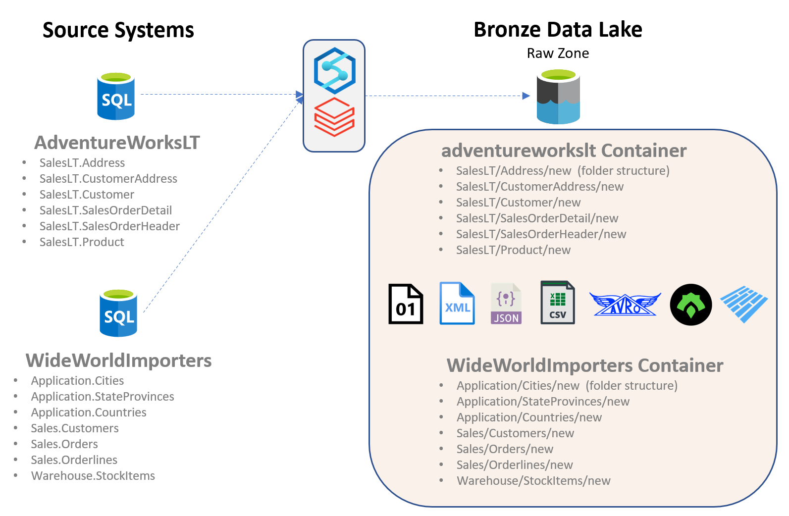
Bronze Silver Gold Using Synapse and Databricks
Challenge 1 - Building Out the Bronze
Environmental Setup
Hydration of Data in the Bronze Data Lake.

Slide 26
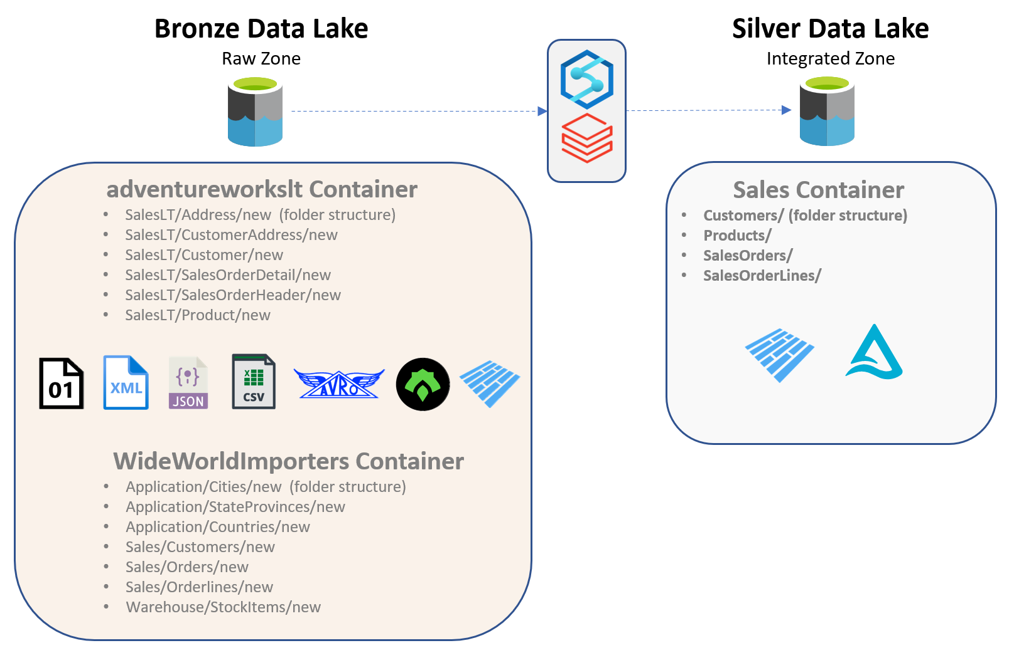
Bronze Silver Gold Using Synapse and Databricks
Challenge 2 - Striving for Silver
Data Lake Storage Format
Domain Separation.
Consolidation
Data Type Standardization
Formatting
Partitioning and Sharding

Slide 27

Bronze Silver Gold Using Synapse and Databricks
Challenge 2 - Striving for Silver
Time Travel

Slide 28
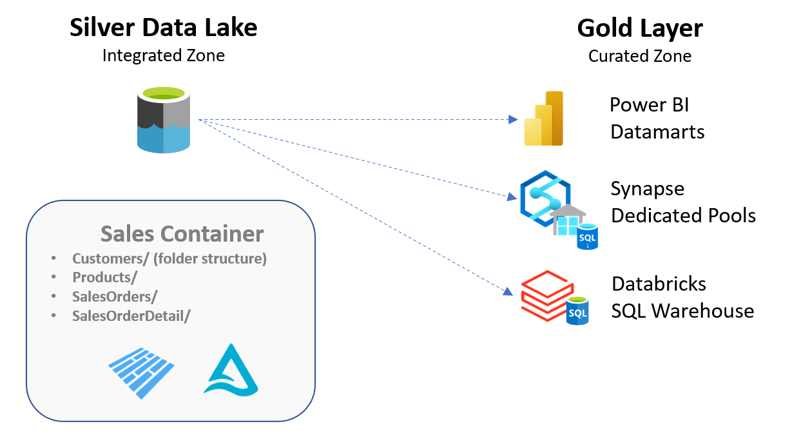
Bronze Silver Gold Using Synapse and Databricks
Challenge 3 - Go for the Gold
Consumer Specific Data Models
Enforce Quality
Security

Slide 29
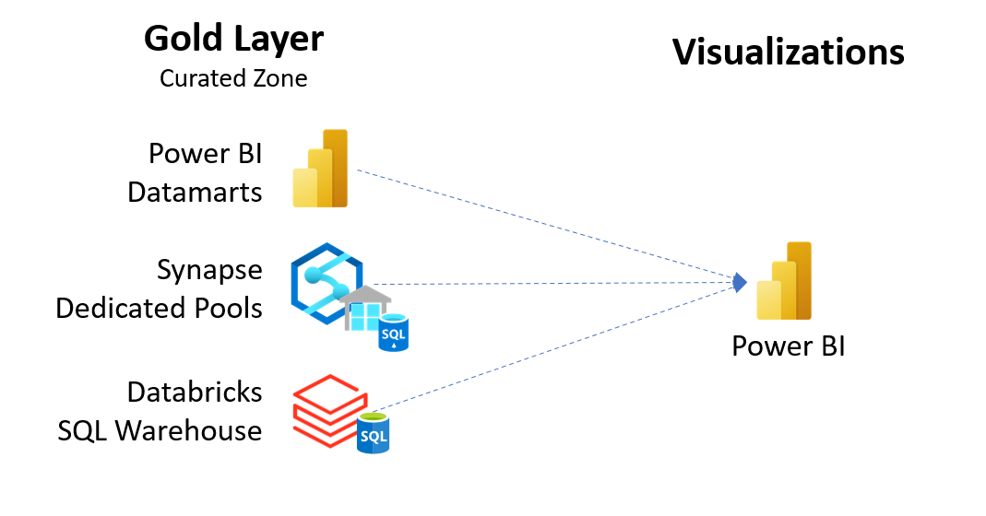
Bronze Silver Gold Using Synapse and Databricks
Challenge 4 – Visualize the Results
Generate Insights
Role Based Row Level Security

Slide 30
Bronze Silver Gold Using Synapse and Databricks
Squad Assignments
1 | 2 | 3 – Now on Squad 1 | 4 | 5 | 6
Dave Wentzel | Rowland Gosling | Mark Badger | James Xu | Nilendra Singh / Jack Bender | Farhan Arif
Amish Sinha | Alan Kleinert | Dhanaji More | Morgan Chesnicka | Angela Kunanbaeva | Armando Marrero
David Azofeifa | Bishnu Agrawal | Emily Holloway | Peter Tassmer | Cameron Kahrs | Bryce Williams
Juichia Che | Ivan Portilla | Melody Yin | Ricardo Marques | Chris Donlan | Diana Betancourt
Kevin Orbaker | Ram Madhurakavi | Mike Rhoads | Sam Istephan | Kevin Bullen | Jed Wu
Sue Tholen | Shankar Raman | Rodney Elmore | Tyler Chessman | Marcelo Zambrana | Joseph Barbosa
 | Nicola Farquharson | Saswata Sengupta | William Brown | Sarah Granade | Naya Giannakopoulou
 |  | Shikha Agrawal |  |  | Pardeep Singla
 |  |  |  |  | Rachel Liu

Slide 31
Bronze Silver Gold Using Synapse and Databricks
Squad Interaction
Please utilize your Teams channel for your squad collaboration
Use the Meet button within your channel to collaborate together.
Share screens, chat as needed, etc.
Video is optional
Only mute when necessary… family background noise is part of life these days

