Slide 1
Build Your Own Copilot with Azure Cosmos DB
Hackathon

Slide 2
Build Your Own Copilot with Azure Cosmos DB
Overview

Slide 3
Introducing the solution accelerator
This solution demonstrates how to design and implement a Generative AI solution that incorporates Azure Cosmos DB with Azure OpenAI Service along with other key Azure services, to build an AI assistant user interface. The core Large Language Model (LLM) interaction pattern is Retrieval Augmented Generation (RAG) and the LLM orchestrator used to implement the pattern is Semantic Kernel.

Slide 4
Main concepts covered
Generating and storing vectors in real-time on transactional data.
Performing vector searches on data in a database.
Generating completions from a large language model.
Managing conversational context and chat history.
Token management for large language models.
Managing data models for defining what data gets vectorized for search.
How to use Semantic Kernel SDK connectors and plug-ins.

Slide 5
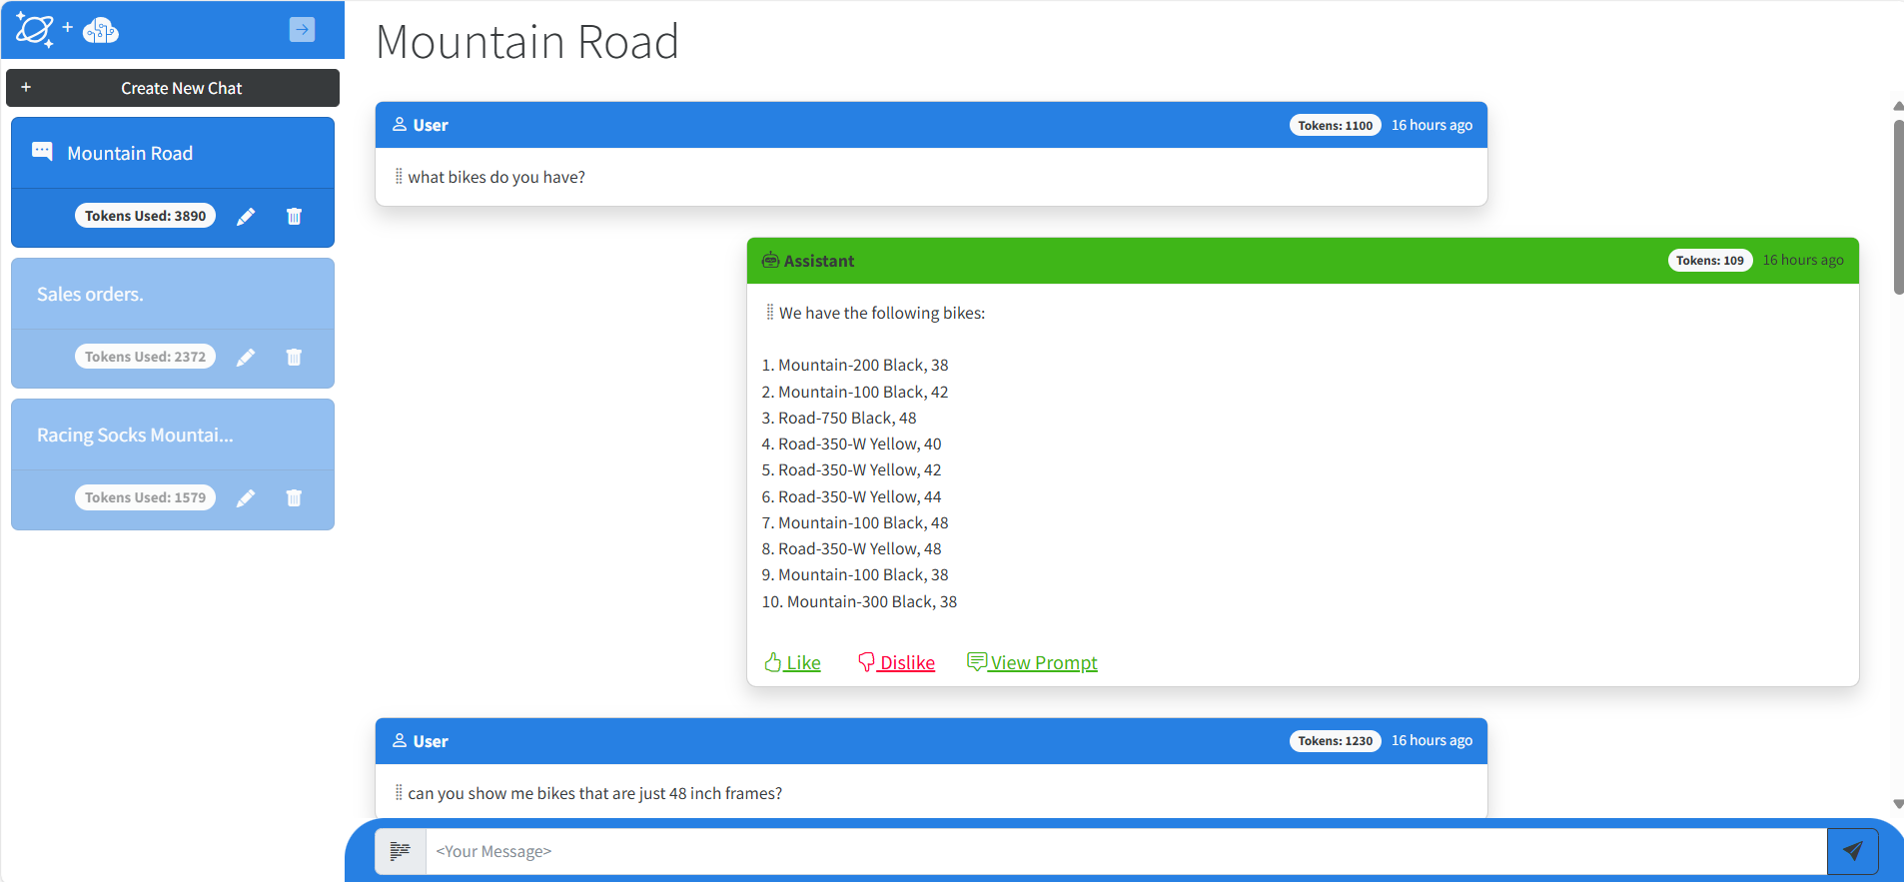
User experience

Slide 6







Architecture
Storage Account
6
Submit Question & History
1
File-based Documents
Persist Q&A
2
System Prompts
+ Return Policies
2
Request Embeddings (Embeddings API)
Vector & Search
Pod
Request Question Embedding (Embeddings API)
3
1
Change Feed: Source Documents
Azure OpenAI (Embeddings API)
Cosmos DB
3
Index Documents & Embedding Vectors
Search for context data
4
Azure
Cosmos DB (Vector store collection)
Source Data
+ Prompts & Completions
4
Persist Embedding Vectors
5
Request Completion (Completions API)
Azure OpenAI (Completions API)
1
Ask Question
Chat
Users
0
Load Q&A Session
Q&A Web App
Legend:
Semantic Kernel Orchestrated Calls
Other Service Calls
User Interaction
Backend data flow
Frontend workflow
1
1

Slide 7
Deployment
Deploys into your own Azure subscription
You can choose between the Azure Container Apps (ACA) and the Azure Kubernetes Service (AKS) deployment versions
The solution accelerator provides all the necessary scripts to complete the automated deployment

Slide 8
Build Your Own Copilot with Azure Cosmos DB
Key Concepts

Slide 9
Retrieval Augmented Generation (RAG)

Slide 10
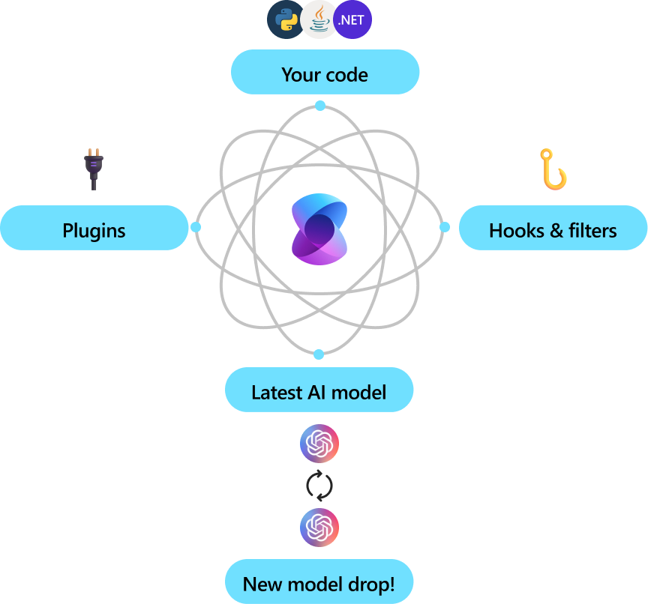
Semantic Kernel

Slide 11
Generating text representations of items
Challenge: Ensuring the data used has the best possible textual representation, especially for structured and semi-structured data stored in Cosmos DB.
Field selection: Select the relevant fields to be used as text representations and transform their values into a single, coherent text representation.
Generic change feed handler: Utilizes an Azure Cosmos DB generic change feed handler (Infrastructure.Services.CosmosDBService.GenericChangeFeedHandler()) to intercept changes in any Cosmos DB container and select the fields and transform values accordingly.
Item transformer interface: The Common.Interfaces.IItemTransformer interface provides a blueprint for creating text representations, including fields such as EmbeddingId, EmbeddingPartitionKey, TextToEmbed, and VectorIndexName.
Model registry: The ModelRegistryItemTransformer class relies on a dictionary (or model registry) to map item types to their respective fields for creating text representations, which can be flexibly adapted or replaced by a more sophisticated model registry.

Slide 12
Generating vectors
Vectorization capability: Provided by the SemanticKernelRAGService.AddMemory() method which generates and manages vector representations of items.
Categories of vector memory stores:
Long-term Memory: Stores vector representations of items in Cosmos DB containers.
Short-term Memory (Volatile Memory): Stores vector representations of text from blob storage, reloading raw data each time the service restarts.
Vector Memory Store Implementation:
Uses instances of SemanticKernel.Plugins.Memory.VectorMemoryStore.
Relies on IMemoryStore to handle basic vector operations. Options include AzureCosmosDBNoSqlMemoryStore (persists the vector index in Cosmos DB) or VolatileMemoryStore (keeps the vector index in memory).
Utilizes ITextEmbeddingGenerationService for text embedding, typically provided by AzureOpenAITextEmbeddingGenerationService.
Text embedding generation: Managed by the AddMemory(IItemTransformer itemTransformer) method, embedding items into vector space and storing them accordingly. Typically uses the text-embedding-3-large model for embeddings.
Configuration and management: The SemanticKernelRAGService manages the configurations and calls necessary methods to handle vector stores and embedding generation based on item attributes and indexing requirements

Slide 13
Generating contexts for completions
User interaction: The process starts with a user querying through a chat UI where they input a natural language question, prompting the system to generate context for completions.
Vector generation: The user prompt is vectorized using the Azure OpenAI Service embeddings API, turning the text input into a vector representation.
Vector search: The vectorized user prompt is then used to perform a vector search on the vector memory stores, which may include Azure Cosmos DB containers and in-memory vector stores.
Context compilation: The search results (including the original source data) are sent together with some parts of the conversation history to the Azure OpenAI Service, which generates a completion response.
Dynamic context generation: The approach uses the Semantic Kernel orchestrator and various plugins to dynamically compile the RAG context, making it adaptable to the user's questions. Plugins such as MemoryStoreContextPlugin help retrieve memories from underlying vector memory stores and integrate them into the context.

Slide 14
Managing conversational context and history
Maintaining history: Large language models such as GPT-4 do not inherently keep a history of prompts or completions. Developers must manage this history to enable follow-up questions and maintain context for meaningful conversations.
Benefits of history: Keeping a detailed conversation history allows users to ask follow-up questions with context and helps in vector searches by providing additional detail on what the user is looking for.
Role of ContextBuilder: The ContextBuilder class manages the conversational history, gathering the most relevant past prompts and completions up to token limits, and returning it as a string for context. This class tracks the number of tokens used and ensures they remain within limits.
Token management: Effective token management is critical, given the token limits of service requests and responses. The ContextBuilder class helps measure token usage through the OptimizePromptSize() method, ensuring the token count in each request is within allowable limits.
Finalizing RAG context: The ContextBuilder class is crucial for the KnowledgeManagementContextPlugin, which generates the final RAG (Retrieval-Augmented Generation) context by invoking relevant plugins and integrating the conversation history with the current query.

Slide 15
Semantic cache
Optimization purpose: The primary role of the semantic cache is to reduce unnecessary calls to the LLMs, thereby optimizing token consumption. This is achieved by storing sequences of completions and their vector forms in an Azure Cosmos DB vector index store.
Similarity comparison: It compares incoming user prompts and completion histories with stored sequences using vector similarity measures. If the similarity measure exceeds a certain threshold, the cache returns the previously stored completion, avoiding a new call to the LLM.
Implementation: The semantic cache is managed by the SemanticCacheService class, which uses a VectorMemoryStore instance to manage the vector index store※. This store is sustained by both AzureCosmosDBNoSqlMemoryStore for persistence and AzureOpenAITextEmbeddingGenerationService for generating text embeddings.
Integration with response flow: The GetResponse() method in SemanticKernelRAGService checks the semantic cache for a possible completion before generating new contexts or calling the LLM. If no suitable completion exists in the cache, the LLM is called and the cache is then updated with the new completion and its vector form.
Special case handling: The system is designed to handle specific situations, such as when a user repeats a previous prompt. In such cases, the semantic cache returns the previous response as the completion, showcasing an example of enhancing the cache's behavior for optimal performance.

Slide 16
Natural language system commands
Purpose and functionality: Natural language system commands were introduced to manage the semantic cache and set thresholds for similarity measures without building new UI components or backend API methods.
Available commands:
Reset Semantic Cache: Clears all entries in the vector store index to reset the cache. Example command: "Can you please reset the semantic cache?“
Set Similarity Threshold: Sets a new similarity threshold for matching cache items that is effective until the backend API service restarts. Example command: "Can you set the semantic cache similarity score to 0.82?"
Implementation: The system commands are implemented through the SystemCommandPlugin class, derived from PluginBase. This makes extensions possible without new UI components.
Execution process: These plugins are created and added to the list of plugins available for execution in the CreateMemoryStoresAndPlugins method of the SemanticKernelRAGService class. The prompts are matched to these system commands and executed accordingly.
Interference mitigation: To avoid potential interference with the normal conversation flow, it is recommended to use system commands in a separate conversation

Slide 17
Build Your Own Copilot with Azure Cosmos DB
Today’s hackathon

Slide 18

https://github.com/solliancenet/byoc-hackathon

Slide 19
Challenges
Challenge number | Challenge code | Description
1 | [Challenge 1] | Deploy the solution accelerator to your Azure subscription and explore the solution architecture.
2 | [Challenge 2] | Learn about the basics of Semantic Kernel, a Large Language Model (LLM) orchestrator that powers the solution accelerator.
3 | [Challenge 3] | Learn about intercepting and using key assets from Semantic Kernel's inner workings - prompt and function calling data.
4 | [Challenge 4] | Learn how prompts are used in the solution accelerator and experiment with changes to the prompts.
5 | [Challenge 5] | Learn about the inner workings and applications of semantic caching in the solution accelerator.
6 | [Challenge 6] | Learn about implementing system commands based on user input in the solution accelerator.

Slide 20

Challenge 1
Deploy the solution accelerator from https://github.com/Azure/BuildYourOwnCopilot

Slide 21
Challenge 2 – Exercise 2.1.1
The Kernel is the core component of the Semantic Kernel library. It is responsible for managing the context and plugins, and for providing the completion services.
The Kernel builder is used to configure the Kernel and its dependencies.
The Kernel builder supports dependency injection.
Semantic Kernel provides a set of extension methods to configure the Kernel builder with the required services.
The AddAzureOpenAIChatCompletion extension method is used to configure the Azure OpenAI-based chat completion service.
Identify the Azure OpenAI account they deployed, its endpoint, completion model deployment and API key.

Slide 22
Challenge 2 – Exercise 2.2.1
Plugins are a key component of Semantic Kernel. If you have already used plugins from ChatGPT or Copilot extensions in Microsoft 365, you’re already familiar with them. With plugins, you can encapsulate your existing APIs into a collection that can be used by an AI. This allows you to give your AI the ability to perform actions that it wouldn’t be able to do otherwise.
Behind the scenes, Semantic Kernel leverages function calling, a native feature of most of the latest LLMs to allow LLMs, to perform planning and to invoke your APIs. With function calling, LLMs can request (i.e., call) a particular function. Semantic Kernel then marshals the request to the appropriate function in your codebase and returns the results back to the LLM so the LLM can generate a final response.
The RAG context is built dynamically using the plugins that are imported into the kernel. The plugins are used to provide the context for the LLM to generate responses.
The main plugin used to generate the context is KnowledgeManagementContextPlugin. It uses a list of more atomic plugins, the MemoryStoreContextPlugin plugins which retrieve data from a vector memory store.
Explore the implementation of the KnowledgeManagementContextPlugin and MemoryStoreContextPlugin plugins.
Explore the chain of calls that leads to the call of the SetContextPlugins method in the KnowledgeManagementContextPlugin plugin.
Note that vector memory stores are the focus of one of the following exercises.

Slide 23
Challenge 2 – Exercise 2.3.1
One of the immediate questions raised by the previous exercise is how are the context plugins selected and used by the LLM. The ContextPluginsListPlugin plugin is responsible for managing the list of context plugins that are used by the LLM.
Explore the implementation of the ContextPluginsListPlugin plugin.
Note how the main role of the ContextPluginsListPlugin plugin is to create a list of plugin names and descriptions which are later used by the LLM to decide which plugins to use.
Note the capability of an LLM to correlate the user question with the descriptions of plugins.

Slide 24
Challenge 2 – Exercise 2.4.1
The VectorMemoryStore is a key abstration of the solution accelerator that allows the LLM to interact with multiple memory stores implemented by Semantic Kernel.\
The VectorMemoryStore class is a wrapper around the IMemoryStore interface that provides the fundamental operations for a memory store: add memory, remove memory, and get all the memories that are closes to a give chunk of text or a vector.
Explore the implementation of the VectorMemoryStore class.

Slide 25
Challenge 2 – Exercise 2.5.1
The AzureCosmosDBNoSQLMemoryStore class is an implementation of the IMemoryStore interface that provides the fundamental operations for a memory store using Azure Cosmos DB.
Explore the implementation of the AzureCosmosDBNoSQLMemoryStore class.
Take a close look at the UpsertAsync method that is used to add or update a memory in the memory store.
Take a close look at the MemoryRecord class that is used by Semantic Kernel to represent a memory in the memory store.
Take a close look at the GetNearestMatchesAsync method that is used to retrieve the memories that are closest to a given vector. Note the query used to retrieve the memories.
Take a close look at the CreateCollectionAsync method that is used to create a vector store collection in the Cosmos DB database. Note the indexing policy and the vector embedding policy used to create the collection.
Explore the Azure Cosmos DB account they deployed, the database, and the vector store collections created by the solution accelerator.

Slide 26
Challenge 2 – Exercise 2.6.1
The AzureOpenAITextEmbeddingGenerationService class is an implementation of the ITextEmbeddingGenerationService interface that provides the fundamental operations for a text embedding service using Azure OpenAI.
Identify the Azure OpenAI account they deployed, its endpoint, embedding model deployment and API key.
Note how embeddings are core to implementing a RAG pattern.
Explore how items added to Cosmos DB are embedded using the Azure OpenAI text embedding service.
Explain how the Cosmos DB change feed capability is used to update the embeddings of the memories in the memory store.
Explore the CosmosDBService.StartChangeFeedProcessors and CosmosDBService.GenericChangeFeedHandler methods.
Read again the KeyConcepts document from the solution accelerator repository to understand the role of embeddings in the solution accelerator.

Slide 27
Challenge 2 – Exercise 2.7.1
Note how everything comes together in the MemoryStoreContextPlugin plugin. This plugin is responsible for retrieving the memories from the memory store and providing them to the LLM.
Explore the implementation of the MemoryStoreContextPlugin plugin.
The solution accelerator uses two types of memory stores: long-term memory stores (with persisted memories) and short-term memory stores (with memories that are kept in memory for a short period of time).
Note how the list of context plugins contains several long-term ones and one short-term one.
Note how the list of long-term memory context plugins is driven by the ModelRegistryKnowledgeIndexing application setting. Encourage attendees to explore the relevant sections of the appsettings.json file in the ChatAPI project.
Semantic Kernel provides the VolatileMemoryStore class to implement short-term memory stores.
Explore the initialization of the short-term memory store via the EnsureShortTermMemory method.
Identify the sources of the short-term memories in the storage account deployed by the solution accelerator.

