Slide 1

What The Hack – Part 2
Automated Response

Slide 2

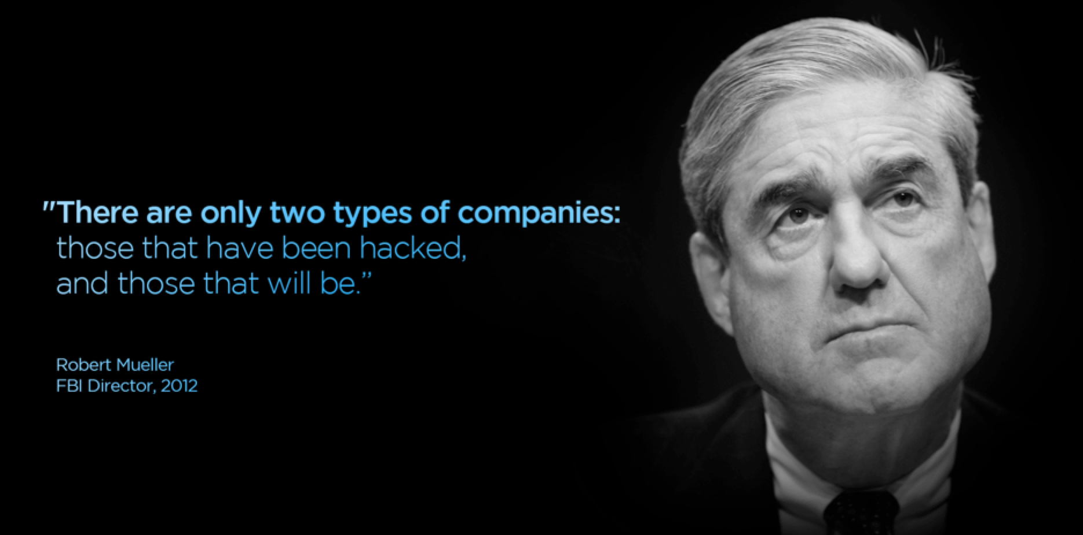

Slide 3
Meeting Invite Contents
In this module we will cover resolving noisy alerts automatically, and automated Incident response with the help of a Watchlist.
What you need:
A server running Windows or Linux in Azure
A Sentinel workspace
The Security Events connector or Syslog connector connected and sending data to log analytics.
If you need help getting this set up prior to the session, reach out anytime Mon-Thu next week.
This session will be more self-driven, some instructions will be provided, along with some hints. If you have experience with Logic Apps, great, if you don’t, don’t worry, step by step instructions will be provided.
The session is booked for 90 to 120 minutes.

Slide 4
Sentinel Security Operations And Response (SOAR)
Many, if not most, alerts and incidents conform to recurring patterns that can be addressed by specific and defined sets of remediation actions.
A playbook is a collection of these remediation actions that can be run from Microsoft Sentinel as a routine. A playbook can help automate and orchestrate your threat response; it can be run manually or set to run automatically in response to specific alerts or incidents, when triggered by an analytics rule or an automation rule, respectively.

Slide 5
Common Terms
Watchlist: Data from external sources imported for event correlation
Use for search, detection rules, threat hunting, and response playbooks. Stored in the Sentinel workspace as name-value pairs and cached for optimal query performance and low latency.
STIX: Structured Threat Information eXpression
A standardized language which has been developed by MITRE in a collaborative way in order to represent structured information about cyber threats.
TAXII: Trusted Automated eXchange of Indicator Information
A collection of services and message exchanges to enable the sharing of information about cyber threats across product, service and organizational boundaries.
Notes:
We are showing all three because they are closely related. Watchlists you create yourself – TI Feeds (both STIX & TAXII formats) are received through a connector configuration.

Slide 6
Review: Common Terms
Event:
A change in the normal behavior of a given system, Examples: process, environment or workflow. Recorded through the creation of a log.
Alert:
Notification of an event requiring an action. Examples: to act on an alert may create an incident.
Incident
An incident is a change in a system that negatively Examples: impacts the organization and results in material loss or loss of public image.
Someone logs in to a device
Potential password spray
A server goes offline unexpectedly
An RDP brute force attack
Anomalous account creation
Malicious credential theft tool detected
SAP priv. user adds priv. to another user.
Unexpected exfiltration of data
Malicious credential theft tool detected
Notes:
Why would someone logging into a device be interesting?
By itself, it is not, so it’s just an event, however if the user has requested a password change then doesn’t log in with 10 minutes, that may be an indicator of a compromise. (Example of government security environment) Automated response to disable the account.
Password spray can be as simple as someone forgetting they changed it and are using their old password four or five times in a short period of time.
Several password spray events at the same time may indicated an RDP brute force Alert.
A successful login after several failed logins when multiple RDP ‘alerts’ are being generated can create an incident .
A single alert on a “Malicious credential theft tool detected’ will immediately generate an Incident.

Slide 7



Environment Check
Sentinel enabled & the Security Events data connector implemented
Windows Server (or Linux) sending (login) events to Sentinel
A Jumpbox you can RDP to, and then RDP to the Win/Linux server above.

Slide 8


Mission Details
The customer needs to know when an Admin logs in from an unusual address.
Right now, it’s way to noisy, every time an admin logs in, it creates an Alert and an Incident.
The alert must trigger whenever an administrator logs in and should be closed unless the IP address is unknow.
Mission: Optimize this and reduce the noise.

