Slide 1
AI Agent Architecture & Observability
Microsoft Agent Framework, OpenTelemetry,
New Relic, Quality Assurance and AI Security & Trust
Notes:
This deck is a template for What The Hack lectures.
It is recommended that Coaches deliver mini-lectures ahead of each Challenge that set context for the challenge and introduce & explain any key technologies.
At a minimum, it is handy to have a slide with the key goals of each challenge to display on the screen when running the hack in-person.

Slide 2
The Hack
In this hack, you'll build AI agents using the Microsoft Agent Framework and instrument them with OpenTelemetry for full-stack observability - powered by New Relic. From tracing agent decisions to monitoring performance and quality, you'll learn how to make your AI systems production-ready with real-time insights.
Theme:
You've just founded 🚀 WanderAI, an exciting new travel planning startup! 🌍✈️
Your mission: Build an AI-powered travel planning assistant that helps your customers discover amazing destinations and create personalized itineraries. But here's the catch—your investors want to see that your AI agents are reliable, observable, and trustworthy.
This hack is your journey from "cool prototype" to "production-ready AI service."
Notes:
Modify this slide and add the pre-reqs specific to your hack here.
Each challenge slide should list the key goals for the challenge.

Slide 3
The Hack
🌱 Learn the Foundation: "What makes an AI agent tick?"
Understand Microsoft Agent Framework concepts
Learn about tools, agents, and multi-agent orchestration
🏗️ Build Your MVP: "Ship the first version of WanderAI!"
Create a Flask web app for travel planning
Build your first AI agent with tool calling
Get customer requests flowing through the system
📊 Add Observability: "Can you see what's happening?"
Initialize built-in OpenTelemetry
Verify traces and metrics in the console
Send the same built-in telemetry to New Relic
🧩 Custom Telemetry: "Add your own signals."
Add custom spans for tools and routes
Record custom metrics for business logic
Correlate logs with trace context in New Relic
🎯 Optimize for Production: "Make it fast, reliable, and insightful."
Implement monitoring best practices
Build custom dashboards for your agents
Detect and alert on problems
Analyze AI response quality
🧪 Quality Assurance for AI: "Prove your agents are trustworthy."
Build evaluation tests for your agents
Create a CI/CD quality gate
Ensure bad outputs never reach customers
Measure and improve AI quality over time
🛡️ Platform Security Baseline: "Configure guardrails first."
Configure Microsoft Foundry Guardrails
Validate intervention points and risk actions
Monitor platform-level security outcomes
🔐 Application Security Controls: "Defend in your code."
- Add app-level prompt injection detection
- Enforce blocking in request flow
- Instrument and validate custom security controls
Notes:
Modify this slide and add the pre-reqs specific to your hack here.
Each challenge slide should list the key goals for the challenge.

Slide 4
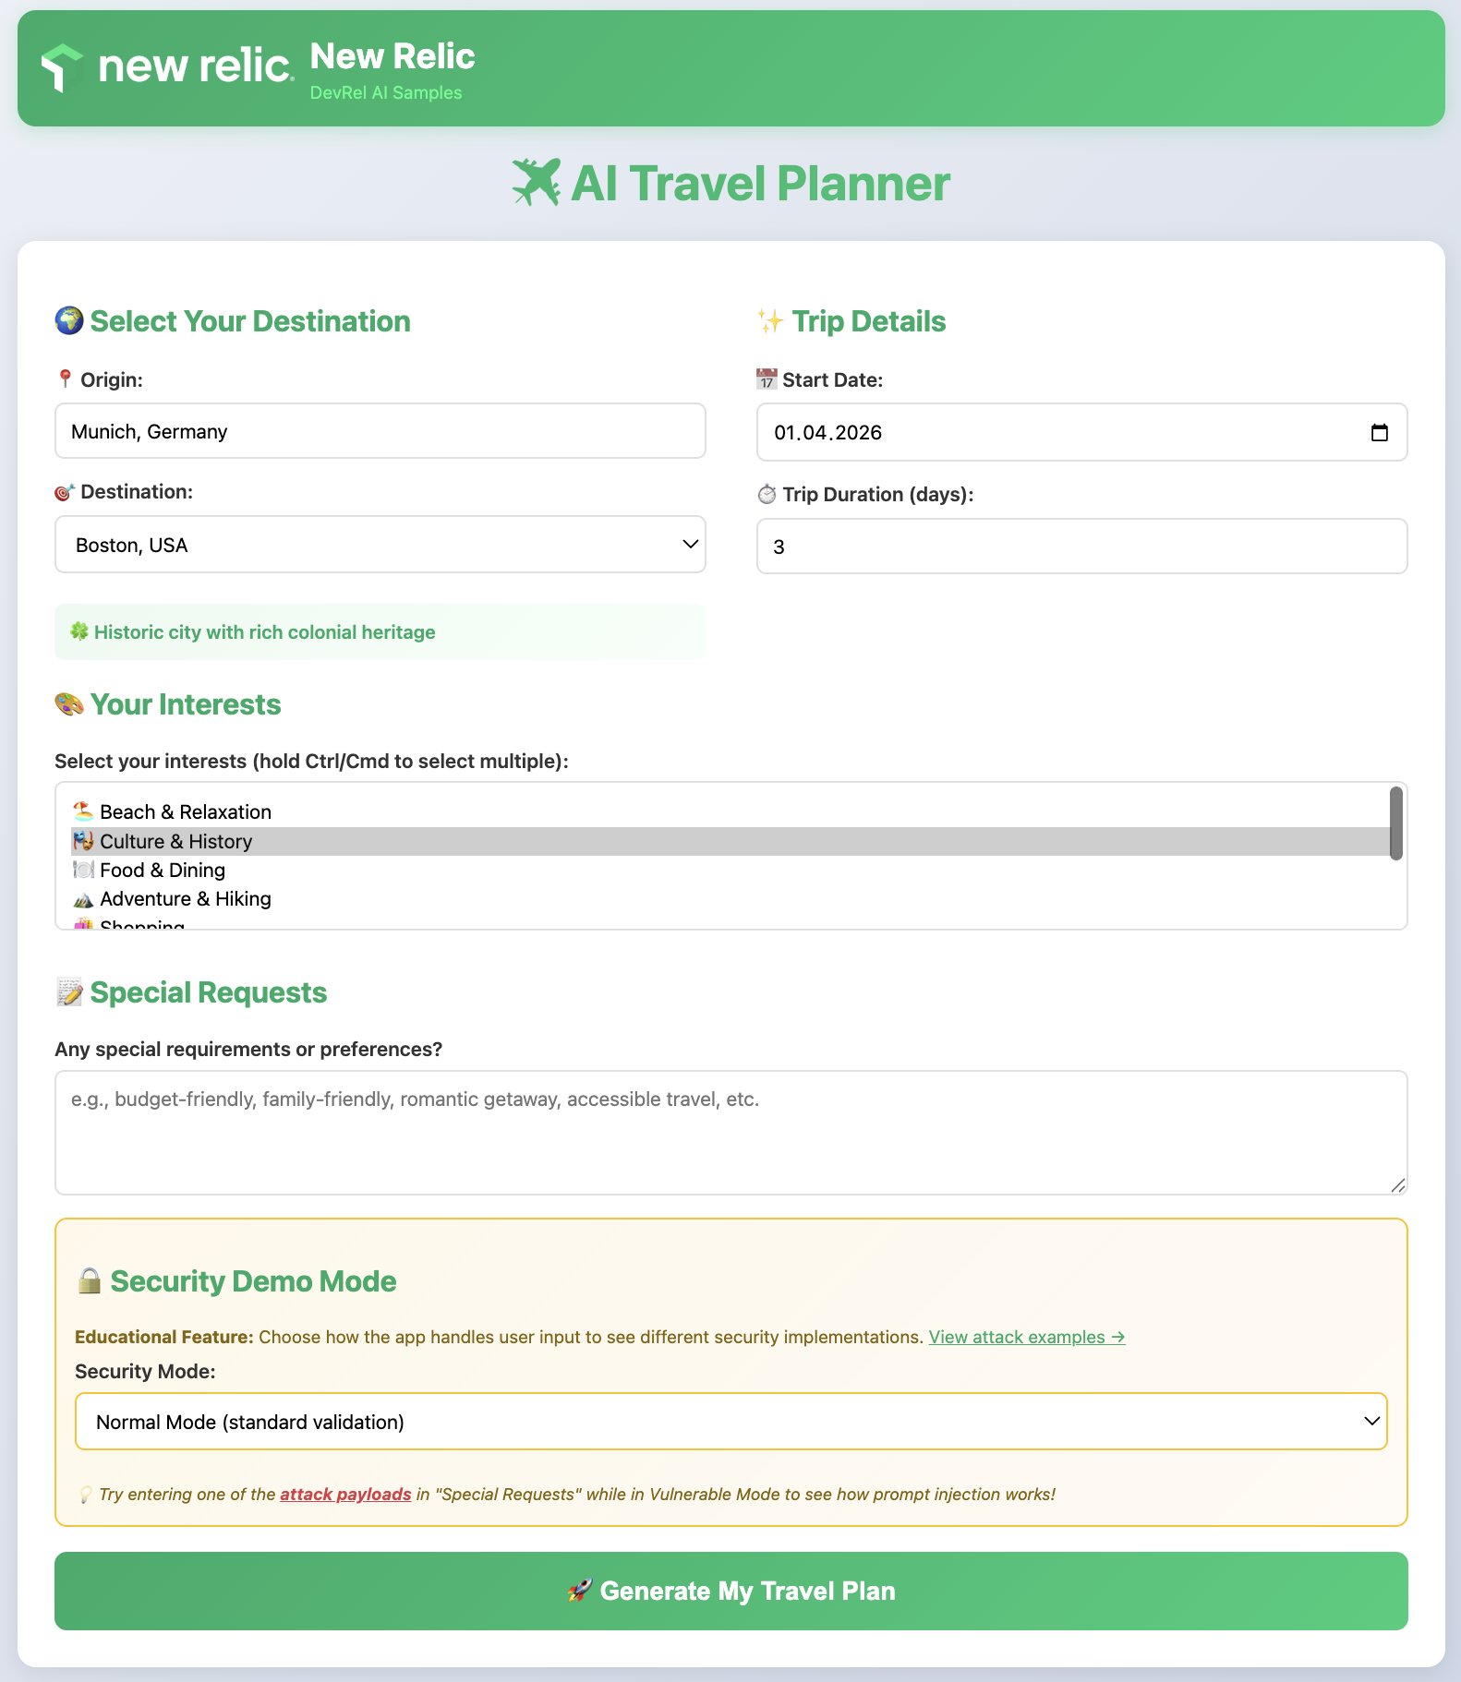
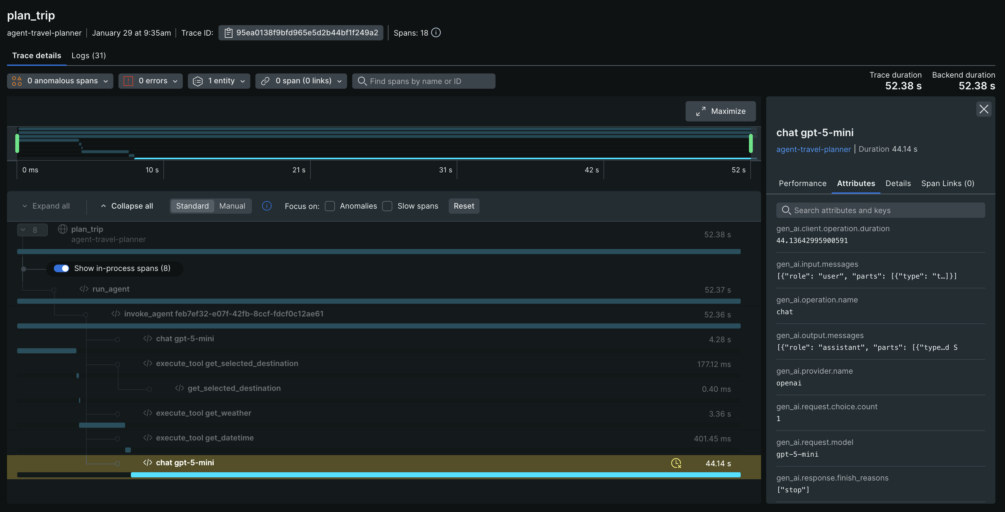
The End Goal
Running, fully functional travel planner app
Observable, safe and secure environment
Notes:
Modify this slide and add the pre-reqs specific to your hack here.
Each challenge slide should list the key goals for the challenge.

Slide 5

🚀 WanderAI - Your Travel Planning Startup
Welcome & Intros
Notes:
Coaches/Presenters for THIS hack/lecture event should be listed on this slide.
Original contributors to the hack content & these slides include:
Please list original contributors to this hack here in the speaker notes and give them credit when delivering this content.
<Original Author 1>
<Original Author 2>
…
<Original Author N>

Slide 6
🚀 WanderAI - Your Travel Planning Startup
Welcome & Intros
Harry Kimpel
Peter Laudati
DevRel @ New Relic
Jemiah Sius
Cloud SA @ MSFT
Spence Taylor
DevRel @ New Relic
Andy Huang
DevRel @ New Relic
Cloud SA @ MSFT
Notes:
Coaches/Presenters for THIS hack/lecture event should be listed on this slide.
Original contributors to the hack content & these slides include:
Please list original contributors to this hack here in the speaker notes and give them credit when delivering this content.
<Original Author 1>
<Original Author 2>
…
<Original Author N>

Slide 7
Challenge Zero
Come up with a name for your team
Get your environments ready!
Deploy Microsoft Foundry (incl. base LLM model)
Deploy Azure Native New Relic Service
Notes:
Modify this slide and add the pre-reqs specific to your hack here.
Each challenge slide should list the key goals for the challenge.

Slide 8
Challenge 1 - Master the Foundations
What makes an AI agent tick?

Slide 9
Challenge #1
Master the Foundations – What makes an AI agent tick?
Before you start building WanderAI's AI agents, you need to understand the core concepts that power them. This challenge focuses on building your foundational knowledge of AI agents, the Microsoft Agent Framework, and observability concepts.
An AI agent is different from a simple LLM API call. While a direct API call just sends a prompt and receives a response, an agent can reason about problems, decide when to use external tools, and orchestrate multiple steps to accomplish complex tasks. Understanding this distinction is crucial for building effective AI-powered applications.
In this challenge, you will study the Microsoft Agent Framework documentation and learn about tool calling, agent lifecycles, and why observability matters for AI systems.
Notes:
Template for a lecture slide with bullets (if you need them).
Try to NOT use bullet lists in your presentation.
Diagrams, puppy pictures, etc are always better. ☺

Slide 10
Challenge #1
Master the Foundations – What makes an AI agent tick?
Your goal is to gain a solid understanding of the following concepts:
AI Agents vs. Simple LLM Calls
Understand what differentiates an agent from a basic chat completion API call
Tool Calling
Learn why agents need tools and how they decide when to call them
Agent-Tool Lifecycle
Understand the flow from user request through agent reasoning to tool execution and response
OpenTelemetry Basics
Learn about traces, metrics, and logs and why they matter for AI systems
Application Architecture
Understand how a Flask web app integrates with the Microsoft Agent Framework
Notes:
For each challenge, list out the key high-level goals.
If there are important specifications, list them here, or remind students to “read the student guide!”

Slide 11
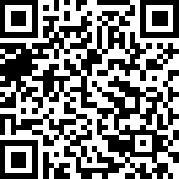
Challenge #1
Master the Foundations – What makes an AI agent tick?
Notes:
For each challenge, list out the key high-level goals.
If there are important specifications, list them here, or remind students to “read the student guide!”

Slide 12
Challenge 2 - Build Your MVP
Ship the first version of WanderAI!

Slide 13
Challenge #2
Build Your MVP - Ship the first version of WanderAI!
It's time to build the first version of WanderAI's Travel Planner service! In this challenge, you will create a Flask web application that leverages the Microsoft Agent Framework to generate personalized travel itineraries.
Your application will accept user travel preferences through a web form and use an AI agent to create beautiful, customized trip plans. The agent will have access to tools that provide real-time information like weather data and current date/time.
Notes:
Template for a lecture slide with bullets (if you need them).
Try to NOT use bullet lists in your presentation.
Diagrams, puppy pictures, etc are always better. ☺

Slide 14
Challenge #2
Build Your MVP - Ship the first version of WanderAI!
You need to build a Flask web application with the following components:
User Interface
A form where users enter their travel preferences (travel date, trip duration, interests, special requests)
Backend
Flask web server with appropriate routes
AI agent that creates travel plans using the Microsoft Agent Framework
Tool functions for getting data (weather, random destinations, current time)
Output
Formatted HTML page with travel itinerary
Beautiful presentation of the AI's recommendations
Notes:
For each challenge, list out the key high-level goals.
If there are important specifications, list them here, or remind students to “read the student guide!”

Slide 15
Challenge 3 - Add Observability
Can you see what's happening?

Slide 16
Challenge #3
Add Observability - Can you see what's happening?
Now that you have a working MVP, it's time to add observability to your WanderAI agents using OpenTelemetry. Right now, if something goes wrong with your agent, you have no visibility into which tool was called, how long operations take, or how to correlate logs to specific requests.
OpenTelemetry is the industry standard for observability in modern applications. By instrumenting your application, you'll be able to see traces showing the full journey of each request, capture timing information, and add structured context to your logs.
Microsoft Agent Framework already integrates with OpenTelemetry out of the box, and more specifically Agent Framework emits traces, logs, and metrics according to the OpenTelemetry GenAI Semantic Conventions.
In this challenge, you will initialize OpenTelemetry, verify telemetry in the console, and then confirm the same telemetry in New Relic before moving on to custom instrumentation in the next challenge.
Notes:
Template for a lecture slide with bullets (if you need them).
Try to NOT use bullet lists in your presentation.
Diagrams, puppy pictures, etc are always better. ☺

Slide 17
Challenge #3
Add Observability - Can you see what's happening?
Your goal is to add basic OpenTelemetry instrumentation to your travel planning application and validate the results:
Initialize OpenTelemetry
Set up the tracer provider and configure resource attributes to identify your service
Verify Console Telemetry
Confirm traces and metrics show up in your terminal
Send Telemetry to New Relic
Switch exporters to OTLP and confirm the same signals in New Relic
Notes:
For each challenge, list out the key high-level goals.
If there are important specifications, list them here, or remind students to “read the student guide!”

Slide 18
Challenge 4 - Custom Telemetry
Add your own signals

Slide 19
Challenge #4
Custom Telemetry - Add your own signals
In Challenge 03, you verified that the Agent Framework automatically generates traces and metrics for your AI agent operations. Now it's time to add custom instrumentation to capture application-specific insights.
Custom instrumentation allows you to:
Create spans for specific business operations (e.g., "plan_trip", "validate_itinerary")
Record custom metrics (e.g., number of destinations, planning duration)
Add structured logging context for better debugging
Correlate application events with AI agent activities
By the end of this challenge, you'll have visibility into both the automatic Agent Framework telemetry and your custom business logic, all flowing to New Relic.
Notes:
Template for a lecture slide with bullets (if you need them).
Try to NOT use bullet lists in your presentation.
Diagrams, puppy pictures, etc are always better. ☺

Slide 20
Challenge #4
Custom Telemetry - Add your own signals
Your goal is to add custom spans, metrics, and structured logging to your travel planning application:
Add Custom Spans
Instrument tool calls and business logic with manual spans
Add Custom Metrics
Record meaningful measurements (trip planning duration, destination counts, etc.)
Add Structured Logging
Correlate logs with spans using trace context
Verify in New Relic
Confirm custom telemetry appears alongside auto-generated signals
Notes:
For each challenge, list out the key high-level goals.
If there are important specifications, list them here, or remind students to “read the student guide!”

Slide 21
Challenge 5 - Optimize for Production
Make it fast, reliable, insightful.

Slide 22
Challenge #5
Optimize for Production - Make it fast, reliable, insightful.
You're now sending telemetry to New Relic, but raw data alone isn't enough. Without dashboards and alerts, you're manually checking traces all the time, you won't notice problems until customers complain, and you can't track performance trends over time.
In this challenge, you'll learn industry best practices for monitoring AI-driven applications by creating custom dashboards, setting up alerts, and tracking key metrics that matter for your travel planning service.
Notes:
Template for a lecture slide with bullets (if you need them).
Try to NOT use bullet lists in your presentation.
Diagrams, puppy pictures, etc are always better. ☺

Slide 23
Challenge #5
Optimize for Production - Make it fast, reliable, insightful.
Your goal is to build a comprehensive monitoring solution for WanderAI that includes dashboards, alerts, and meaningful metrics collection.
Enhanced Metrics Collection
Add custom metrics to your application using the OpenTelemetry meter
Emit these metrics from your application code at appropriate points (request handlers, error handlers, tool functions).
Create a New Relic Dashboard
Build a dashboard in New Relic called "WanderAI Agent Performance”
Use NRQL queries to power your dashboard widgets.
Set Up Alerts
Configure alerts in New Relic to notify your team
Notes:
For each challenge, list out the key high-level goals.
If there are important specifications, list them here, or remind students to “read the student guide!”

Slide 24
Challenge 6 - AI Quality Assurance
Prove your agents are trustworthy

Slide 25
Challenge #6
AI Quality Assurance - Prove your agents are trustworthy
You can't just ship AI without testing. What if the agent returns a non-existent destination? What if the itinerary is way too long or short? What if recommendations are unsafe (war zones, extreme weather)? What if the response includes toxicity or negativity?
In this challenge, you'll build an automated quality gate for your AI agents using New Relic's AI Monitoring platform. Quality gates ensure that only high-quality travel plans reach your customers.
Notes:
Template for a lecture slide with bullets (if you need them).
Try to NOT use bullet lists in your presentation.
Diagrams, puppy pictures, etc are always better. ☺

Slide 26
Challenge #6
AI Quality Assurance - Prove your agents are trustworthy
Your goal is to implement a comprehensive evaluation & quality assurance system for your AI-generated travel plans. Several layers of evaluation working together.
Layer 1: Custom Events for New Relic AI Monitoring
Enterprise AI evaluation by capturing AI interactions as structured events
Layer 2: Rule-Based Evaluation
Implement deterministic checks against business rules
Layer 3: Integration into Your Application
Integrate the evaluation system into your Flask application
Layer 4: User Feedback Collection
Capture real user feedback to measure actual satisfaction with AI-generated travel plans
Layer 5: LLM-Based Quality Evaluation (Optional)
Use another LLM to evaluate responses
Notes:
For each challenge, list out the key high-level goals.
If there are important specifications, list them here, or remind students to “read the student guide!”

Slide 27
Challenge 7 - AI Security: Platform-Level Guardrails
Configure and validate
Foundry Guardrails

Slide 28
Challenge #7
AI Security: Platform-Level Guardrails
WanderAI now runs in production, and your first security priority is to establish a platform-level baseline before writing custom detection code.
In this challenge, you will configure and validate Microsoft Foundry Guardrails as the first line of defense for your agent. You’ll focus on built-in controls, intervention points, and observability of guardrail decisions.
Notes:
Template for a lecture slide with bullets (if you need them).
Try to NOT use bullet lists in your presentation.
Diagrams, puppy pictures, etc are always better. ☺

Slide 29
Challenge #7
AI Security: Platform-Level Guardrails
You will implement baseline protection using Foundry Guardrails:
Configure guardrails for user input and output
Optionally enable tool call/tool response monitoring (preview)
Validate detection against known prompt-injection patterns
Notes:
For each challenge, list out the key high-level goals.
If there are important specifications, list them here, or remind students to “read the student guide!”

Slide 30
Challenge 8 - AI Security: Application-Level
Build custom detection and blocking

Slide 31
Challenge #8
Secure Against Prompt Injection - Keep your agents safe.
In Challenge 07, you configured platform-level guardrails to establish baseline protection. In this challenge, you will add application-level controls directly to your Python app.
Your goal is to implement domain-specific defenses for the WanderAI travel planner that complement Microsoft Foundry Guardrails.
Notes:
Template for a lecture slide with bullets (if you need them).
Try to NOT use bullet lists in your presentation.
Diagrams, puppy pictures, etc are always better. ☺

Slide 32
Challenge #8
Secure Against Prompt Injection - Keep your agents safe.
You will enhance `web_app.py` with custom security controls:
Input validation and sanitization
Rule-based and heuristic prompt injection detection
Risk scoring and blocking logic in `/plan`
Hardened system instructions for the agent
OpenTelemetry metrics, events, and traces for security decisions
Notes:
For each challenge, list out the key high-level goals.
If there are important specifications, list them here, or remind students to “read the student guide!”

Slide 33
Thank You for Attending!
https://aka.ms/wth
Notes:
Thank students for attending and share the link to the What The Hack website with them.

