Slide 1






Redis
Get / Post
http://localhost:8000/bindingname
{
"user":"johndoe"
}
Kafka
App
Event Hubs
Twitter
SQS

Slide 2



Redis
Event Hubs
App
“myApp”
DynamoDB
Post
http://localhost:3500/v1.0/bindings/bindingname
CosmosDB
{
"data":
{
"sku":"v100",
"quantity":"50"
}
}
Kafka
Twilio

Slide 3

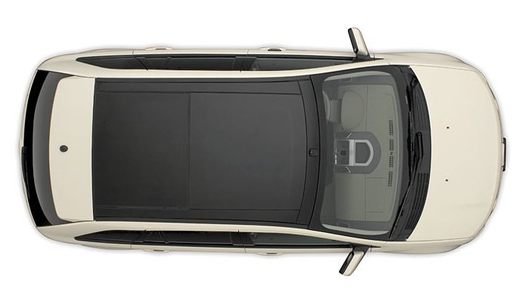
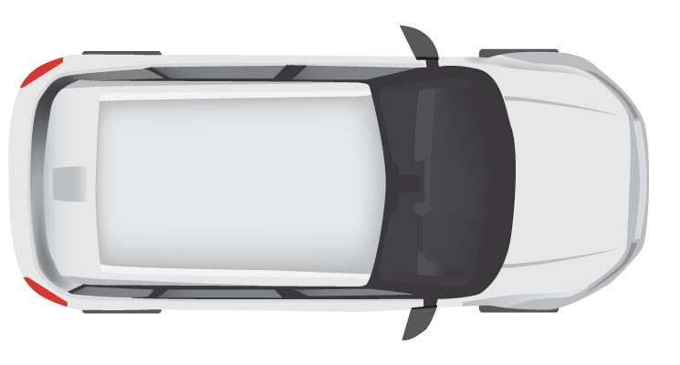
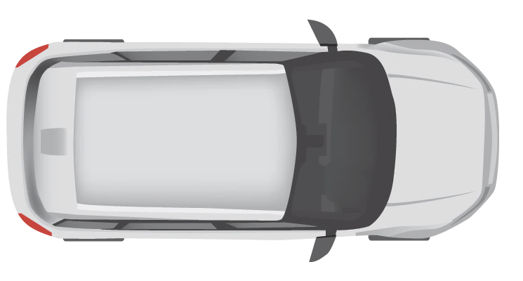
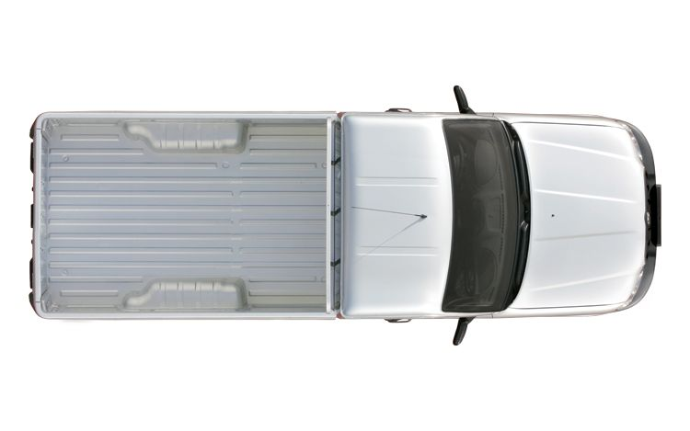



10 km
Entry Cam 1
Exit Cam 1
Entry Cam 2
Exit Cam 2
Entry Cam 3
Exit Cam 3
Department Of
Motor Vehicles (DMV)
Central Fine Collection Agency

Slide 4
Camera
Simulation
Traffic
Control
Service
Fine
Collection
Service
Vehicle
Registration
Service
/entrycam
/vehicleinfo/ {license-number}
/collectfine
/exitcam

Slide 5
Camera Simulation
Traffic Control
Service
Fine Collection Service
Vehicle Registration Service
Camera
Simulation
/entrycam
/exitcam
/collect fine
/vehicle
info
POST VehicleRegistered
Random
Interval
Store VehicleState
POST VehicleRegistered
Get VehicleState
Calculate Average Speed
[AvgSpeedOverLimit]
POST SpeedingViolation
Calculate Fine
GET /vehicleinfo/13-XK-46
Send Email

Slide 6






Camera
Simulation
MQTT
Sidecar
Traffic
Control
Service
5
5
5
/entrycam
7
5
/exitcam
2
3
Redis
3
RabbitMQ
2
Sidecar
Fine
Collection
Service
2
2
/collectfine
1
4
6
SMTP
4
1
Sidecar
Vehicle
Registration
Service
Secrets
1
/vehicleinfo/ {license-number}
6
1
Service invocation
3
State management
5
Input binding
7
Actors
2
Publish / subscribe
4
Output binding
6
Secrets management

Slide 7
Camera Simulation
Traffic Control
Service
Fine Collection Service
Vehicle Registration Service
Camera
Simulation
MQTT
/entrycam
/exitcam
Redis
RabitMQ
/collect fine
/vehicle info
SMTP
VehicleRegistered
VehicleRegistered
Random
Interval
Store VehicleState
VehicleRegistered
VehicleRegistered
Get VehicleState
Calculate Average Speed
[AvgSpeedOverLimit]
SpeedingViolation
SpeedingViolation
Calculate Fine
GET /vehicleinfo/13-XK-46
InvokeBinding
Send email

Slide 8
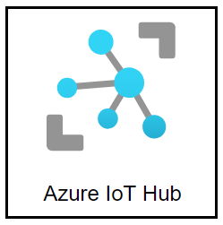


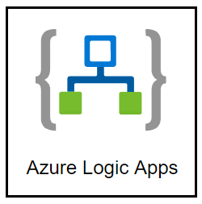

5
Camera
Simulation
Sidecar
Traffic
Control
Service
5
5
/entrycam
5
5
/exitcam
Azure Event Hub
2
3
3
2
Sidecar
Fine
Collection
Service
2
2
/collectfine
1
4
6
4
1
Sidecar
Vehicle
Registration
Service
1
/vehicleinfo/ {license-number}
6
1
Service invocation
3
State management
5
Input binding
2
Publish / subscribe
4
Output binding
6
Secrets management

Slide 9
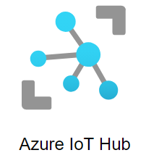



Camera Simulation
Traffic Control
Service
Fine Collection Service
Vehicle Registration Service
Camera
Simulation
/entrycam
/exitcam
/collect fine
/vehicle info
VehicleRegistered
VehicleRegistered
Random
Interval
Store VehicleState
VehicleRegistered
VehicleRegistered
Get VehicleState
Calculate Average Speed
[AvgSpeedOverLimit]
SpeedingViolation
SpeedingViolation
Calculate Fine
GET /vehicleinfo/13-XK-46
InvokeBinding
Send email

Slide 10
Assignment 2:
Camera
Simulation
Traffic
Control
Service
/entrycam
/exitcam
Sidecar
Fine
Collection
Service
/collectfine
1
1
Sidecar
Vehicle
Registration
Service
1
/vehicleinfo/ {license-number}
1
Service invocation

Slide 11
Assignment 3:
Camera
Simulation
Sidecar
Traffic
Control
Service
/entrycam
/exitcam
2
RabbitMQ
2
Sidecar
Fine
Collection
Service
2
2
/collectfine
1
1
Sidecar
Vehicle
Registration
Service
1
/vehicleinfo/ {license-number}
1
Service invocation
2
Publish / subscribe

Slide 12
Assignment 3:
Camera
Simulation
Sidecar
Traffic
Control
Service
/entrycam
/exitcam
2
2
Sidecar
Fine
Collection
Service
2
2
/collectfine
1
1
Sidecar
Vehicle
Registration
Service
1
/vehicleinfo/ {license-number}
1
Service invocation
2
Publish / subscribe

Slide 13
Assignment 4:
Camera
Simulation
Sidecar
Traffic
Control
Service
/entrycam
/exitcam
2
3
Redis
3
RabbitMQ
2
Sidecar
Fine
Collection
Service
2
2
/collectfine
1
1
Sidecar
Vehicle
Registration
Service
1
/vehicleinfo/ {license-number}
1
Service invocation
3
State management
2
Publish / subscribe

Slide 14
Assignment 4:
Camera
Simulation
Sidecar
Traffic
Control
Service
/entrycam
/exitcam
2
3
3
2
Sidecar
Fine
Collection
Service
2
2
/collectfine
1
1
Sidecar
Vehicle
Registration
Service
1
/vehicleinfo/ {license-number}
1
Service invocation
3
State management
2
Publish / subscribe

Slide 15
Assignment 5:
Camera
Simulation
Sidecar
Traffic
Control
Service
/entrycam
/exitcam
2
3
Redis
3
RabbitMQ
2
Sidecar
Fine
Collection
Service
2
2
/collectfine
1
4
SMTP
4
1
Sidecar
Vehicle
Registration
Service
1
/vehicleinfo/ {license-number}
1
Service invocation
3
State management
2
Publish / subscribe
4
Output binding

Slide 16
Assignment 5:
Camera
Simulation
Sidecar
Traffic
Control
Service
/entrycam
/exitcam
2
3
3
2
Sidecar
Fine
Collection
Service
2
/collectfine
1
4
4
4
1
Sidecar
Vehicle
Registration
Service
1
/vehicleinfo/ {license-number}
1
Service invocation
3
State management
2
Publish / subscribe
4
Output binding

Slide 17
Assignment 6:
Camera
Simulation
MQTT
Sidecar
Traffic
Control
Service
5
5
5
/entrycam
5
/exitcam
2
3
Redis
3
RabbitMQ
2
Sidecar
Fine
Collection
Service
2
2
/collectfine
1
4
SMTP
4
1
Sidecar
Vehicle
Registration
Service
1
/vehicleinfo/ {license-number}
1
Service invocation
3
State management
5
Input binding
2
Publish / subscribe
4
Output binding

Slide 18
Assignment 6:
5
Camera
Simulation
Sidecar
Traffic
Control
Service
5
/entrycam
5
5
5
5
5
/exitcam
5
Azure Event Hub
2
3
3
2
Sidecar
Fine
Collection
Service
2
/collectfine
1
4
4
1
Sidecar
Vehicle
Registration
Service
1
/vehicleinfo/ {license-number}
1
Service invocation
3
State management
5
Input binding
2
Publish / subscribe
4
Output binding

Slide 19
Assignment 7:
Camera
Simulation
MQTT
Sidecar
Traffic
Control
Service
5
5
5
/entrycam
5
/exitcam
2
3
Redis
3
RabbitMQ
2
Sidecar
Fine
Collection
Service
2
2
/collectfine
1
4
6
SMTP
4
1
Sidecar
Vehicle
Registration
Service
Secrets
1
/vehicleinfo/ {license-number}
6
1
Service invocation
3
State management
5
Input binding
2
Publish / subscribe
4
Output binding
6
Secrets management

Slide 20
Assignment 7:
5
Camera
Simulation
Sidecar
Traffic
Control
Service
5
5
/entrycam
5
5
/exitcam
Azure Event Hub
2
3
3
2
Sidecar
Fine
Collection
Service
2
/collectfine
1
4
6
6
4
1
Sidecar
Vehicle
Registration
Service
1
/vehicleinfo/ {license-number}
6
6
1
Service invocation
3
State management
5
Input binding
2
Publish / subscribe
4
Output binding
6
Secrets management

Slide 21










Assignment 8:
TrafficControlService container
VehicleRegistrationService container
Azure Kubernetes Service
Container Registry
Simulation app
Dapr sidecar container
Dapr sidecar container
TrafficControlService pod
VehicleRegistrationService pod
IoT Hub
FineCollectionService container
Dapr sidecar container
FineCollectionService pod
Event Hub
Logic App
Service Bus
App Insights
KeyVault
Azure Redis Cache

Slide 22

Assignment 8:
TrafficControlService container
VehicleRegistrationService container
Container Registry
Azure Container Apps
Simulation app
Dapr sidecar container
Dapr sidecar container
TrafficControlService Container App
VehicleRegistrationService Container App
IoT Hub
FineCollectionService container
Dapr sidecar container
FineCollectionService Container App
Event Hub
Logic App
Service Bus
App Insights
KeyVault
Azure Redis Cache

