Slide 1
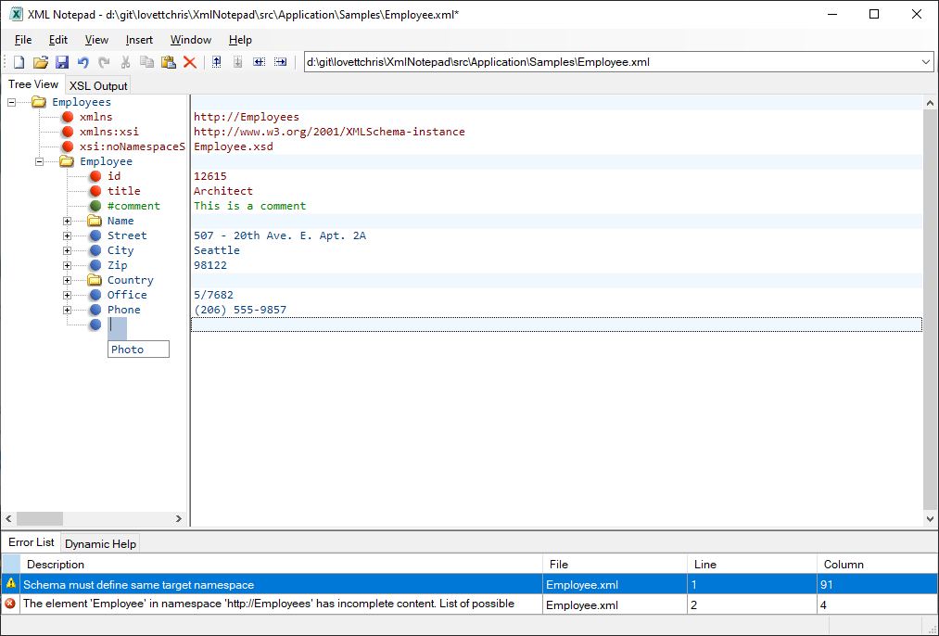
Address bar
Menu bar
Toolbar
Node Text View
Pane resizers
Tree View
Intellisense
Schema validation

