Slide 1
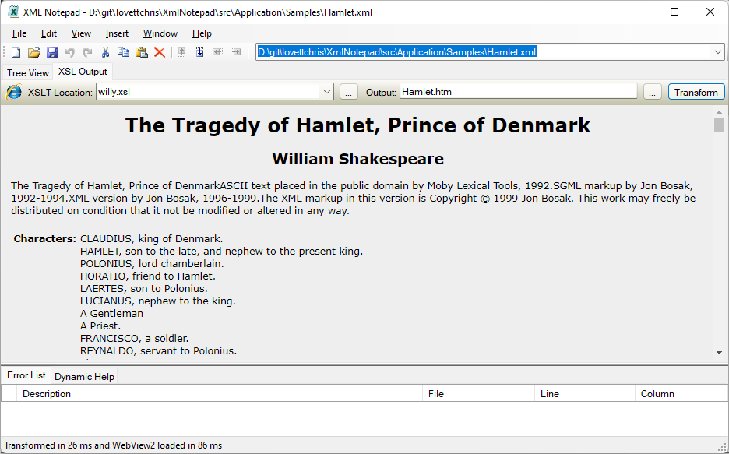
XSLT output filename
XSLT filename
Rerun XSLT transform
XSLT recent files
XSLT browse
XSLT output browse
Browser type and transform time

