Slide 1
Portable Apps
2026

Slide 2





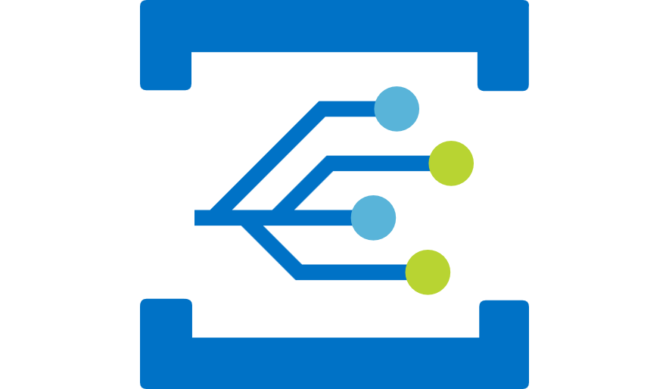





Architecture
Author/Gen
Tool
Ops
App
model
Portable App
…
Portable App
…
Platform
Capabilities
Repo
Deployment Tool
Control Plane
Cloud/Edge
Infrastructure
Dev

