Slide 1
Unlock Your Agents Potential with Model Context Protocol (MCP) Workshop
Dave Glover
Principal AI Cloud Advocate
Australia

Slide 2
Introduction
Setting the scene
Notes:
We’ll exploring the AI Agents.
Core concepts and talk about "what is an agent"
what sets them apart from just using LLMs for chat completion

Slide 3


Use case
You are a sales manager at Zava, a DIY retail company.
You need to analyze sales data to find trends, understand customer preferences and make informed business decisions.
Notes:
Imagine you are a sales manager at Zava, a retail DIY company with stores across Washington State and a growing online presence. You specialize in outdoor equipment, home improvement tools, and DIY supplies.
You need to analyze sales data to find trends, understand customer preferences, and make informed business decisions. To help you, Zava has developed a conversational agent that can answer questions about your sales data and even help customers find products using image search.

Slide 4
Definition of agent
Agent
Semi-autonomous software that can be given a goal and will work to achieve that goal without you knowing in advance exactly how it's going to do that or what steps it's going to take.
Notes:
Keep it simple
So, what differentiates AI conversations and Agents
There are many definitions of an Agent
This is the definition we’ve settled on.
Simple as data analysis
Complex as onboarding a new hire
Semi-autonomous software that can be given a goal and will work to achieve that goal without you knowing in advance exactly how it's going to do that or what steps it's going to take.

Slide 5
How can MCP help us?
Notes:
At this point, we’re probably thinking how can LLM, a large language model help me with sales analysis process?
Well, let’s put it to the test, what if we craft a prompt on sales analysis, let’s see what it can do for us..

Slide 6

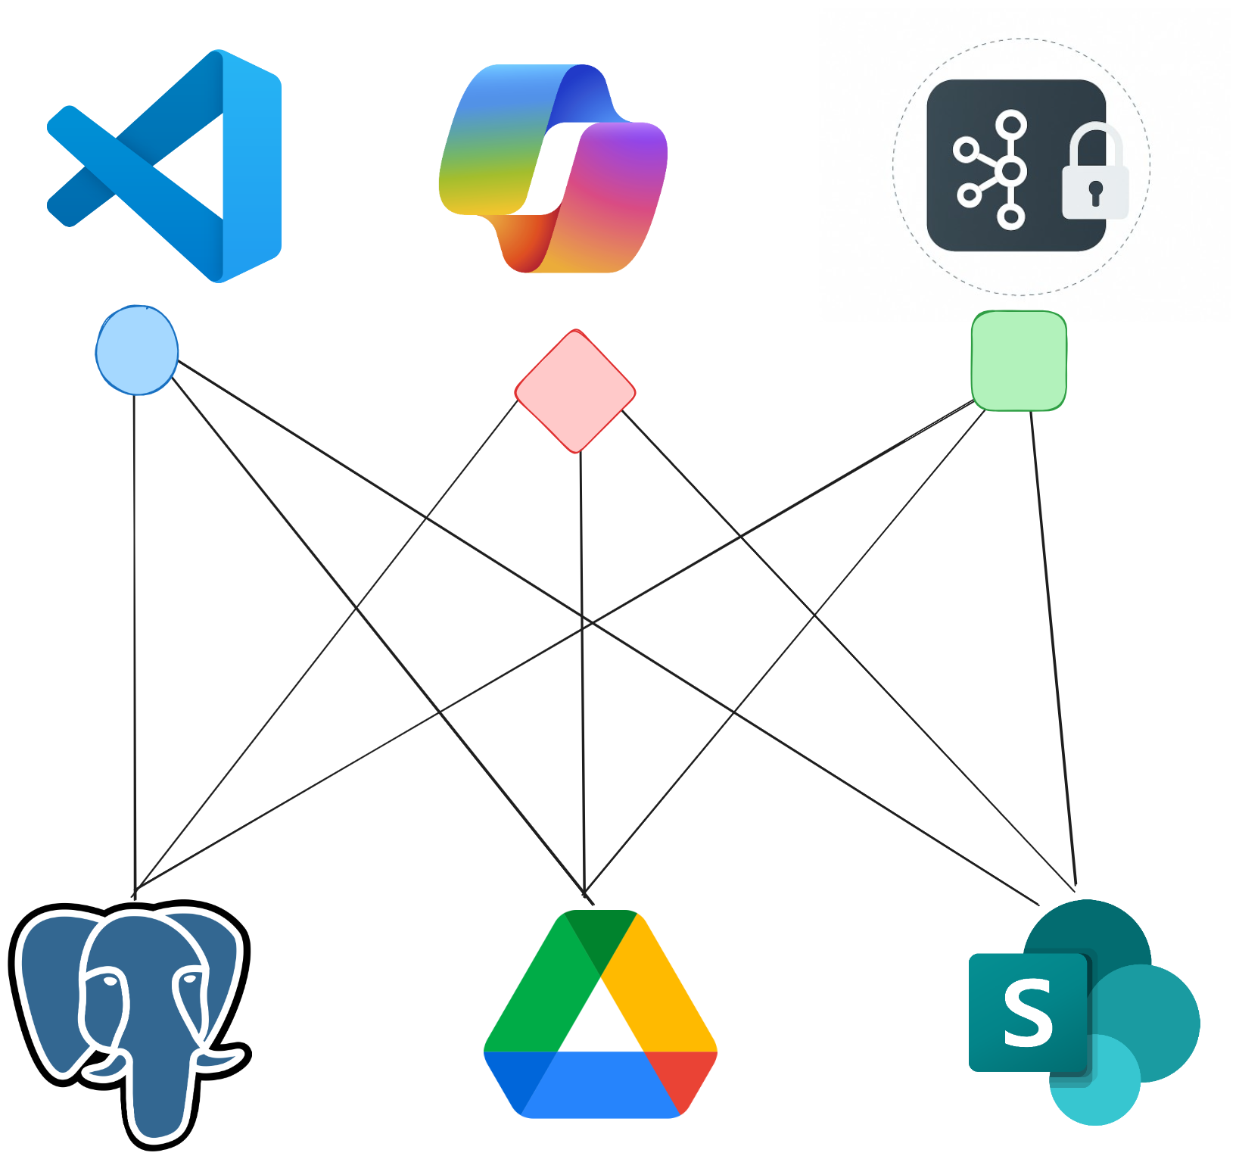
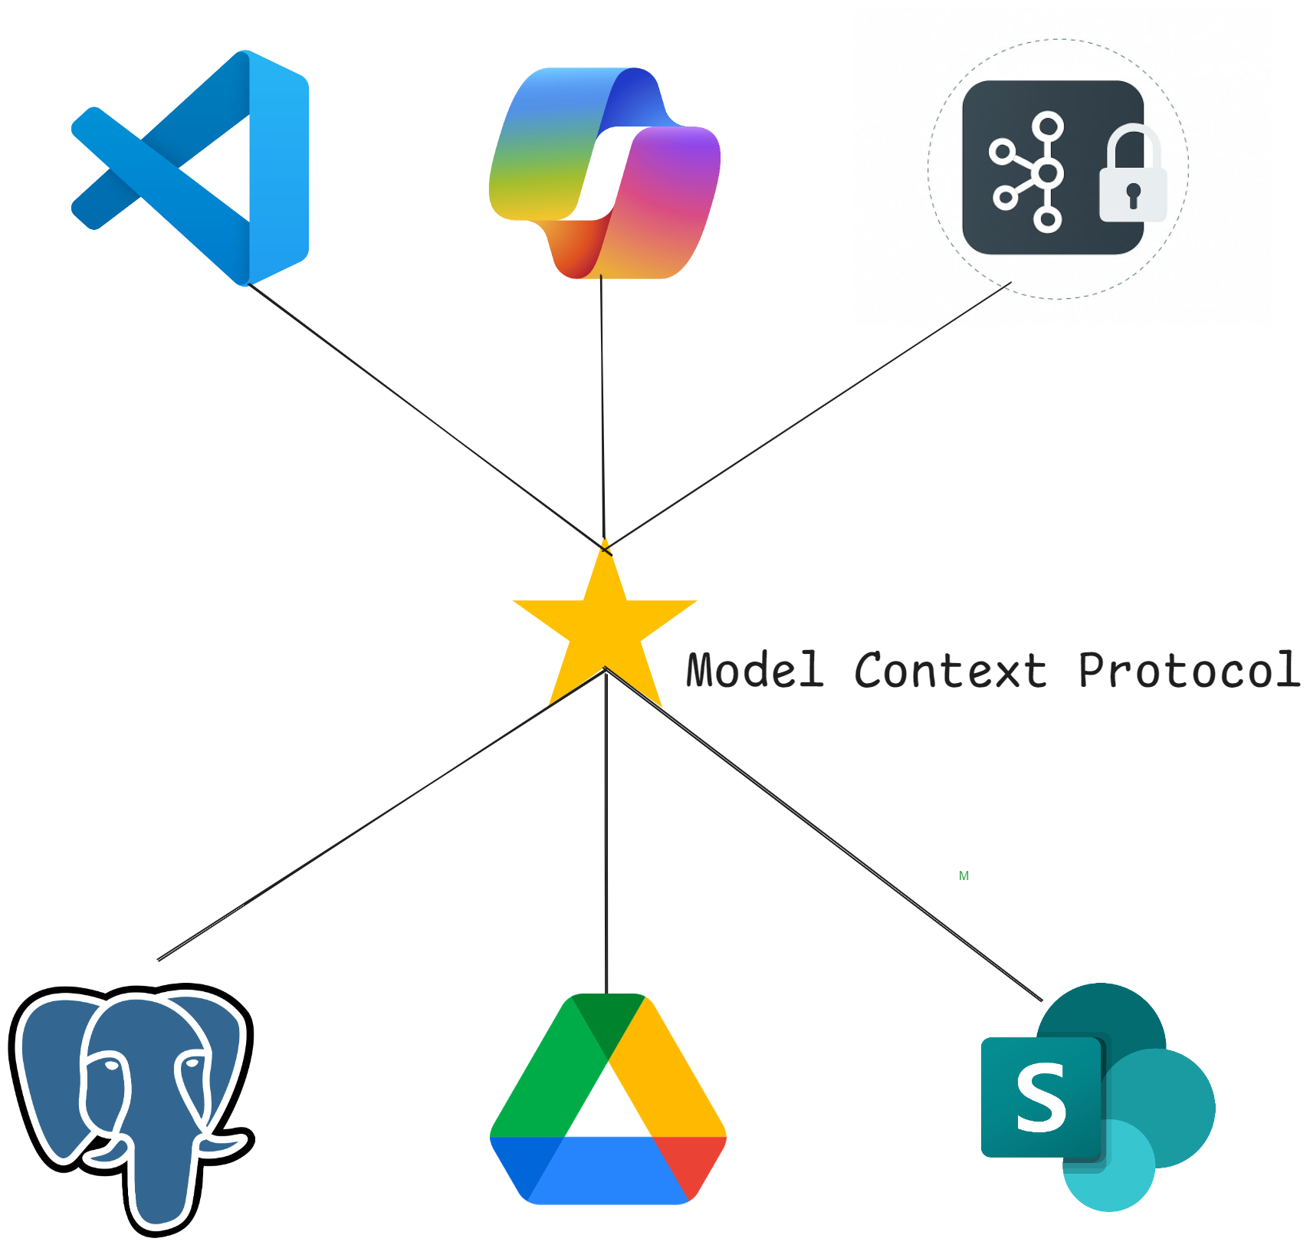




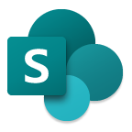
MCP simplifies tool access for LLMs
Model Context Protocol
LLM tools are core to an agents capability
Before MCP
integration chaos!!!
With MCP
simplified LLM tools
Notes:
Developers have been working to come up with solutions to integrate with different external tools and capabilities...
BUT every new integration required its own custom implementation which led to an explosion custom extensions and plug-ins. This increased maintenance, security, and performance risks, and was really difficult to scale.
For example, if you're developing an app and want to connect to different data sources or services you would need to install several extensions, open several web pages, or build a custom solution.
Or, if your company has a bunch of different data sources that are managed by different teams, they may all be implementing external data integrations differently which can be confusing and redundant.
Zava use their data analysis agent, but they also partner architects, and they want to be able to share data with the architects’ home design AI Agent. With MCP this is infinitely simpler for Zava to share data with their partners.
That's where MCP comes in...

Slide 7
Definition of MCP
Model Context Protocol
MCP is an open protocol that standardizes how applications provide discovery, actions, and context to LLMs
It’s like USB-C but for AI
Enables business agility
Notes:
Keep it simple
So, what differentiates AI conversations and Agents
There are many definitions of an Agent
This is the definition we’ve settled on.
Simple as data analysis
Complex as onboarding a new hire
Semi-autonomous software that can be given a goal and will work to achieve that goal without you knowing in advance exactly how it's going to do that or what steps it's going to take.

Slide 8
What are we building?
Notes:
Use case where we sent a prompt to get help with the sales process, for Contoso ecommerce.
Build an agent rather than just interacting with a pre-trained LLM.
For this app we’ve simple goals
There are many agent frameworks and APIs – LC, SK, AutoGen, Crew AI, LangGraph
Azure AI Agent Service and evolution of the Assistants API
Azure AI service which makes it easier to build agentic apps.
Stateful, manages context, designed to reduce the complexity of building agent app

Slide 9
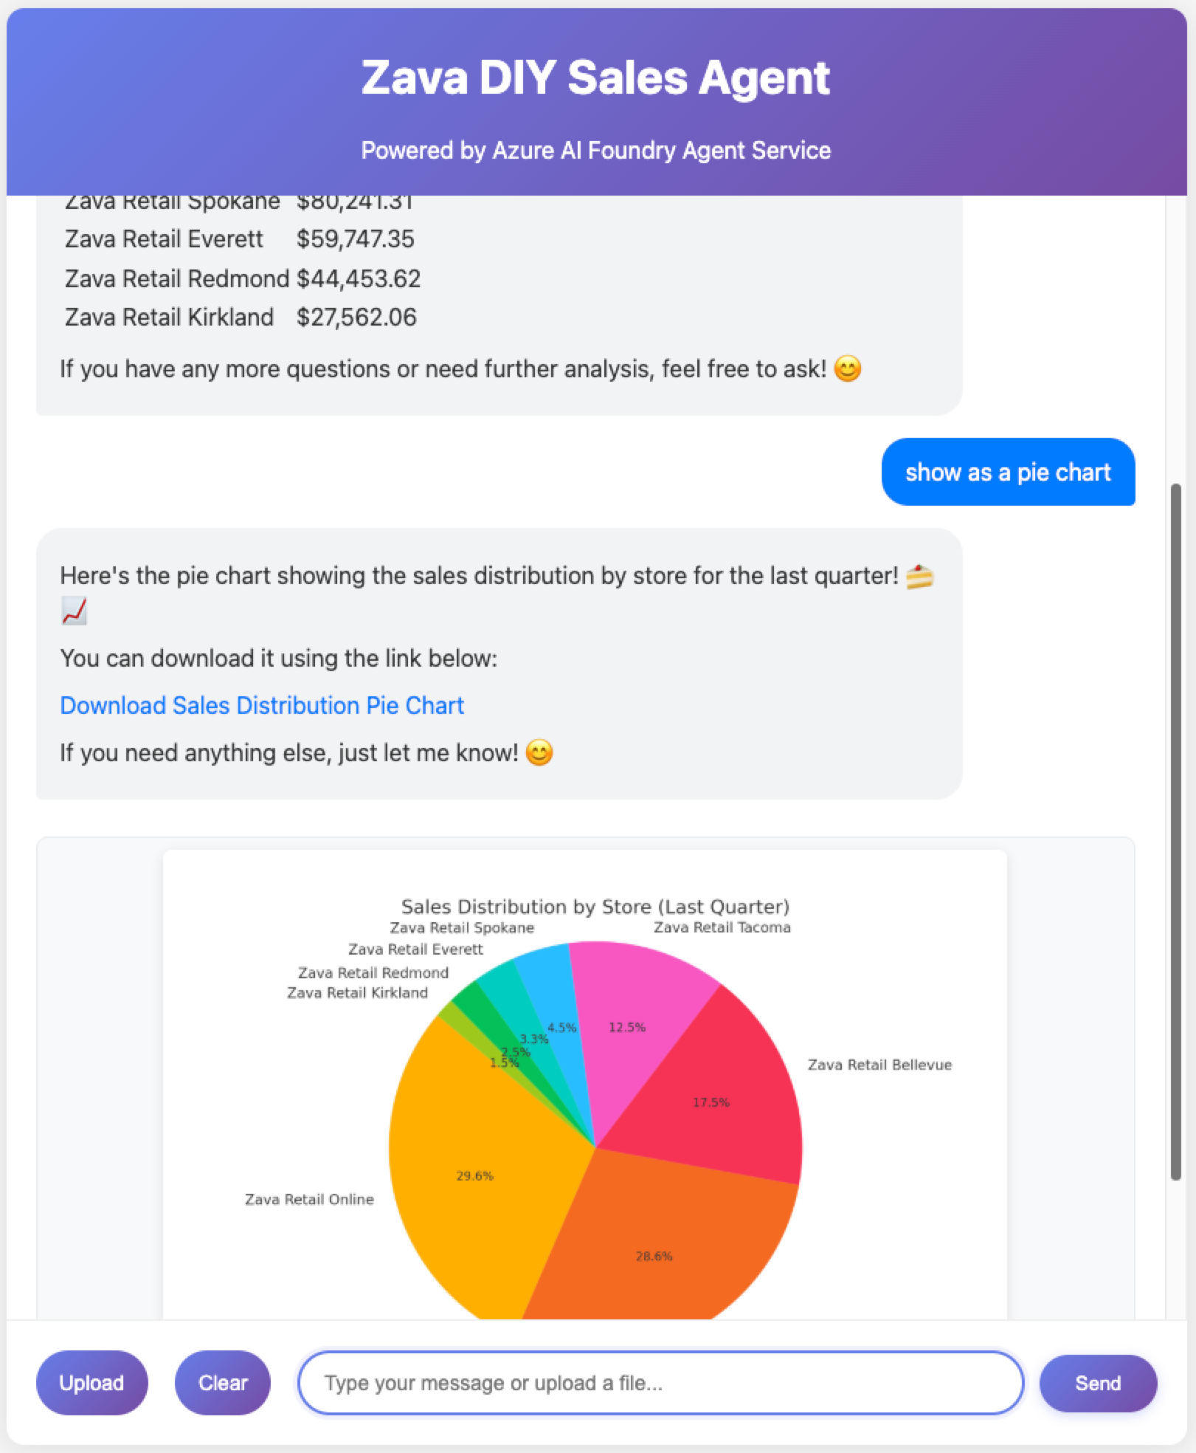
Zava Sales Agent
An agent built with Microsoft Foundry Agent Service, PostgresSQL and MCP
E2E Demo
Notes:
Zava Sales Agent
1. As you can see, there are some prompt starters in the center of the window. So, let’s start by selecting one of those and especially the ‘Help’ starter to understand how the agent can helps us.
2. Now, let’s try with a prompt specific for the financial use case. Create a vivid pie chart of sales by store.

Slide 10
Zava Sales Analysis Solution Architecture
Web Chat
Web App app.py
Developer Desktop with VS Code
Agent Manager
app.py
MCP Server
sales_analysis.py
Azure Cloud
Microsoft Foundry
Foundry AI Agent Service
OpenAI gpt-4o & text-embedding-3-small
Azure Database for PostgreSQL
Zava DB
pgvector extension

Slide 11
Zava Sales Analysis Solution Architecture
Web Chat
Web App app.py
Developer Desktop with VS Code
Agent Manager
app.py
MCP Server
sales_analysis.py
Azure Cloud
Microsoft Foundry
Foundry AI Agent Service
OpenAI gpt-4o & text-embedding-3-small
Azure Database for PostgreSQL
Zava DB
pgvector extension

Slide 12

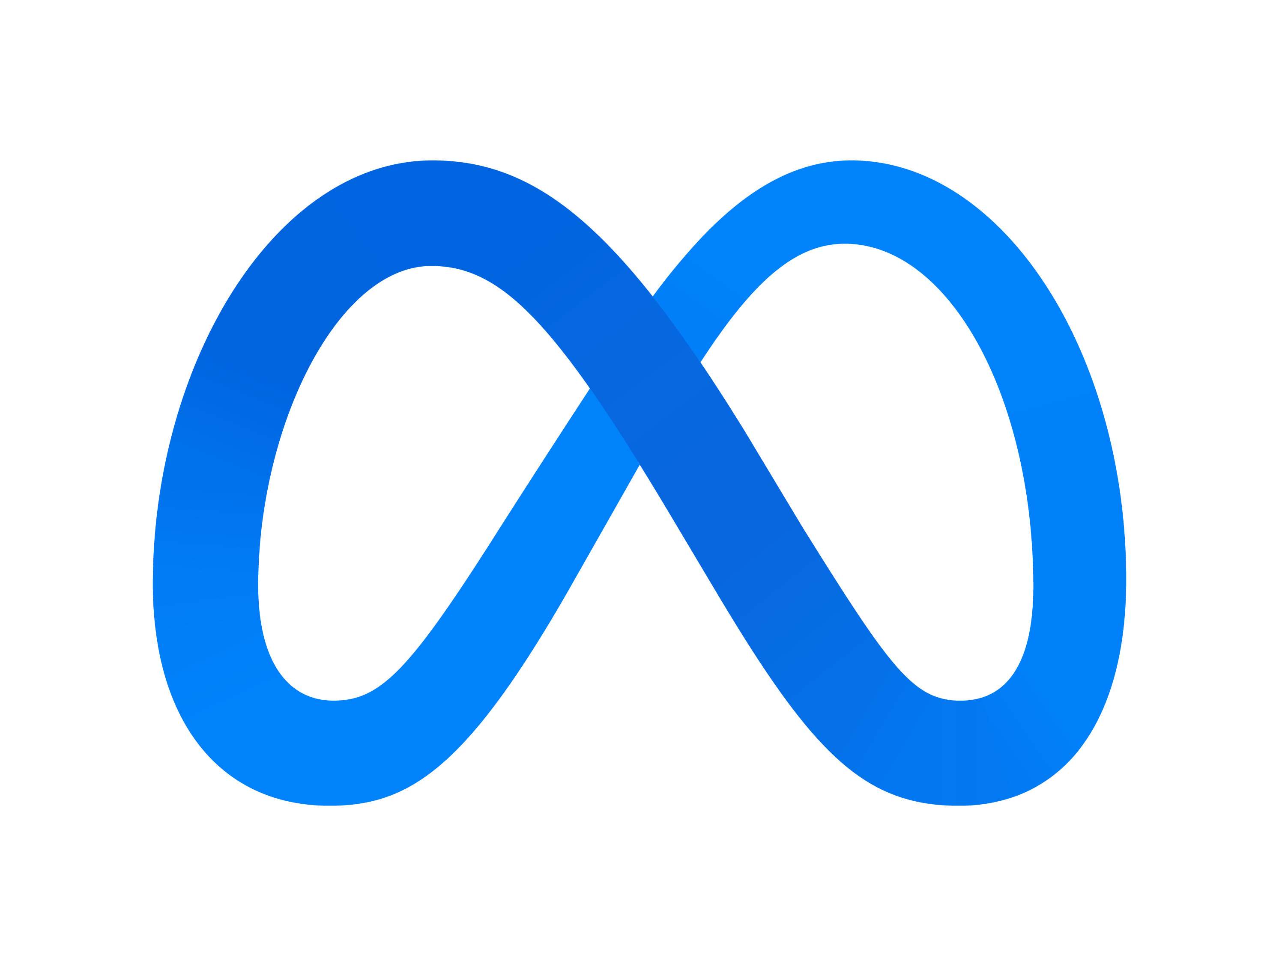
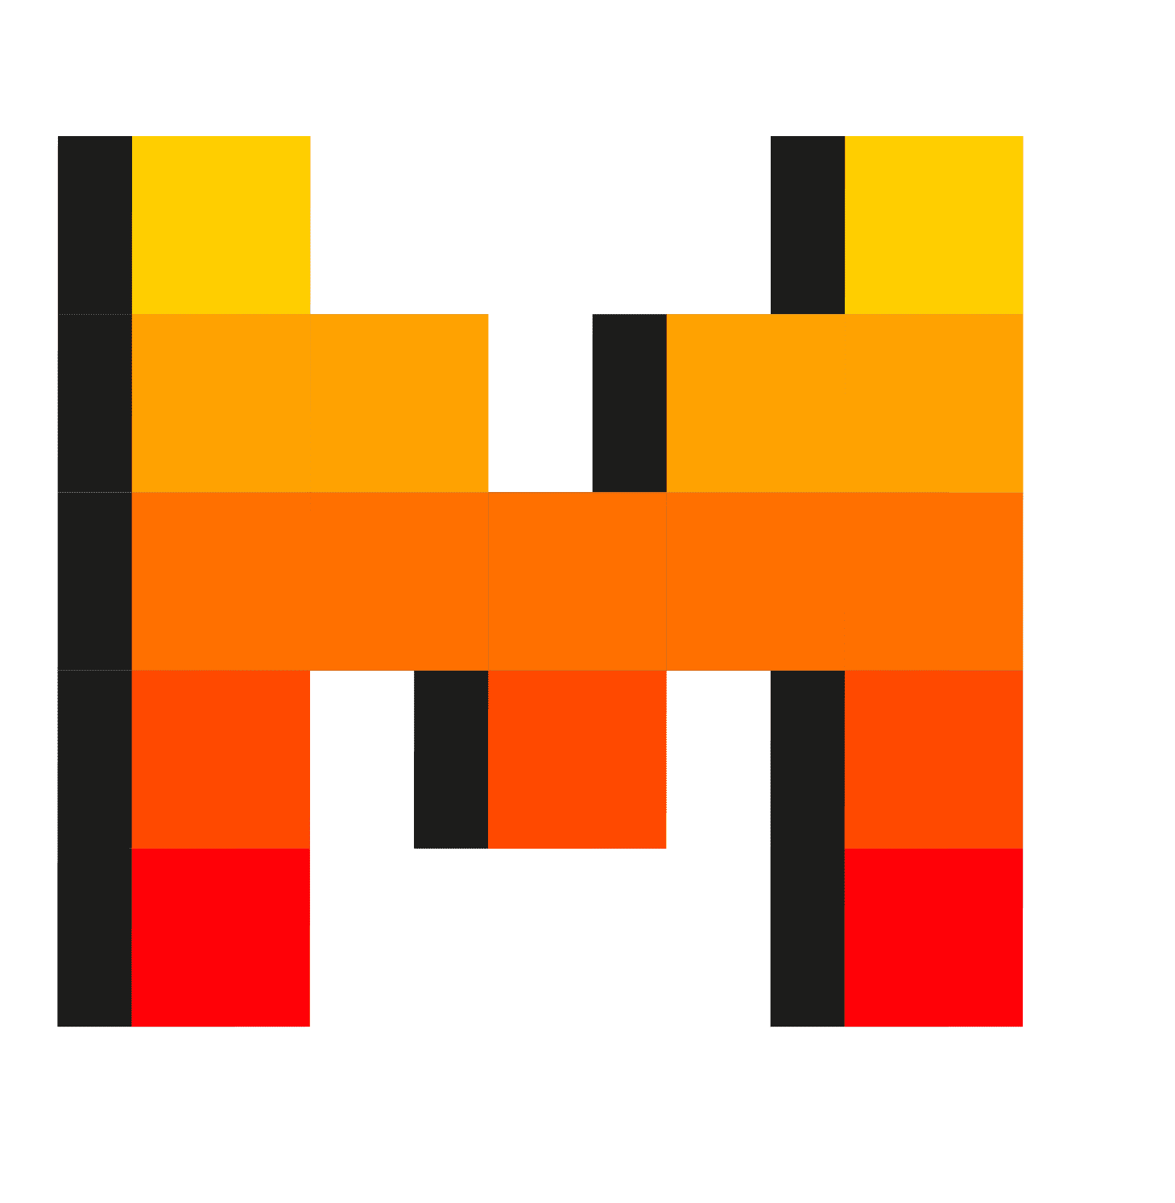



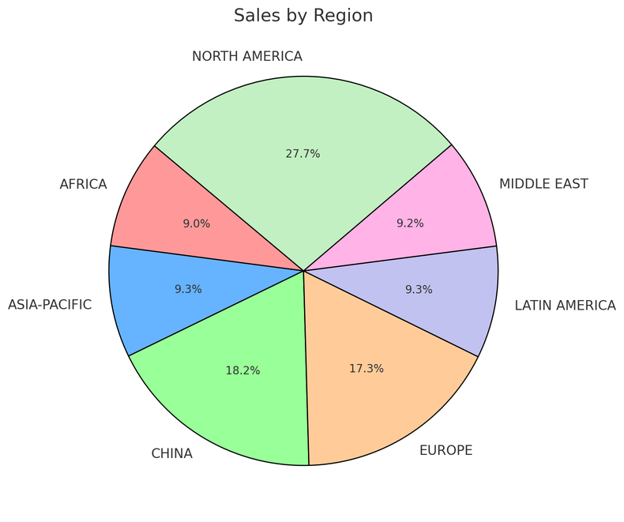
AI Agent Service in Action
Step 1:
Create an Agent
Step 2:
Create a Thread
Step 3:
Run the Agent
Step 5:
Check the Run status
Step 6:
Display the Agent’s Response
Agent
Sales Agent
Thread
Sales analysis
Instructions:
You are an advanced sales analysis agent for Zava, specializing in assisting users with sales data inquiries
Run 1
User’s message
Tell me the total sales by store
1
MCP Calling Tool
Query Postgres DB
Model
Agent’s message
Here is the sales:
Online: $15478.00
Seattle: $78792.00
2
Create message
Your data (optional)
Azure AI Search
Run 2
Files (local or Azure Blob)
User’s message
Show as a pie chart
1
Code Interpreter Tool
Create a pie chart
LLM Tools
MCP Servers
File Search
Code Interpreter
Function Calling
Bing Search
Microsoft SharePoint
Microsoft Fabric
Azure Logic Apps
Azure Functions
OpenAPI 3.0 specified tools
Agent’s message
2
Create message
Notes:
This slide has lots of animations
So, a bit more of a drill down
High level – this is how the AI Agent Service works
Create/define agent,
Create a thread which is a unit of conversation
Run the Agent
Check status till complete
Show output
Break this down futher

Slide 13
Observability
Microsoft Foundry:
Evaluators (e.g quality and safety)
Dashboards and Azure Monitor
Tracing
Observability ensures AI systems are reliable, safe and high-quality by enabling continuous monitoring and evaluation.

Slide 14
Workshop
Let's get started!
Notes:
Set the scene for the next 45 minutes
We’ll exploring the AI Agents.
Core concepts and talk about "what is an agent"
what sets them apart from just using LLMs for chat completion
Quick look at more complex architectures, including multiple agents working together.
Plenty of demos

Slide 15
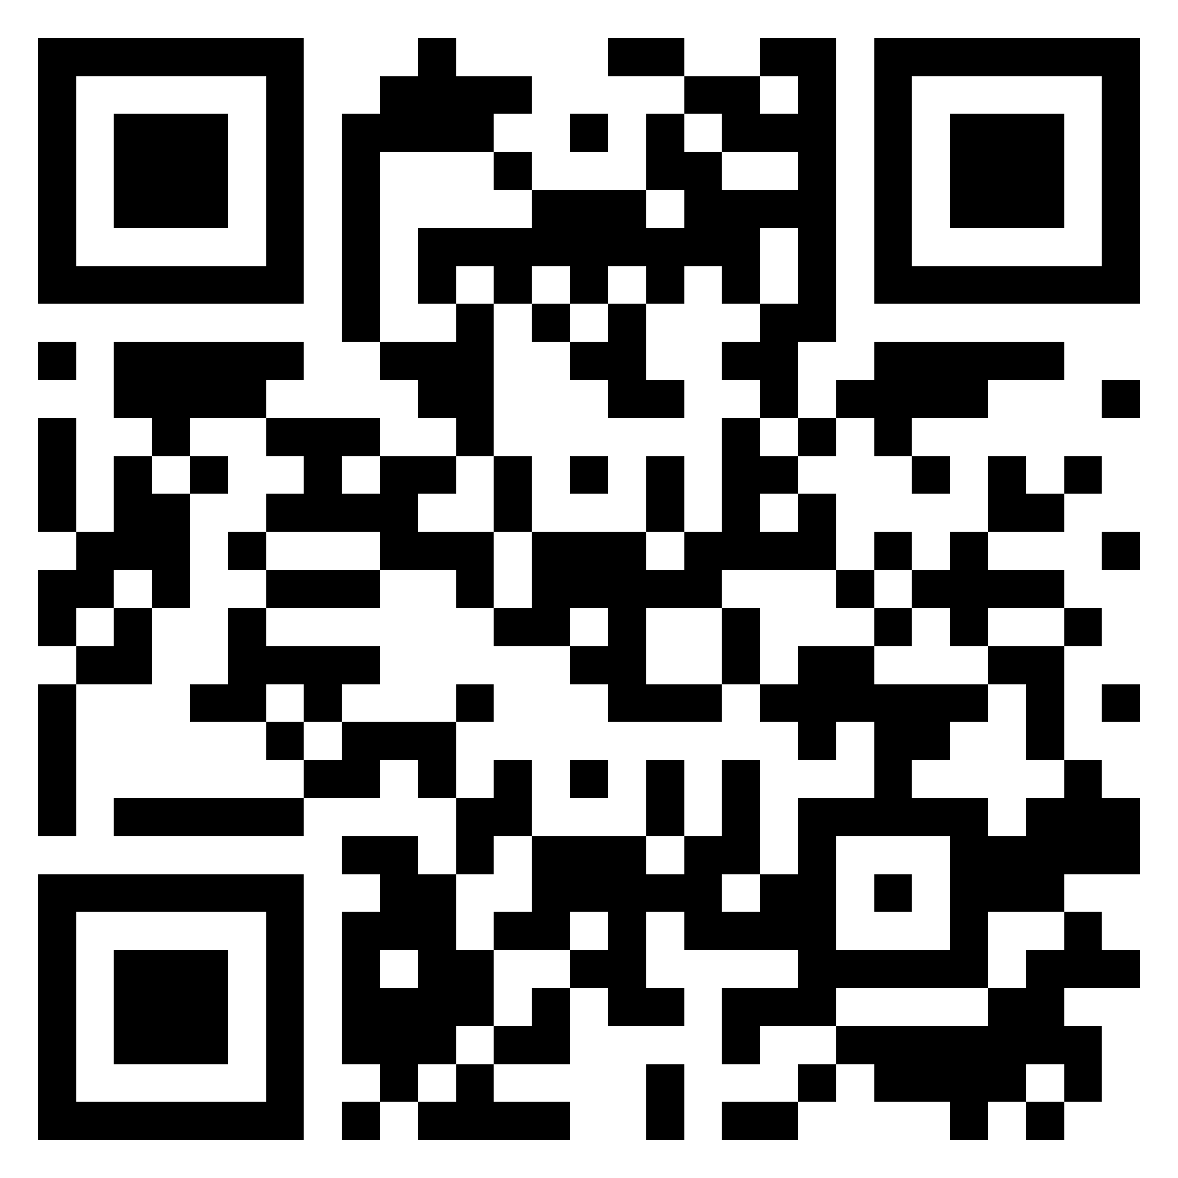
Link for today’s workshop
https://aka.ms/mcaps/wrk540
…or scan the QR code.
Scan QR code to download

Slide 16
Self Paced Lab Time
This is not an active call. Lab proctors are available on this call, please ask questions in the chat.
Lab Walk Throughs aka.ms/AgenticHackCamp/Recordings

