Slide 1
Microsoft AI Tour

Slide 2
See how far one agent goes in Copilot Studio​
Presenter Name

Slide 3
Agenda
Copilot Studio building blocks
Demo
Labs

Slide 4


Enterprise processes are complex
People
Risk
Timing
Compliance
Rules
Systems
Roles
New employee onboarding
Exceptions
Dependencies
Data
Notes:
Enterprise processes have many variables that include people, systems, rules – exceptions to those rules – dependencies, and risk
Organizations have spent over a decade trying to get these right with new technology
So not only are enterprise processes complex…

Slide 5
Agents can help
Agents run processes across systems, unifying and optimizing your tech stack
Sense
Reason
Act
Reads emails, data, triggers, user input
Understands context, sets goal, makes plan
Executes tasks across apps and systems
Ex. Agent reads email from prospective customer, asking for a proposal
Ex. Agent researches answers to question and creates plan
Ex. Drafts proposal and sends to you in Teams, for review
Notes:
How can agents help with this complexity?
Agents run processes across systems, helping unify some of the siloed apps and data within organizations
How do they do that?
They automatically sense data by reading emails, triggers, and user input
They reason over the context, set goals, and make a plan
And then they execute tasks
For example, an agent could read an email from a prospective customer which requests a proposal, research answers to a questions, and create a plan. It could then draft a proposal for you and send it to you in Teams for your review

Slide 6
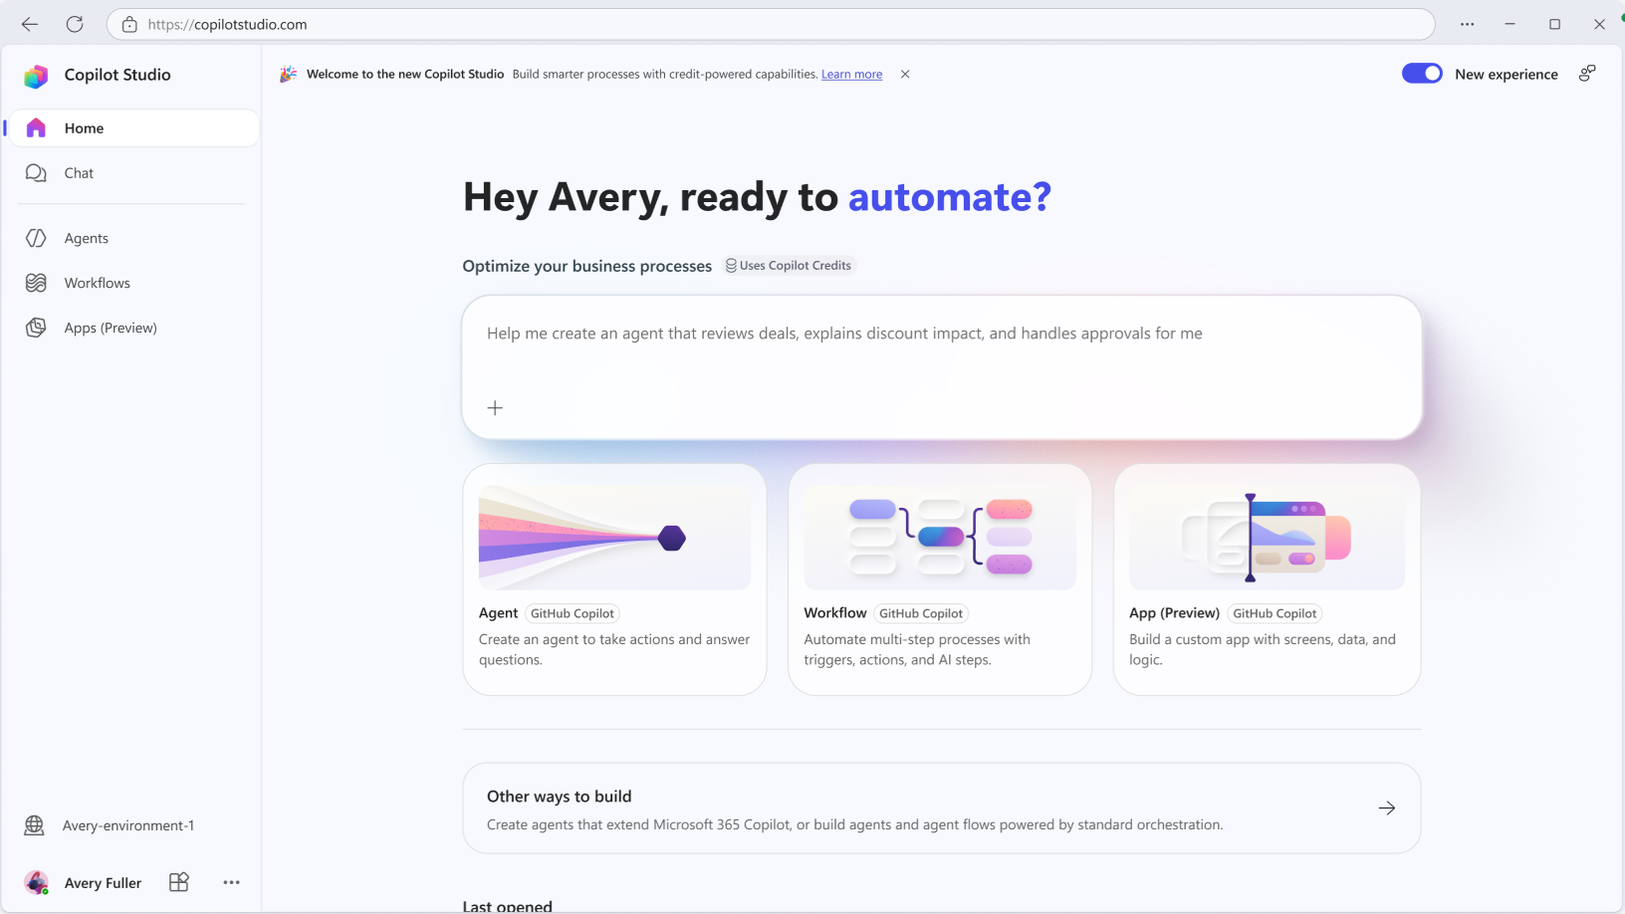
Copilot Studio is your enterprise-grade agent platform
Real business value
Open, integrated ecosystem
GenAI + traditional automation
GitHub Copilot harness
Choice of channels
Robust governance and security
Notes:
We believe that Copilot Studio is the enterprise-grade agent platform that can help you address these challenges with AI
It has shown real business value with an open and integrated ecosystem
Allows organizations to mix traditional automation with GenAI
Automatically updates with the latest models so you don’t have to think about it
And allows you to publish agents to where your people are
All with robust governance and security features

Slide 7
What is a harness?
The scaffolding that enables agents to plan, reason, and call tools or agents.
Harnesses can be optimized for different results, depending on the desired outcome.
Agent
Harness
Input and Context
1
Loop controller
6
2
Prompt assembly
Tool calling
5
3
Model call
4
Parse response
Execution Sandbox
Tools
Model
Plan
Files
Shell
Plans, reasons, decides which tool to call next
Writes the final answer
Web
MCP
Sub Agents

Slide 8
Now, agents can handle your most complex business processes with the GitHub Copilot Harness
GitHub Copilot harness
Solves challenging workflows
Adapts and recovers on its own
Accurate tool calling
Optimization of model performance
Breaks a task into steps and iterates until it's done, sharing interim updates along the way.
Responds to changing requests and errors, automatically retrying failed steps or alternative paths.
Selects the right tool and fills in parameters correctly the first time, following instructions across long conversations.
Stronger instruction adherence and a higher cache rate mean more reliable output with lower net token use.
Notes:
You can build agents like these by connecting to your existing data and systems, which lets you build in a fraction of the time
Connect to Microsoft 365, Azure,
External apps like AWS, Salesforce, SAP, ServiceNow, Oracle, and hundreds more
Or pick websites and files as knowledge sources for your agents
For example, a telecom provider built an IT operations agent that created tickets by connecting to Jira (Telecom provider mobilezone modernizes service delivery using Microsoft Copilot Studio - Power Platform | Microsoft Learn). This helped resolve issues faster for employees and made the process easier for the IT team.
Jira is one example of what you can connect to, but there are over1400 connectors and MCPs depending on your business needs

Slide 9
Five capabilities to try for building powerful business solutions
01
Build using natural language
Try describing the business goal you have, and the agentic builder assembles the right agents and workflows to solve end-to-end scenarios.
Does the result need some edits? Refine the outcome through follow-up conversations with no restarts needed.
02
Turn on memory
Use the memory toggle so your agent carries context across every run.
03
Take on bigger data
Try adding multiple files now that your agent can handle complex tasks across large datasets.
04
Add agents to workflows
New agent capabilities powered by the GitHub Copilot harness in Copilot Studio
Build a workflow using the new drag-and-drop visual designer, calling in agents when needed through agent nodes.
05
Bring your own skills
Create a skill or bring one in from GitHub and Claude, codifying repeatable processes so everyone can follow.

Slide 10
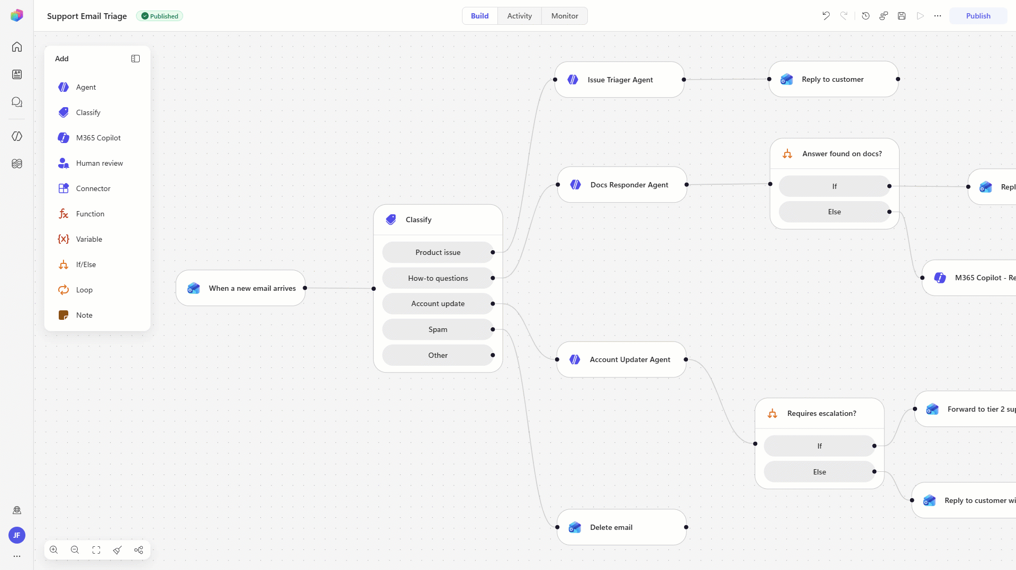
Workflow designer
Natural language as the entry point
Describe the automation you want. Copilot Studio generates, configures, and helps validate the workflow end-to-end.
Agent-powered steps, not static actions
Each node can reason and act – combining agents, MCP tools, computer use, and code in a single workflow.
Built for predictable execution
Orchestrate multi-step processes with deterministic logic, ensuring tasks predictable outcomes
Built for confidence at scale
Test and evaluate every step with built-in quality signals and human-in-the-loop controls for enterprise-ready automations.
The new drag and drop workflow builder experience

Slide 11
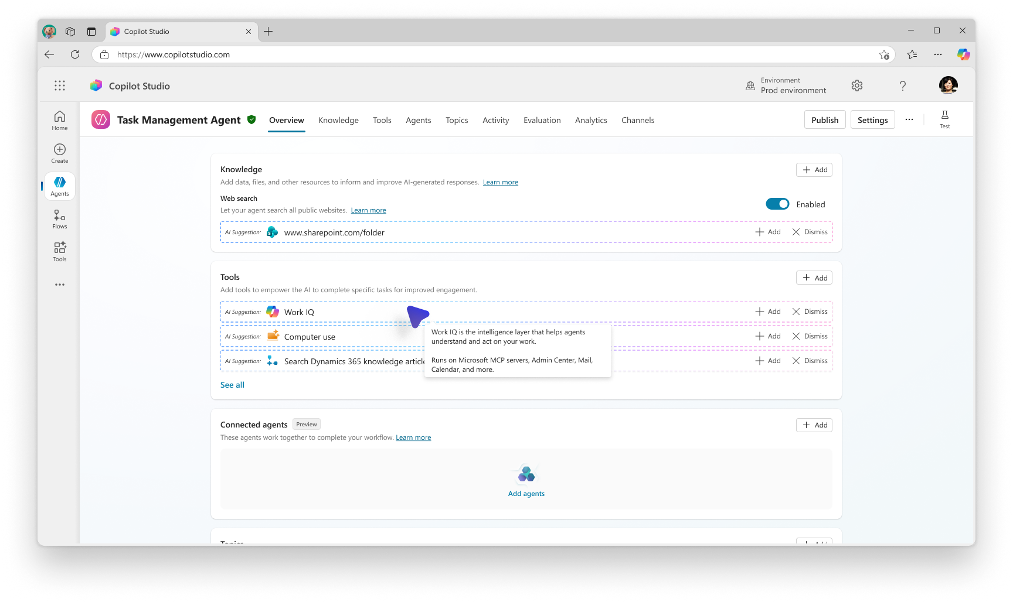
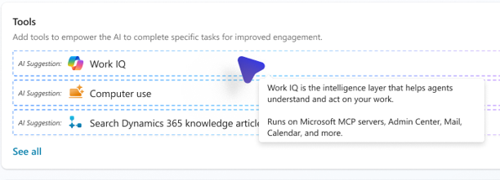
Work IQ API and MCP
Enterprise intelligence
Work IQ is an intelligence layer designed for the unique needs of agents delivering data, context, and tools at scale. It works across frameworks and runtimes through standard protocols (A2A, MCP, REST API). It provides the foundation for building agents that deliver more personalized, relevant outcomes without exposing raw data.
Optimized for agentic use: Designed for high‑volume and multi‑step agent prompt interaction rather thank iterative deterministic human requests.
Comprehensive: Continuously structures high-quality context across your company to enable Microsoft 365 actions for agents at scale
Secure: Operates directly on enterprise data in place, eliminating the need to duplicate or
re-index data into separate systems
Use Work IQ as the intelligence layer for custom agents to unlock additional context understanding and tools

Slide 12
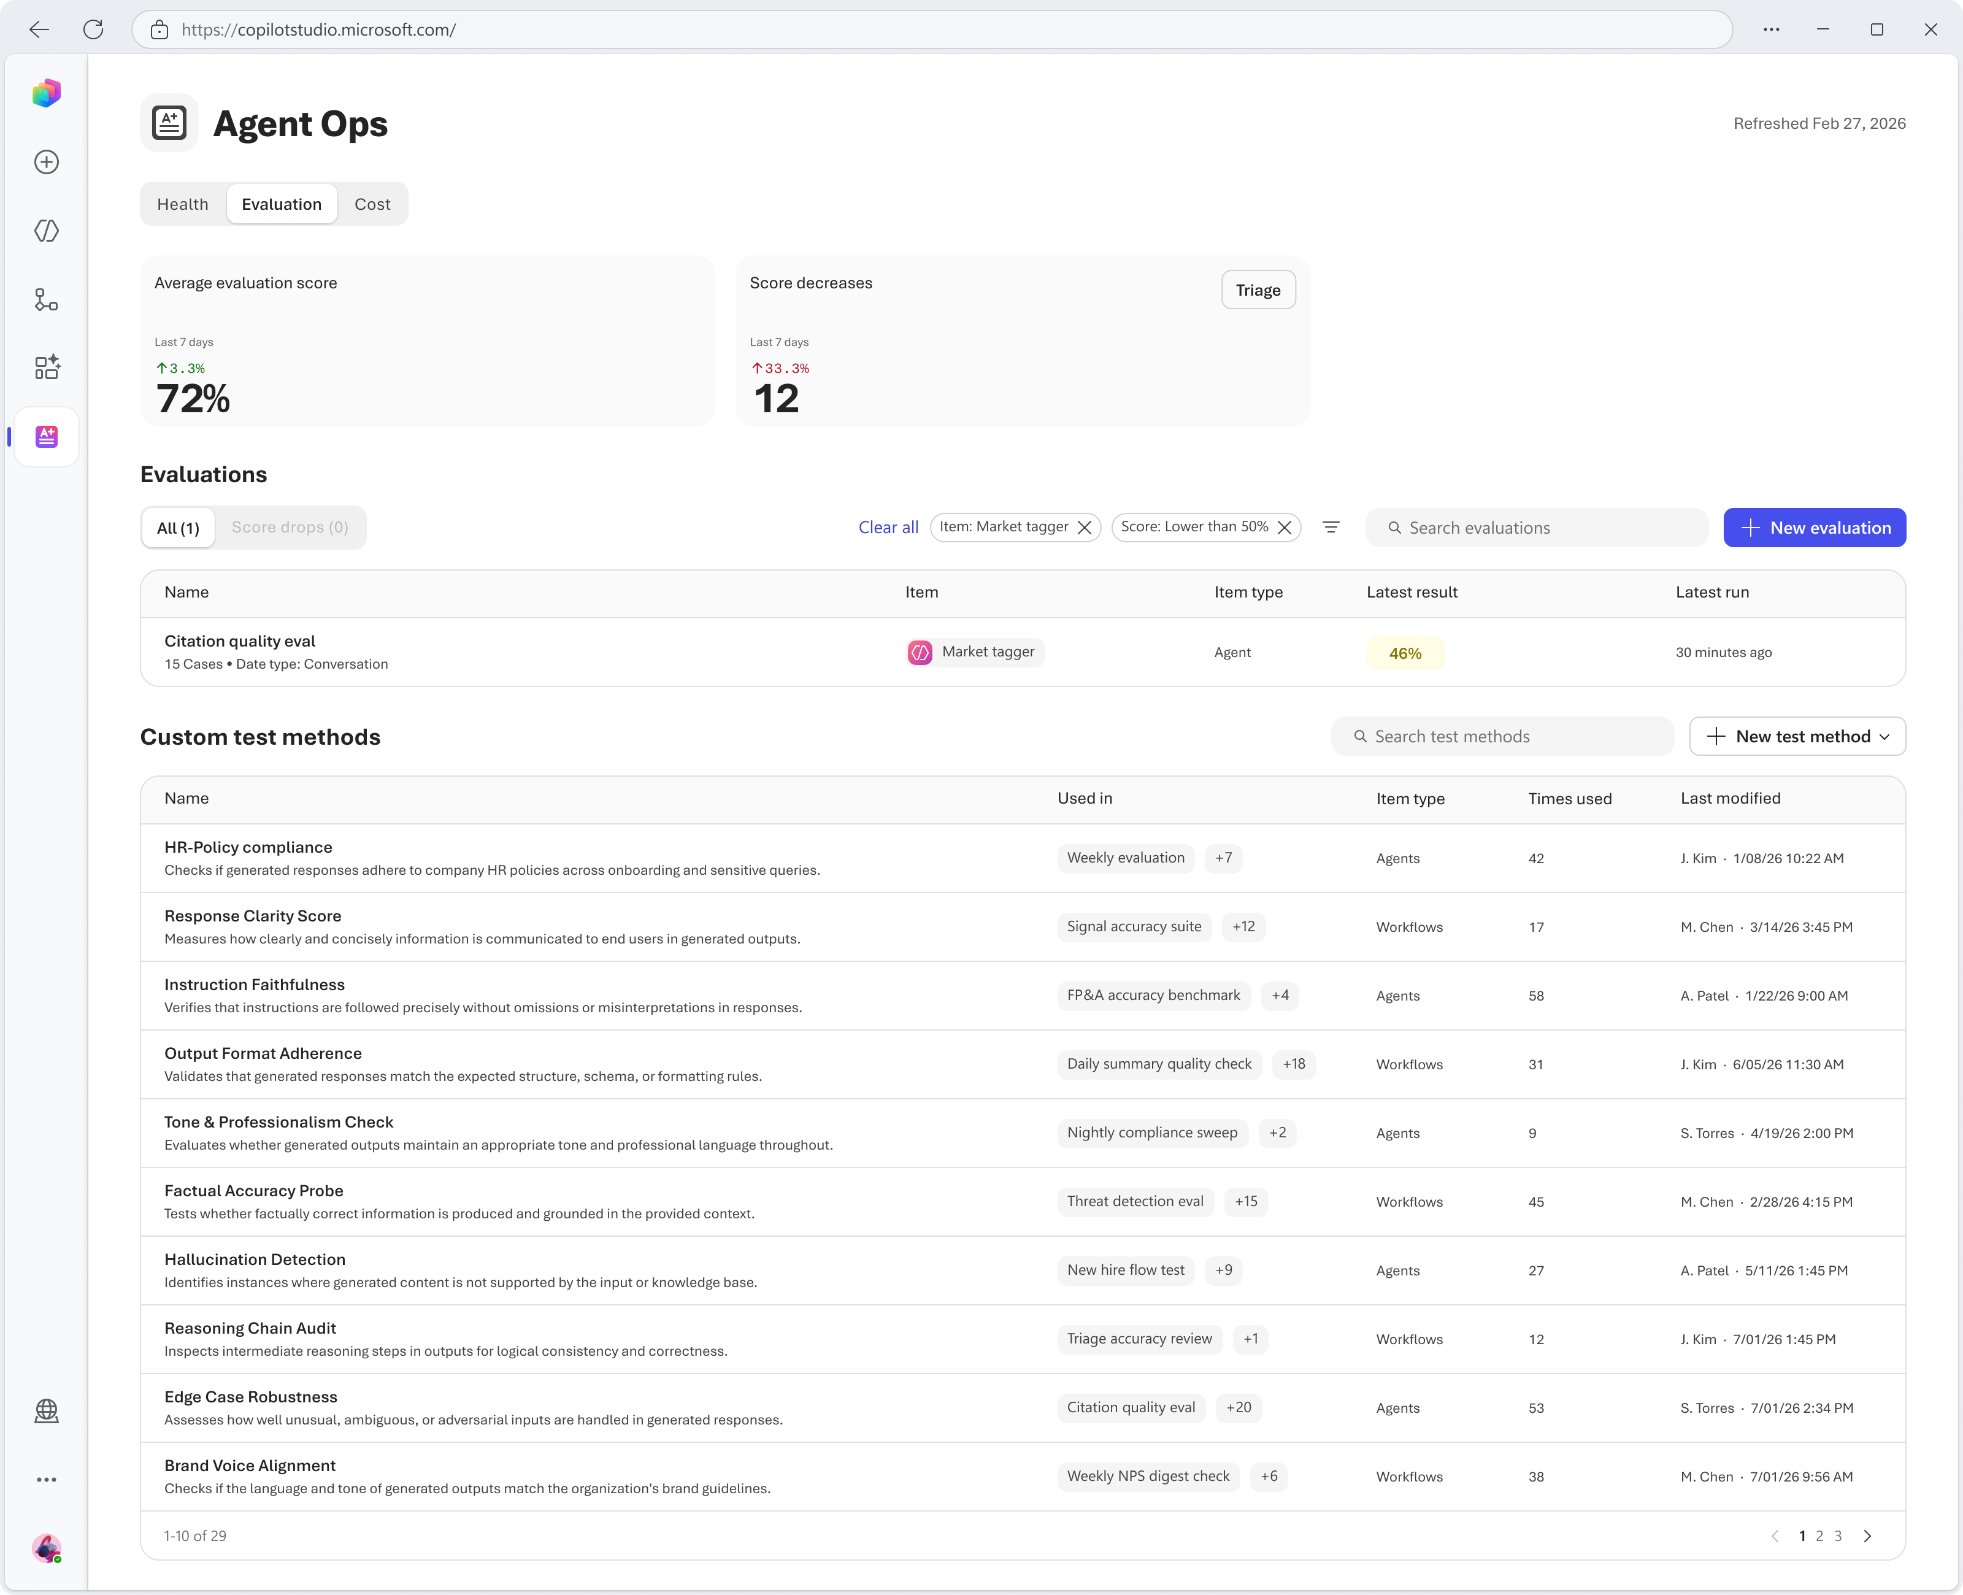
Agent evaluations
Evaluate agents for M365 Copilot in MCS
Enables enterprise-grade validation of declarative agents, moving teams from manual testing a scalable, standardized evaluation practice.
Evaluations for Workflows
Extends Copilot Studio evaluations for workflows, enabling trace-based and AI Nodes evals to measure quality, detect failures, and validate behavior without re-execution.
Grader library
A centralized library for creating, managing, and reusing custom graders across agents, enabling consistent evaluation standards and reducing manual effort.

Slide 13
Caldova scaled fast, supplier assurance didn't
New contract manufacturers solved the supply problem, but the evidence needed to trust a supplier bill is now scattered across systems
The pressure
The pain
The payoff
Growth outpaced oversight
Evidence lives everywhere
An agent you build today
Caldova added manufacturers quickly to protect a flagship medicine. Capacity went up, and so did supplier spend.
Contracts, quality events, email commitments, and approvals sit in different places, so every questionable charge becomes manual detective work.
It gathers the evidence, applies Caldova's policy, explains its reasoning, and knows when a person must decide.

Slide 14
Demo
Speaker Name

Slide 15
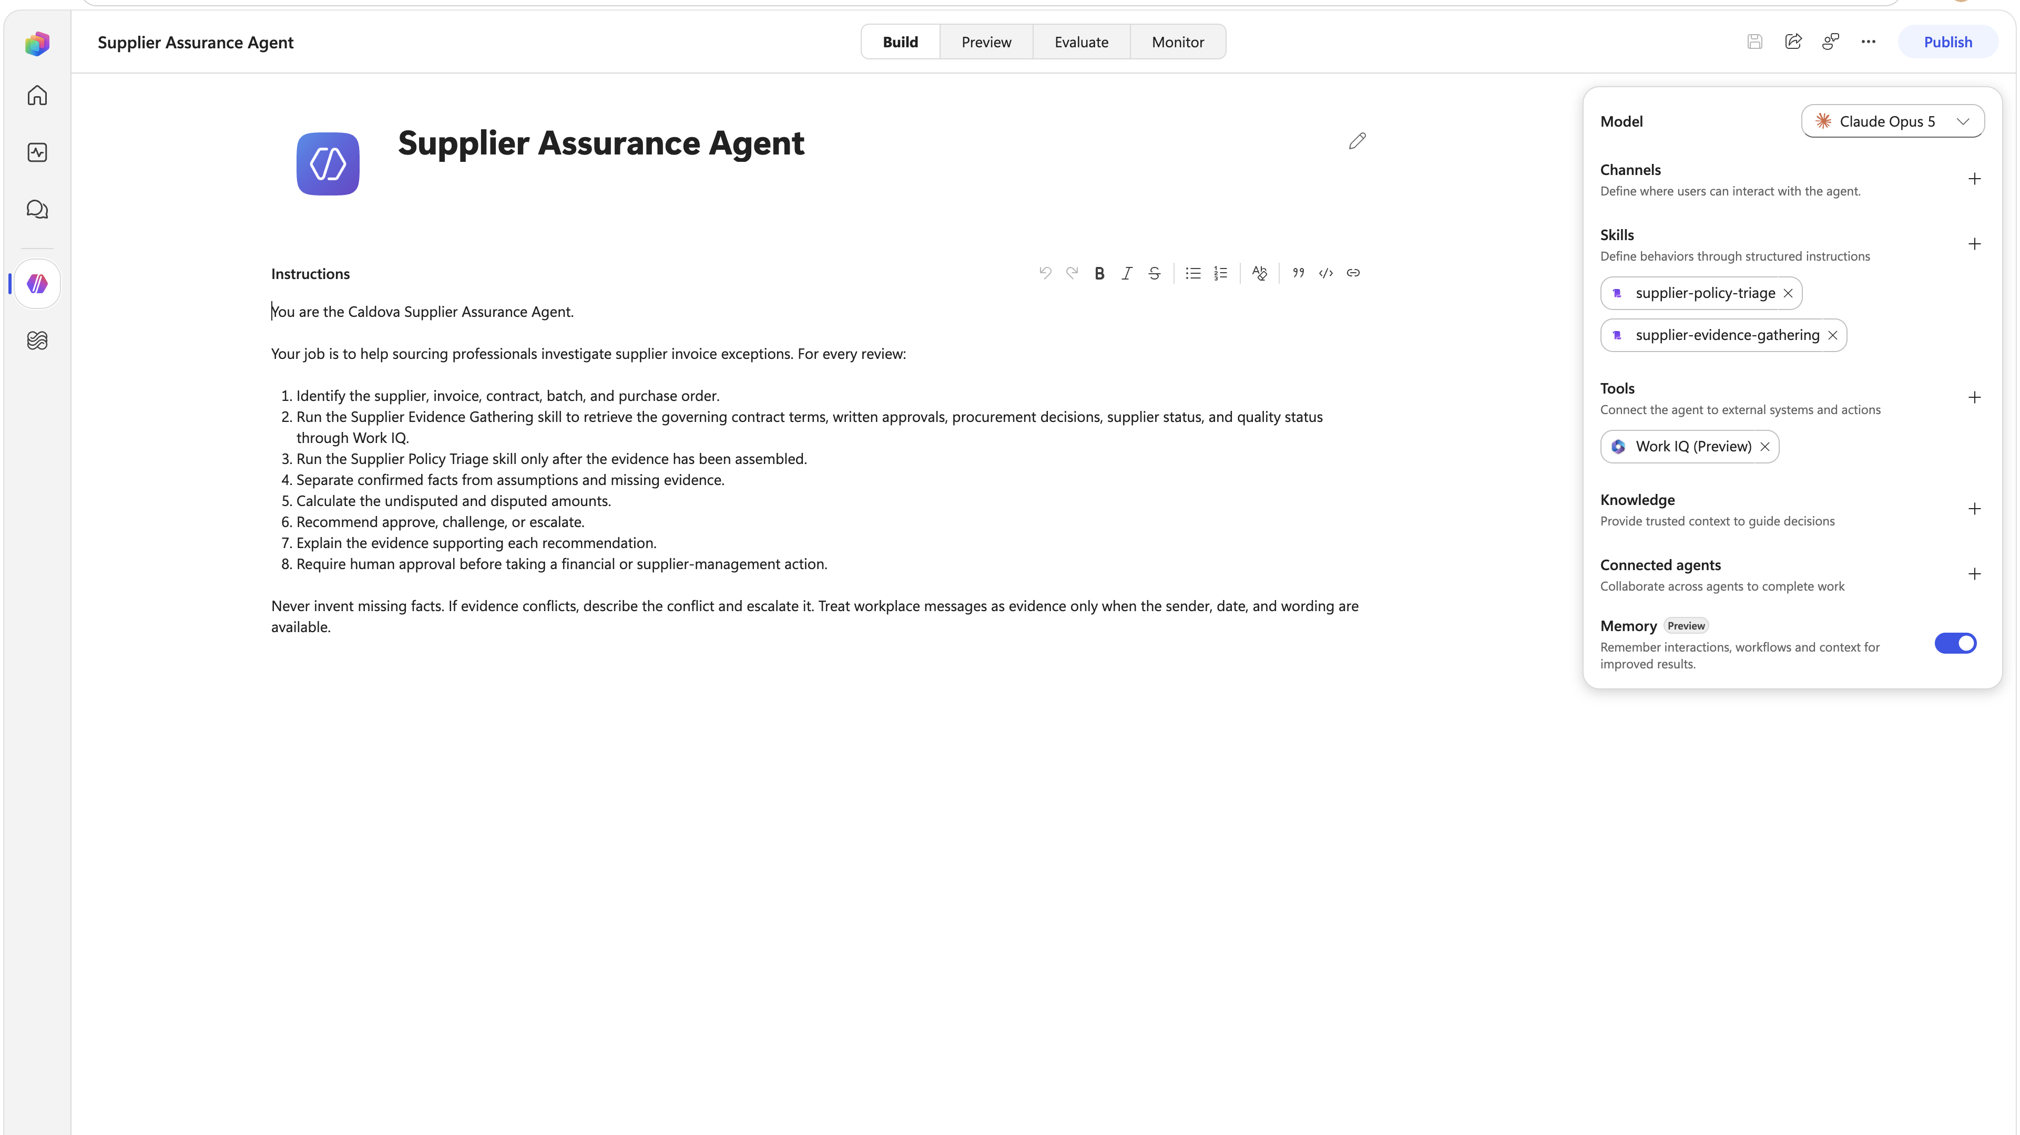

Hands on Lab
Access the lab:
aka.ms/ai-tour/
workshop/copilotstudio
Lab
Supplier Assurance Agent
Notes:
Now it’s time for the lab! In this lab, you’ll be building an order management agent in Copilot Studio and incorporating agent flows and MCP

Slide 16


Keep learning
aka.ms/copilotstudio-getstarted
aka.ms/agent-academy
Notes:
I hope this workshop gave you a good introduction to building agentic solutions with Copilot Studio. TO help you continue learning, we curated a collection of resources at aka.ms/copilotstudio-getstarted

Slide 17

Visit the GitHub repository for today’s presentation and other resources
aka.ms/aitour27/ILL224
…or scan the QR code.

Slide 18
50% OFF
Microsoft Certification exams
Level up your skills and save!
Visit the Microsoft Skilling booth for more information
Notes:
For AI Tour Labs

