Slide 1
Intro to Aspire
Speaker Name
Role, Company
@social

Slide 2

Modern apps are like being in a
Big city without a map
Editor/IDE
Frontends
Services
Agents + AI
Env
> Operating systems
> Shells + terminals
> Coding agents
> Extensions
> Endless languages + frameworks
> Databases + storage
> Auth
> Caches + queues
> Messaging
> Models, deployments, frameworks
> Secrets/tokens/keys
> Provisioning parameters
> Non-source-controllable assets
> Changing ports and dependencies
Backends
Observability
> Microservices, monoliths, containers, VMs
> Different data pipelines for different parts of the app
Manifests + Scripts
Deployment handoff
> Manifest languages (YAML, JSON, Dockerfiles)
> Hard-to-read scripts (Bash, pwsh)
> README.md, internal wikis, "tribal knowledge"
> Manual deployments
> Automated CI/CD
> Enterprise devops workflow

Slide 3
Complex dev,
complex deploy
Dev Loop
Deployments
> Impossible to "clone and run“
> No easy way to add new services
> Local dev does not reflect actual running system
> Coding agents can’t see the entire system
> Fragile, always-changing assets
> Complicated handoffs for architecture changes
> "Only in prod" observability
> Configuration drift becomes challenging

Slide 4
Aspire is an agent-ready, code-first tool to compose, debug, and deploy any distributed app.

Slide 5
What is Aspire?
Aspire is an agent-ready, code-first tool to compose, debug, and deploy any distributed app.
5
Frontend
4
Web API
Code-first development and deployment experience maps your entire distributed app.
Agents have knowledge about every detail of your system.
Over one hundred integration packages designed to simplify connections to popular services, platforms and stacks.
Visualize all your logs, endpoints, and resources in a single dashboard.
3
Cache
2
Database
1
Cloud service
Notes:
Aspire helps you cut through the chaos of complex distributed systems by providing a code-first experience for local development, debugging, and seamless deployment. With no rewrites, Aspireify any existing system.
Aspire fuels your coding agents with knowledge about every detail of your system, from writing code, to debugging issues through detailed Open Telemetry traces and logs so you can build and debug faster.
Hundreds of integration packages are designed to simplify connections to popular services, platforms and stacks. Each one handles compute resource setup and provides standardized patterns for health checks, telemetry, and configuration.
Visualize your entire stack in a Dashboard -- your command center. Powered by OpenTelemetry it automatically collects traces, metrics, and structured logs from every resource in your AppHost and surfaces them through a rich, interactive UI.

Slide 6
What is Aspire?
The important parts
Aspire CLI
The CLI provides an interactive, agent-ready control plane so you can create, run and deploy distributed apps seamlessly.
> aspire init
Your agent-ready control plane
Aspire AppHost
Aspire Integrations
Aspire Dashboard
Define your stack in code
Plug in anything, ship faster
Your app, at a glance
The AppHost is the map for your distributed app. It is the code-first place where you declare your application’s services and their relationships.
Aspire integrations are a curated suite of over one hundred packages that make it easy to connect your cloud-native applications with popular services.
The Aspire dashboard is powered by OpenTelemetry and collects traces, metrics, and structured logs and surfaces them through a rich, interactive UI and an MCP server for agents.
Notes:
The CLI provides an interactive, agent-ready control plane so you can create, run and deploy distributed apps seamlessly. Use the Aspire CLI to streamline development workflows and coordinate distributed services.
Thie AppHost is the map for your distributed app. It is the code-first place where you declare your application’s services and their relationships. Describe the architecture in code and Aspire handles local orchestration so you can focus on building features.
Aspire integrations are a curated suite of over one hundred packages that make it easy to connect your cloud-native applications with popular services and provide essential cloud-native capabilities through automatic setup and standardized configuration.
The Aspire Dashboard is your command center. Powered by OpenTelemetry it automatically collects traces, metrics, and structured logs from every resource in your AppHost and surfaces them through a rich, interactive UI and an MCP server for agents.

Slide 7
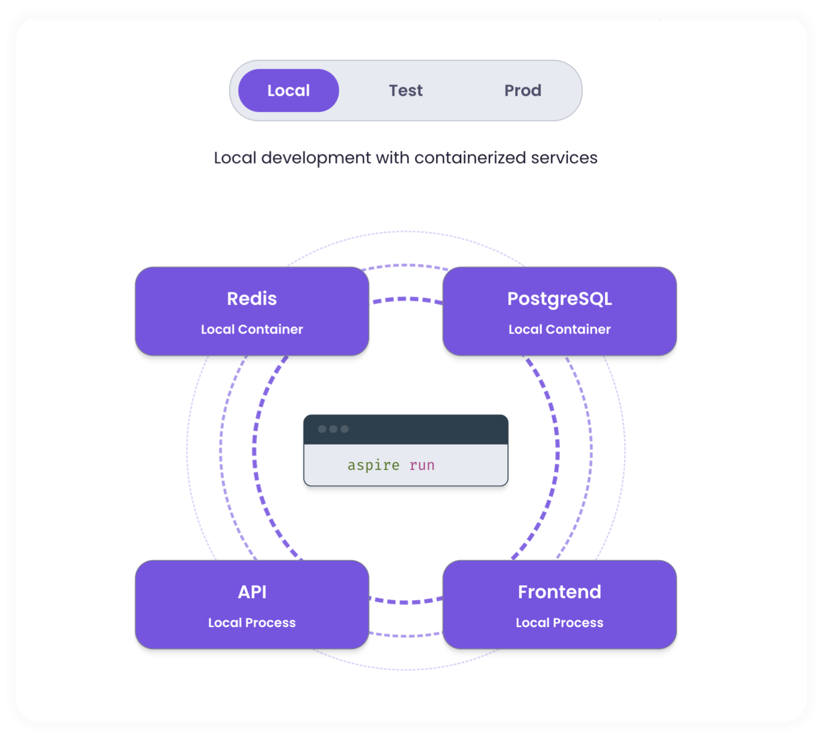
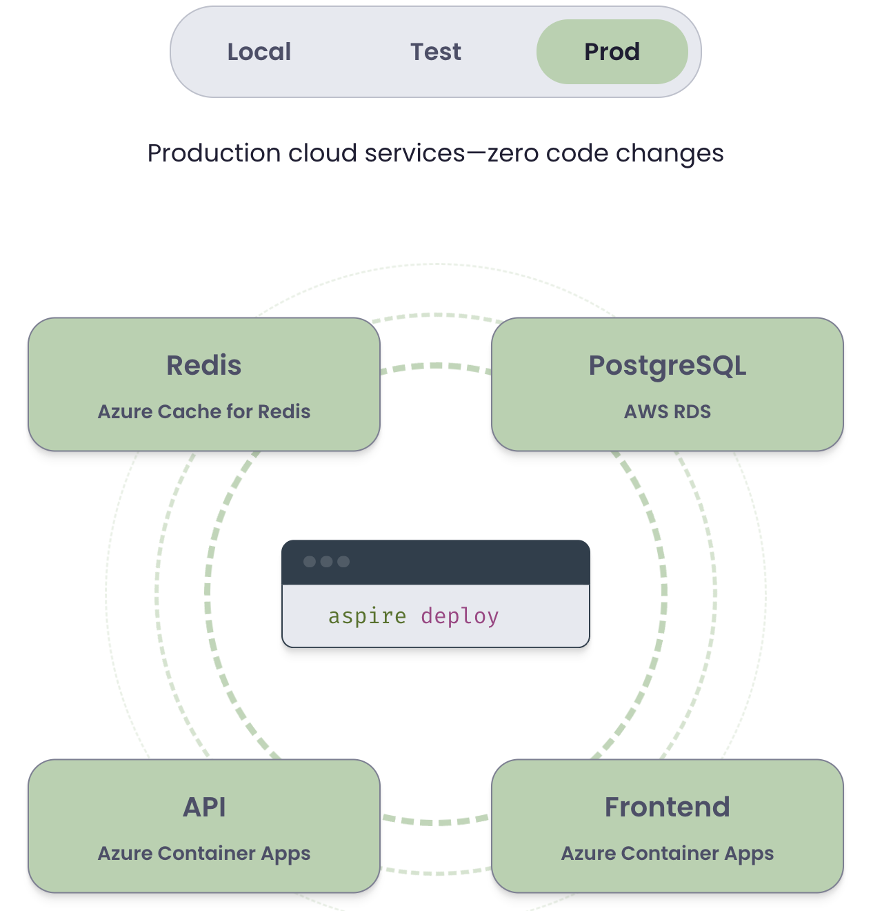
App Host + CLI
Dev first, ops friendly
Clone and run any repo, add new services in one command, and deploy – or hand off to your deployment pipeline – without code changes, from one CLI.
Notes:
NOTE: The diagram animates from “aspire run” to “aspire deploy” on click

Slide 8
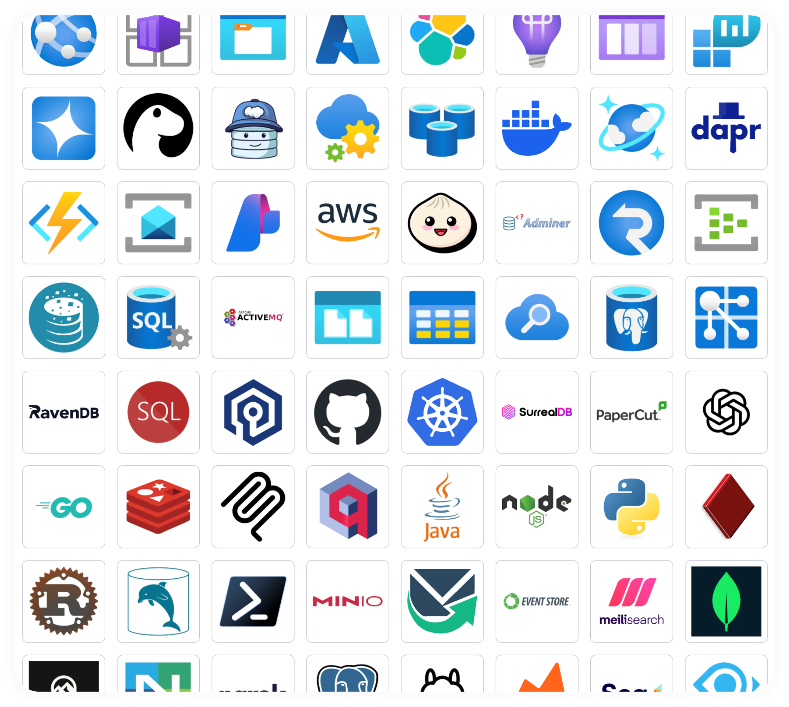
Integrations
Building blocks, not black boxes
Choose from hundreds of prebuilt packages or bring your own. Bootstrap and run any type of container, CLI, or AI agent with a few lines of code.

Slide 9
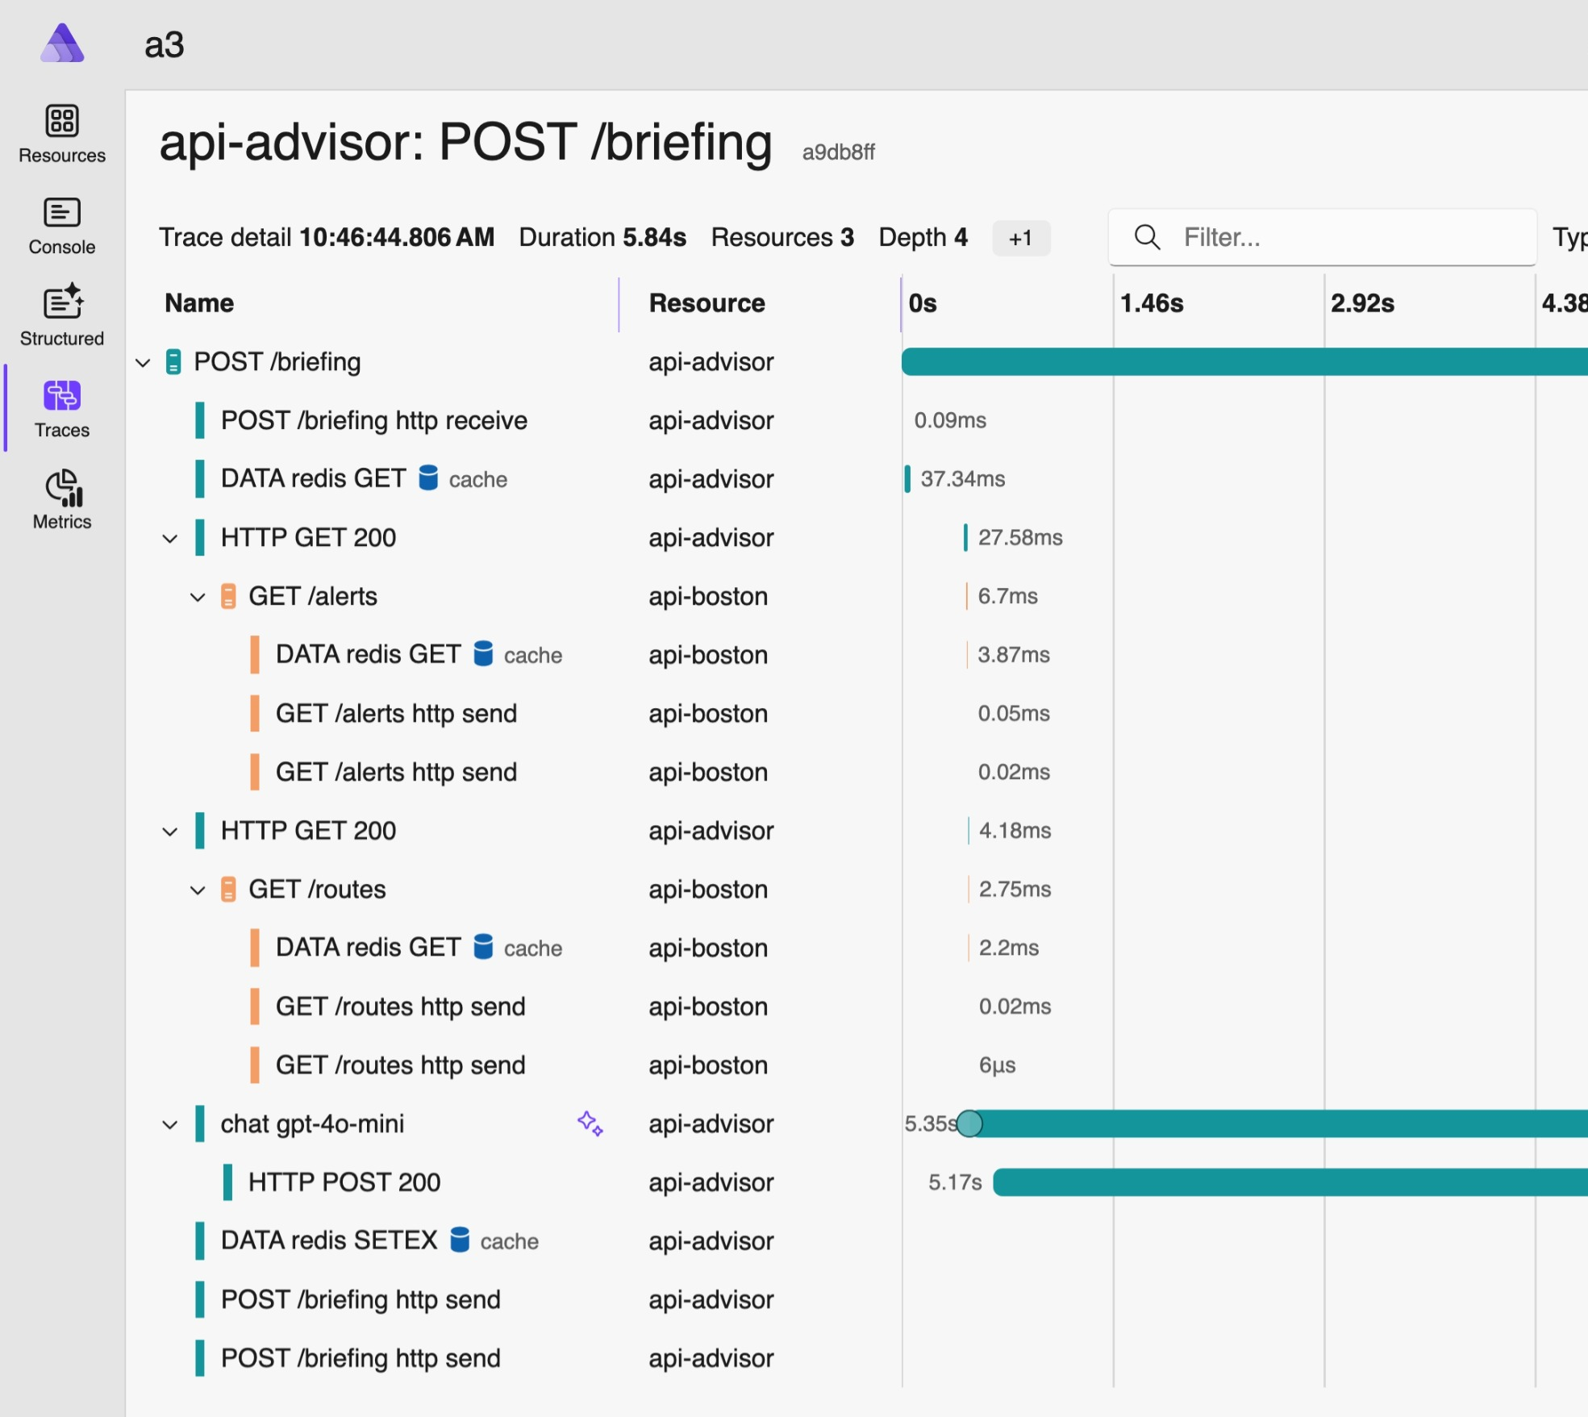
Dashboard
Observability from the start
Logs, traces, health checks—all wired up automatically. OpenTelemetry included with zero setup.

Slide 10
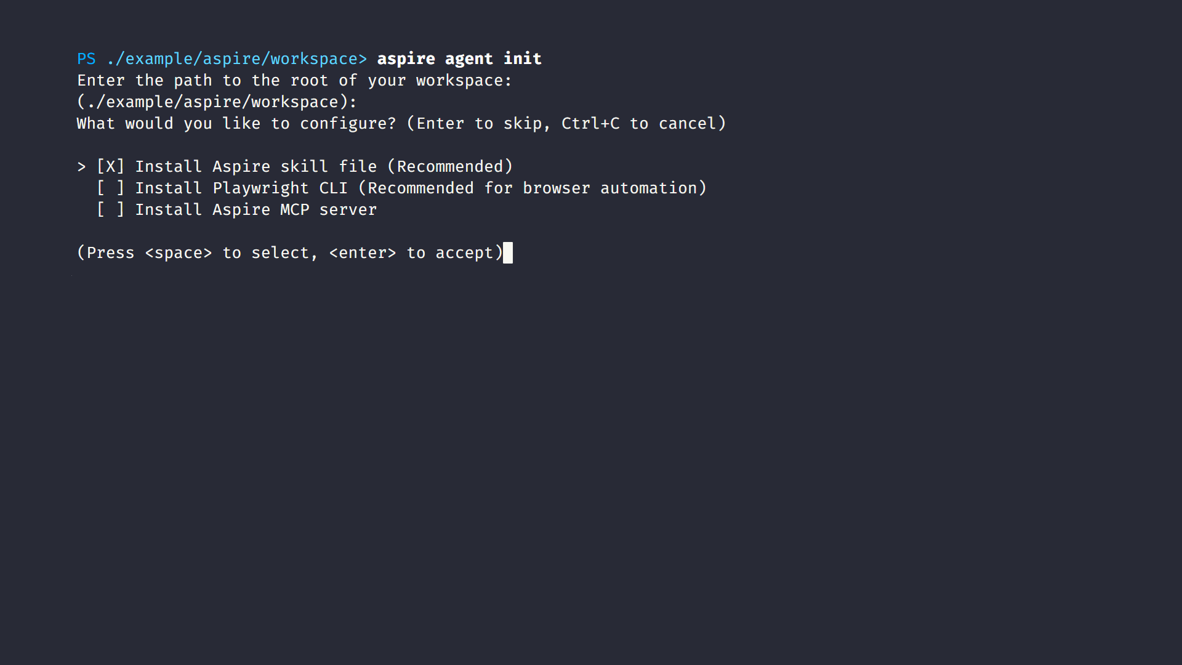
Agent-ready CLI
Ready for any coding agent
The Aspire CLI automatically gives context to your preferred coding agents, providing them with knowledge about your system to help you develop and debug faster.

Slide 11
Aspire is agent-ready
Give agents structure, not more prompts
Aspire CLI outputs structured, minimal-token responses built for agent consumption. And aspire init ships agent skills and an MCP out of the box.
> aspire init
Built-in agent skills
Preconfigured skills and MCP
Code-first app topology
Simplified execution model
Optimized feedback loop
Agents love code, not config
Agents use one command
Agents see what’s happening
The Aspire AppHost gives you the same functionality as a compose.yml or launch.json but in typesafe, compilable, TypeScript or C# code. An agent can easily read and modify it to understand and build the full topology of your app.
Every resource in your stack is defined in the apphost, and aspire start kicks off and keeps track of all of them. APIs, frontends, containers, databases, started in the right order, on the right ports, with the right configuration. Use detached and isolated modes for working with multiple agents.
The Aspire CLI exposes full OpenTelemetry data during local development like traces, metrics, and structured logs. Agents can do things like profile slow requests, trace failing workflows, pinpoint exact errors, right in the terminal. Pair it with a tool like Playwright CLI to test your app and fix it.

Slide 12
Demo

Slide 13
Thank you

Slide 14
Intro to Aspire
Speaker Name
Role, Company
@social

Slide 15

Modern apps are like being in a
Big city without a map
Editor/IDE
Frontends
Services
Agents + AI
Env
> Operating systems
> Shells + terminals
> Coding agents
> Extensions
> Endless languages + frameworks
> Databases + storage
> Auth
> Caches + queues
> Messaging
> Models, deployments, frameworks
> Secrets/tokens/keys
> Provisioning parameters
> Non-source-controllable assets
> Changing ports and dependencies
Backends
Observability
> Microservices, monoliths, containers, VMs
> Different data pipelines for different parts of the app
Manifests + Scripts
Deployment handoff
> Manifest languages (YAML, JSON, Dockerfiles)
> Hard-to-read scripts (Bash, pwsh)
> README.md, internal wikis, "tribal knowledge"
> Manual deployments
> Automated CI/CD
> Enterprise devops workflow

Slide 16
Complex dev,
complex deploy
Dev Loop
Deployments
> Impossible to "clone and run“
> No easy way to add new services
> Local dev does not reflect actual running system
> Coding agents can’t see the entire system
> Fragile, always-changing assets
> Complicated handoffs for architecture changes
> "Only in prod" observability
> Configuration drift becomes challenging

Slide 17
Aspire is an agent-ready, code-first tool to compose, debug, and deploy any distributed app.

Slide 18
What is Aspire?
Aspire is an agent-ready, code-first tool to compose, debug, and deploy any distributed app.
5
Frontend
4
Web API
Code-first development and deployment experience maps your entire distributed app.
Agents have knowledge about every detail of your system.
Over one hundred integration packages designed to simplify connections to popular services, platforms and stacks.
Visualize all your logs, endpoints, and resources in a single dashboard.
3
Cache
2
Database
1
Cloud service
Notes:
Aspire helps you cut through the chaos of complex distributed systems by providing a code-first experience for local development, debugging, and seamless deployment. With no rewrites, Aspireify any existing system.
Aspire fuels your coding agents with knowledge about every detail of your system, from writing code, to debugging issues through detailed Open Telemetry traces and logs so you can build and debug faster.
140+ integration packages are designed to simplify connections to popular services, platforms and stacks. Each one handles compute resource setup and provides standardized patterns for health checks, telemetry, and configuration.
Visualize your entire stack in a Dashboard -- your command center. Powered by OpenTelemetry it automatically collects traces, metrics, and structured logs from every resource in your AppHost and surfaces them through a rich, interactive UI.

Slide 19
What is Aspire?
The important parts
Aspire CLI
The CLI provides an interactive, agent-ready control plane so you can create, run and deploy distributed apps seamlessly.
> aspire init
Your agent-ready control plane
Aspire AppHost
Aspire Integrations
Aspire Dashboard
Define your stack in code
Plug in anything, ship faster
Your app, at a glance
The AppHost is the map for your distributed app. It is the code-first place where you declare your application’s services and their relationships.
Aspire integrations are a curated suite of over one hundred packages that make it easy to connect your cloud-native applications with popular services.
The Aspire dashboard is powered by OpenTelemetry and collects traces, metrics, and structured logs and surfaces them through a rich, interactive UI and an MCP server for agents.
Notes:
The CLI provides an interactive, agent-ready control plane so you can create, run and deploy distributed apps seamlessly. Use the Aspire CLI to streamline development workflows and coordinate distributed services.
The AppHost is the map for your distributed app. It is the code-first place where you declare your application’s services and their relationships. Describe the architecture in code and Aspire handles local orchestration so you can focus on building features.
Aspire integrations are a curated suite of hundreds of packages that make it easy to connect your cloud-native applications with popular services and provide essential cloud-native capabilities through automatic setup and standardized configuration.
The Aspire dashboard is your command center. Powered by OpenTelemetry it automatically collects traces, metrics, and structured logs from every resource in your AppHost and surfaces them through a rich, interactive UI and an MCP server for agents.

Slide 20
App Host + CLI
Dev first, ops friendly
Clone and run any repo, add new services in one command, and deploy – or hand off to your deployment pipeline – without code changes, from one CLI.
Notes:
NOTE: The diagram animates from “aspire run” to “aspire deploy” on click

Slide 21
Integrations
Building blocks, not black boxes
Choose from hundreds of prebuilt packages or bring your own. Bootstrap and run any type of container, CLI, or AI agent with a few lines of code.

Slide 22
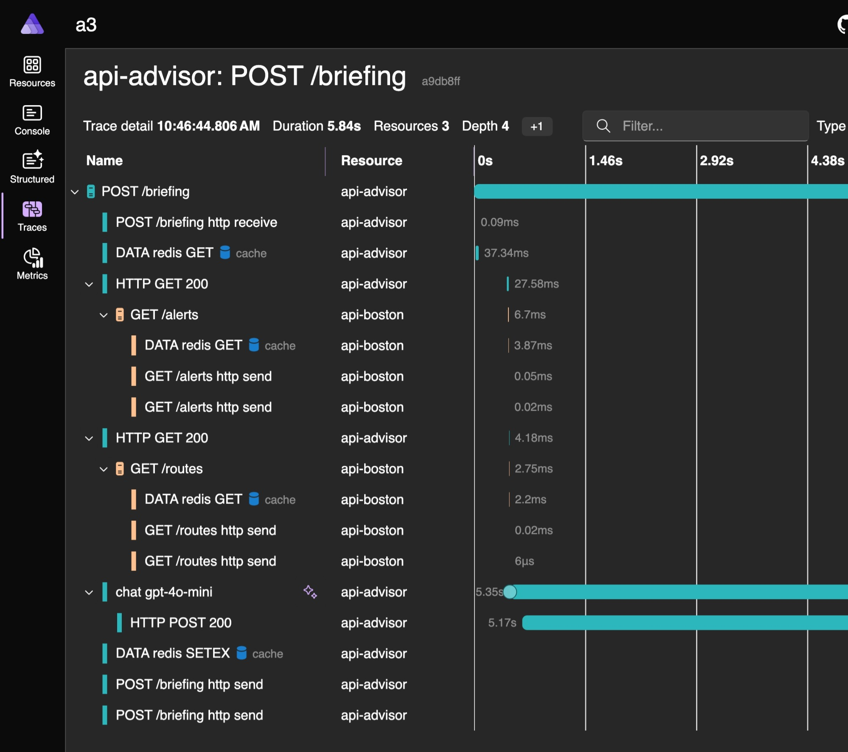
Dashboard
Observability from the start
Logs, traces, health checks—all wired up automatically. OpenTelemetry included with zero setup.

Slide 23
Agent-ready CLI
Ready for any coding agent
The Aspire CLI automatically gives context to your preferred coding agents, providing them with knowledge about your system to help you develop and debug faster.

Slide 24
Aspire is agent-ready
Give agents structure, not more prompts
Aspire CLI outputs structured, minimal-token responses built for agent consumption. And aspire init ships agent skills and an MCP out of the box.
> aspire init
Built-in agent skills
Preconfigured skills and MCP
Code-first app topology
Simplified execution model
Optimized feedback loop
Agents love code, not config
Agents use one command
Agents see what’s happening
The Aspire AppHost gives you the same functionality as a compose.yml or launch.json but in typesafe, compilable, TypeScript or C# code. An agent can easily read and modify it to understand and build the full topology of your app.
Every resource in your stack is defined in the apphost, and aspire start kicks off and keeps track of all of them. APIs, frontends, containers, databases, started in the right order, on the right ports, with the right configuration. Use detached and isolated modes for working with multiple agents.
The Aspire CLI exposes full OpenTelemetry data during local development like traces, metrics, and structured logs. Agents can do things like profile slow requests, trace failing workflows, pinpoint exact errors, right in the terminal. Pair it with a tool like Playwright CLI to test your app and fix it.

Slide 25
Demo

Slide 26
Thank you

Slide 27
Your icon library

Slide 28
Your icon library
You can recolor these icons to match your theme. Avoid using the icons too large.
Get more icons

Slide 29
Your icon library
You can recolor these icons to match your theme. Avoid using the icons too large.
Get more icons

Slide 30
Your icon library

Slide 31
Your icon library
You can recolor these icons to match your theme. Avoid using the icons too large.
Get more icons

Slide 32
Your icon library
You can recolor these icons to match your theme. Avoid using the icons too large.
Get more icons

