Slide 1

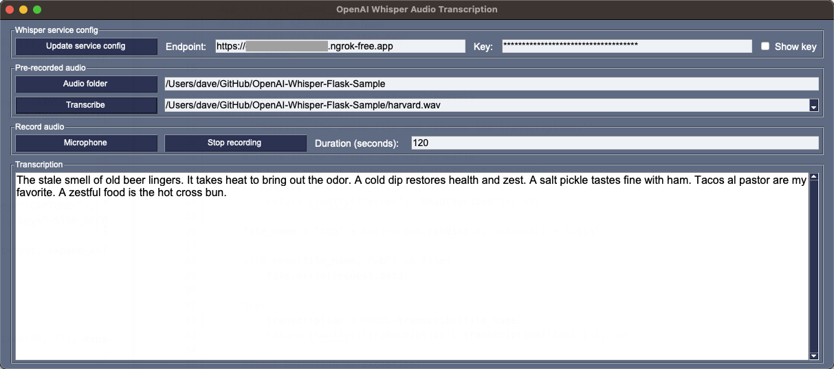

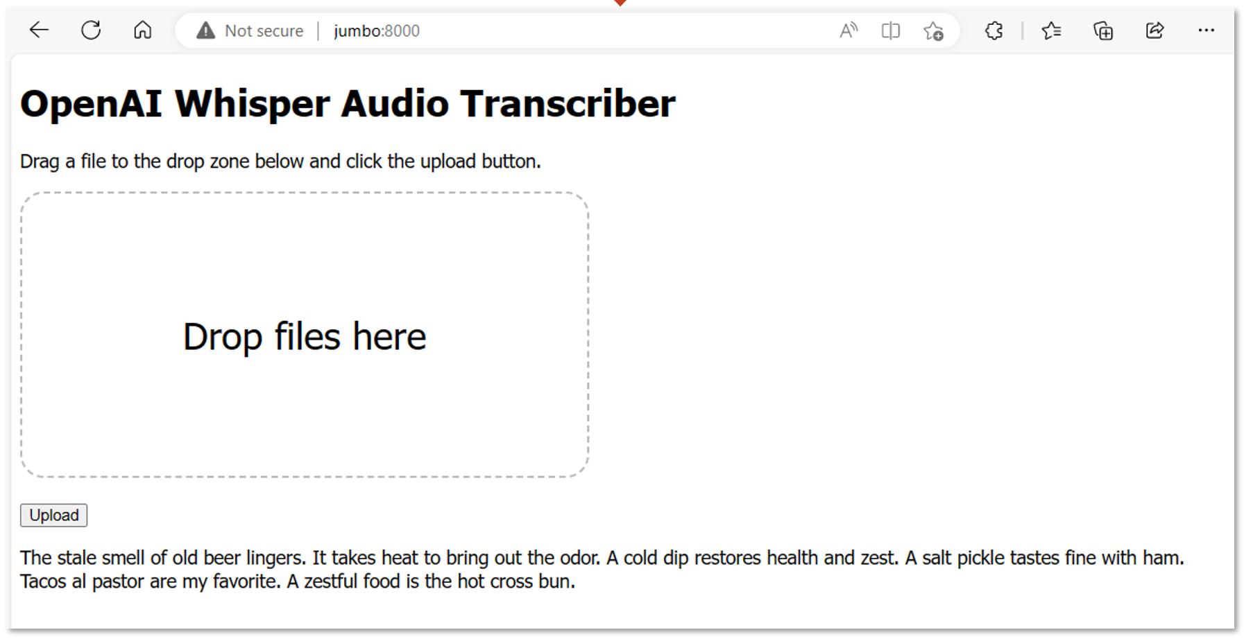
Whisper Transcription Service
Whisper Clients
Whisper GUI Client
Windows, WSL, Linux, or macOS
Audio
Python Flask REST API
Whisper Model
Whisper Web Client
Text
Nvidia GPU or
X64 & Apple Silicon CPUs

