Slide 1
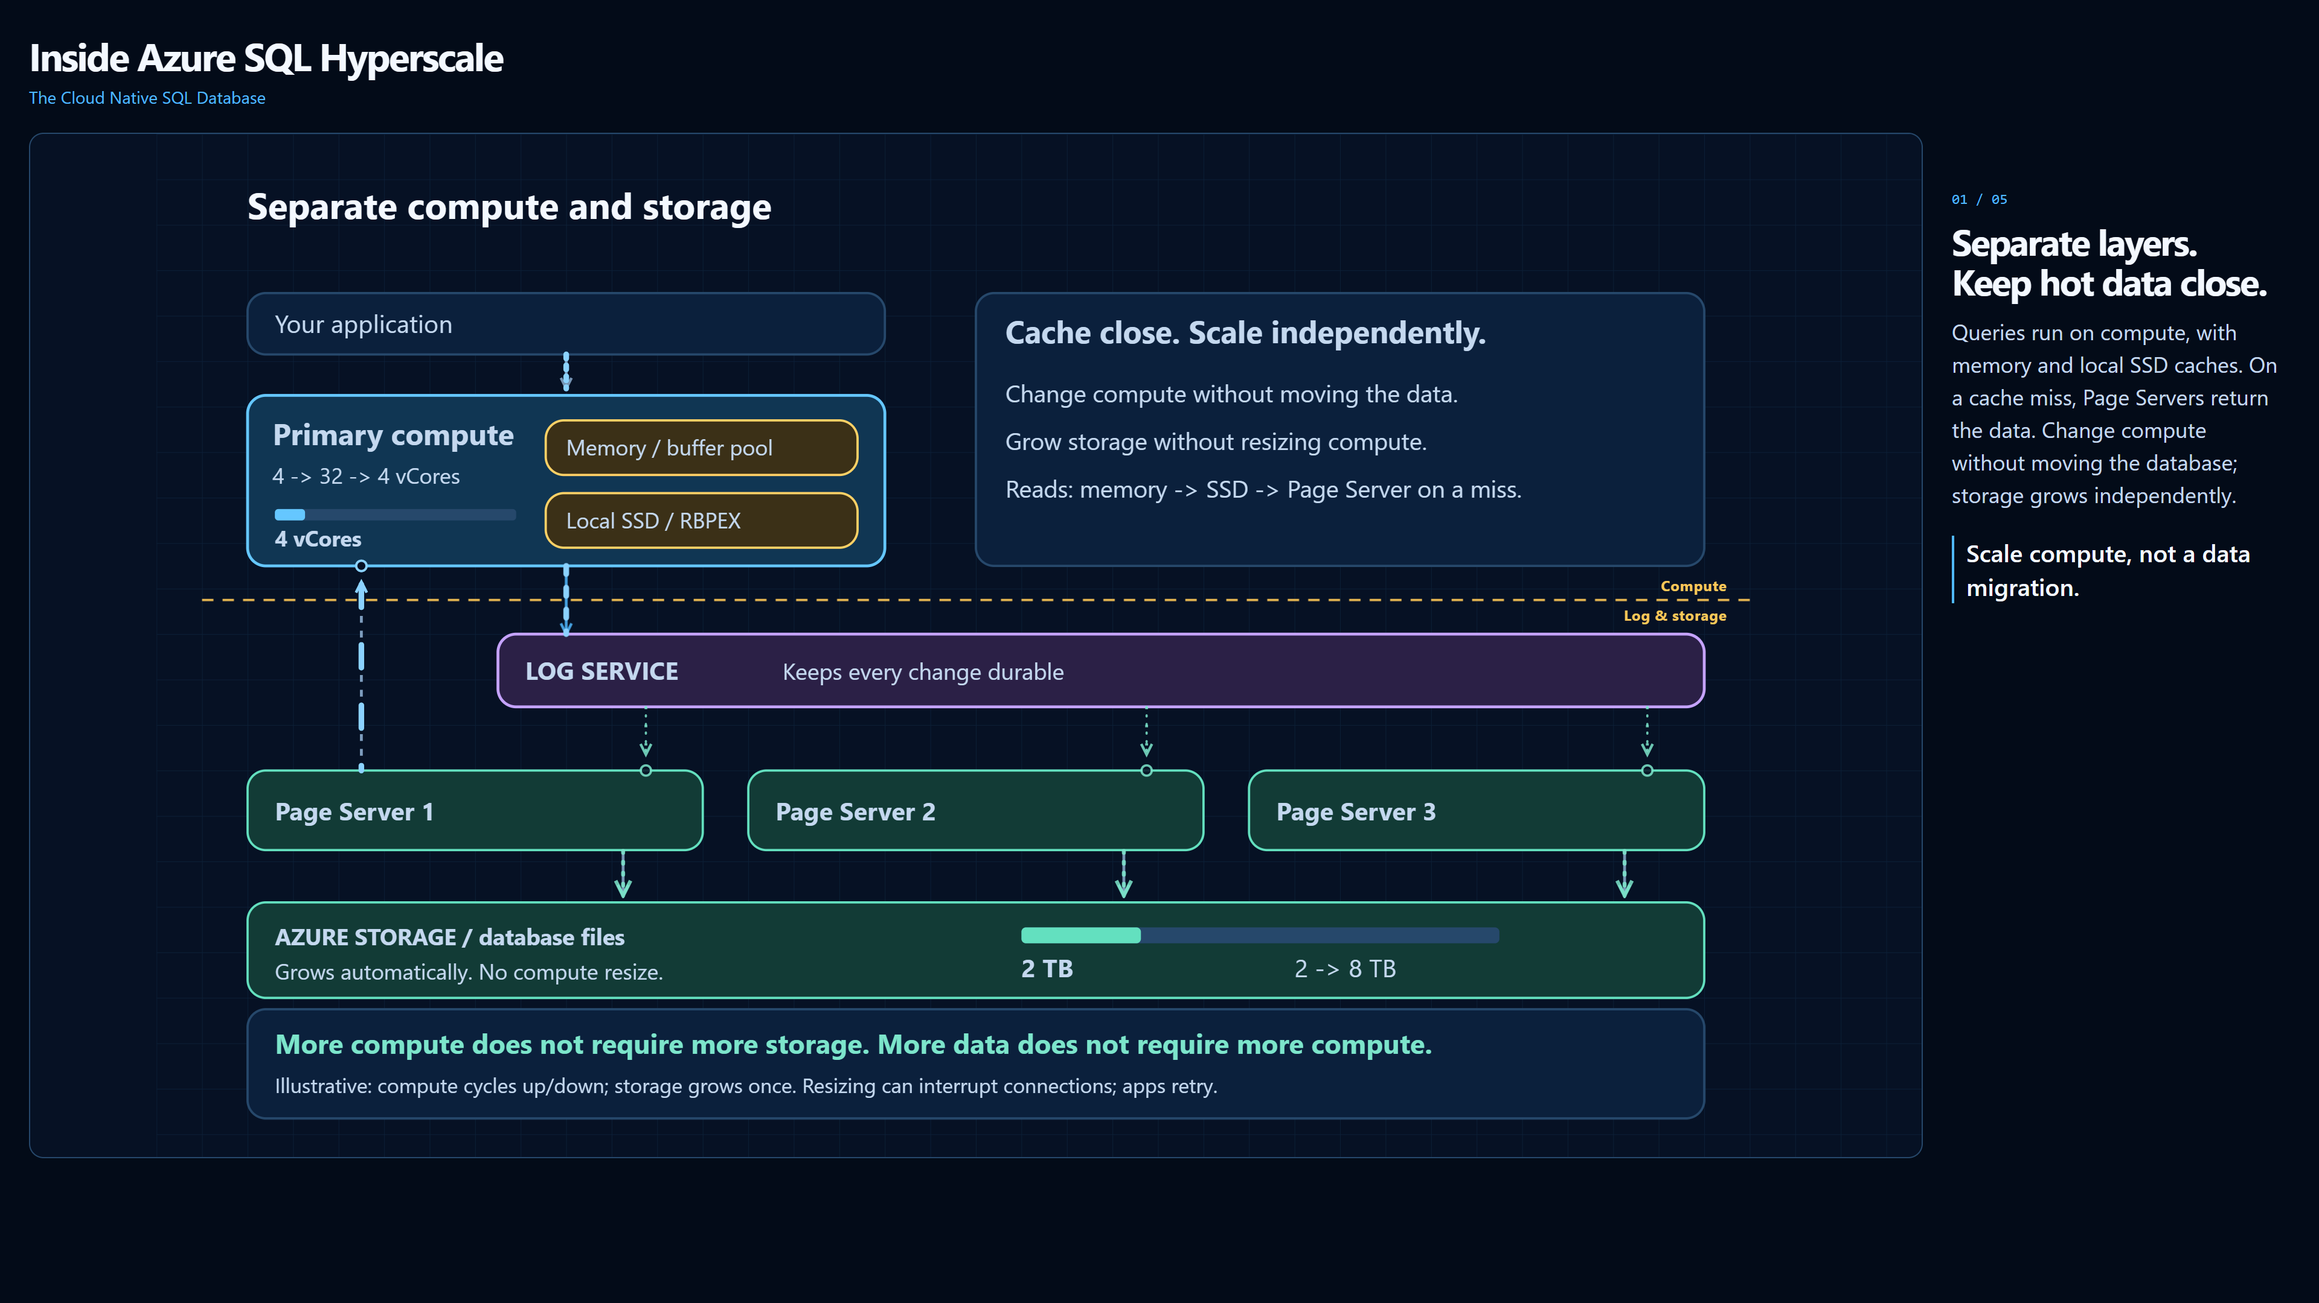
1 Layers + caching
2 HA + zones
3 Serverless + pools
4 Read scale
5 Start here. Stay here.
Notes:
Layers + caching - 20 seconds.
Section 1 is highlighted in the footer. The footer has no click actions, so the section indication survives copying this slide into a larger deck. Open the companion .ppsx for full-screen playback. The video starts automatically on entry; no click is required. Advance slides normally. Use PowerPoint's video controls to pause/play. Videos are embedded; no browser or network is required.
HTML source SHA-256: cb57adc61de7a48cbe7efa19f1306a86d8973290d4a664196b81ec58fb1906e5

Slide 2
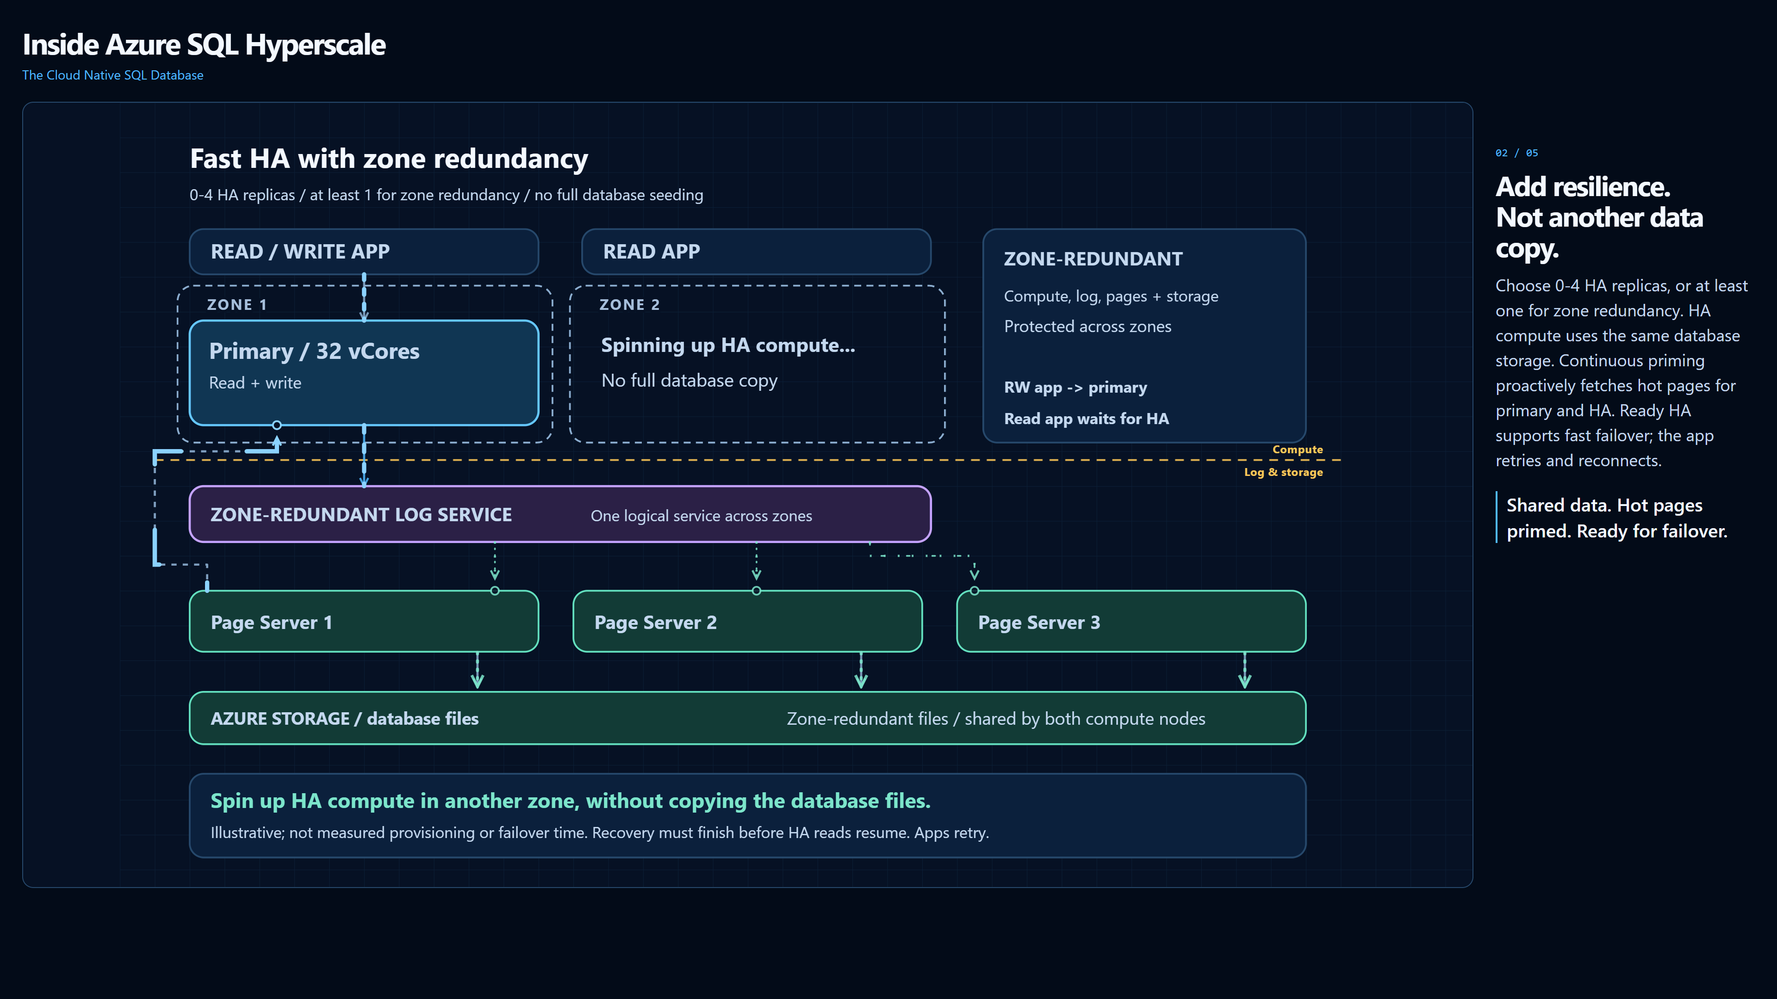
1 Layers + caching
2 HA + zones
3 Serverless + pools
4 Read scale
5 Start here. Stay here.
Notes:
HA + zones - 25 seconds.
Section 2 is highlighted in the footer. The footer has no click actions, so the section indication survives copying this slide into a larger deck. Open the companion .ppsx for full-screen playback. The video starts automatically on entry; no click is required. Advance slides normally. Use PowerPoint's video controls to pause/play. Videos are embedded; no browser or network is required.
HTML source SHA-256: cb57adc61de7a48cbe7efa19f1306a86d8973290d4a664196b81ec58fb1906e5

Slide 3
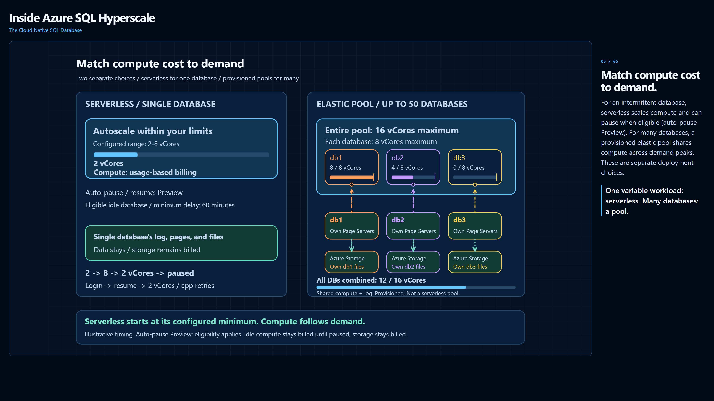
1 Layers + caching
2 HA + zones
3 Serverless + pools
4 Read scale
5 Start here. Stay here.
Notes:
Serverless + pools - 24 seconds.
Section 3 is highlighted in the footer. The footer has no click actions, so the section indication survives copying this slide into a larger deck. Open the companion .ppsx for full-screen playback. The video starts automatically on entry; no click is required. Advance slides normally. Use PowerPoint's video controls to pause/play. Videos are embedded; no browser or network is required.
HTML source SHA-256: cb57adc61de7a48cbe7efa19f1306a86d8973290d4a664196b81ec58fb1906e5

Slide 4
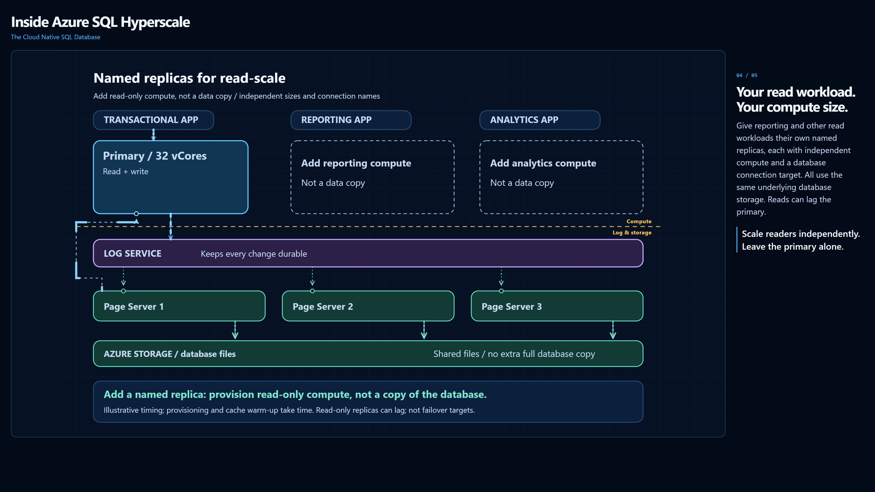
1 Layers + caching
2 HA + zones
3 Serverless + pools
4 Read scale
5 Start here. Stay here.
Notes:
Read scale - 20 seconds.
Section 4 is highlighted in the footer. The footer has no click actions, so the section indication survives copying this slide into a larger deck. Open the companion .ppsx for full-screen playback. The video starts automatically on entry; no click is required. Advance slides normally. Use PowerPoint's video controls to pause/play. Videos are embedded; no browser or network is required.
HTML source SHA-256: cb57adc61de7a48cbe7efa19f1306a86d8973290d4a664196b81ec58fb1906e5

Slide 5
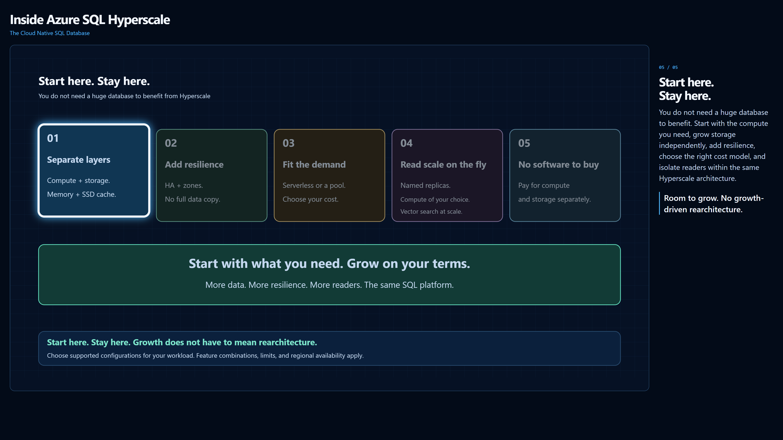
1 Layers + caching
2 HA + zones
3 Serverless + pools
4 Read scale
5 Start here. Stay here.
Notes:
Start here. Stay here. - 10 seconds.
No footer indicators are highlighted; a lifted, glowing spotlight cycles across the middle benefit cards left to right, two seconds each, continuously, while the other four cards dim. The footer has no click actions, so the section indication survives copying this slide into a larger deck. Open the companion .ppsx for full-screen playback. The video starts automatically on entry; no click is required. Advance slides normally. Use PowerPoint's video controls to pause/play. Videos are embedded; no browser or network is required.
HTML source SHA-256: cb57adc61de7a48cbe7efa19f1306a86d8973290d4a664196b81ec58fb1906e5

