Slide 1
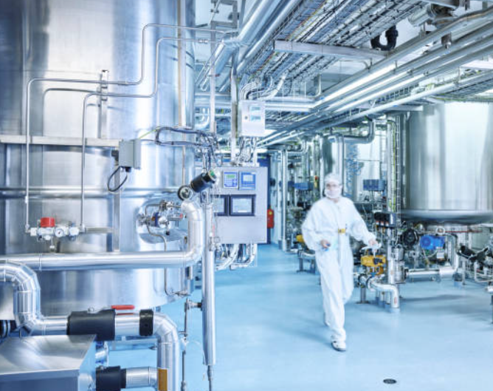
Chemical Reactor Optimization

Slide 2
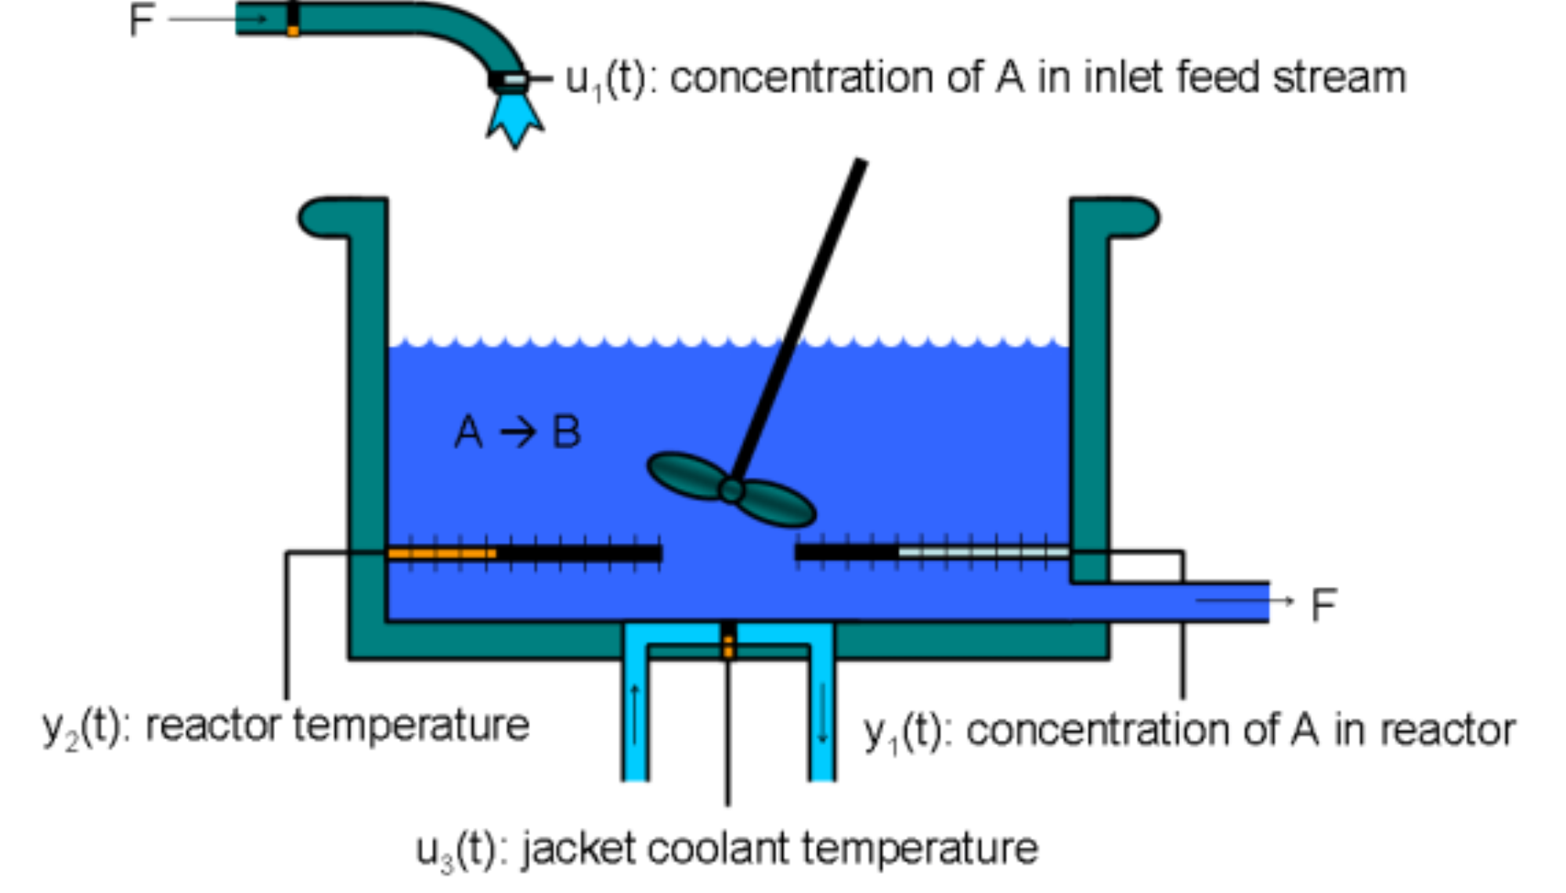
Chemical Reactor Optimization
Overview
Continuously stirred tank reactor (CSTR)
Exothermic reaction must be controlled to prevent thermal runaway (> 400 degrees K)
Continuous production of a single product, it is a steady-state process
Transitioning the reactor to producing another product requires close monitoring
T_{r}
C_{r}
T_{c}
Steady-state
Transition
C_{r}
T_{r}
Time

Slide 3

Chemical Reactor Optimization
Current Methods
Advanced control methods
Adaptive Proportional, Integral Derivative Control (PID)
Model Predictive Controller (MPC)

Slide 4
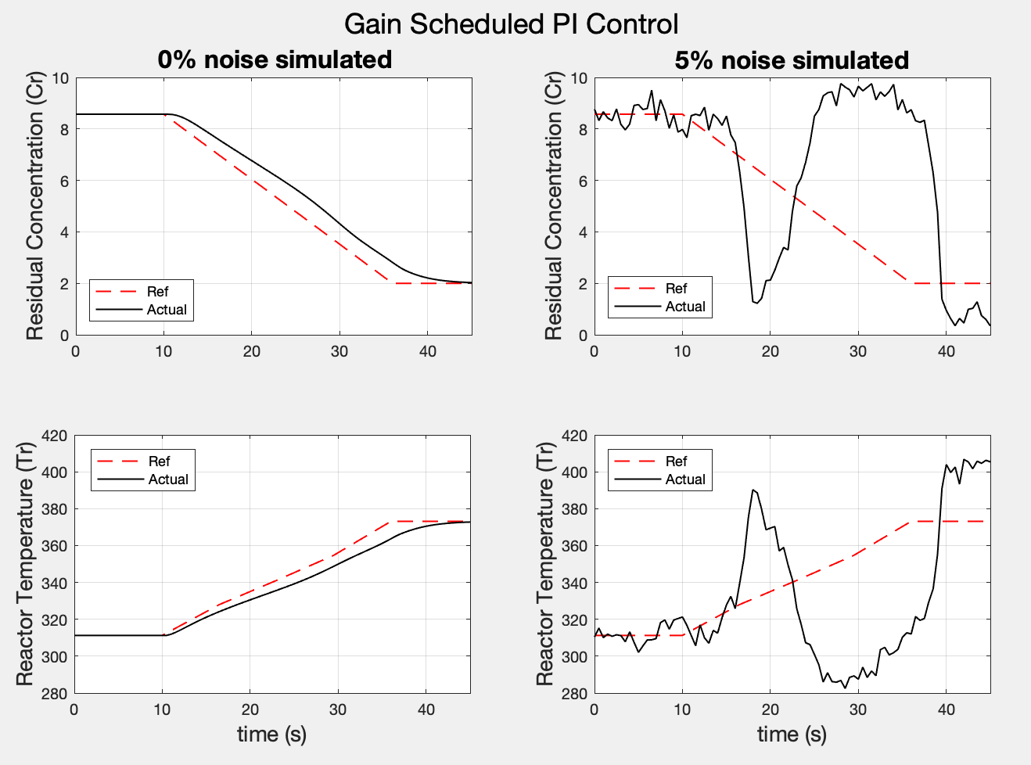
Chemical Reactor Optimization
Limitations of current methods
Adaptive PID does not respond well to noise or variability
MPC is extremely time consuming to develop and drifts over time
Can take months for experienced engineers to develop new product transition controllers
Thermal Runaway

Slide 5
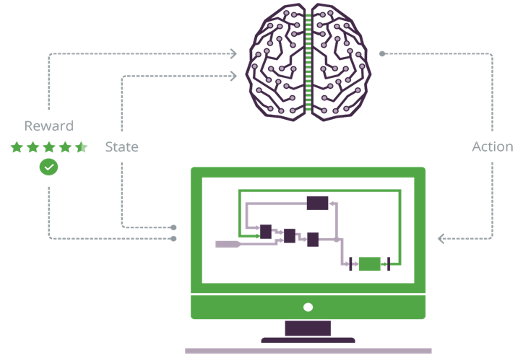
Chemical Reactor Optimization
Solution: Autonomous AI
Develop an Autonomous AI Brain using Deep Reinforcement Learning
Brain learns to adapt by training in simulation
AI can generalize across scenarios
Can handle uncertainty, like noise
Brain training can be scaled on the cloud to accelerate AI development
brain
Simulation

Slide 6
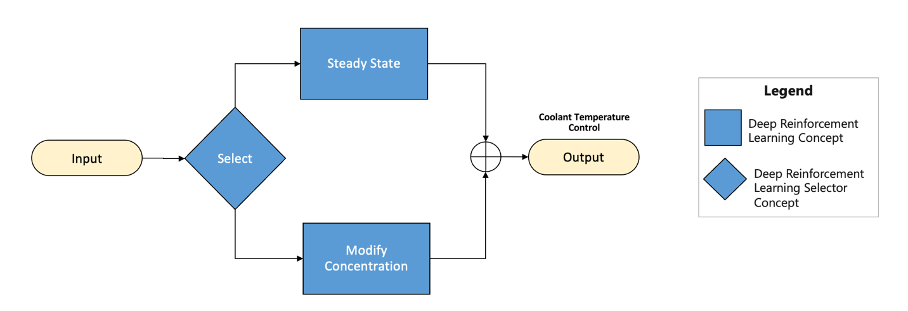
Chemical Reactor Optimization
States:
C_{r}
C_{ref}
T_{r}
Tc
Action:
𝚫T_{c}
Brain Design
Steady State Concept operates the reactor coolant temperature when there is a constant reference concentration
Modify Concentration Concept operates the reactor coolant temperature during a product transition
Selector Concept chooses the appropriate concept based on observing the reactor conditions

Slide 7
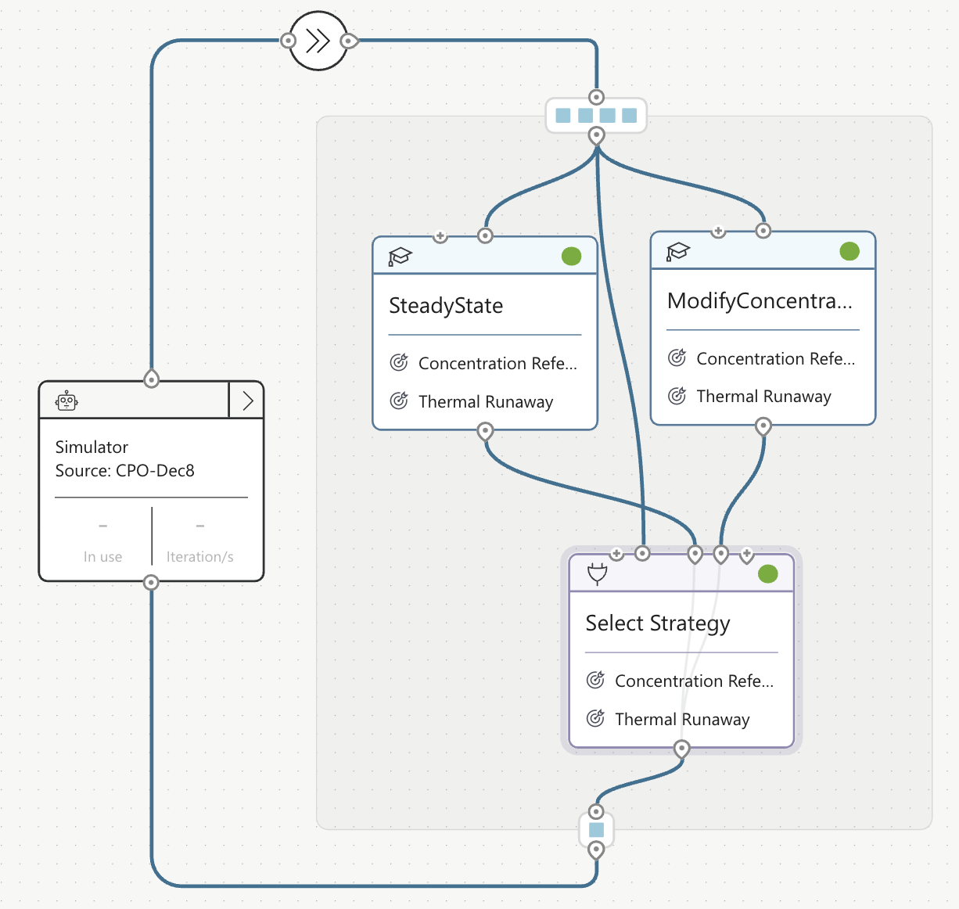
Chemical Reactor Optimization
Brain Development
Objectives:
Prevent thermal runaway while transitioning the residual concentration of a CSTR
→Minimize Error to reference concentration
→Avoid Thermal Runaway (>400 K)
Training:
Vary Sensor Noise 0-5% noise

Slide 8
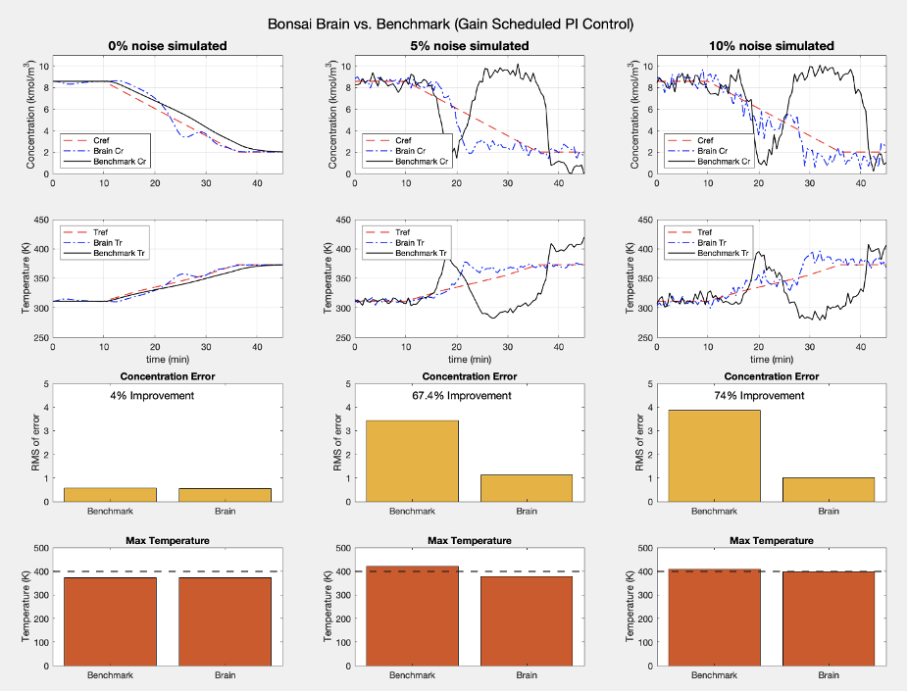
Chemical Reactor Optimization
Results
Brain outperforms Benchmark Gain Scheduled PI Controller with more margin the more realistic the simulation (more noise)
Benchmark results in thermal runaway for 5% noise
Brain avoids thermal runaway for up to 10% noise

