Slide 1

REUSABLE FOUNDATION + REFERENCE IMPLEMENTATION
From AI agents to
accountable agentic
business processes.
Agents reason. People decide.
The process remembers.
Microsoft Copilot Studio - GitHub Harness
Notes:
Open with the gap between building an agent and operating a business process. This repository supplies a reusable process foundation plus an email-to-SAP-payload reference implementation. It is a reference accelerator, not a separate commercially supported product. The two READMEs are the main narrative sources.
Sources:
Repository overview - reusable Core, architecture, deployment and licensing
../../README.md
Order Processing - process, agents, human gates and sample limitations
../../business-processes/order-processing/README.md

Slide 2

01 / INTRODUCTION
Where standalone agents are not enough
The opportunity: document-heavy work that crosses systems, teams, decisions and time.
01
02
03
04
Interpret the input
Apply business
Keep work accountable
Integrate systems of
judgment
record
Turn documents, emails and
Check facts against policies,
Pause for people. Track
Read trusted data from CRM,
conversations into structured
eligibility, risk and
ownership.
ERP and business systems.
facts.
commercial terms.
Preserve the evidence when
Write approved outcomes
Resolve missing or
Explain exceptions and
a decision takes days.
back with validation and
ambiguous information.
trade-offs.
error handling.
Reference Implementation
Order intake
Use Case Opportunities:
Claims
Loans
Deals
RFQ
Contracts
Best fit:
event-triggered, long-running multi-stage work with reasoning, human control and traceability.
Agentic Business Process Automation on Copilot Studio
02 / 23
Notes:
Position this as agentic business process automation rather than a generic chatbot or pure document OCR. The four patterns apply across scenarios: interpret mixed evidence, apply business rules, preserve accountable decisions, and integrate systems of record. Examples include claim evidence and coverage, loan documents and eligibility, deal context and commercial terms, RFQ requirements, contract obligations and order details. These are opportunities, not delivered scenarios. The best fit is event-triggered, long-running work spanning systems, teams and human decisions, with persisted state maintaining traceability. Order Processing is the reference implementation; the README describes car insurance claims as work in progress. Systems-of-record integration is a solution requirement, not a claim that this sample performs ERP write-back: Order Processing generates a SAP-ready JSON payload, and production posting requires additional integration.
Sources:
Repository overview - reusable Core, architecture, deployment and licensing
../../README.md
Order Processing - process, agents, human gates and sample limitations
../../business-processes/order-processing/README.md

Slide 3
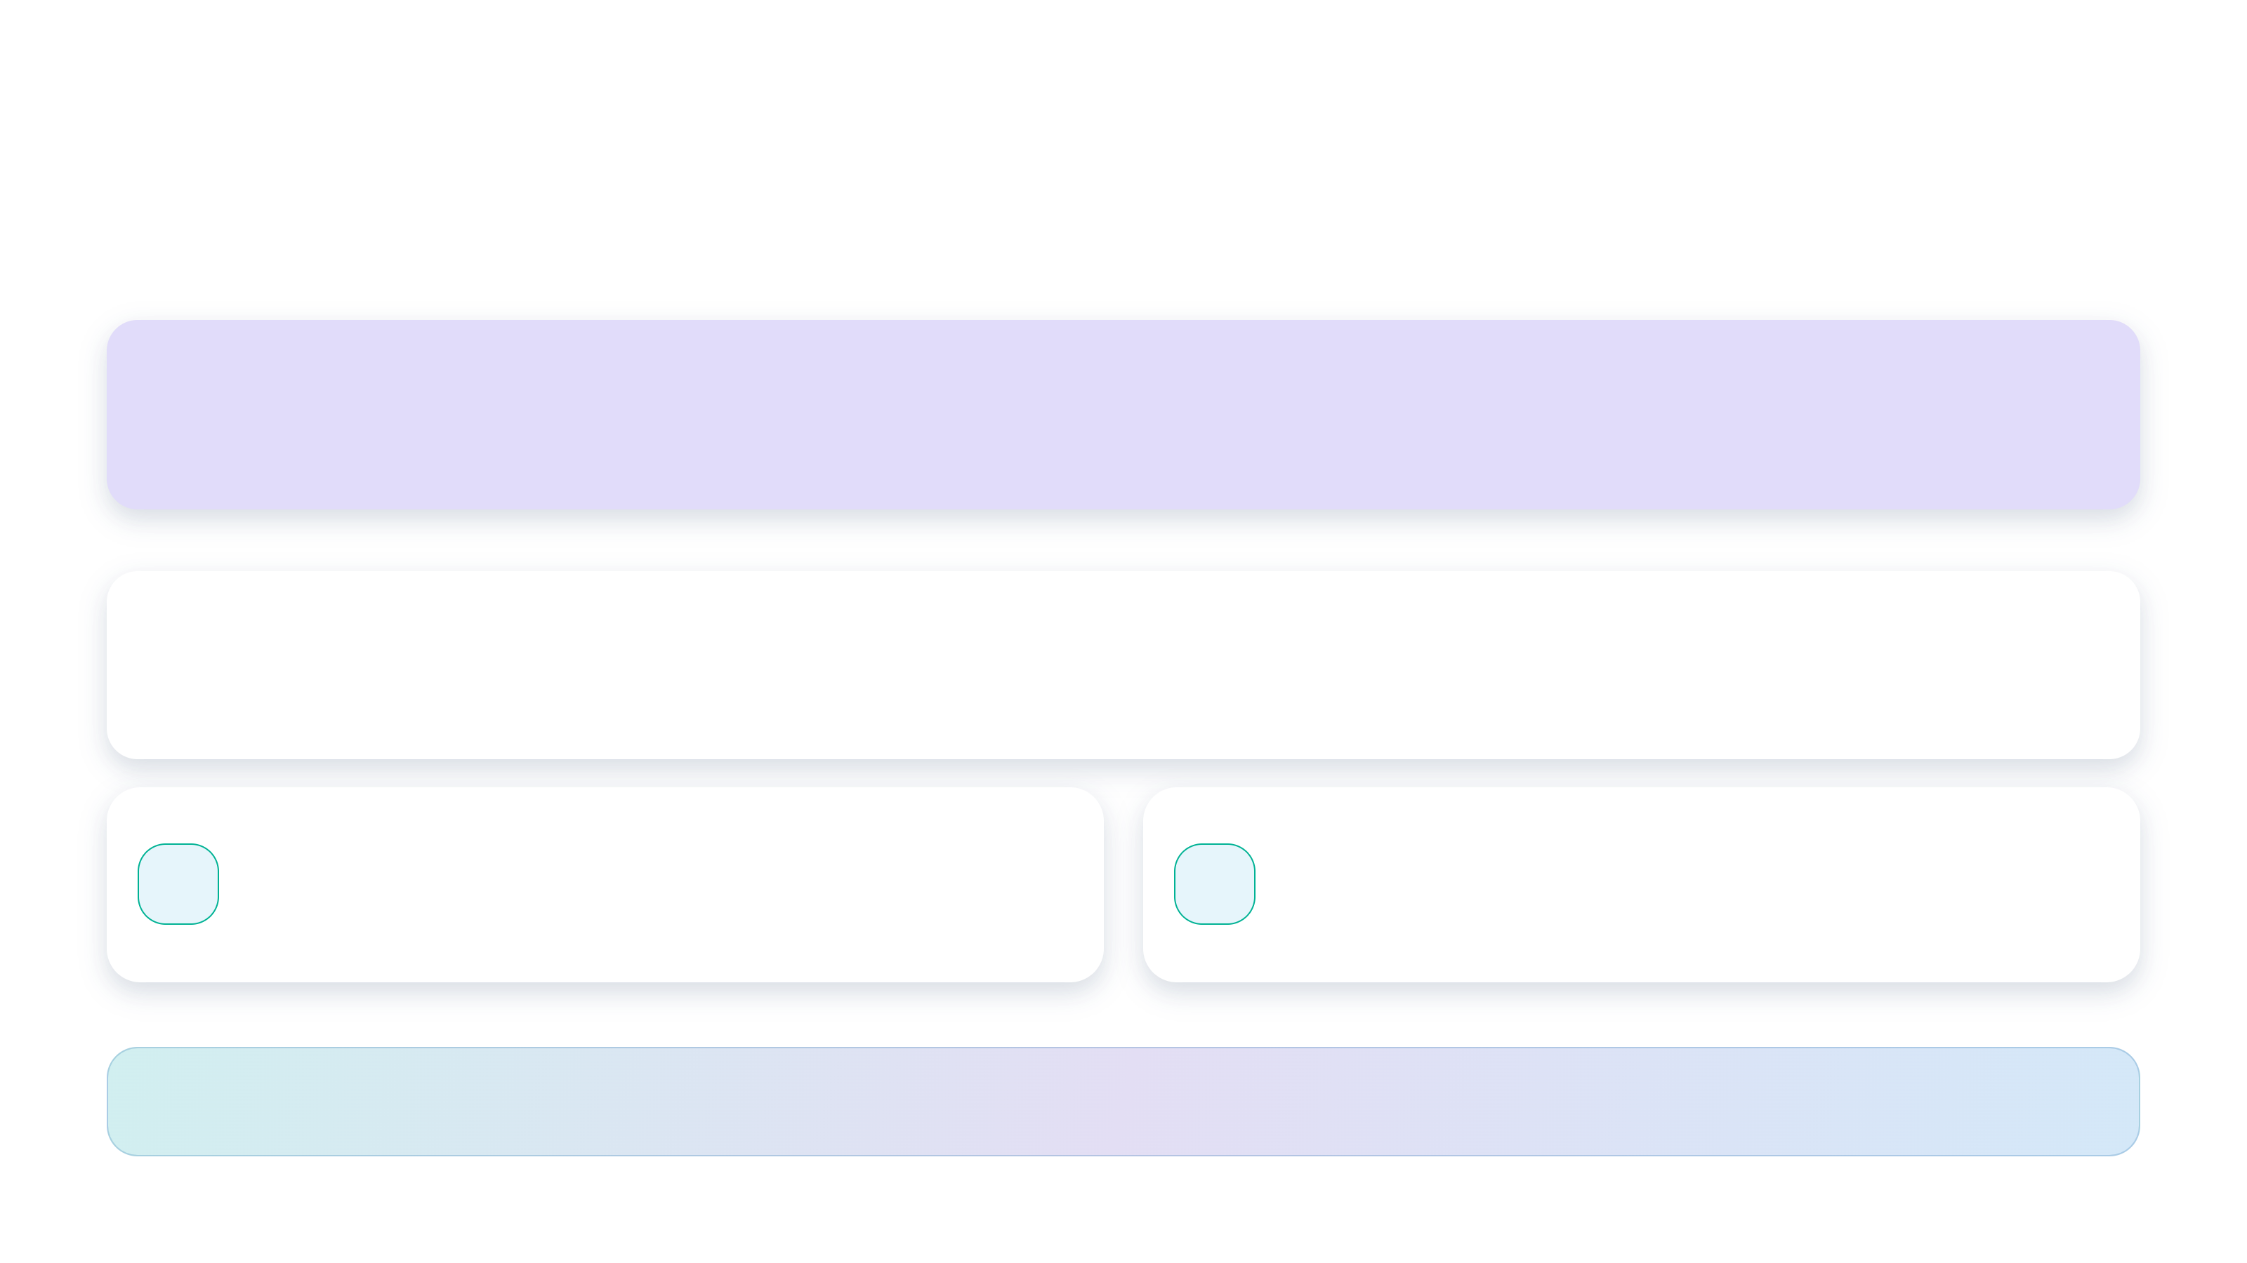
01 / INTRODUCTION
One reusable core. Your business logic on top.
Stop rebuilding the task queue, process history and human-review experience.
Order Processing - or your next scenario
REFERENCE PROCESS
Domain workflows / agent skills / review widgets / roles
uses shared process and task contracts
State, tasks, review UI, notifications and monitoring
BUSINESS PROCESS
CORE
Long-running / resumable / auditable / human-controlled
GitHub Copilot harness
Agent skills = business logic
AI
Reasoning-heavy, multi-step execution
MD
Portable, reviewable, versionable rules.
inside Copilot Studio.
Loaded into context when needed.
Deploy the
reusable building block
. Tailor the process.
Version the business rules.
Agentic Business Process Automation on Copilot Studio
03 / 23
Notes:
1 / Point to BUSINESS PROCESS CORE: an agent is not yet a business process.Copilot Studio makes it easy to build an agent. It does not, on its own, give you a business process: a long-running, resumable, auditable unit of work that spans multiple agents and flows, pauses for days waiting on a human decision, and can still answer "where is this case, who is sitting on it, and what did the agent actually decide?" three weeks later. The case may be an order, a claim, a loan application, a deal, an onboarding request - the mechanics are the same every time.Stay on the Core layer and point across its shared capabilities.Every maker who tries to build one ends up reinventing the same plumbing - a state table, a task queue, a review UI, a notification fan-out, and a way to resume the process after a human clicks Approve. This repository provides that plumbing as a reusable agentic business process building block that you can deploy as a solution in your environment. The Core is installed once; process stages advance through persisted state rather than a single flow waiting for days.2 / Move up to REFERENCE PROCESS and its connection to the Core.The repository also comes with a business-specific scenario, Order Processing, that serves as a reference implementation for using the Core building blocks in real-world processes. Each process adds its domain workflows, skills, review widgets and roles while reusing the shared process and task contracts. Claims, loans, deals and onboarding illustrate where the same mechanics could be applied; they are not all delivered implementations.3 / Point to the GitHub Copilot harness card.It is built on the most capable engine Copilot Studio offers, the GitHub Copilot harness - the reasoning-heavy runtime designed for this class of multi-step work. The harness runs inside Copilot Studio; it is not the GitHub Copilot service. Developer-side GitHub Copilot in VS Code can separately assist with deployment.4 / Point to the Agent skills = business logic card, then close on the bottom takeaway.The harness also unlocks what this solution treats as its unit of business logic: agent skills - portable Markdown packages of instructions, references and scripts that each hand an agent one body of business rules, loaded into context only when a task actually calls for them. Business logic becomes reviewable, versionable content a domain expert can correct. Loading focused rules helps avoid an ever-longer prompt as the rule base grows; accuracy still needs to be evaluated rather than assumed. Close with the visual summary: deploy the reusable building block, tailor the process, and version the business rules.
Sources:
Repository overview - reusable Core, architecture, deployment and licensing
../../README.md
Order Processing - process, agents, human gates and sample limitations
../../business-processes/order-processing/README.md
Microsoft Learn - Harnesses in Copilot Studio
https://learn.microsoft.com/microsoft-copilot-studio/harnesses-overview
Microsoft Learn - Agent skills: portable instructions, scripts and resources
https://learn.microsoft.com/microsoft-copilot-studio/agents-experience/skills-overview

Slide 4

Agentified Order
Processing Intake
Notes:
Transition from the reusable foundation to the customer story. Introduce Order Processing as the reference implementation, then walk through the benefits, process stages and human-review experience.
Sources:
Order Processing - process, agents, human gates and sample limitations
../../business-processes/order-processing/README.md

Slide 5
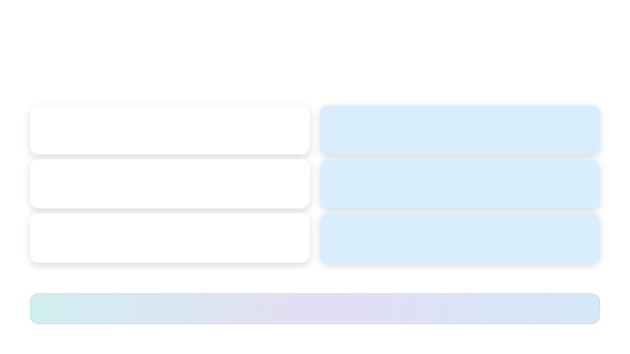
02 / ORDER PROCESSING
Less re-keying. Better-informed decisions.
A customer proposition built around the cost of exceptions - not just typing.
TODAY'S FRICTION
DESIRED CUSTOMER OUTCOME
Manual transcription
Review instead of re-key
People interpret and re-enter each order.
Start from extracted, structured order data.
Inconsistent checks
Consistent, explainable evaluation
Invalid products, stock gaps and disputed discounts.
Use focused skills to surface field-level findings.
Invisible handoffs
Visible ownership and evidence
Who has the order? What was approved?
Track tasks, decisions and artifacts end to end.
Measure in a pilot:
handling time, correction rate and approval turnaround.
Expected benefits to validate in a pilot - no measured ROI is claimed.
05 / 23
Notes:
Sell the opportunity, not an invented percentage. The reference implementation demonstrates capabilities; the repository does not provide measured ROI. Both human gates are part of the normal path, so do not describe this as unattended or exception-only processing. Suggested pilot measures need a customer-specific baseline and observed results.
Sources:
Order Processing - process, agents, human gates and sample limitations
../../business-processes/order-processing/README.md
Repository overview - reusable Core, architecture, deployment and licensing
../../README.md

Slide 6

02 / ORDER PROCESSING
From incoming order to SAP-ready payload
Four workflows. Two explicit human gates. One traceable process instance.
WORKFLOW 1
WORKFLOW 2
HUMAN GATE 1
WORKFLOW 3
HUMAN GATE 2
WORKFLOW 4
Receive
Extract
Review
Validate
Approve
Finalize
Email arrives in
Agent reads the
Verify and correct
Check products,
Accept or reject
Generate and
the shared
document into a
the extracted
inventory and
the agent's
store a schema-
mailbox.
fixed JSON
order.
promotions.
evaluation.
bound SAP
contract.
payload.
Document stored
Structured order
Reviewer decision
Explained findings
Approver decision
Downloadable JSON
Agent / workflow execution
Human control
Rejection at either gate stops that order.
The sample
generates the SAP payload
. It does not post an order to SAP.
Agentic Business Process Automation on Copilot Studio
06 / 23
Notes:
Walk through the approval path from left to right. Extraction review precedes business validation; evaluation approval precedes SAP payload generation. Both rejection paths close the process. Each stage persists state in Dataverse. The final artifact is a JSON file; ERP posting and its operational safeguards are additional integration work.
Sources:
Order Processing - process, agents, human gates and sample limitations
../../business-processes/order-processing/README.md

Slide 7

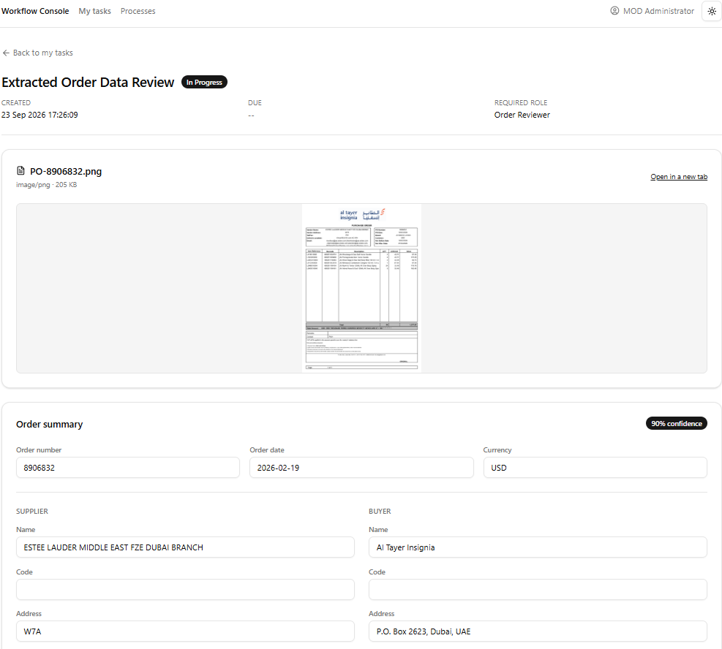
Review what the agent
actually read
Human gate 1 / extracted order data
review
Review source and extracted data
Compare the original document with
the agent's interpretation.
Correct before proceeding
Fix identifiers, quantities and other
extracted values.
Keep the human decision
Save the reviewed data and outcome
with the process.
Customer value:
reduce
transcription effort without
surrendering control.
Notes:
The supplied extracted-data-review.png shows the Workflow Console's Extracted Order Data Review task, with the source purchase order preview above editable order summary, supplier and buyer fields. Use these as visual cues for comparing evidence and correcting extracted values. Line items and approval/rejection controls are outside this capture; describe those capabilities without implying they are visible here. Extraction confidence is agent-provided, not a calibrated accuracy guarantee. Confirm that the displayed business information is approved for the intended audience before external distribution.
Sources:
Order Processing - process, agents, human gates and sample limitations
../../business-processes/order-processing/README.md

Slide 8
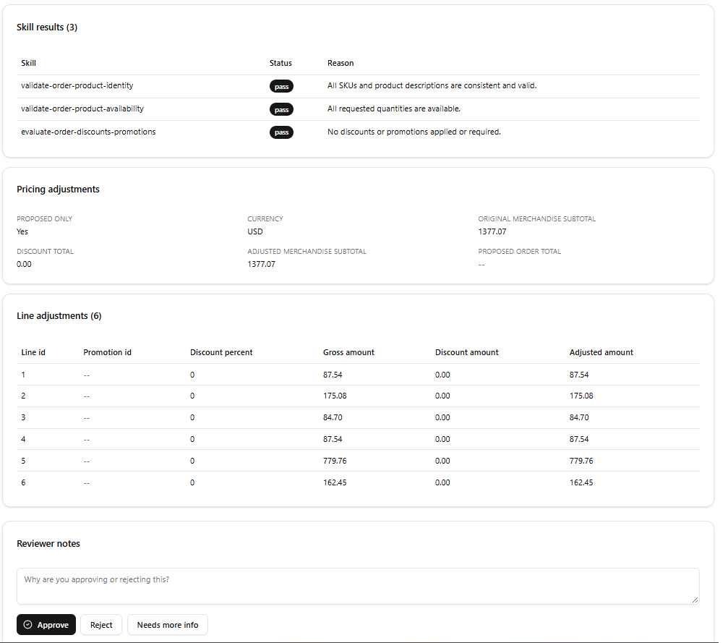
Validate business rules
- not just fields
Human gate 2 / inspect skill results,
pricing adjustments and decision
controls
01 / Product identity
Resolve SKUs, barcodes and
descriptions against the catalog.
02 / Availability
Check requested quantities against
inventory.
03 / Promotions
Explain eligibility and proposed pricing
adjustments.
Identity + availability drive the
verdict.
Promotion findings do
not block the order.
Notes:
The supplied validating-order.png shows results from the three ordered skills, pricing and line adjustments, reviewer notes, and decision controls. Point from each skill result to the corresponding business-rule explanation. In this capture all three skills pass and no discount is applied. The validation agent uses catalog.json, inventory.json and promotions.json: fictional demo knowledge, not live ERP data. Availability assumes one warehouse and immediate fulfillment, with no backorders or partial fulfillment. Promotion findings remain visible but do not change the verdict; the human still approves or rejects the evaluation.
Sources:
Order Processing - process, agents, human gates and sample limitations
../../business-processes/order-processing/README.md

Slide 9

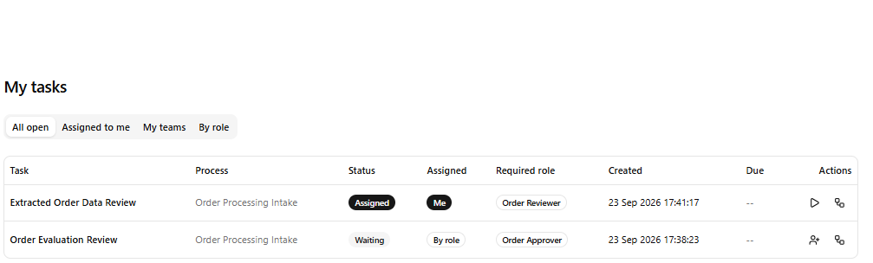
Put work in the right
hands
A shared operating experience, with a
clear task owner
Route by capability
Order Reviewer and Order Approver
roles determine task routing.
Notify in Teams
Eligible users receive a deep link to the
exact task.
Claim. Start. Complete.
Concurrency checks and transactional
completion protect the decision.
People can change.
The process
does not need a named person
hard-coded into it.
Notes:
The supplied task-queue.png shows My tasks filters, an extraction-review task assigned to the current user, and an evaluation-review task waiting for the Order Approver role. Point to the Status, Assigned, Required role and Actions columns. Teams notifications are a related capability, not shown in this screenshot. Role-based routing does not grant row access: Dataverse privileges and app sharing are separate requirements. Claims use row-version checks and completion writes the outcome, outputs and step closure transactionally.
Sources:
Repository overview - reusable Core, architecture, deployment and licensing
../../README.md
Order Processing - process, agents, human gates and sample limitations
../../business-processes/order-processing/README.md

Slide 10

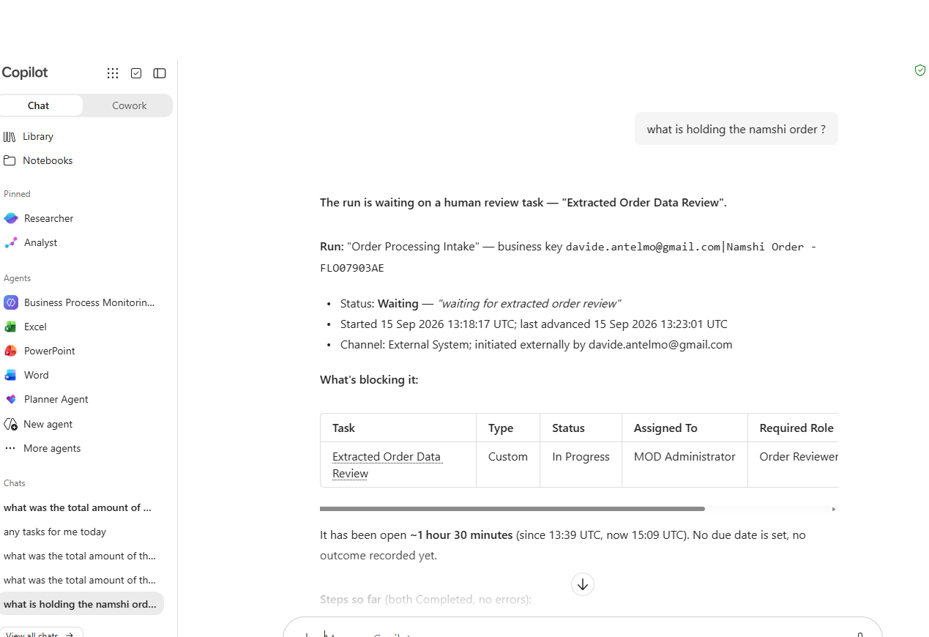
Ask where work is
stuck
Conversational process monitoring in
Microsoft 365 Copilot
QUESTION SHOWN
What is holding the Namshi
order?
One process history
Inspect running instances, stuck steps
and open work.
The same API surface
Monitoring and the Console share
caller-scoped process APIs.
Customer value:
operational
visibility without investigating
individual flow runs.
Notes:
The supplied business-process-monitoring-agent.png shows the agent in Microsoft 365 Copilot, rather than Teams. The user asks what is holding the Namshi order; the response identifies the blocking Extracted Order Data Review task and shows process status, assignee and required role. Point from the question to the blocking-task explanation and task table. Treat the timing and statuses as details of this captured example, not general performance claims. The agent is for process and task enquiry; do not imply autonomous remediation or automatic SLA escalation. Caller-scoped Dataverse security remains authoritative. This capture contains an email address and business identifiers; confirm audience authorization or use a redacted copy before external distribution.
Sources:
Repository overview - reusable Core, architecture, deployment and licensing
../../README.md

Slide 11
High-Level Solution
& Reusable Core
Notes:
Transition from the customer experience to the architecture. Explain what the Core provides once, what belongs to the business process, and which reference patterns can be reused for the next scenario.
Sources:
Repository overview - reusable Core, architecture, deployment and licensing
../../README.md
Order Processing - process, agents, human gates and sample limitations
../../business-processes/order-processing/README.md

Slide 12

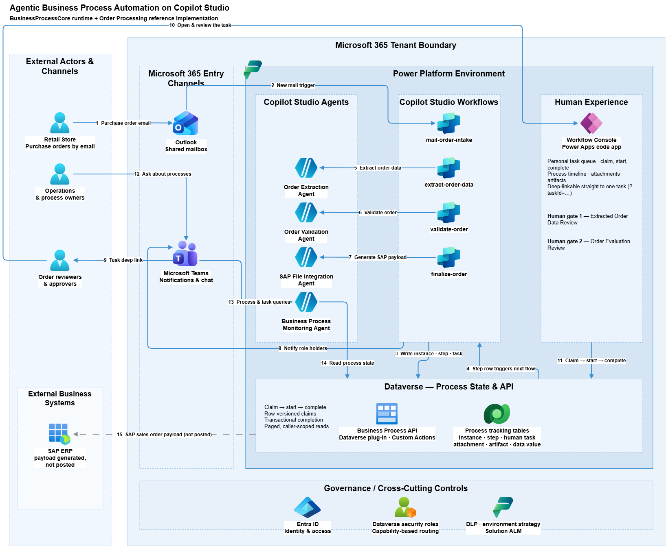
Agentic Order Intake Processing - High-Level Solution
Notes:
Use the repository architecture diagram to trace the order from a supplier email through intake, extraction, validation and SAP payload generation. Point out the two human review gates in the Workflow Console, Teams notifications and the monitoring agent. Dataverse holds durable process state; step-row events start the next workflow. The Core provides the shared state, API and human-task capabilities while Order Processing supplies the domain workflows and reasoning. The SAP payload is generated, not posted to an ERP. The image is shown in full without cropping; open the detailed diagram source below when a closer view of its labels is needed.
Sources:
Repository overview - reusable Core, architecture, deployment and licensing
../../README.md
Order Processing - process, agents, human gates and sample limitations
../../business-processes/order-processing/README.md
Repository detailed solution architecture
../agentic-business-process-architecture.png

Slide 13
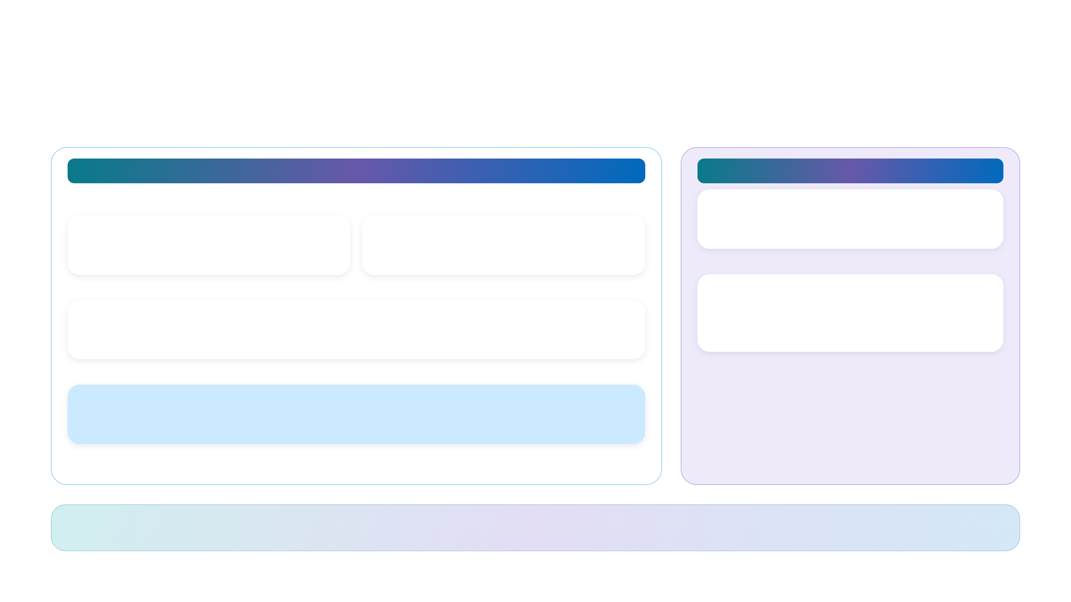
03 / HIGH-LEVEL SOLUTION
How the solution fits together
A shared process foundation; separate, business-specific execution.
REUSABLE BUSINESS PROCESS SOLUTION
ORDER PROCESSING SOLUTION
Reviewers & approvers
Operations / Teams
Domain workflows
Workflow Console
Monitoring Agent
Intake / extract / validate / finalize
Queue + tailored review widgets
Conversational process enquiry
↓ Invoke domain reasoning
↓ Task operations and process queries
Agents + skills
Business Process API
Copilot Studio
Caller-scoped reads / claim / start / transactional complete
GitHub Copilot harness
↓ Persist and read
Process → Dataverse
Dataverse process state
Write state, tasks and outputs.
Dataverse → process
Instances / steps / tasks / attachments / artifacts / data values
Step events start the next stage.
Domain widgets extend the Console.
Core owns the
shared runtime
. Each process owns
its business logic
.
Agentic Business Process Automation on Copilot Studio
13 / 23
Notes:
This is a simplified logical view of the README architecture, not a deployment/network boundary diagram. Core provides the API, state model, console, monitoring, security and configuration. Workflows write state and raise tasks in Dataverse; step-row events trigger the next stage. Console and monitoring consume the shared APIs. Teams carries notifications and conversations. Refer to the detailed repository diagram for the full interaction map.
Sources:
Repository overview - reusable Core, architecture, deployment and licensing
../../README.md
Order Processing - process, agents, human gates and sample limitations
../../business-processes/order-processing/README.md
Repository detailed solution architecture
../agentic-business-process-architecture.png

Slide 14

03 / HIGH-LEVEL SOLUTION
What you do not have to build again
Business Process Solution: Business-agnostic capabilities inherited by every process.
01
02
03
Persistent process state
Human task lifecycle
Review experience
Instances, steps, tasks and typed
Role-based routing, claiming and
A task queue, deep links and a host for
outputs keep the work resumable.
transactional completion.
tailored review widgets.
04
05
Evidence & history
Operational monitoring
Build the business process.
Decisions, documents and generated
Process and task enquiry through the
Reuse the plumbing.
artifacts attached to the process.
Console and monitoring agent.
Dataverse security remains authoritative.
Agentic Business Process Automation on Copilot Studio
14 / 23
Notes:
Group the reusable features around what a delivery team avoids rebuilding. Do not claim this provides regulatory certification, immutable records or all production controls out of the box. The repository's core includes Dataverse tables, a C# plug-in API, a React code app, a monitoring agent and security/configuration. Role-based routing does not replace row privileges.
Sources:
Repository overview - reusable Core, architecture, deployment and licensing
../../README.md

Slide 15
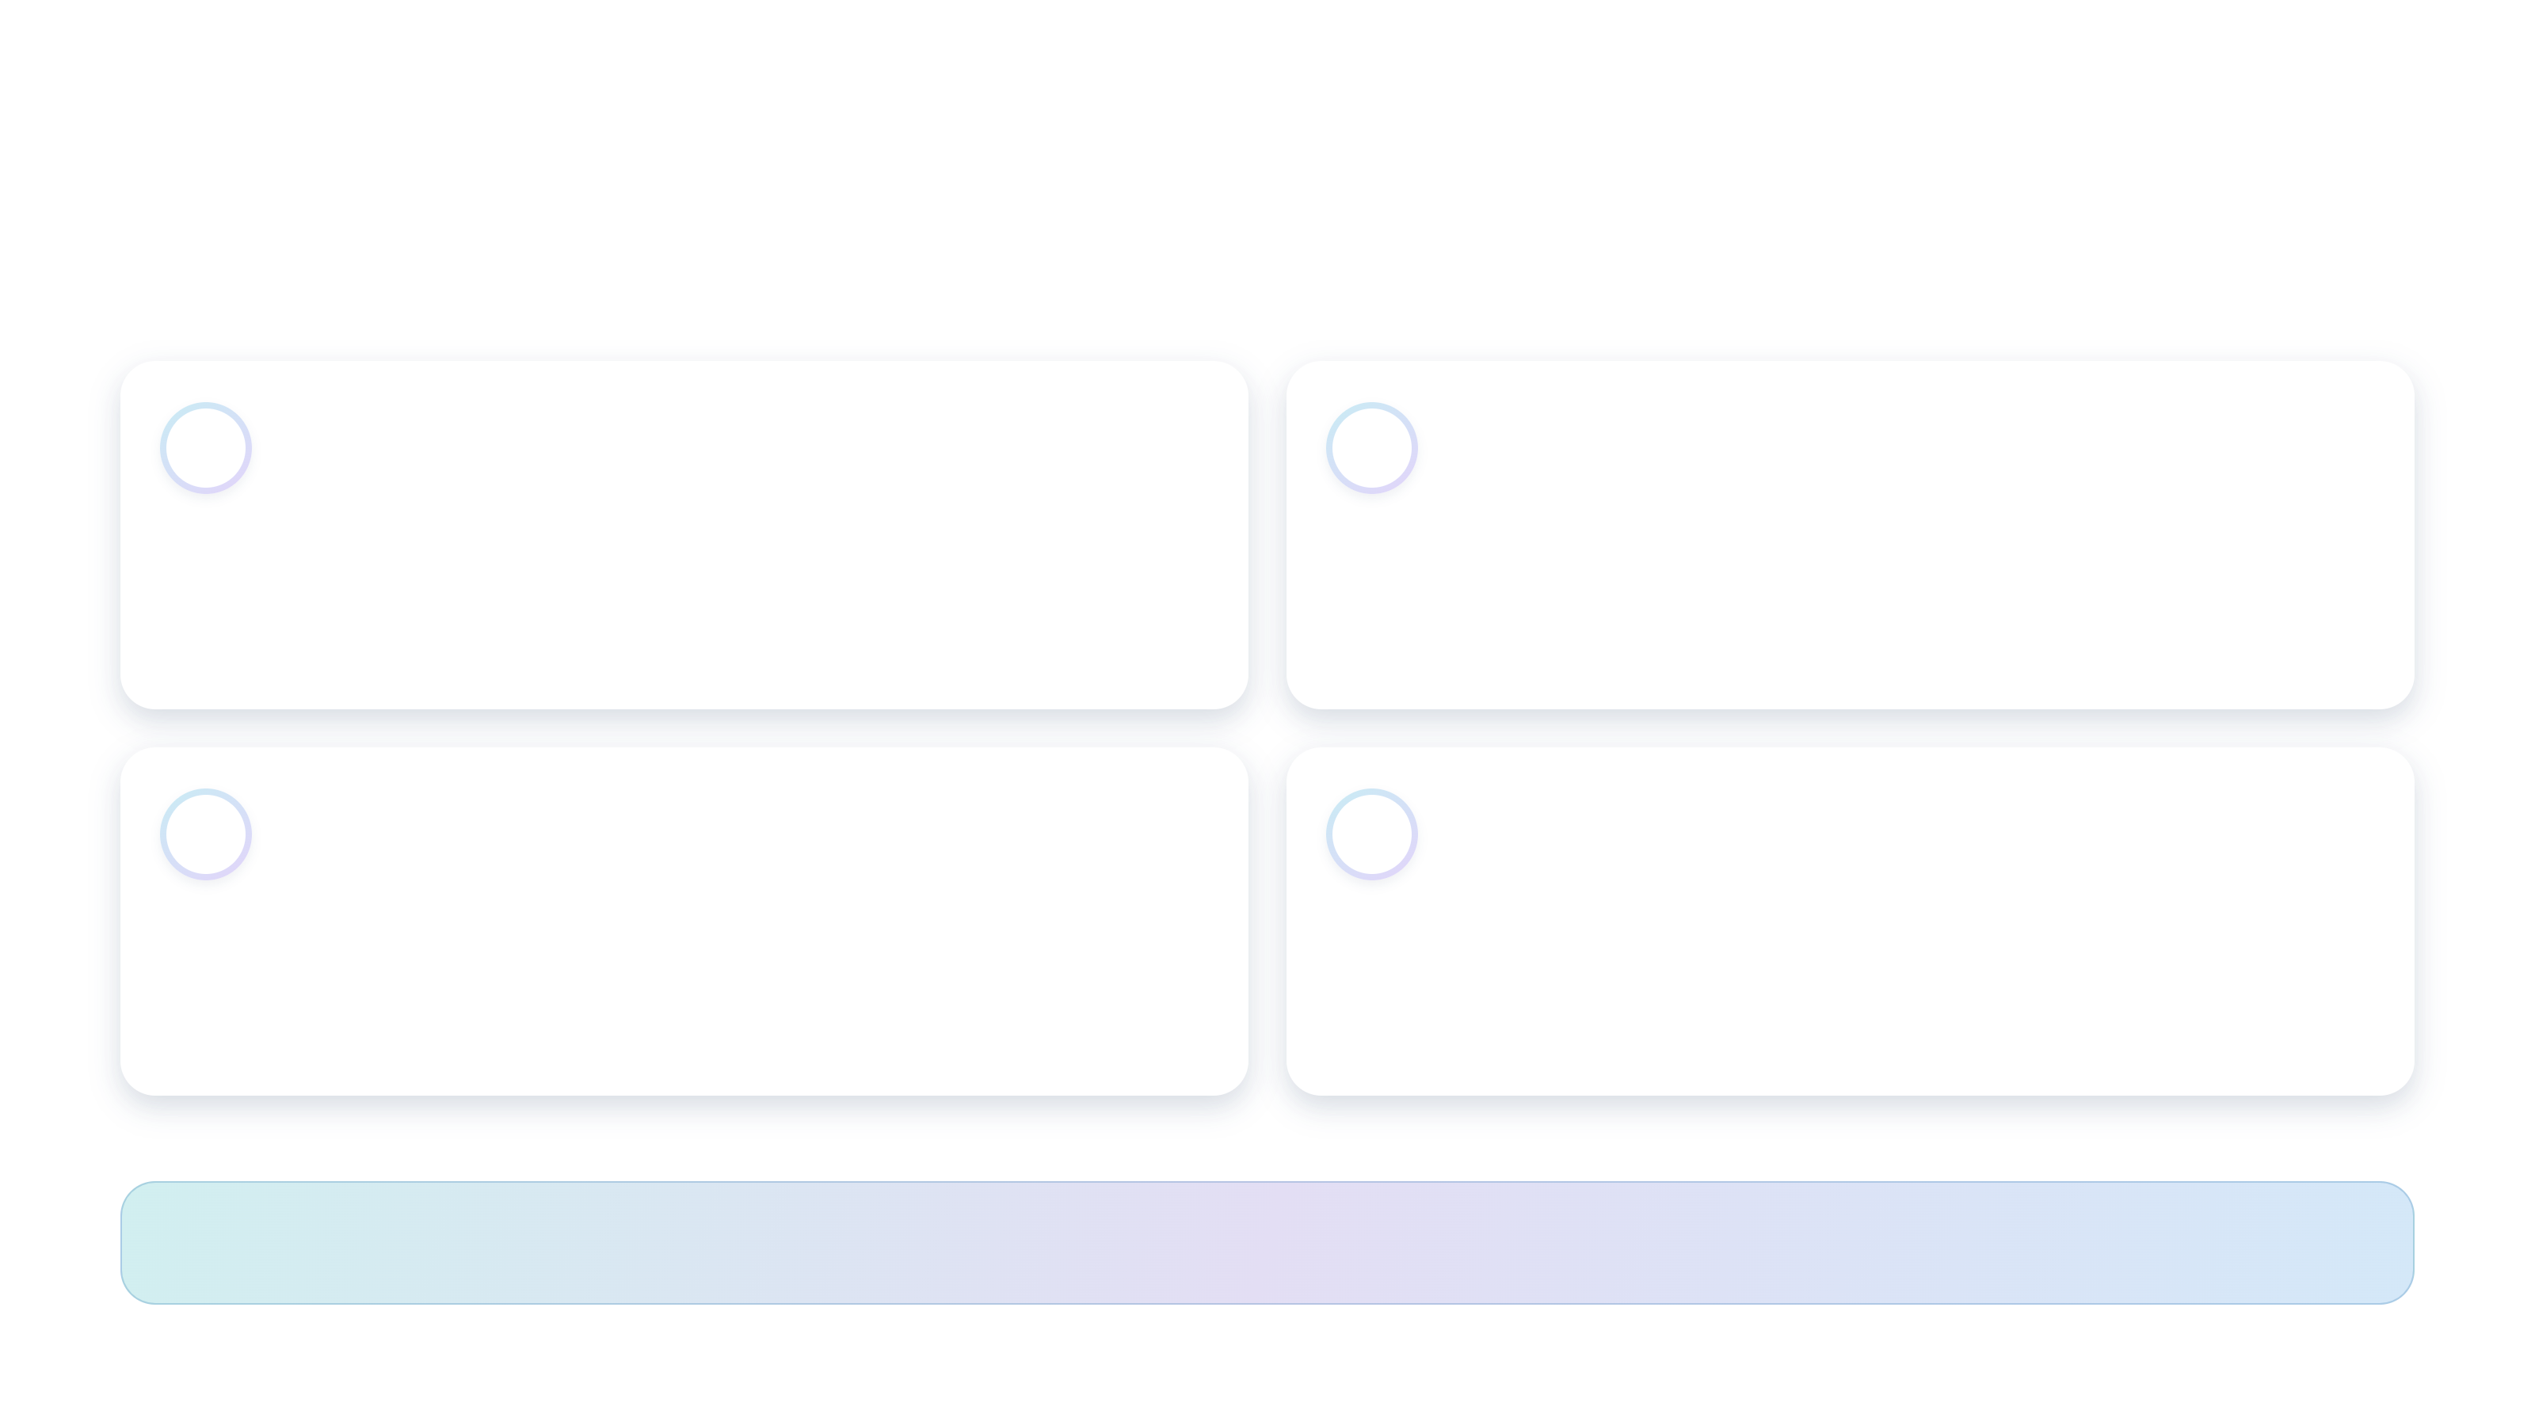
03 / HIGH-LEVEL SOLUTION
Reference patterns worth repeating
Separate reasoning, durable process state and accountable human decisions.
01
Persist between stages
02
Keep skills focused
A Dataverse step event starts the next workflow.
Version business rules as focused skill packages.
No long-lived parent flow waits for a human.
Load the relevant instructions and knowledge.
03
Use explicit contracts
04
Make decisions safe
Fixed extraction JSON; field-level evaluation;
Human gates, row-versioned claims and atomic
schema-bound SAP output with no invented fields.
completion preserve who decided what.
Reason with agents.
Coordinate through persisted state. Keep people accountable.
Agentic Business Process Automation on Copilot Studio
15 / 23
Notes:
These are patterns demonstrated by the reference, not a claim that the sample solves every reliability problem. Persisted state supports long waits and explicit recovery; it is not an exactly-once delivery or automatic retry guarantee. Skills are reviewable, versionable Markdown packages. Schema instructions guide generation but do not make model output infallible. Test business rules, output validation and recovery behavior before production.
Sources:
Repository overview - reusable Core, architecture, deployment and licensing
../../README.md
Order Processing - process, agents, human gates and sample limitations
../../business-processes/order-processing/README.md
Microsoft Learn - Harnesses in Copilot Studio
https://learn.microsoft.com/microsoft-copilot-studio/harnesses-overview

Slide 16

03 / HIGH-LEVEL SOLUTION
Build your next process - not another runtime
Use Order Processing as the reference for extending the core.
YOU CONTRIBUTE
YOU INHERIT
The domain-specific pieces
The shared process foundation
Workflows
State and history
Stages, transitions and integrations
Instances, steps and typed process data
Agents & skills
Tasks and decisions
Business rules and trusted knowledge
Claiming, completion and concurrency
Review widgets
A human work surface
The evidence and inputs people need
Console, deep links and notifications
Roles & configuration
Operational visibility
Who can act and where data comes from
Monitoring, attachments and artifacts
Start with one bounded process.
Extend through the same contracts.
Agentic Business Process Automation on Copilot Studio
16 / 23
Notes:
The reference contributes four workflows, two standalone agents (plus an extraction agent node), five agent skills, two review widgets, two roles and a mailbox environment variable. A new process follows this approach; it is not a one-click conversion of any process. Claims, loans and onboarding are possibilities and need their own domain controls and evaluation.
Sources:
Repository overview - reusable Core, architecture, deployment and licensing
../../README.md
Order Processing - process, agents, human gates and sample limitations
../../business-processes/order-processing/README.md

Slide 17
Demo
Notes:
Switch to the live demonstration of Agentic Order Intake Processing. Return to Getting Started afterward to cover deployment and prerequisites.
Sources:
Order Processing - process, agents, human gates and sample limitations
../../business-processes/order-processing/README.md

Slide 18





04 / DEMO
Contoso Order Intake team
Meet the people behind the demo.
Aadi
Alan
Carlos
Davide
Global Order
Global Order
Backoffice
Contoso Retail
Reviewer
Approver
Customer Support
Store Manager
Agentic Business Process Automation on Copilot Studio
18 / 23
Notes:
Introduce the demo team: Aadi is the Global Order Reviewer, Alan is the Global Order Approver, Carlos is Backoffice Customer Support, and Davide is the Contoso Retail Store Manager. The reviewer verifies extracted order data; the approver reviews the business-rule evaluation and makes the decision. Global describes their demo responsibilities; the solution-owned Dataverse security roles remain Order Reviewer and Order Approver. Backoffice Customer Support and Contoso Retail Store Manager are demo persona labels, not additional solution-owned Dataverse security roles.
Sources:
Order Processing - process, agents, human gates and sample limitations
../../business-processes/order-processing/README.md

Slide 19
Getting Started
Official repository
Placeholder link - official URL to be added
Notes:
Transition from solution design to adoption. Cover deployment skills, readiness checks, licensing and the changes needed to turn the reference into a customer-specific pilot. The official repository link uses a dummy URL; replace it with the official URL before sharing.
Sources:
BusinessProcessCore deployment guide
../../core/solution/DEPLOYMENT.md
OrderProcessing deployment guide
../../business-processes/order-processing/solution/DEPLOYMENT.md

Slide 20
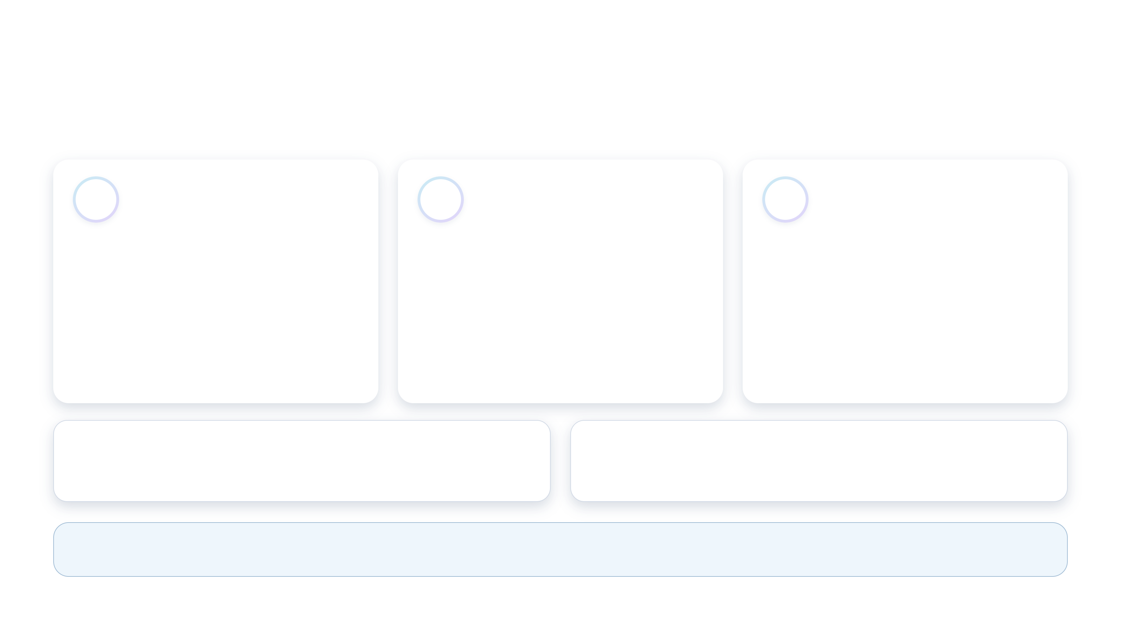

05 / GETTING STARTED
Deploy Core once. Add the process. Verify.
Repository deployment skills guide the setup through explicit confirmation.
01
02
03
Check readiness
Install Core
Add Order Processing
Select the environment.
Configure the runtime identity, import
Configure the automation account and
Check access, licenses, credits and
the solution and wire connections.
mailbox; activate workflows and assign
required features.
roles.
Verify Core components.
Confirm before changes.
Verify the installation.
ASK GITHUB COPILOT IN VS CODE
THEN ASK
Deploy Business Process Core
Deploy Order Processing
deploy-business-process-core
deploy-order-processing
Automated assistance,
not a bypass of permissions or administrator approval.
Agentic Business Process Automation on Copilot Studio
20 / 23
Notes:
The skills install or verify tooling and perform readiness checks before making changes. Core requires Dataverse administrator access and Entra app-registration rights; provisioning an environment adds Power Platform administrator access. Order Processing adds user/license and Exchange administration requirements, a dedicated automation user and a shared mailbox with delegated access. The manual guides are available for the same operations. Developer-side GitHub Copilot access is distinct from runtime Copilot Studio licensing.
Sources:
Repository overview - reusable Core, architecture, deployment and licensing
../../README.md
Order Processing - process, agents, human gates and sample limitations
../../business-processes/order-processing/README.md
BusinessProcessCore deployment guide
../../core/solution/DEPLOYMENT.md
OrderProcessing deployment guide
../../business-processes/order-processing/solution/DEPLOYMENT.md

Slide 21
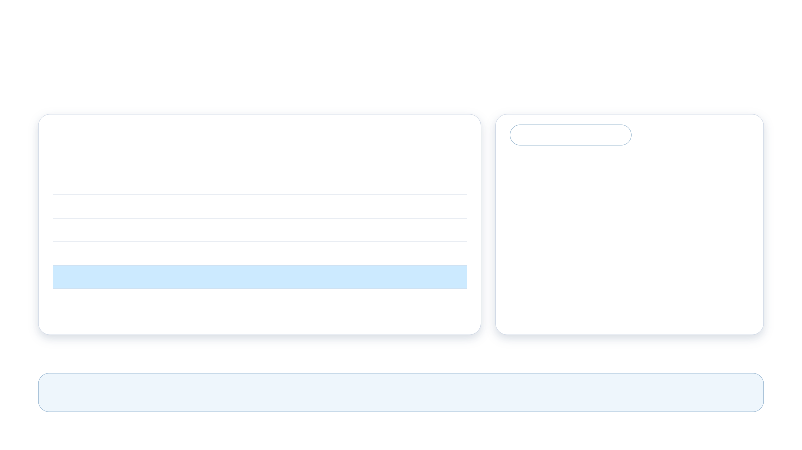
05 / GETTING STARTED
What you need to run - and move beyond - the demo
Plan user access, consumption and the path to a customer-specific pilot.
Runtime licensing checklist
FROM SAMPLE TO PILOT
REQUIREMENT
APPLIES TO
Make it yours
Power Apps Premium
Console users, reviewers and approvers
Copilot Studio user license
Makers + automation account
1.
Replace fictional catalog, inventory and
promotion data.
Microsoft Teams
Users + automation account
Exchange Online
Automation account for mailbox access
2.
Add and validate the ERP integration -
payload generation is not posting.
Copilot Credits
GitHub Copilot harness: build, test, run
3.
Review access, evaluate agent behavior
Prepaid capacity or pay-as-you-go. M365 Copilot does not cover this harness consumption.
and measure customer outcomes.
Verify tenant entitlements.
Deploy. Exercise the reference. Choose the next business process.
Agentic Business Process Automation on Copilot Studio
21 / 23
Notes:
This is a planning checklist, not a binding licensing assessment. User-license entries are sourced from the two READMEs. Microsoft Learn confirms Power Apps Premium for code app end users and Copilot Credit consumption from authoring through runtime for the GitHub Copilot harness. Reconfirm current user entitlements, tenant capacity, environment features, admin rights and commercial terms before deployment. The MIT repository license does not grant Microsoft service licenses. Production work also includes testing, access controls, reliable integration and monitoring. Shared-mailbox licensing depends on configuration; the listed Exchange requirement is for the automation account.
Sources:
Repository overview - reusable Core, architecture, deployment and licensing
../../README.md
Order Processing - process, agents, human gates and sample limitations
../../business-processes/order-processing/README.md
Microsoft Learn - Usage-based billing for the GitHub Copilot harness
https://learn.microsoft.com/microsoft-copilot-studio/agents-experience/billing-credit-overview
Microsoft Learn - Power Apps code apps prerequisites and licensing
https://learn.microsoft.com/power-apps/developer/code-apps/overview
BusinessProcessCore deployment guide
../../core/solution/DEPLOYMENT.md
OrderProcessing deployment guide
../../business-processes/order-processing/solution/DEPLOYMENT.md

Slide 22

05 / GETTING STARTED
Add a new business process
Reuse the Business Process Solution. Specify and build only what makes your process different.
Build on the reference pattern
Accelerate with Agent Forge
WORK IN PROGRESS
1.
Define the process contract
Proposed spec-driven, agentic development path
Trigger, stages, data, business rules, human gates and acceptance
criteria.
Analyst Agent
2.
Implement the domain pieces
Clarify requirements, process rules and exceptions.
Create a new folder under business-processes, alongside order-
processing. Add stage workflows, agents + skills, review widgets,
roles and configuration.
Product Owner Agent
Turn the agreed specification into a prioritized backlog and
3.
Connect to the shared runtime
acceptance criteria.
Persist typed outputs; advance through Dataverse step events; use
the Core task APIs.
GitHub Copilot
4.
Validate and deploy
Implement and test scoped work against the specification and
Test rules, permissions, human decisions, recovery and integrations.
reference patterns.
Package as a separate process solution.
Agentic Business Process Automation on Copilot Studio
22 / 23
Notes:
Start with a bounded business process and agree its inputs, stages, human decisions, exception paths, system-of-record integrations and measurable acceptance criteria. Follow Order Processing as the reference rather than rebuilding the shared runtime. The process contributes stage workflows, Copilot Studio agents and focused skills, review widgets, security roles and environment variables. Use the Core contracts for durable state, typed outputs and human tasks; stage continuation is driven by persisted Dataverse step events. Test domain rules, output schemas, access, concurrency, recovery and integrations before deploying the process as its own solution on the installed Core. The right-hand section presents the proposed Agent Forge approach requested for this presentation: Analyst Agent clarifies requirements; Product Owner Agent shapes the approved specification into implementable backlog items and acceptance criteria; GitHub Copilot assists with implementation and tests. These responsibilities describe an intended workflow, not a verified integration in this repository. Explicitly call it work in progress. Faster delivery is an aim, not a measured claim. Human approval, code review, evaluation and deployment controls remain necessary. Developer-side GitHub Copilot is distinct from the Copilot Studio GitHub Copilot harness used at runtime.
Sources:
Repository overview - reusable Core, architecture, deployment and licensing
../../README.md
Order Processing - process, agents, human gates and sample limitations
../../business-processes/order-processing/README.md

Slide 23
Notes:
Close with discussion and questions. Return to Getting Started for the official repository link; replace its placeholder URL before sharing externally.
Sources:
Repository overview - reusable Core, architecture, deployment and licensing
../../README.md
Order Processing - process, agents, human gates and sample limitations
../../business-processes/order-processing/README.md

