Slide 1
DatagenDV: Python Constrained Random Test Stimulus Framework
Jonathan George
James Mackenzie
Microsoft
Notes:
Welcome to my presentation on DatagenDV.
My python stimulus framework.
My name is Jonathan George and I am a design verification engineer from Microsoft.
My partner on this paper was James Mackenzie.

Slide 2
Agenda
Infrastructure Background
Features of DatagenDV
Python Libraries Leveraged
Examples of DatagenDV
Lessons learned
Notes:
For this presentation, I am going to discuss my framework for generating test data using python.
To start, I will give some background on my group’s test infrastructure prior to my contribution.
This will lead into how DatagenDV enhanced this existing test flow.
Datagen’s features are all supported by standard and open-source python libraries.
And I think the most useful and interesting thing about Datagen is how I was able to combine all of these useful tools into a single framework with the aim of generating test data.
Finally, I’ll go over how I was able to make use of Datagen on my project and what I learned from this experience.

Slide 3
Existing Infrastructure
Limitations:
C Stimulus generation during sim is slow
YAML stimulus generation is limited
Test Inputs
C Header
YAML
C Definitions
C Test Settings
Simulation
Emulation
Validation
Embedded C Test
Notes:
My group’s chip test environment is not the standard UVM SV testbench.
Because our chips have embedded SOCs, the stimulus was done thru C firmware.
These C testcases could be controlled through a YAML test configuration file to allow for the same code to handle many different testcases.
These same tests were used for Simulation, Emulation and Validation.
This approach worked well for directed testcases, but would hit a wall when we wanted to create more complex scenarios.
*Transition*
If test data was generated in the embedded C environment, then we wasted countless simulator clock cycles.
On the other hand, YAML isn’t a very useful language for data generation.
On previous projects, test writers got around these issues by creating stimulus generation scripts.
Datagen is an attempt to solve this problem for all our projects going forward.

Slide 4
DatagenDV
Datagen
Input
YAML
1
Datagen Parameters
Python
DatagenDV
Constrained Random
3
Data Generation
Datagen
Outputs
C Header
YAML
C Binary
2
1
2
Generated Definitions
C Test Settings
Compressed Test Data
Simulation
Emulation
Validation
Embedded C Test
Notes:
Datagen is a pre-simulator python application which allows us to take advantage of an OOP language to accomplish complex stimulus generation.
There are 3 main features of Datagen I want to highlight today.
*Transition*
First is YAML parsing and dumping.
To keep Datagen’s interface consistent with legacy tests, it is controlled using the same YAML configuration format.
Datagen augments it as needed before passing it onto the C test which runs with the simulator.
*Transition*
Secondly, We need to make the transfer of data from Datagen to C as smooth as possible.
Datagen does this by generating common structures and definitions for the C environment to use.
The data generated can be written out as C binary files.
This is a more efficient format for loading raw input data into the embedded test environment.
*Transition*
Finally, Datagen also supports constrained randomization allowing us to more create complex stimulus.

Slide 5
Python Libraries
Python standard or open-source library
Datagen
Input
ruamel.yaml
YAML
Datagen Parameters
Python
dataclasses
DatagenDV
PyVSC
Constrained Random
Data Generation
Datagen
Outputs
ctypes
ctypes
C Header
YAML
C Binary
ruamel.yaml
Generated Definitions
C Test Settings
Compressed Test Data
Simulation
Emulation
Validation
Embedded C Test
Notes:
Now I didn’t invent any of these features or ideas.
They were already implemented open-source python libraries.
Currently python is the most used programming language.
In my opinion, its biggest strength is its very active developer community.
This can be a bit foreign if you have always worked with SystemVerilog or Specman e.
It seems that whenever I google something about SystemVerilog, the answers always come from the same person.
Thanks for all the help Dave.
In addition to the abundance of online help,
Python makes developing, deploying and installing libraries straightforward and easy.
The hardest part is usually finding the person with ‘pip install’ permissions for your project.
Now there is still some work to be done to apply these libraries to verification.
Datagen’s primary value is showcasing how these different libraries can be integrated together.

Slide 6
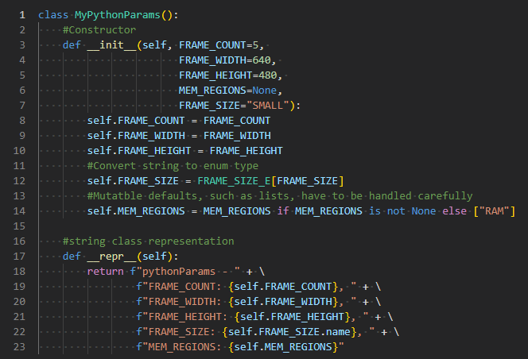
The Different Syntax of Python Classes
Where are the fields?
‘new()’ -> ‘__init__()’
‘print()’ -> ‘__repr__()’?
‘this’ -> ‘self’?
“I’ll just use dictionaries instead”
Notes:
Before we dig into Datagen and its libraries, lets quickly talk about python classes.
I wanted Datagen to feel familiar to engineers coming from UVM and classes are a big part of that world.
Python’s default class syntax is pretty different from System Verilog.
If I asked you to tell me what the fields of this class were, it would probably take you a second.
How about their type?
It’s not so obvious in vanilla python.
The constructor is called init, the print() function is called __repr__.
Instead of the ‘this’ keyword, you use ‘self’ and you use it everywhere.
My experience is that generally, verification engineers learning python stop when they get to classes.
*Transition*
Instead, they go back to dictionaries which are more intuitive to them.
On long lived scripts and larger applications, overusing dictionaries doesn’t scale and leads to messy spaghetti code.
This is why I highly recommend using the Dataclasses library.

Slide 7
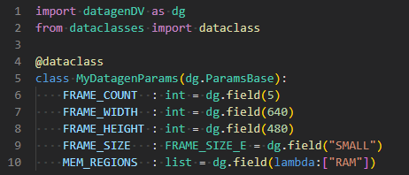
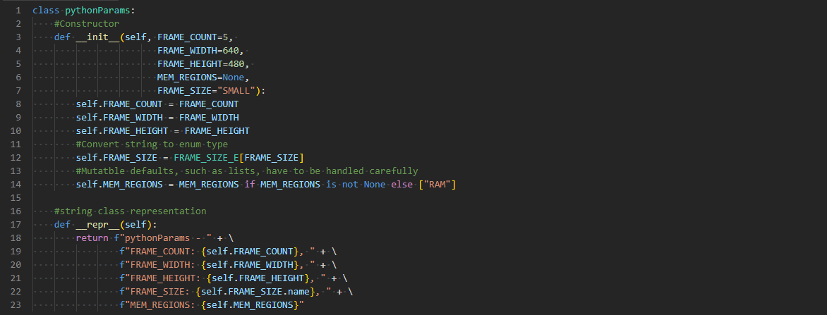
Dataclasses – UVM Object Macros for Python
dataclasses
Generated by @dataclass
Notes:
The Dataclasses library makes python classes less intimidating.
It looks a lot more like a class definition in other OOP languages.
Each field is declared up front with their name, their typehint and their default value.
*Transition*
The dataclass decorator, notated by the @ on line 4, handles the details by generating the constructor and print functions.
Much of what the dataclasses library does is analogous to the UVM object utility macros.
So the next time you go to write a python application, use the dataclass library.
when we are building our own framework like Datagen, there is a more useful feature: Introspection.

Slide 8
Dataclasses – Introspection
dataclasses
Dataclass.fields(MyDatagenParams)
{ name='FRAME_COUNT', type=<class 'int'>, default=5 }
{ name='FRAME_WIDTH', type=<class 'int'>, default=640 }
{ name='FRAME_HEIGHT', type=<class 'int'>, default=480 }
{ name='FRAME_SIZE', type=<enum 'FRAME_SIZE_E'>, default='SMALL' }
{ name='MEM_REGIONS', type=<class 'list'>, default_factory=<lambda> }
DatagenDV
Features
Automatic type checking
Converts strings to enums
Safeguards against mutable default types
Notes:
Introspection allows our code to examine itself which is critical when writing generic, dynamic code.
Using the Dataclass.fields() function we can see all the details about each field in the class.
*transition*
This introspection enables DatagenDV to do many useful things.
Datagen’s ParamsBase class uses it to provide type checking, type conversion and preventing common mistakes with around mutable default types.
These features help ease the verification engineer into their python work while hiding the magic.
Familiar Class Structure using Dataclasses
Python classes can be intimidating at first glance because it's syntax is fairly different from languages like SV or C++. Many engineers to tend to avoid them and overuse dictionaries instead which leads to less maintainable spaghetti code.
Dataclasses is a standard built in library which changes the class syntax to something closer to more familiar languages.
To make things even easier for users, DatagenDV provides a wrapper which handles additional features like explicit type checking and yaml directional specification.

Slide 9
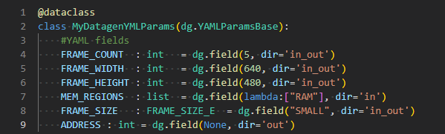
YAML Class Loading and Dumping
ruamel.yaml
Dataclass.fields(MyDatagenYMLParams)
{ name='FRAME_COUNT’, ... , metadata={ yml_dir=‘in_out'} }
{ name='FRAME_WIDTH’, ... , metadata={ yml_dir=‘in_out'} }
{ name='FRAME_HEIGHT', ... , metadata={ yml_dir=‘in_out'} }
{ name=MEM_REGION’, ... , metadata={ yml_dir=‘in'} }
{ name='FRAME_SIZE’, ... , metadata={ yml_dir=‘in_out'} }
{ name=‘ADDRESS’, ... , metadata={ yml_dir=‘out'} }
DatagenDV
Features
YAML loading/dumping directly into/from objects
Fields loaded/dumped based on direction
Notes:
Now that our framework has a foundation with dataclases, we can extend it to support the features we need.
The first feature is loading YAML into objects and then dumping it back out.
Datagen uses a library called ruamel.yaml to automate this behavior
This is done through a base class implementing the required class functions.
I highly recommend using classes instead of dictionaries for loading configuration data.
They act as pseudo documentation which will stay up to date as things change.
Datagen helps encourage this by requiring that the configuration file’s data matches the class field type and spelling.
Recall that Datagen supports using YAML both as input and output.
However, sometimes we wanted to include or exclude a field for various reasons.
This “directional” preference is easily stored as part of the dataclass field as “metadata”.
*Transition*
Here I’ve replicated how this changes the fields() structure.
The base class then uses this information to adjust the loading and dumping.
Being able to wrap the dataclasses functionality in your own custom interface is a powerful tool for designing the user experience of your framework.

Slide 10
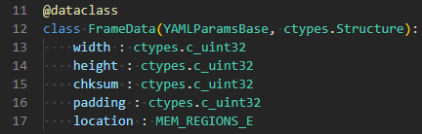
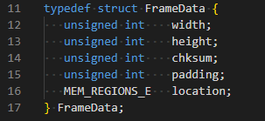

ctypes – Bridging the Language Gap
ctypes
DatagenDV
Features
Generation of C headers (structs, enums, defines)
Generation of binary data
Notes:
The next feature of Datagen is its utility functions to convert classes and data into their C counterparts.
In this case, we leverage ctypes library.
Those familiar with python know that its variable types are less strict and from C’s types.
By replacing our python typehints with the types provided by the ctypes library, we can match our C environment more exactly.
In this example, we use unsigned 32-bit integers.
These types are leveraged by Datagen to do two useful things.
*Transition*
The first is taking a python class definition and convert it to a C struct.
Automating this conversion means we don’t have to maintain both a python copy and a C copy of every class.
*Transition*
The second function takes an object populated with test data and converts it to a binary file.
This binary file’s format matches the memory layout of our C compiler.
Let me explain why this is useful.

Slide 11


ctypes – Loading Binary data into C
ctypes
Notes:
In this example, we have created a python object with the desired data.
Datagen converts this into both the struct definition and a binary file.
You can see here both the binary files format as well as the raw hexdump.
The full C code to load this data is seen in this center code section.
First, we open the binary file.
Then we declare can pointer of the struct and allocate memory for it.
Now we can read the data from the file into that memory location.
At this point, the data is fully accessible through the struct without any need for additional parsing.
This way of loading outside data into our C environment proved more efficient and was ideal for large raw input data which our DUT would process.
Now I have to put a big disclaimer here.
Bit packing isn’t part of the C Standard and is supported differently across compilers.
Ctypes doesn’t support all packing formats, specifically very tightly packed structs.
If you run into this issue, I recommend writing a custom function to generate the needed format.
I also wouldn’t recommend this approach if you might change compilers suddenly.

Slide 12
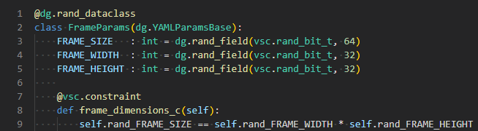
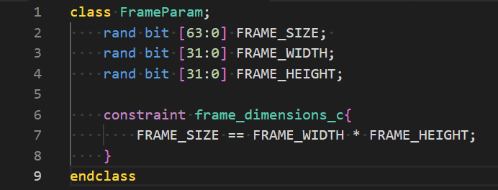
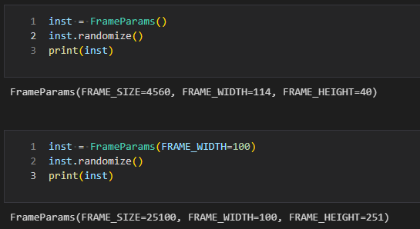
PyVSC - Constrained Randomization
PyVSC
Full random
Override FRAME_WIDTH
Datagen
Features
Integrated PyVSC into dataclass objects
Override values through constructor or YAML loading
Notes:
Now that we can get data in and out of our framework, we need to start generating data.
Datagen supports constrained randomization through PyVSC.
PyVSC is an open-source library which aims to implement the same constraint API of System Verilog.
I was able to integrate PyVSC into Datagen’s class framework by creating custom decorators and field functions.
This example shows the basic constraint relationship between the sides of a rectangle and its area.
We created three random integer fields with the constraint “Width * Height equals Size”
*Transition*
The corresponding SV code looks like this.
You can see that it is very similar, line for line, and that is pretty much true for any SV we converted into PyVSC.
This made converting block testbench constraints to PyVSC for our chip testbench very easy.
*Transition*
To randomize, we call the randomize function.
As an additional feature, Datagen allows us to override fields directly by declaring their value through the constructor
This is convenient for controlling randomization directly from our configuration YAML.
Constrained randomization using PyVSC
The most useful feature of DatagenDV is it's leveraging of PyVSC for constrained randomization and overriding constraints from YAML to tune testcases.
Datagen's rand_field() wrapper creates pyvsc variables used for randomizing with a rand_ prefix. Having two variables helps facilitate overriding values from yml or the class constructor.
In this simple example, we've created constraints to calculate the area of a square based on the height and width.
If we create the object passing in the area and randomize it, then that value is preserved, and the constraints take it into account
Likewise if we specify the width, then the area and height are calculated accordingly.

Slide 13
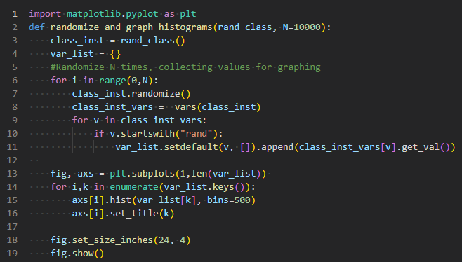
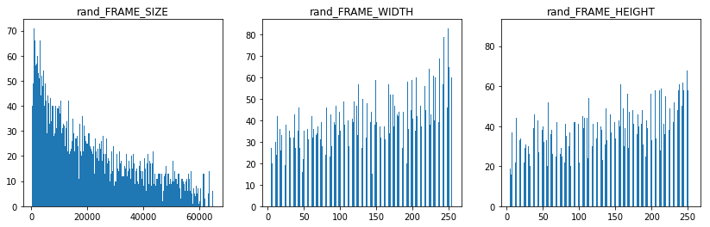
PyVSC – Randomization Analysis
Leverage python’s data science libraries to analyze constraints!
Notes:
Here is one easy way to analyze a class with constraints.
This function takes any Datagen class and randomizes it 10000 times.
Then it generates histograms for each field.
Using this method, we were able to identify distribution anomalies.
We reported these issues back to the pyVSC developer and quickly got back fixes and suggestions.
My main point here is that python gives you great tooling to analyze and find issues ahead of when they are a problem.

Slide 14
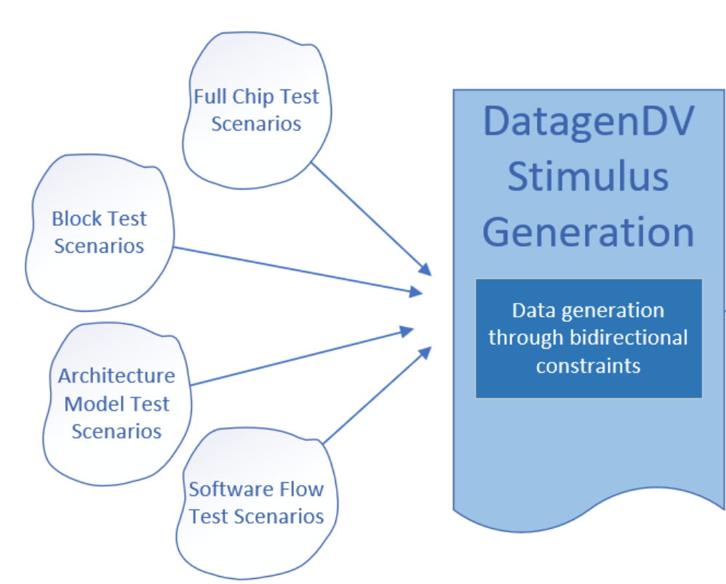
Project Implementation
Leveraged block constraints
Supported many different scenarios
YAML as a “universal language”
Notes:
On my project, we were able to save a lot of time by converting SV constraints into PyVSC constraints.
Without a constraint solver, we would have had to write this with sequential randomization logic which would have taken longer and been far more limiting.
These bidirectional constraints allowed our testcases to employ a “fill in the blank” strategy.
When the architecture model’s dumps didn’t contain every field, Datagen was able to derive valid values.
When we wanted to target a specific block in a test, Datagen could randomize the remaining blocks to match those requirements.
Because YAML is human readable and commonly used. It was intuitive to our stakeholders from the architects up to the software team.
It served us well as a universal language for talking about testcases.

Slide 15
Lessons Learned
Successes
Designing up front!
Training others on Python
Challenges
Ctypes doesn’t support all packing formats
Suggestion: Prototype first.
PyVSC can require fine tuning
Suggestion: Analyze randomization results
Notes:
Datagen’s success on our project was largely due to the initial time I was able to spend planning and designing our strategy at the beginning of our project.
There was an emphasis from our verification lead to learn from past projects and design something which would live beyond the current one.
I think this approach helped us avoid the mistakes of past projects but also set us up for success on the next project.
Secondly, Python has continued to prove to be easy to train other engineers on.
Most college grads come out knowing a lot of python.
It is also very helpful if you craft your framework towards those transitioning from UVM.
Although Python open-source libraries provides a lot of benefit, there were some challenges.
Ctypes doesn’t support tightly packed struct formats.
In some cases, we had to write custom binary generation functions to work around this.
My suggestion is to prototype and check your assumptions in this area to avoid painful debugging later
Secondly, although it is very impressive and useful, PyVSC is still maturing as a library.
Some constraints can require some fine tuning to get the best distribution.
My suggestion here is to make good use of Python’s data analysis libraries.

Slide 16
What’s Next?
DatagenDV is open source.
https://github.com/microsoft/datagenDV
Executable Jupyter Notebook Examples!
MIT License
Future Development:
Leverage existing C definitions
Automated conversion of SV to PyVSC constraints
Contributing to PyVSC and other Python verification tools
Notes:
If you are interested in seeing more Datagen examples or want to dig into its source code (600 lines), then take a look at it’s github repo.
I have jupyter notebook examples that you can run yourself.
I expect that it is most useful as an example and inspiration for your own python verification applications. I doubt that there are many of you interested in a YAML based C stimulus generator.
There are a number of possible enhancements for Datagen.
First is support for parsing and leveraging existing C definitions.
I have some code kicking around that can do this, but it still needs some refining.
I’d also like to have automated conversion of SV constraints to PyVSC.
And finally, I’d love to see and be involved in more development of python constraint solvers and other verification tools.
I think python verification has a lot of potential if it ends up getting similar development opportunity as SystemVerilog.
I want this because I think programming in python is a lot of fun!

Slide 17
Questions?

