Slide 1


Jayne Doe
Jane Doe
Fuzzy Matching IP
Doe, Janie, Ms.
AC&AI Domain (D&AI)
July 2020
Jane R. Dough

Slide 2
This is an internal document. Do not distribute
Questions: contact alison.king@microsoft.com, Isaac.gritz@microsoft.com, or willie.ahlers@microsoft.com

Slide 3
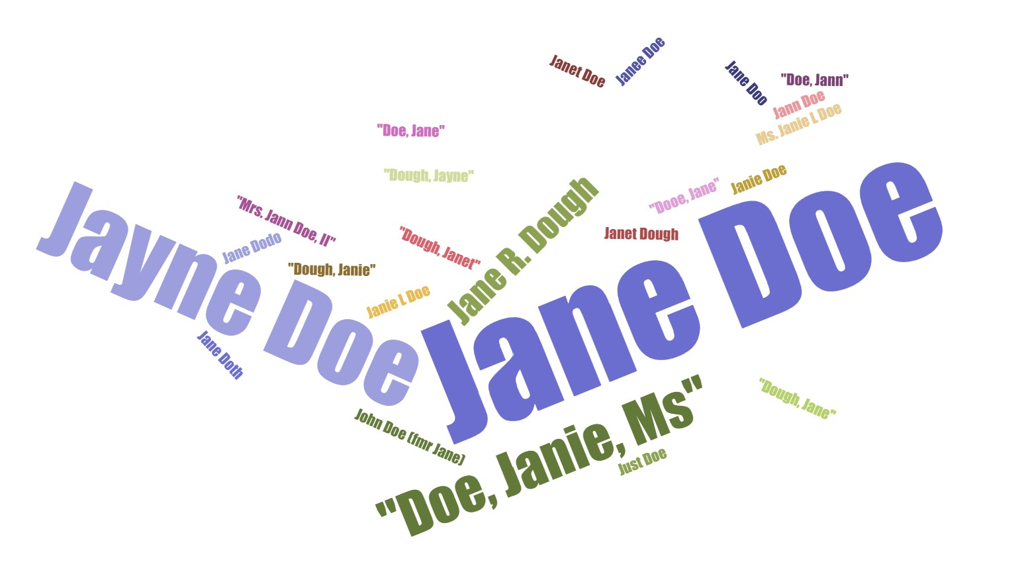


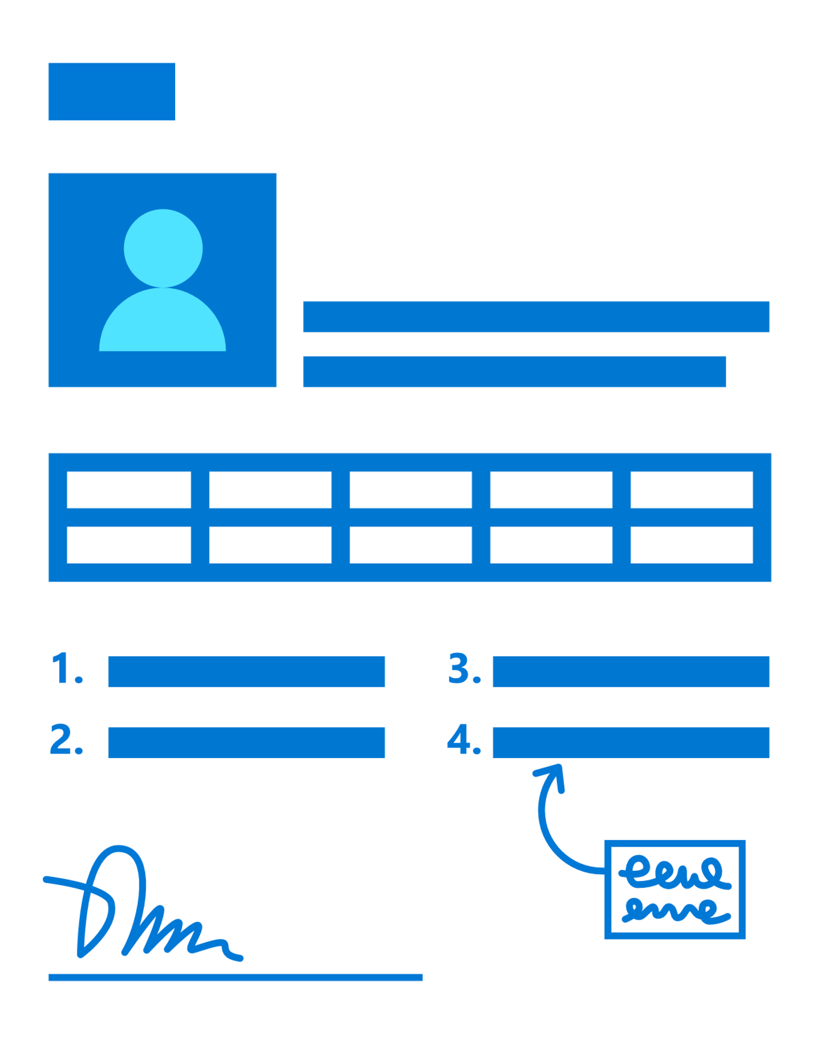

When to use Fuzzy Matching?
Situations in which the client needs to develop data-driven insights from disparate data sources with missing keys, messy data and/or unstructured data.
Examples include:
Single view of the customer (golden record or single source of truth)
Employee records, including skills & capabilities
Longitudinal patient records
Other master data management applications
Jane R. Doe
?
?
?
Jane Doe
Notes:
https://www.forbes.com/sites/williamarruda/2020/07/12/6-trends-that-will-shape-the-gig-economy-in-the-2020s/#22b3e8b41565
https://microsoft.myhbp.org/leadingedge/asset/view/H05EPT-PDF-ENG
https://microsoft.myhbp.org/leadingedge/asset/view/H03VU5-PDF-ENG
graph source:
https://hbr.org/2013/05/talent-management-boards-give

Slide 4
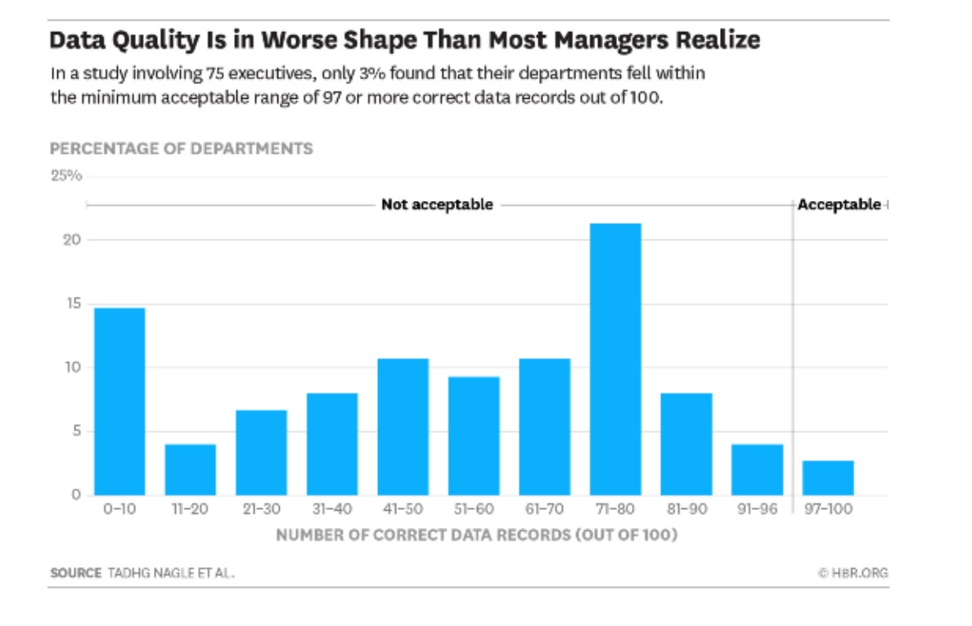
Common client pain points
“You can’t do anything important in your company without high-quality data, and most people suspect, deep down, that their data is not up-to-snuff. They do their best to clean up their data, install software to find errors automatically, and seek confirmation from external sources — efforts I call “the hidden data factory.” It is time-consuming, expensive work, and most of the time, it doesn’t go well.” – HBR, Feb 10 2020
This deck will describe Fuzzy Matching, use cases, process best practices and links to IP.
Notes:
https://www.forbes.com/sites/williamarruda/2020/07/12/6-trends-that-will-shape-the-gig-economy-in-the-2020s/#22b3e8b41565
https://microsoft.myhbp.org/leadingedge/asset/view/H05EPT-PDF-ENG
https://microsoft.myhbp.org/leadingedge/asset/view/H03VU5-PDF-ENG
graph source:
https://hbr.org/2013/05/talent-management-boards-give

Slide 5
The need for Fuzzy Matching is ubiquitous
Taxation Office
Ad Agency
Home Healthcare
Public Sector
Taxation office needs to match employee name to internal records in order to pay that employee
Large global advertising agency needs to match existing experts with new project demands
Large at-home healthcare company needs to optimize their field work force scheduling
Public sector client needs to match historical system risk statements to new systems
Utility Company
Recruiter
Accounting Firm
Tax Authority
Large utility company needs to scan complicated invoices to ensure veracity of billing and revenue collection
Start-up recruiting company needs to match unstructured job requisitions with different unstructured talent descriptions
Large accounting firm wants to optimize their employee account assignments
Tax authority wants to deduplicate records to uncover fraud
Credit Card Company
Microsoft
Consulting Firm
Health Insurer
Large credit card company needs to deduplicate multiple source records
Microsoft Learning needs to recommend learning path for new college hires
Consulting firm needs to assess workforce skills against changing client demands
Healthcare company wants to create patient longitudinal record

Slide 6

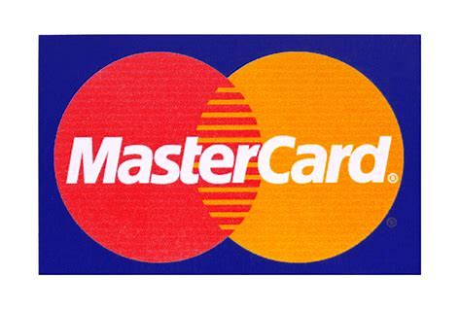












Microsoft Consulting is engaged to solve these problems for our global clients
To date:
Every engagement that uses fuzzy matching has started from scratch and defined their own approach.
Of the clients on this slide, we didn’t always win their business because the solution was custom (and expensive) or we couldn’t describe the impact effectively.
There is no shared repository for fuzzy matching knowledge even though it is incredibly common in our custom solutions.
We are behind competitors in using fuzzy matching to solve key business challenges.

Slide 7
Examples
designer
UX architect
UX consultant
UX/UI consultant
UX lead
information Architect
design strategist
facilitator
graphic designer
Jayne Doe
Jane Doe
Jane Doe
is a
Doe, Janie, Ms.
Jane R. Dough
lead Scrum
code C#
do user testing
code Python
do data science
do business analytics
play Bach on a kazoo
Jane Doe who lived at 1822 Main Ave, Anytown, USA between September 1993 and August 1995
Jane Doe
Jane Doe
knows
how to

Slide 8


Seven Scenarios across two categories represent the highest use cases
People Matching
Data Management
finding experts
staffing projects
hiring
skill/training recommender
master record
deduplication
entity matching

Slide 9
Process Overview
Ingest
Match
Output
Structured
Data
Jane R. Doe
[jane, r, doe]
1
Pre-Process
Doe, Janie Ms.
[doe, janie, ms]
Jane Doe
[jane, doe]
Name | …. | …
Doe, Janie Ms. | … | …
Name 1 | Name 2 | Match
[jane, r, doe] | [doe, janie, ms] | 90%
[doe, janie, ms] | [jane, doe] | 93%
[jane, r, doe] | [jane, doe] | 95%
2
Matching
Jane Doe
Unstructured
Data
3
Set threshold & link or de-duplicate records
> 90% match
Name | …
Jane Doe | …
Jane Doe | …
Jane Doe | …
Jane R. Doe
Jane Doe

Slide 10




In designing a Fuzzy Matching system, the client needs to also set up the “So what” for the output
e.g.
Jane Doe
record
updated
kicks out to a human
operator for review
feedback provided via interactive experience, e.g. App, web interaction
action taken
Fuzzy Matching
Output
automated
high touch

Slide 11

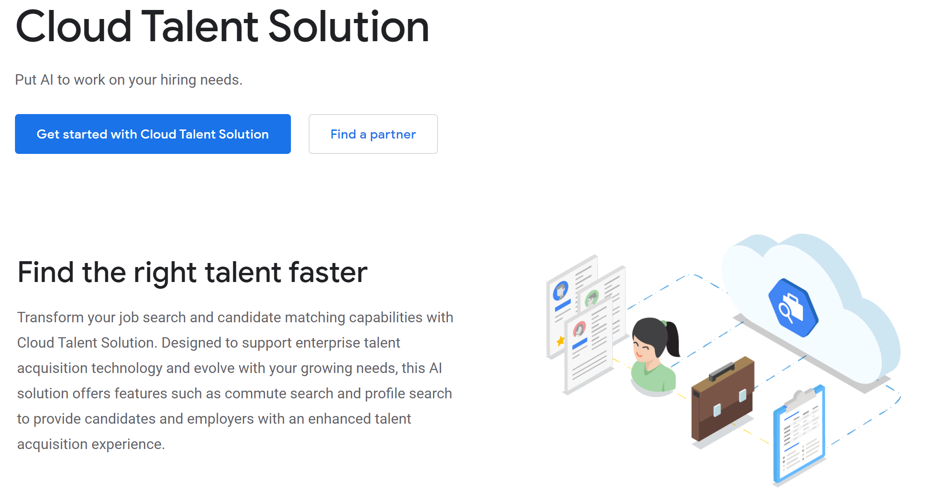
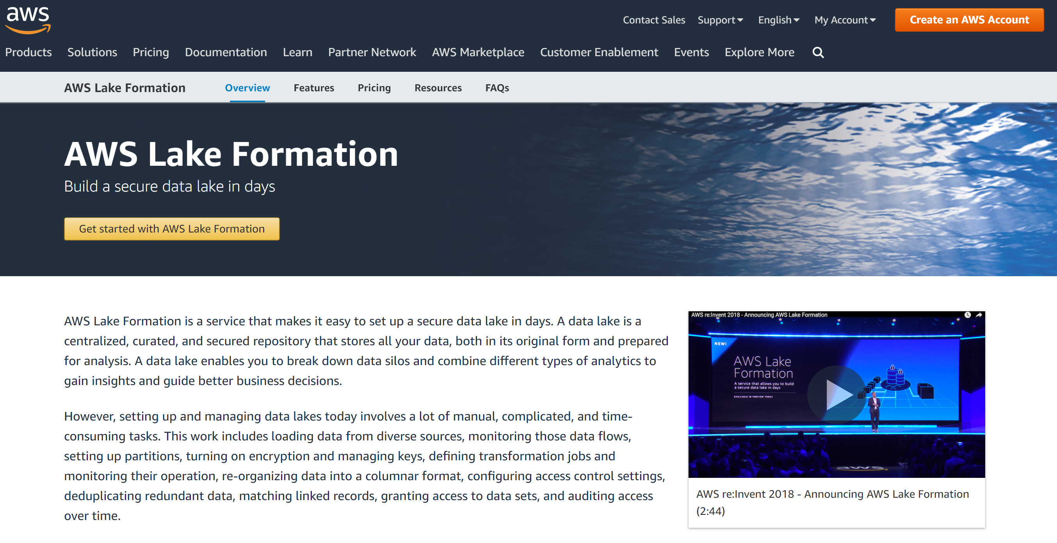
Competitors have offerings in talent management and data management
This is a challenge...if we were able to accelerate, we could open up these conversations with customers again.
Google Talent Solution
AWS Lake Formation
https://cloud.google.com/solutions/talent-solution
https://aws.amazon.com/lake-formation/
It would be a huge benefit for an Azure catalog

Slide 12
Tips and lessons learned
ALL:
The client needs to own the “so what” of the model
A semantic knowledge graph solution is the most complex solution and more challenging than other architectures
People Matching:
It is generally important to use an existing skill ontology
Stronger need for UX than other types of fuzzy matching problems
User testing is crucial to ensure the accuracy of the system
LinkedIn IP is only available via an enterprise license and legal contract for limited use.
A speech-to-text user experience and/or NLU can add an additional layer of error with fuzzy matching solutions
Data management:
In addition to this work, check out CSEO Data Unification.
Adding Azure data catalog gen2 and into AZ roadmap
It may require a labeled training set to achieve sufficient accuracy
Scalability is a really big concern so techniques like blocking and Spark-based approaches are important.

Slide 13
What’s in this IP toolkit and how to use it
This associated wiki contains in-depth best practices and resources for implementing fuzzy match solutions. The wiki is broken down into the following sections:
Data Management
People Matching
Knowledge Graphs
ubiquitous

Slide 14
Participate!
Contribute to the Fuzzy Matching Wiki:
Questions: contact alison.king@microsoft.com, Isaac.gritz@microsoft.com, or willie.ahlers@microsoft.com

Slide 15
Thank you to:
Simon Lidberg
Alex Curtis
Andre Magni
Arief Bavan
Norah Abokhodair
Dieter Schwarenthorer
Jean Louis Lezaun
Srinath Sivalenka
Angshuman Kalita
Richard Bumann
Philip Carpenter
Martin Kayser
Ben Wright-Jones
Nadeem Ishqair
Manoj Kumar
Ahmar Kazi (KAZI)
Salim Naim
Vijay Anala

Slide 16
Appendix

Slide 17
While all Fuzzy Matching, the use cases have different degrees of difficulty
 |  |  | unstructured data | training taxonomy | training set | explainability | maintenance | high UX | curation
1 | people | finding experts
2 | people | staffing projects
3 | people | hiring
4 | people | skill/training recommender
5 | data | master record
6 | data | deduplication
7 | data | entity matching
simpler
difficult

Slide 18
Complete list of links and more material
Wiki
CSEO Data Unification Service
WW Learning
Knowledge Graph Solution on Azure

Slide 19

Knowledge Graph
Knowledge graphs allow you organize unstructured and structured data in a contextually aware, domain-specific graph.
contextually-aware recommendations
improved organization search
advanced intelligent bots
better alignment of structured and unstructured data sources
increased transparency into the connections between organizational data

