Slide 2
Data unification at scale
Danny Godbout
CSEO Data
aka.ms/dataunification

Slide 3
Session goals
How Unification enables 360 insights
Highlight challenges in current solution landscape
End-to-end overview of MDU
Introduce key differentiators/advancements
Notes:
This slide is required. Do NOT delete. This should be the first slide after your Title Slide.
This slide should describe what your goals are for this session. This information lets your audience know what you are trying to accomplish with your talk or tutorial—ie, what value will attendees get by investing 25 minutes or 2 hours of their time listening to you.
You should not spend more than 1 minute presenting this slide.
General examples of session goals could be (you will have to create your own specific goals):
Introduce a new technique or approach to solve a customer problem
Compare two approaches and explain why one is superior
Describe a project and the learnings that audience members can apply from it
Teach audience members how to use a specific technology

Slide 4
Motivation

Slide 5



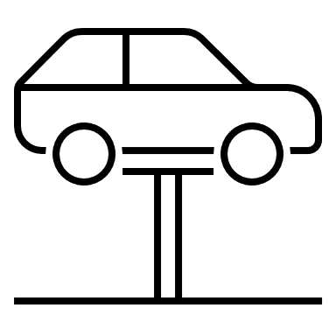



Transaction example
Dealer
Customer
Dealer
Name | Address | Country | ID
Joe Contoso | 123 Microsoft Way, Redmond, WA | US | 12345
Joseph Contosso | 123 Microsoft W. Suite 5, Redmond | US | ABCDEFG
Notes:
In the automotive industry, dealerships are independent from OEMs and manage their own business systems.
When we look at records coming from dealerships, they will refer to the same customer with different spellings.
If a large customer is negotiating for a discount, how does the OEM 1) Find prior discounts offered to the customer and 2) Optimize pricing based on customer segmentation if transactions are fragmented?
In a real project, 6 months of a 9 month consulting engagement was spent manually cleaning data for modeling. The day that activity ended, the data started going stale.
Ongoing data management required multi-million $ MDM investment, kicked off customer 360 effort that tried to align the corporation on a single definition of customer.
C360 then starts linking sales systems to finance, warranty, service, etc. systems that were never keyed to be joined.
Why are the barriers to entry so high? Why is it so expensive and time consuming to do something so simple?

Slide 6
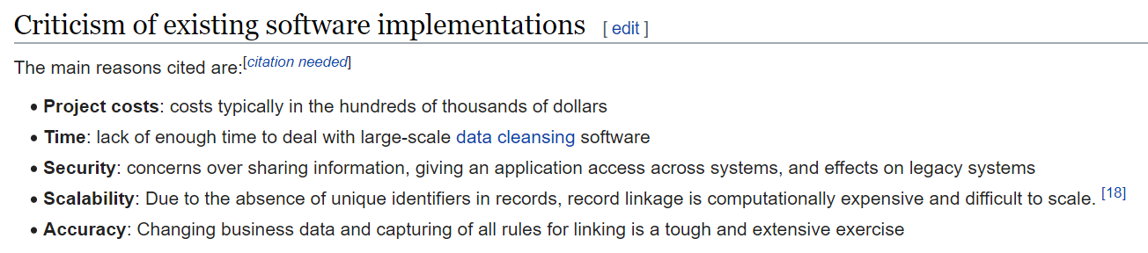
Challenges
+ Domain-Specific Platforms (e.g. Customer or Product Mastering)
Notes:
https://en.wikipedia.org/wiki/Record_linkage#Criticism_of_existing_software_implementations
O(n^2) time complexity == Limited scale
Cost: $250k/year → Master Data effort, solution by committee
Deterministic Linkage: Complex rule authorship
Difficult to validate
Domain specific

Slide 7

Goals
Domain agnostic
Rule-free
Interpretable
Elastic and cloud native
Notes:
Goals are to reduce the barriers to unifying records with a product that is:
Domain agnostic
Rule-free
Interpretable
And elastic + cloud native

Slide 8
Solution architecture

Slide 9
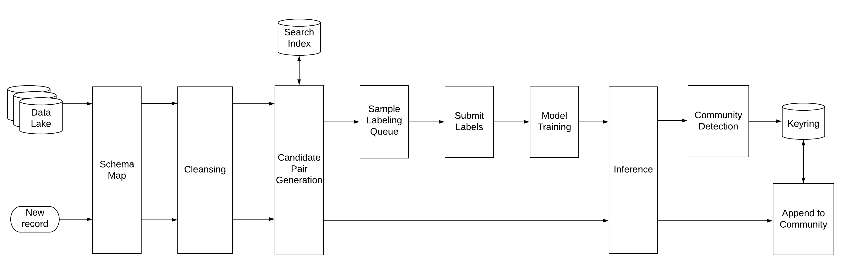



Architecture diagram
Active learning eliminates rules
High recall, low precision filter
Graph linkage
Notes:
Indexing/Pair Generation: High Recall, Low Precision Filter
Similarity Measurement
Active Learning
Community Detection
Inspection

Slide 10
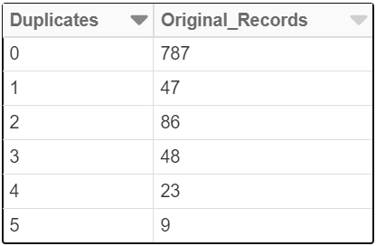
Approach
Records
‘Pair’ comparing two records
FEBRL synthetic dataset with Ground Truth (1000 original, 500 duplicates):
Notes:
We’ll step through each step in detail. For this case, we’ll show a dataset representing individuals- this is a special case where we know the ground truth, thanks to FEBRL’s ‘generate’ engine.
We can think of the records as nodes in a graph and their connections as edges. In the beginning, without context, this is a fully connected graph that requires us to measure all pair similarities to find the matches between records.
‘’’
FEBRL Synthetic Dataset: py -2 generate.py dataset2.csv 1000 500 5 2 2 poisson
‘’’

Slide 11
Filter plausible pairs
Notes:
The first step is to use a highly efficient approach to reducing the number of candidate pairs. In addition to methods like blocking (only compare records in same country), we use Minhash LSH.

Slide 12

Minhash-LSH indexing: Only inspect plausible pairs of records
S1: contosso → [_c, co, on, nt, to, os, ss, so, o_]
S2: contoso corp → [_c, co, on, nt, to, os, so, o_, or, rp, p_]
 | S1 | S2
at | 0 | 0
p_ | 0 | 1
Kl | 0 | 0
nt | 1 | 1
… | … | …
Min(s1) = 3
Min(s2) = 1
Filter plausible pairs
MH(s1) → [3, 1, 3, 10, 1, …]
MH(s2) → [1, 1, 3, 10, 3, …]
Locality sensitive hash table with threshold t
Notes:
https://medium.com/@bassimfaizal/finding-duplicate-questions-using-datasketch-2ae1f3d8bc5c
Minhash: https://www.cs.utah.edu/~jeffp/teaching/cs5955/L5-Minhash.pdf

Slide 13
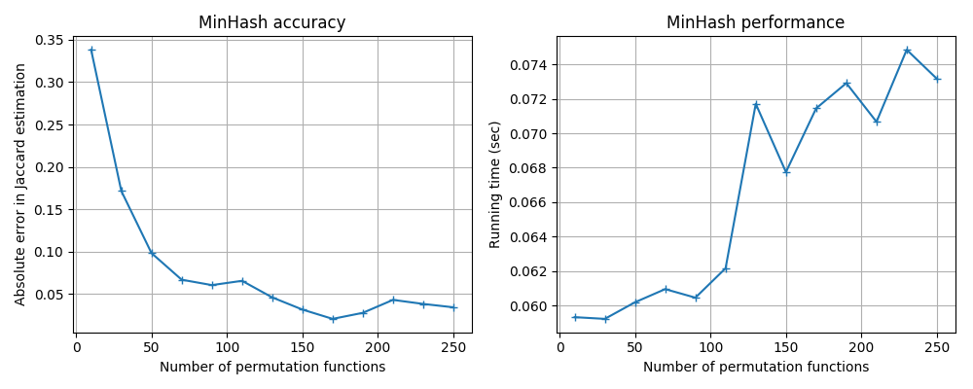
Runtime example:
47M Record set
1.1Q Pairs
Time @1M pairs/sec: 35 years
Actual time: ~90 minutes @ 100 iterations
Filter plausible pairs
Notes:
We see good performance from LSH, working through a 47M row dataset in 90 minutes.

Slide 14
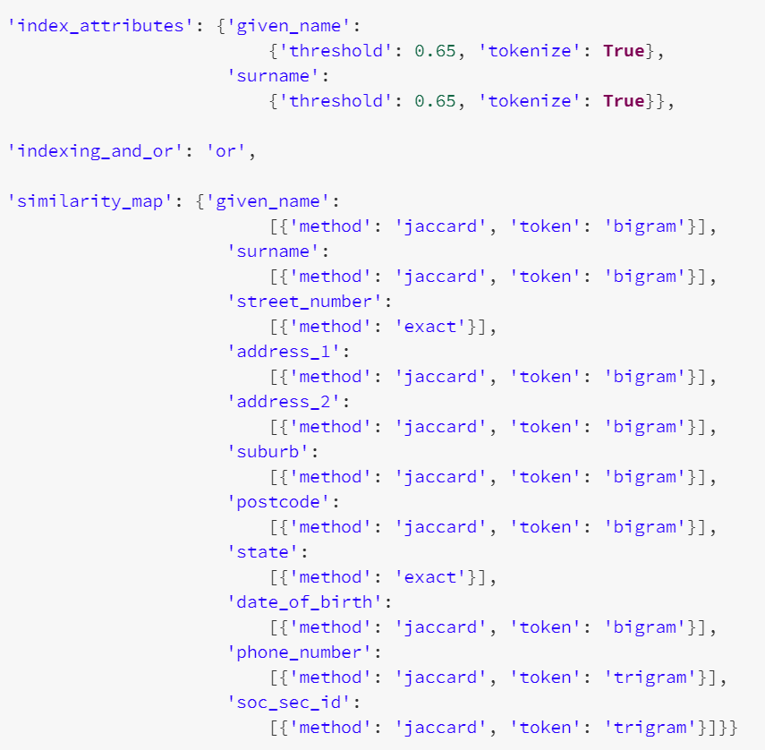
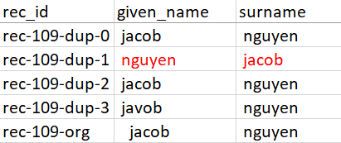
Ground Truth pairs
Positive | Negative
958 | 1,123,292
Pairs generated | Index output
 | Precision: 0.085
 | Recall: 0.90
 | TP | TN | FP | FN
10,151 | 864 | 1,114,005 | 9,287 | 94
Transitive potential (Positive pairs only)
Precision: NA
Recall: 0.92
TP | FN
878 | 80
Filter plausible pairs
Notes:
We see on our sample data that LSH is effective at eliminating the vast majority of pairs, leaving only ~1% to process with higher fidelity.
Notice that some False Negatives are lost in the process. The transitive nature of the graph structure can self-heal some of the lost pairs through secondary nodes (transitive potential), but we still see 80 missing pairs. Inspection of these missing pairs shows severe quality errors that can be overcome by concatenating names.
For the sake of this demonstration, we leave the error alone as it illustrates the importance of data quality to unification. When noise>signal, unification becomes unreliable.

Slide 15
[s1, s2, …]
[s1, s2, …]
[s1, s2, …]
[s1, s2, …]
[s1, s2, …]
[s1, s2, …]
[s1, s2, …]
[s1, s2, …]
[s1, s2, …]
[s1, s2, …]
[s1, s2, …]
[s1, s2, …]
Filter plausible pairs
Measure pair similarity
Notes:
With the remaining pairs, we calculate record similarities as arrays of similarity scores for each attribute in the schema.

Slide 16
[s1, s2, …]
[s1, s2, …]
[s1, s2, …]
[s1, s2, …]
[s1, s2, …]
[s1, s2, …]
[s1, s2, …]
[s1, s2, …]
[s1, s2, …]
[s1, s2, …]
[s1, s2, …]
[s1, s2, …]
Filter plausible pairs
Measure pair similarity
Notes:
Similarity settings.

Slide 17
[s1, s2, …]
[s1, s2, …]
[s1, s2, …]
[s1, s2, …]
[s1, s2, …]
[s1, s2, …]
[s1, s2, …]
[s1, s2, …]
[s1, s2, …]
[s1, s2, …]
[s1, s2, …]
[s1, s2, …]
Filter plausible pairs
Measure pair similarity
Infer match
Notes:
Next, we use binary classification to infer match/no-match relationships.

Slide 18
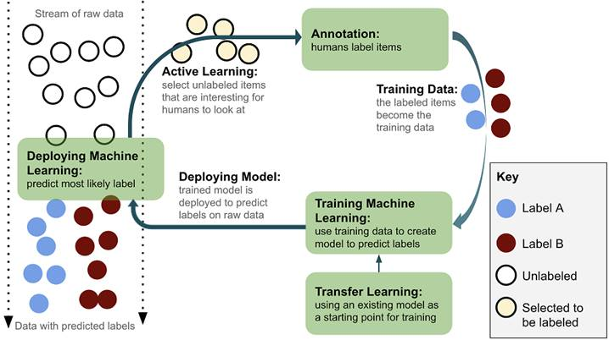
[s1, s2, …]
[s1, s2, …]
[s1, s2, …]
[s1, s2, …]
[s1, s2, …]
[s1, s2, …]
[s1, s2, …]
[s1, s2, …]
[s1, s2, …]
[s1, s2, …]
[s1, s2, …]
[s1, s2, …]
Filter plausible pairs
Measure pair similarity
Infer match
Image Source: https://livebook.manning.com/book/human-in-the-loop-machine-learning/chapter-1/v-2/
Notes:
We use Active Learning, in which the model not only classifies, but also selects the most impactful pairs for labeling. This dramatically reduces the number of labels required to build a robust model (~70%).

Slide 19

[s1, s2, …]
[s1, s2, …]
[s1, s2, …]
[s1, s2, …]
[s1, s2, …]
[s1, s2, …]
[s1, s2, …]
Selection
Hi/Low similarity
Random
Certainty
Training
RF for speed, interpretability
Grid search + CV
Metrics: Recall, precision, F1
[s1, s2, …]
[s1, s2, …]
[s1, s2, …]
[s1, s2, …]
[s1, s2, …]
Filter plausible pairs
Measure pair similarity
Infer match
Notes:
We use an ensemble of sampling techniques to balance the model-based sampling with exploration techniques. At every iteration, we can measure precision, f1, recall easily BUT have to be careful about the conclusions we draw! This is a VERY biased dataset because of the selection method! It is recommended that users also label an independent holdout set for reliable quality measures.

Slide 20
[s1, s2, …]
[s1, s2, …]
[s1, s2, …]
[s1, s2, …]
[s1, s2, …]
[s1, s2, …]
[s1, s2, …]
[s1, s2, …]
[s1, s2, …]
[s1, s2, …]
[s1, s2, …]
[s1, s2, …]
Label count/iterations | Classifier output
 | TP | TN | FP | FN
33/2 | 838 | 9,017 | 210 | 13
41/3 | 857 | 9,285 | 2 | 2
Index recall:
TP = 859
Filter plausible pairs
Measure pair similarity
Infer match
Notes:
We see that the model does a good job of filtering out the remaining False Positive pairs from our original low-precision filtering. In the process we do lose a small number of matches (2), but we will see how the graph structure compensates for this.

Slide 21
C
[s1, s2, …]
C
[s1, s2, …]
[s1, s2, …]
[s1, s2, …]
[s1, s2, …]
[s1, s2, …]
A
C
[s1, s2, …]
C
[s1, s2, …]
[s1, s2, …]
[s1, s2, …]
B
[s1, s2, …]
B
[s1, s2, …]
graph.connectedComponents()
B
Filter plausible pairs
Measure pair similarity
Infer match
Assert communities
Notes:
In the final set, we use Connected Components to ‘cluster’ linked records to a common ID.

Slide 22
C
[s1, s2, …]
C
[s1, s2, …]
Label count/iterations | Full system
 | TP | TN | FP | FN
33/2 | 857 | 1,122,951 | 341 | 101
41/3 | 878 | 1,123,290 | 2 | 80
[s1, s2, …]
[s1, s2, …]
[s1, s2, …]
[s1, s2, …]
A
C
[s1, s2, …]
C
[s1, s2, …]
[s1, s2, …]
[s1, s2, …]
B
Precision: 0.998
Recall: 0.916
[s1, s2, …]
B
[s1, s2, …]
B
Index transitive potential:
TP = 878
FN = 80
Filter plausible pairs
Measure pair similarity
Infer match
1.1M Records, 11 attributes
Imbalanced +:- (1:1173)
41 Labels
Assert communities
Notes:
This helps us overcome some of our missing pairings to achieve the max potential linkage, with a Recall of .916 and precision of 0.998.
Note the effectiveness of Active Learning in this scenario. Among 1.1M records with very strong class imbalance (1:1173), we need only 41 labels for a serviceable model here. We often see good models on more complex data at ~150 labels. Bear in mind that all scenarios need a bespoke model and we don’t have ground truth data to inform a class-balancing strategy, so it’s encouraging to see Active Learning overcome the challenge by seeking out decision boundaries.

Slide 23
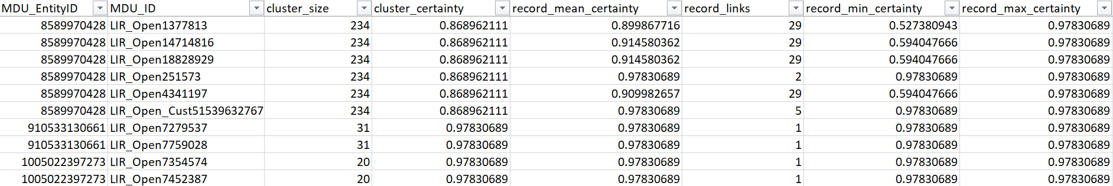
Output and inspection
0.8
0.3
Cluster certainty (False +)
Cluster density (False +)
Record attachment (False +)
Related clusters (False -)
0.7
-0.1
0.7
-0.9
0.6
0.1
-0.9
-0.9
1
2
3
Notes:
The graph structure of our solution also creates opportunity for enhanced entity inspection methods:
Cluster Weight: Mean certainty score of relationships within a cluster
Cluster Density: How densely connected is the cluster?
Record Attachment: Are any records weakly attached to the cluster?
Related Clusters: Clusters with no positive matches to a target cluster, but many candidate matches with weak negative linkage

Slide 24
Performance

Slide 25
Compute profiles
31M Records
480T Pairs
Pre-check throughput:
97B Pairs/Sec
Inference throughput:
7M Pairs/Sec
Cost (2 weeks):
$595 (MDU) vs. $14,250 (3P)
MDU: 3.4B pairs | 3PT: 6.6M pairs sampled from 4B
Notes:
By leveraging Azure’s native Spark capabilities, we realize significant performance improvements over a 3rd party tool that we considered to be best-in-class (Spark based). In addition to accelerating solutions, we see large cost savings as a result of speed and elasticity.

Slide 26
Availability

Slide 27
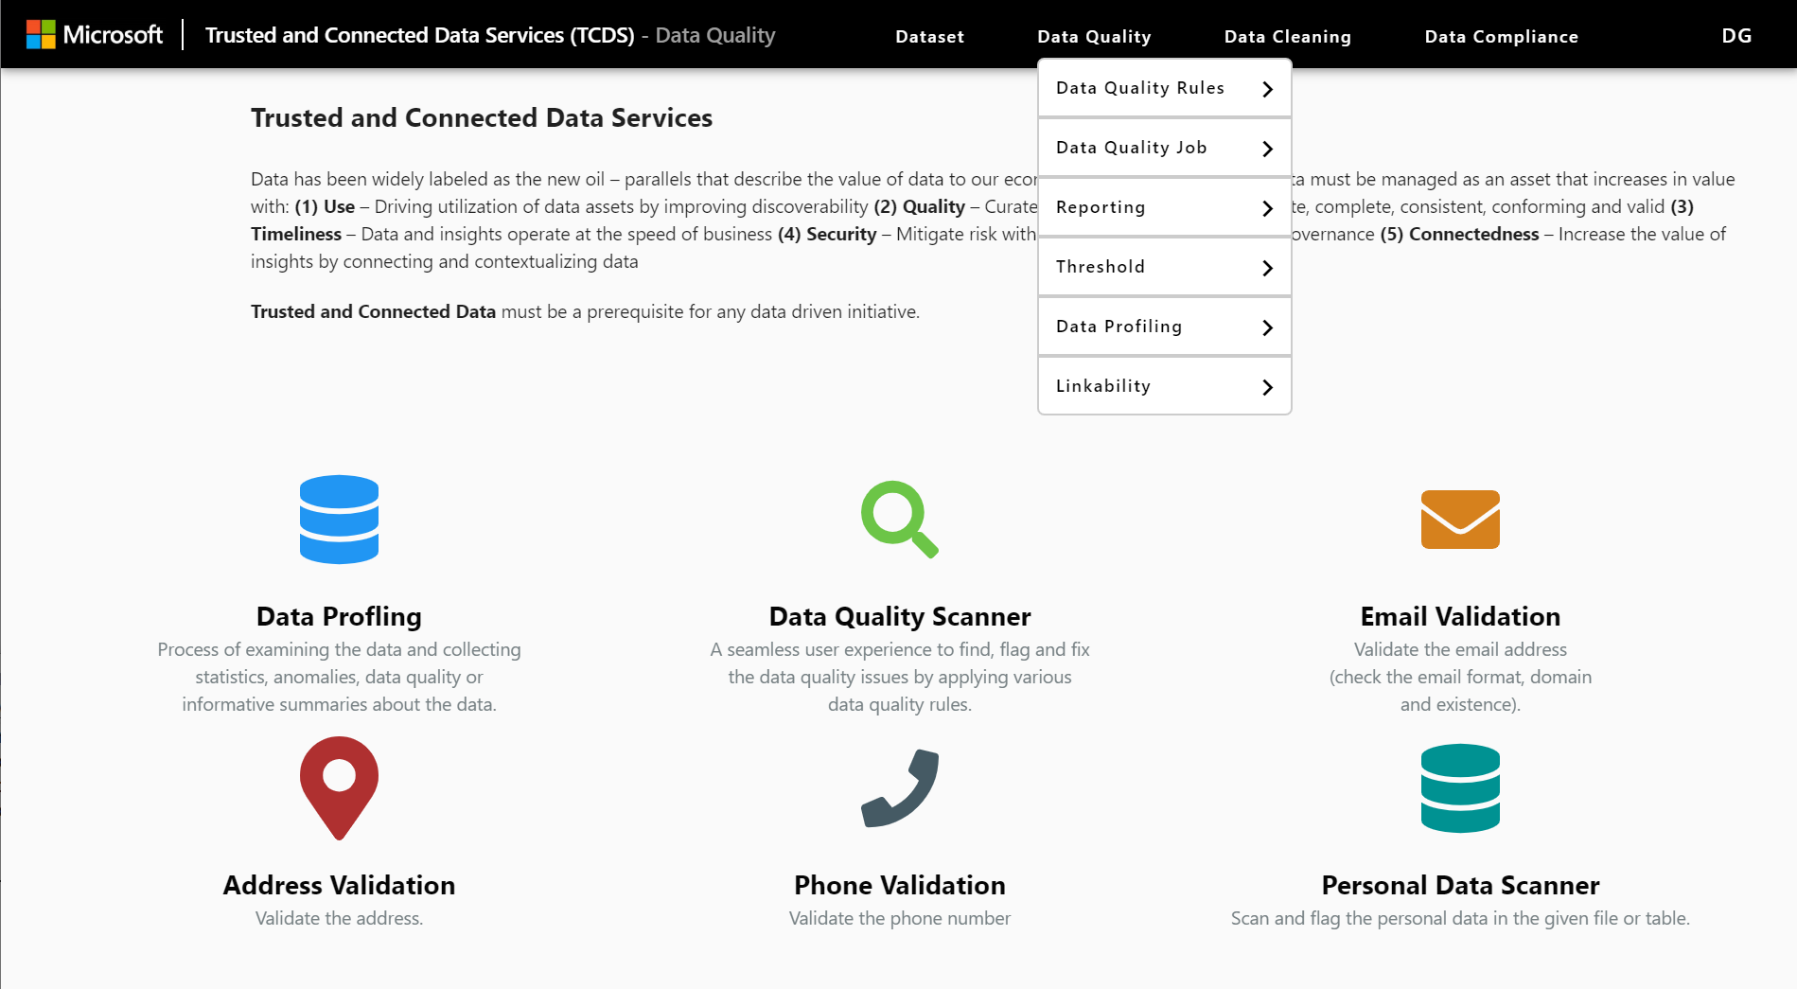
Availability (aka.ms/dataunification)
MDU Coming to TCDS in Q1
Contact: CSEODataMDUTeam@service.microsoft.com

Slide 28
Q&A
Notes:
This slide is required. Do NOT delete.
You must allow 5 minutes for Q&A with the audience following your 20-minute presentation

Slide 29
Thank you for attending the MLADS Conference and helping to build a strong community
To find recordings, presentations, and other resources from the event, go to: http://aka.ms/spring2020mlads
More information about the Machine Learning Community: http://aka.ms/wwc-ml
More information about the Artificial Intelligence Community: http://aka.ms/wwc-ai
Your feedback is valued and is imperative to the success of our event, both session and event evaluations will be available within the
MLADS Hubb Event Portal during the conference dates—to access them, navigate to the ‘Evaluations’ tab on the left-hand navigation panel
We request that session evaluations are submitted following each day of programming. Evaluations for both weeks of the conference will be open until 11:59 PM PDT on Friday, June 18th

