Slide 2
WiFi Information
Network: MLADS2018
Password: MLADS2018!

Slide 3
Expertise Finding: Automated Methods for Quantifying and Recommending Expertise in an Enterprise
Isaac Gritz

Slide 4
Session goals
Gain insight into the advantages of automated expertise finding systems over traditional knowledge management platforms
Learn best practices for implementing an expertise finding system.
Understand how these techniques are being leveraged internally, with our customers, and how you can too.
Notes:
This slide is required. Do NOT delete. This should be the first slide after your Title Slide.
This slide should describe what your goals are for this session. This information lets your audience know what you are trying to accomplish with your talk or tutorial—ie, what value will attendees get by investing 25 minutes or 2 hours of their time listening to you.
You should not spend more than 1 minute presenting this slide.
General examples of session goals could be (you will have to create your own specific goals):
Introduce a new technique or approach to solve a customer problem
Compare two approaches and explain why one is superior
Describe a project and the learnings that audience members can apply from it
Teach audience members how to use a specific technology

Slide 5
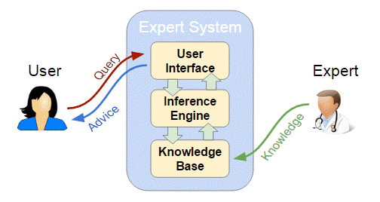
Why Expertise Finding?
Expertise finding – using information to assess and locate expertise
As organizations grow and become more geographically dispersed, they need a system that enables employees to locate the right people and the right resources
Capitalize on knowledge assets to increase productivity and collaboration

Slide 6
Benefits Over Traditional Knowledge Management
Traditional Knowledge Management |  | Expertise Finder Systems
Manually maintain skill ontologies and folksonomy (tags) |  | Data-driven skill ontologies from documents, organizational data
Often become outdated, subject to bias, provide an incomplete picture |  | Driven by multiple, up-to-date data sources and normalized across users.
Not personalized |  | Allow for personalized search, filtering, better search experience

Slide 7
General Framework
Identifying and extracting data sources
Expertise modelling algorithm – quantifying expertise
Matching mechanism – initiated by user query
User interface returns a ranked list of experts

Slide 8
Expertise
Knowledge/ Experience Possessed
Performance compared to others
Reputation/
Credibility
Authority/ Seniority

Slide 9
Data Sources
Implicit Indicators | Explicit Indicators
Document or Code Authorship (quantity and quality) | HR Data
Name occurrence in non-authored papers | User profiles
Telemetry (search history, use of systems) | Enterprise skill taxonomy (Job, Role, Associated Skills)
Department/Projects Worked In | Time at Company
Activity in Community Groups/Internal Initiatives | Domain, Department, Role History
Community-Based Signals (LinkedIn Endorsements, Peer Ratings) | Performance Evaluations, Resume/CV
Social Signals and Tags from Enterprise Social Media | User-Rated Skills
Questions and Answers on Bullet Boards/Forums/Distribution Lists | Educational Background
Emails | Job History, Industry
Chat Logs | Certifications, Papers, Patents

Slide 10
Approaches
Expertise Modeling |  | Ranking/Recommendations
Heuristics – weighted averages based on business rules, SME knowledge |  | Clustering – recommend experts that are in the same “cluster” and therefore share characteristics
Logistic Regression/Classification – predict (user, skill) expertise based on known experts and user-skill data |  | Personalized Ranking – Learning to Rank Functions such as HITS, PageRank to incorporate factors such as social closeness, geographic closeness, etc.
Keyword Frequency – Tf-idf, bag of words, other NLP techniques applied to emails, chat logs, documents, etc |  | User Experience – filter, sort and navigate experts via a website, application or chatbot

Slide 11
Skill Recommendation
Recommendation engines such as collaborative filtering enable recommending “missing” skills based on similar users.
Android Design
IOS Design
Bob
Android Design
Mobile Design
Jim
Android Design
IOS Design
Jim
Mobile Design
IOS Design

Slide 12

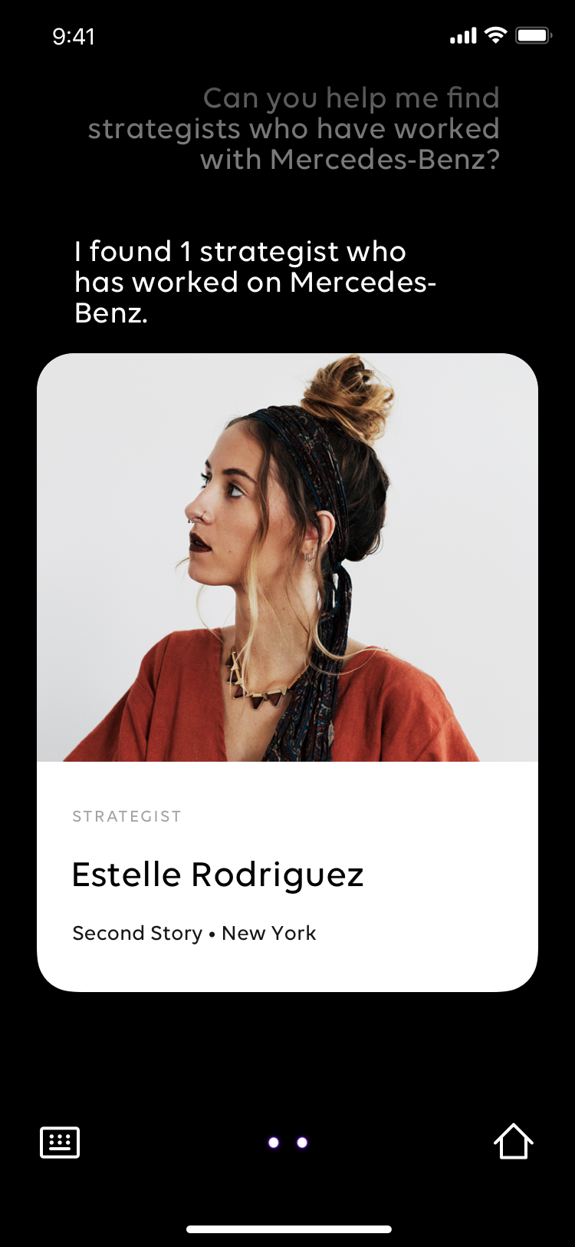
Customer Example: Publicis Marcel
Marcel is an intelligent assistant and transformative AI solution for Publicis Groupe, one of the largest advertising companies in the world
Identify relevant connections amongst the organization's 80,000 employees and find the right people that can help an employee

Slide 13
Customer Example: Publicis Marcel
App
Telemetry
Users submits question
Person-Skill Score
“True” Experts
Consolidate & Prepare
Data Sources
Train Expert Score
Model
Score
Marcel
Users
Interpret User Query
Rank
Results
UX Displays to User
Non-Expert
Users
Geo Closeness
Overall Expertise
Documents Authored
Content
Topic Modeling
Awards
CertificationsPublications
Graph Connectedness
Peer Ratings
Bookmarks
Favorites
Job Level/
Seniority

Slide 14
Internal Example: Talent Profile
AI-powered, user-centered, aggregated experience that modernizes, and personalizes the employee experience across career, community, and skill development.
Facilitate on-boarding
Network and community development
Allow users to find, develop and engage the right talent, and will facilitate talent growth and retention

Slide 15
Demo
Kaggle Expertise Modelling
Isaac Gritz

Slide 16

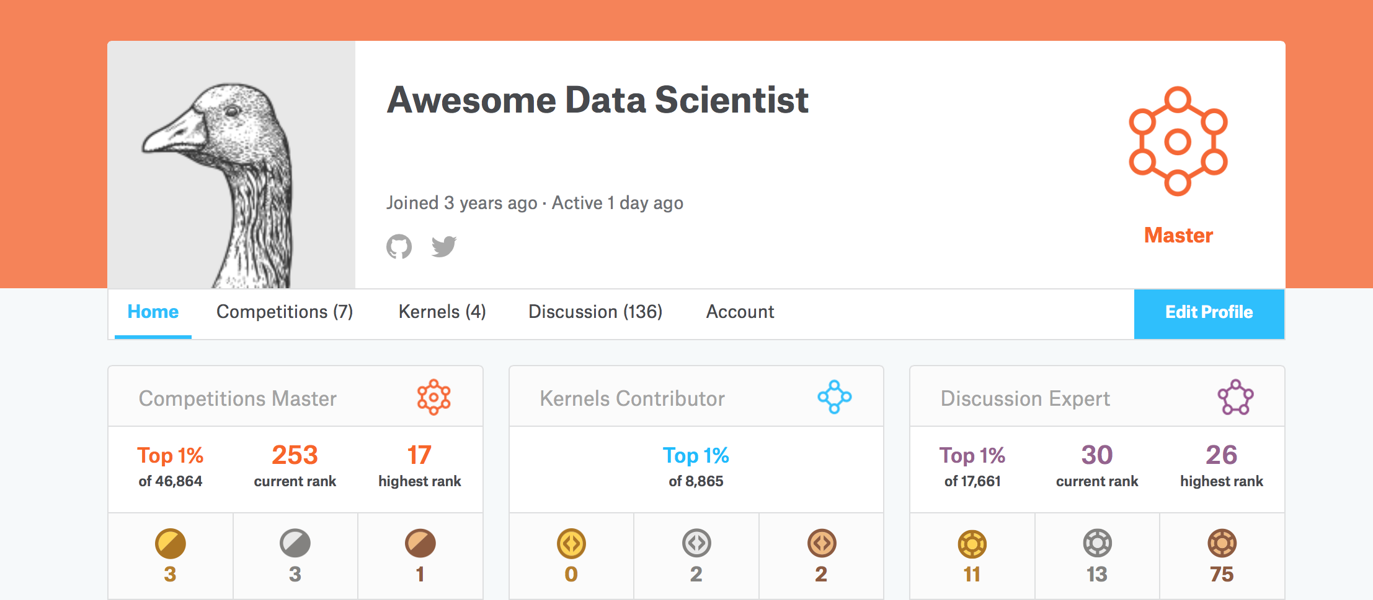
Demo: Kaggle Expertise Modelling
Kaggle is a website where data scientists work on data science projects or competitions
Leveraged Kaggle’s public user and competition data to create a simple expert modelling system in Python

Slide 17
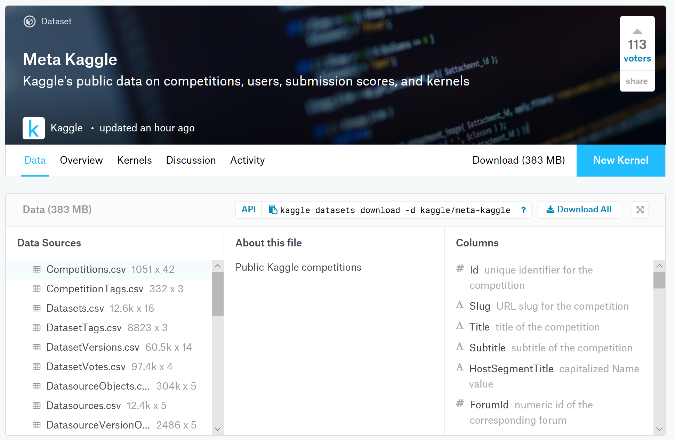
About the Meta Kaggle Data Set
Collection of datasets on Kaggle Users, Competitions, Organizations, Teams, Kernels (scripts submitted on Kaggle), Datasets, and Discussion Forums
Kaggle user expertise determined at an overall level, but not determined or searchable on a skill level

Slide 18

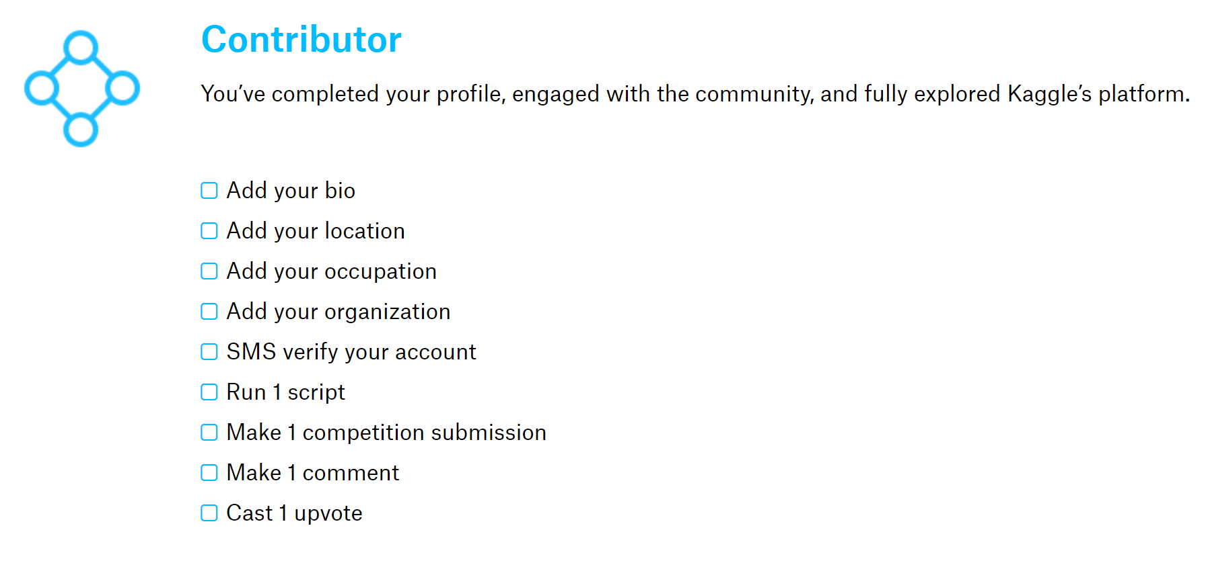
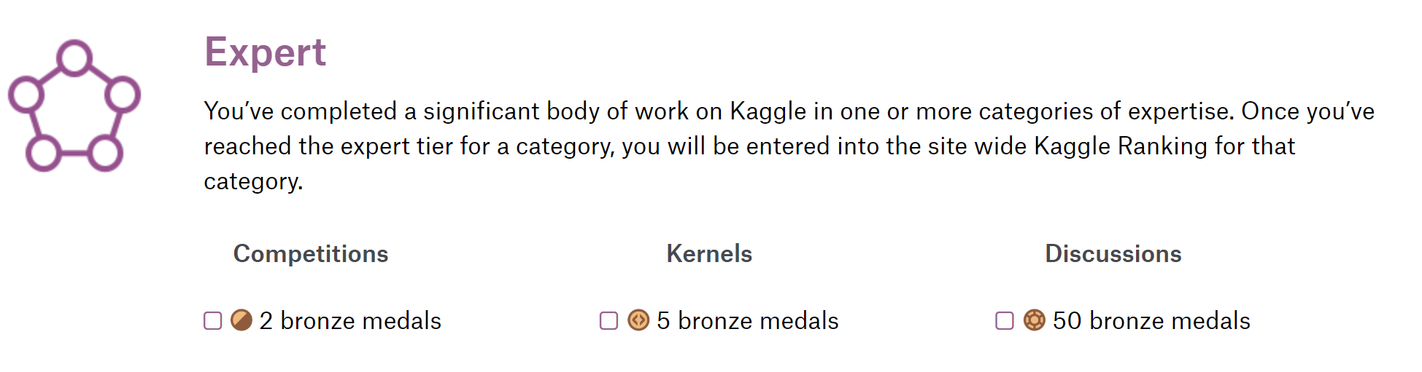
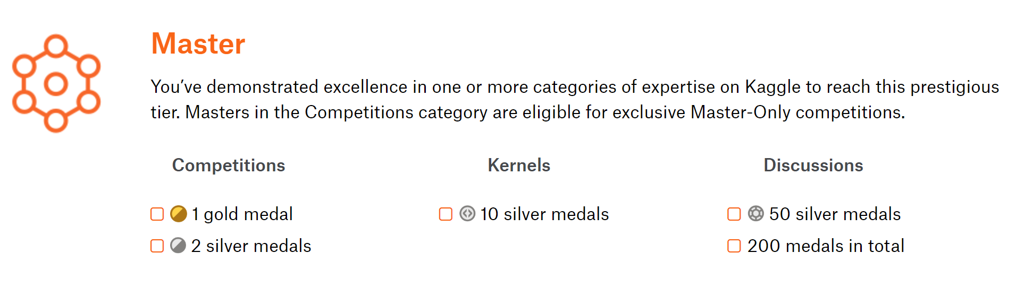

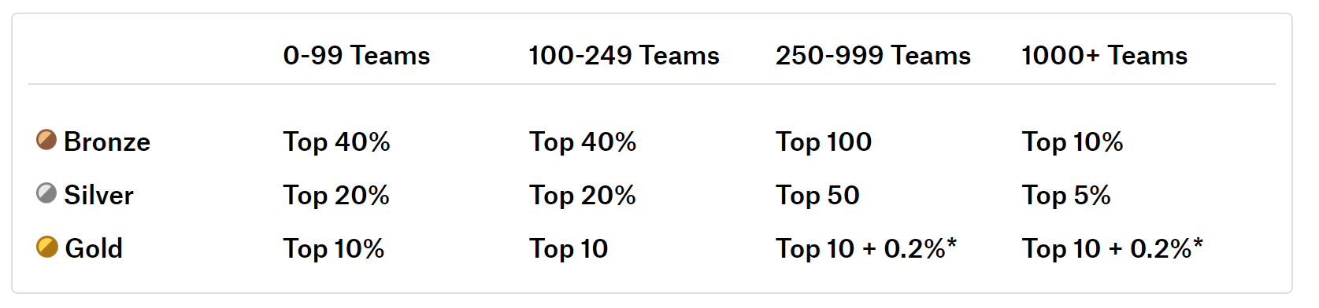

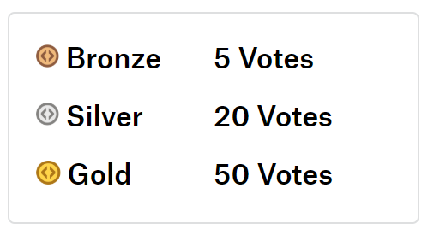
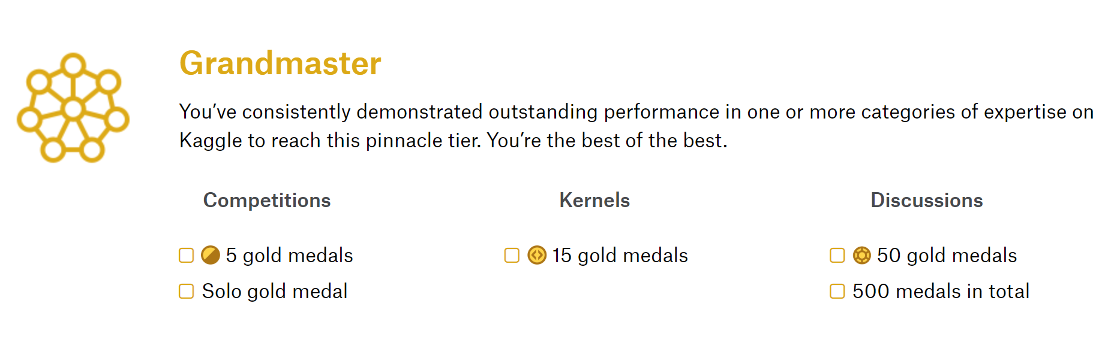

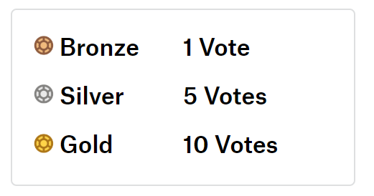
Kaggle Progression System
Kaggle uses a 5-level performance tier system to track users “growth as a data scientist”
5 Levels: Novice, Contributor, Expert, Master, and Grandmaster
Categories of Expertise: Competitions, Kernels, Discussions
Kaggle uses “medals” to quantify and give awards across the 3 areas of expertise
Competition Medals
Kernel Medals
Discussion Medals

Slide 19
Kaggle Expertise Modelling Approach
Data Sources |  | Users |  | Datasets |  | Kernels |  |  |  | Competitions |  | Tags
Expertise Modelling Algorithm |  | User Expertise |  |  |  |  |  | Skill Expertise
Matching Mechanism
User interface

Slide 20
Data Sources
Tags
(Skills)
Users
Organizations
Teams
Datasets
Users (Followers)
Kernels
Achievements
Compet-itions
Tags
(Skills)
Tags
(Skills)

Slide 21
Expertise Modelling Algorithm: User Expertise
Feature Engineering: developed a feature vector for user expertise similar to the Kaggle Progression System
Training Data: users with performance tier 1-2 (novice and contributor) used as labelled “non-experts”, users with performance tiers 3-5 (expert, master, grandmaster) used as labelled “experts”
Used Logistic Regression: to determine a more granular 0-1 probability that a user is an expert based on the user expertise feature vector and Kaggle labelled training set
Experience Possessed | # of organizations | # of datasets created | # of kernels created
Reputation/Credibility | # of followers
Performance Compared to Others | # of user achievements
 | discussion medals | competition medals | dataset medals
UserId | UserName | DisplayName | PerformanceTier | NumOrgs | NumFollower | TotalGoldDisc | TotalSilverDisc | TotalBronzeDisc | TotalGoldComp | TotalSilverComp | TotalBronzeComp | TotalGoldScript | TotalSilverScript | TotalBronzeScript | DatasetsCreated | KernelsCreated
368 | antgoldbloom | Anthony Goldbloom | 5 | 2 | 240 | 6 | 7 | 57 | 0 | 0 | 0 | 0 | 1 | 6 | 7 | 146
381 | iguyon | Isabelle | 2 | 0 | 1 | 0 | 1 | 53 | 0 | 0 | 0 | 0 | 0 | 0 | 0 | 0

Slide 22
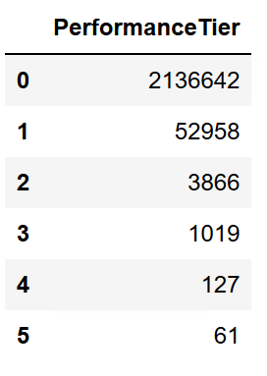
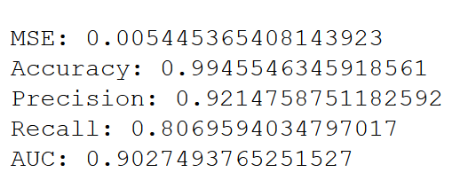
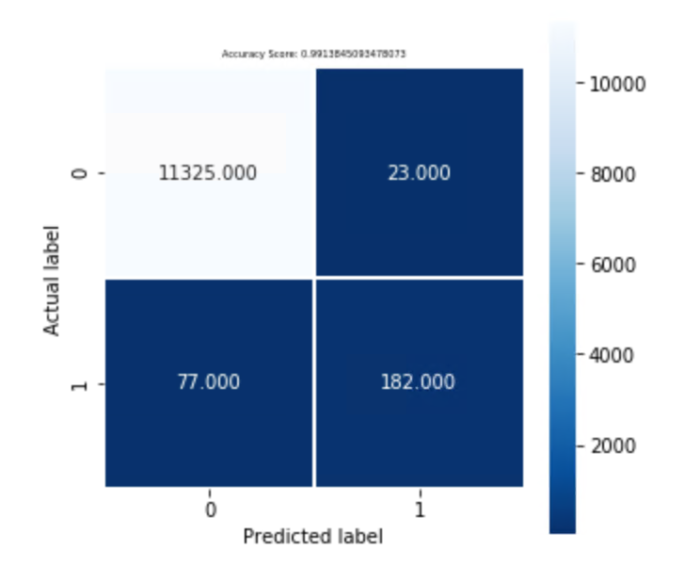
Expertise Modelling Algorithm: User Expertise
Resolves challenge of a relatively small number of performance tier 3-5 “experts” by giving a more precise Expertise Score
Low MSE, high accuracy, precision, and recall metrics because the model is very similar to the one used by Kaggle
UserId | DisplayName | ExpertiseScore | PerformanceTier | NumOrgs | NumFollower | TotalGoldDisc | TotalSilverDisc | TotalBronzeDisc | TotalGoldComp | TotalSilverComp | TotalBronzeComp | TotalGoldScript | TotalSilverScript | TotalBronzeScript | DatasetsCreated | KernelsCreated
368 | Anthony Goldbloom | 0.872298 | 5 | 2 | 240 | 6 | 7 | 57 | 0 | 0 | 0 | 0 | 1 | 6 | 7 | 146
381 | Isabelle | 0.00111 | 2 | 0 | 1 | 0 | 1 | 53 | 0 | 0 | 0 | 0 | 0 | 0 | 0 | 0

Slide 23
Expertise Modelling Algorithm: Skill Expertise
Competitions
Tags
(Skills)
Users
Teams
Datasets
Kernels
Tags
(Skills)
Tags
(Skills)

Slide 24
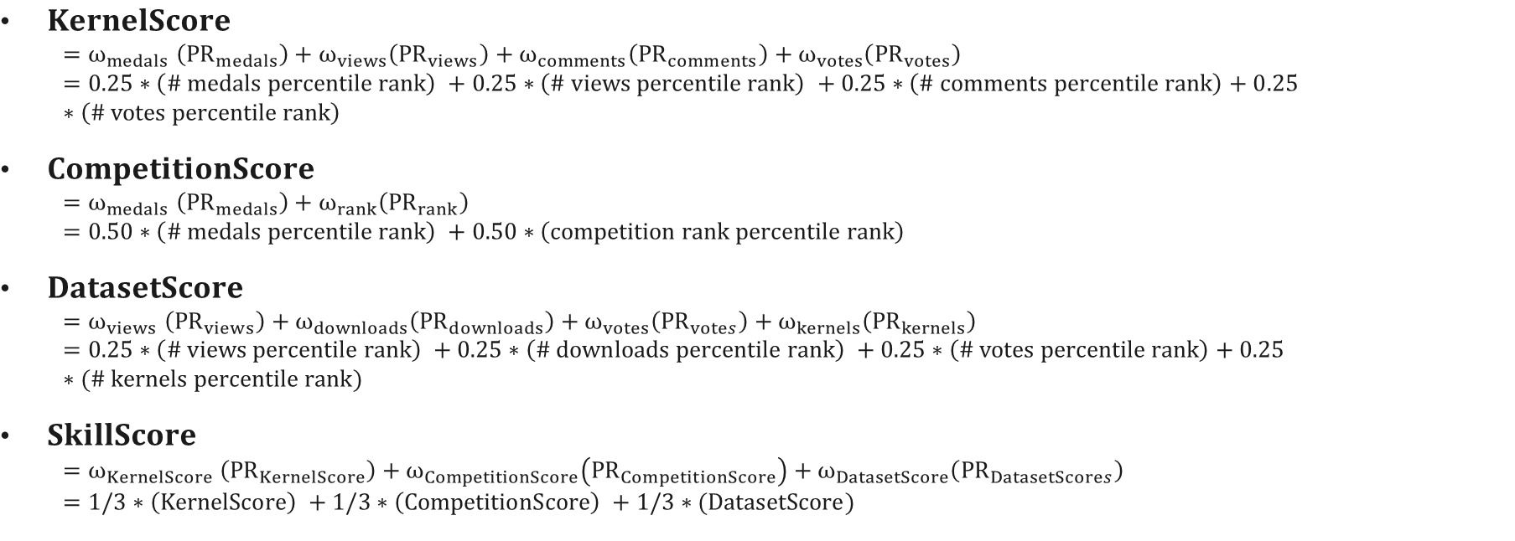
Expertise Modelling Algorithm: Skill Expertise
$KernelScore$
$${=ω}_{medals}\left({PR}_{medals}\right)+ω_{views}\left({PR}_{views}\right)+ω_{comments}\left({PR}_{comments}\right)+ω_{votes}\left({PR}_{votes}\right)$$
$$=0.25∗\left(\# medals percentile rank\right) +0.25∗\left(\# views percentile rank\right) +0.25∗\left(\# comments percentile rank\right)+0.25∗\left(\# votes percentile rank\right)$$
$CompetitionScore$
$${=ω}_{medals}\left({PR}_{medals}\right)+ω_{rank}\left({PR}_{rank}\right)$$
$$=0.50∗\left(\# medals percentile rank\right) +0.50∗\left(competition rank percentile rank\right)$$
$DatasetScore$
$${=ω}_{views}\left({PR}_{views}\right)+ω_{downloads}\left({PR}_{downloads}\right)+ω_{votes}\left({PR}_{votes}\right)+ω_{kernels}\left({PR}_{kernels}\right)$$
$$=0.25∗\left(\# views percentile rank\right) +0.25∗\left(\# downloads percentile rank\right) +0.25∗\left(\# votes percentile rank\right)+0.25∗(\# kernels percentile rank)$$
$SkillScore$
$${=ω}_{KernelScore}\left({PR}_{KernelScore}\right)+ω_{CompetitionScore}\left({PR}_{CompetitionScore}\right)+ω_{DatasetScore}\left({PR}_{DatasetScores}\right)$$
$$=1/3∗\left(KernelScore\right) +1/3∗\left(CompetitionScore\right) +1/3∗(DatasetScore)$$

Slide 25
Skill Expertise Example
Kernel Score quantification example
KernelId | AuthorUserId | Medal | TotalViews | TotalComments | TotalVotes | MedalsPer | ViewsPer | CommentsPer | VotesPer | KernelScore | TagId | Name
936270 | 283575 | 3 | 676 | 10 | 7 | 0.62888457 | 0.93578455 | 0.988629629 | 0.95997709 | 0.87831896 | 13208 | data visualization
1067174 | 283575 | 0 | 66 | 0 | 1 | 0 | 0.7140374 | 0.461580795 | 0.85221257 | 0.50695769 | 13208 | data visualization
1126714 | 283575 | 0 | 72 | 0 | 3 | 0 | 0.72678238 | 0.461580795 | 0.92435192 | 0.52817877 | 13208 | data visualization
1277247 | 283575 | 0 | 302 | 1 | 2 | 0 | 0.8840775 | 0.935602759 | 0.90129492 | 0.68024379 | 13208 | data visualization
1126714 | 283575 | 0 | 72 | 0 | 3 | 0 | 0.72678238 | 0.461580795 | 0.92435192 | 0.52817877 | 12101 | artificial intelligence
AuthorUserId | UserName | DisplayName | artificial intelligence | data visualization
283575 | rj1993 | Rohit Jain | 0.528178773 | 0.648424804

Slide 26
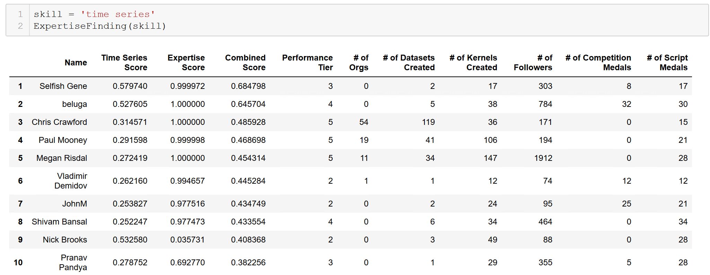
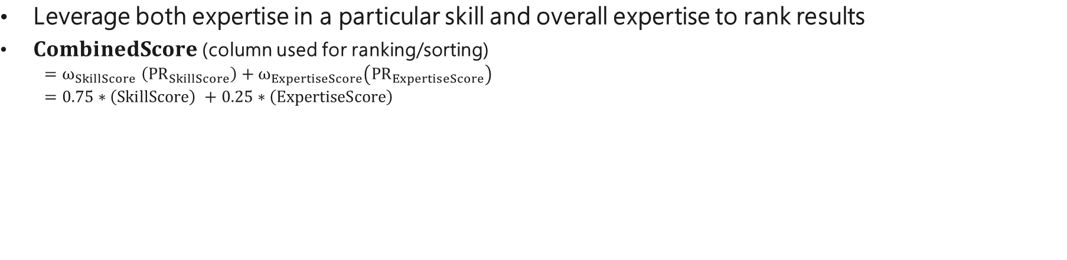
Matching Mechanism
Leverage both expertise in a particular skill and overall expertise to rank results
$CombinedScore$ (column used for ranking/sorting)
$${=ω}_{SkillScore}\left({PR}_{SkillScore}\right)+ω_{ExpertiseScore}\left({PR}_{ExpertiseScore}\right)$$
$$=0.75∗\left(SkillScore\right) +0.25∗\left(ExpertiseScore\right)$$

Slide 27
Further Enhancements
Kaggle Expertise Finding can be built on in several ways:
Related skills/tags - using a recommendation algorithm such as collaborative filtering to infer "missing skills" based on other users with similiar profiles
Text analysis on Kaggle forum messages i.e. TFIDF to extract keywords and use keyword frequencies to imply expertise or supplement existing data
Kaggle forum asker-helper network - infer expertise from users answering other users' questions in forums
Personalized ranking - incorporate ranking/sorting criteria such as geographic closeness, social closeness, prioritizing people on the same team/in the same organization and website clickstream data to serve personalized results
Learning to Rank function for more sophisticated ranking
ML approach on person-skill level in addition to on an overall level after more skill level data is added from text analysis, "missing skills", etc
UX on top of this algorithm that allows users to filter and sort manually on different fields

