Slide 1
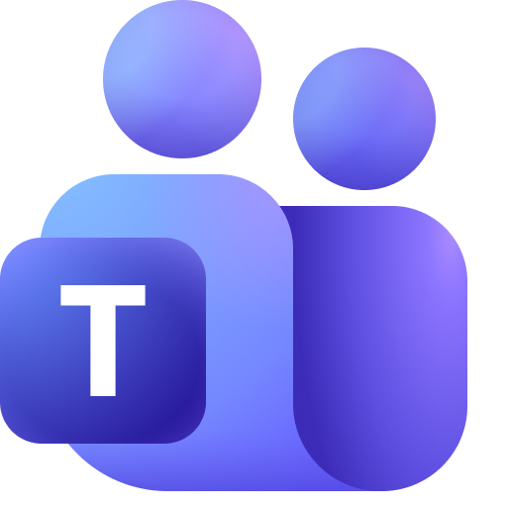



Approval outcome notification (informational)
Microsoft Teams
Power Automate
Agent channel (conversation)
Purchase assistant agent
Build with
Dynamics 365 ERP MCP Server
(Model Context Protocol)
Microsoft Copilot Studio
Supply Chain Management
Approval handled by standard Dynamics 365 workflow

