Slide 1
Dynamics 365 / Power Apps / Microsoft Copilot Studio
Microsoft Entra ID
Model-driven app
Microsoft Copilot Studio
Microsoft Authentication Library (MSAL)
Microsoft 365 Agents SDK
Public Client Application Registration
Form in Dynamics 365
Power Apps component framework (PCF) control
Custom agent

Slide 2
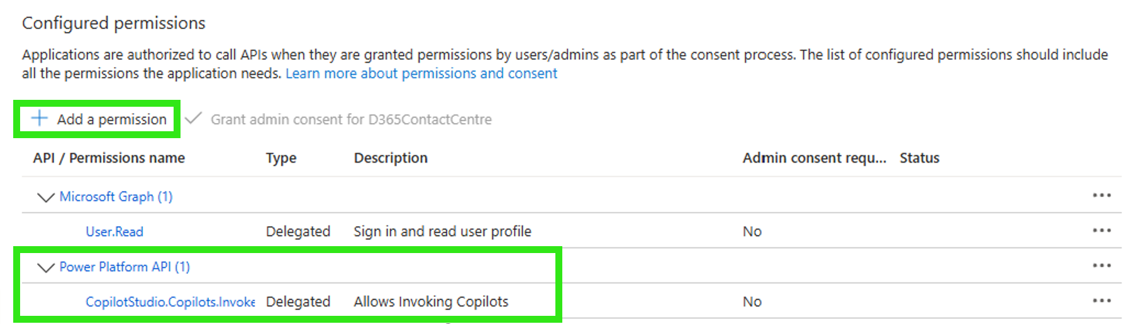

Slide 3
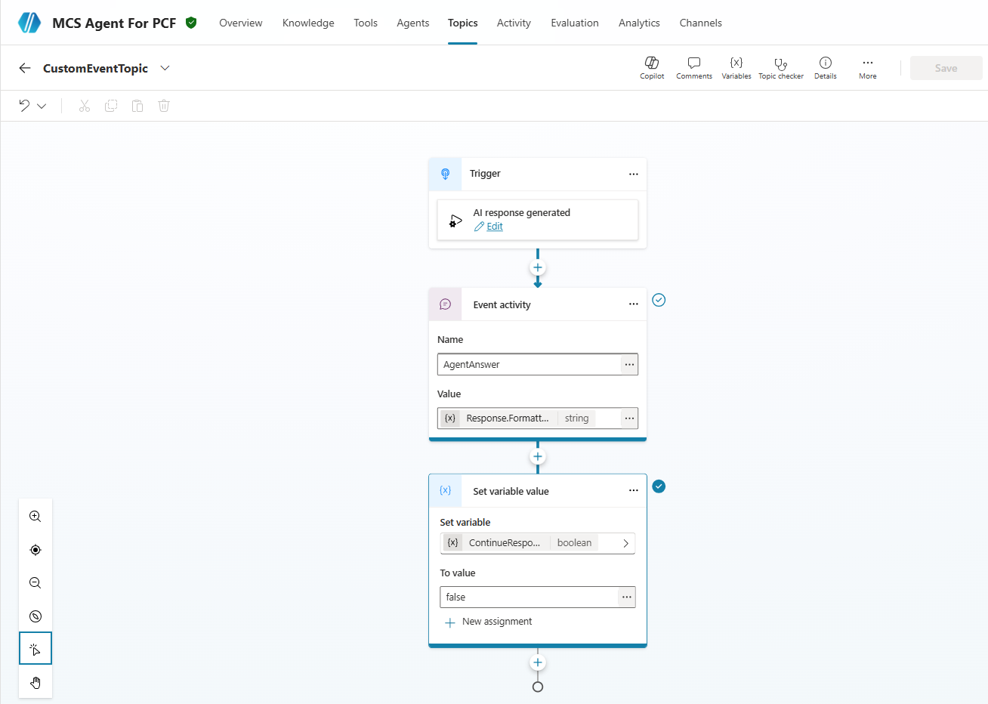

1
2
3

Slide 4
