Slide 1
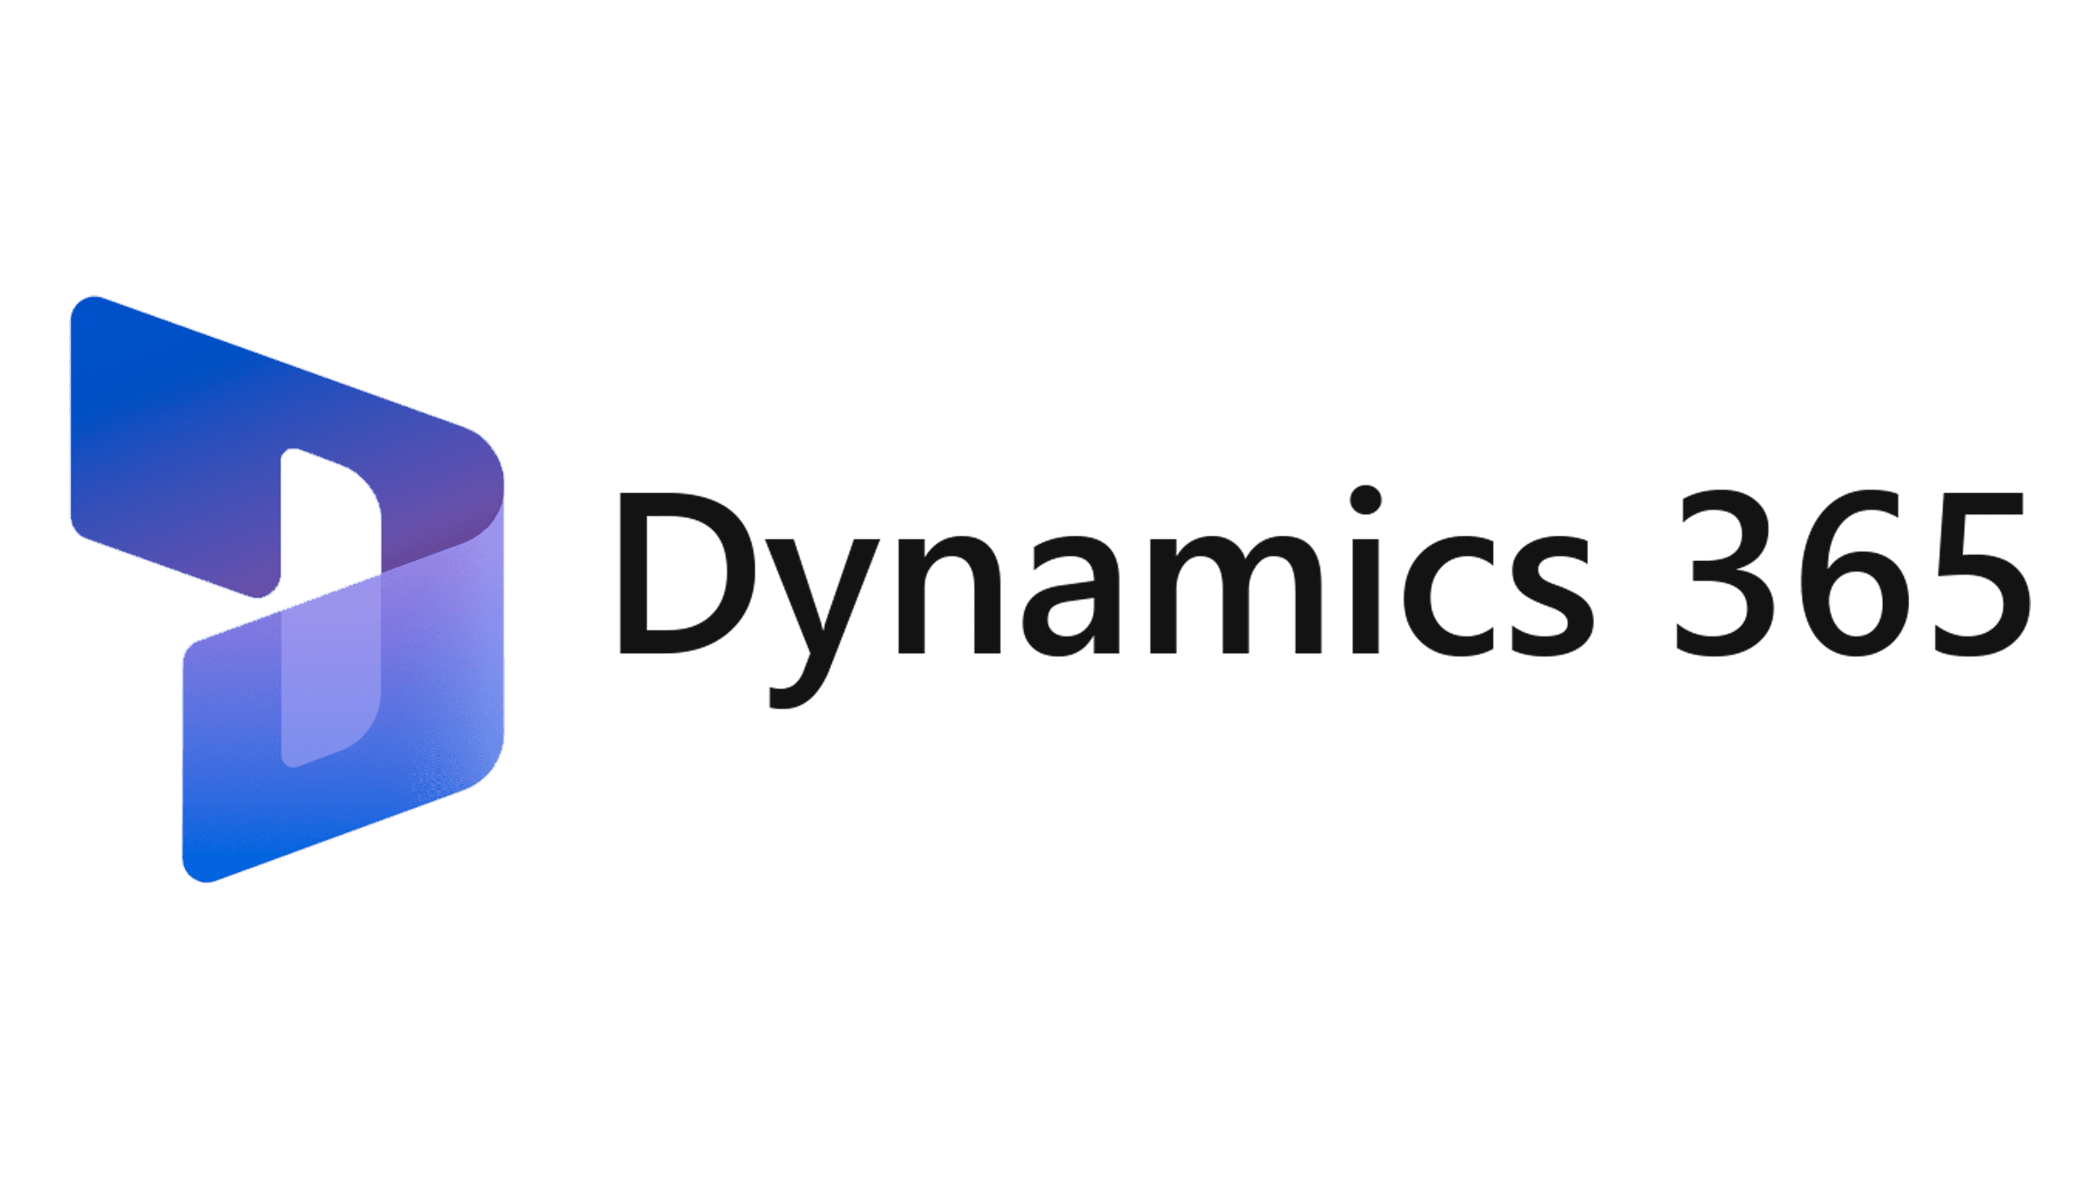




Power Platform
Supply chain management main features:
Purchase requisitions submission
Approval process for Purchase requisitions using standard workflow
Supply chain management main features:
Warehouse management app for products receipt
Purchase requisition app main features:
Procurement categories, products and vendors selection and filtering.
Creation of favourites.
Purchase requisition creation and submission.
Visibility of each steps of the approval process.
Virtual entities

Slide 2


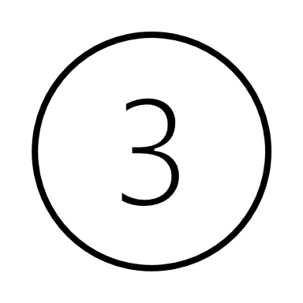





Purchase requisition App (canvas app)
Dataverse, holding the customizations for the Canvas app as well as the data that will be exposed within Dataverse using Virtual entities
Virtual entities
Supply chain management
Warehouse management mobile app
Power Platform

