Slide 1
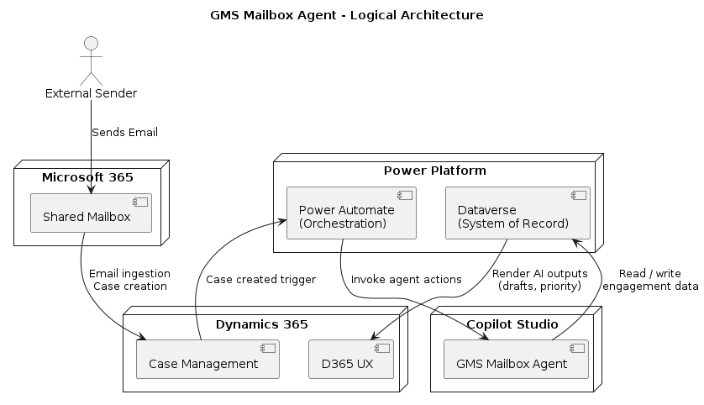
LOGICAL ARCHITECTURE
The logical architecture describes the end‑to‑end solution components and how they interact at a high level. Inbound emails are received in the engagement shared mailbox and ingested into Dynamics 365 Customer Service, where a case/activity record is created as the system-of-record entry point. A Power Automate cloud flow is triggered by case creation to orchestrate downstream processing. The flow persists normalized email content, metadata, and processing status into Microsoft Dataverse, and then invokes Microsoft Copilot Studio agent actions for AI reasoning (classification, prioritization, and response drafting). The Copilot agent reads only engagement-scoped records from Dataverse and writes back structured outputs (category, priority, confidence, draft text, evidence references). Finally, the D365 Model‑Driven UX surfaces these AI outputs to users for review, editing, approval, and case completion—ensuring the operational work remains within D365 while AI remains advisory and governed.

Slide 2
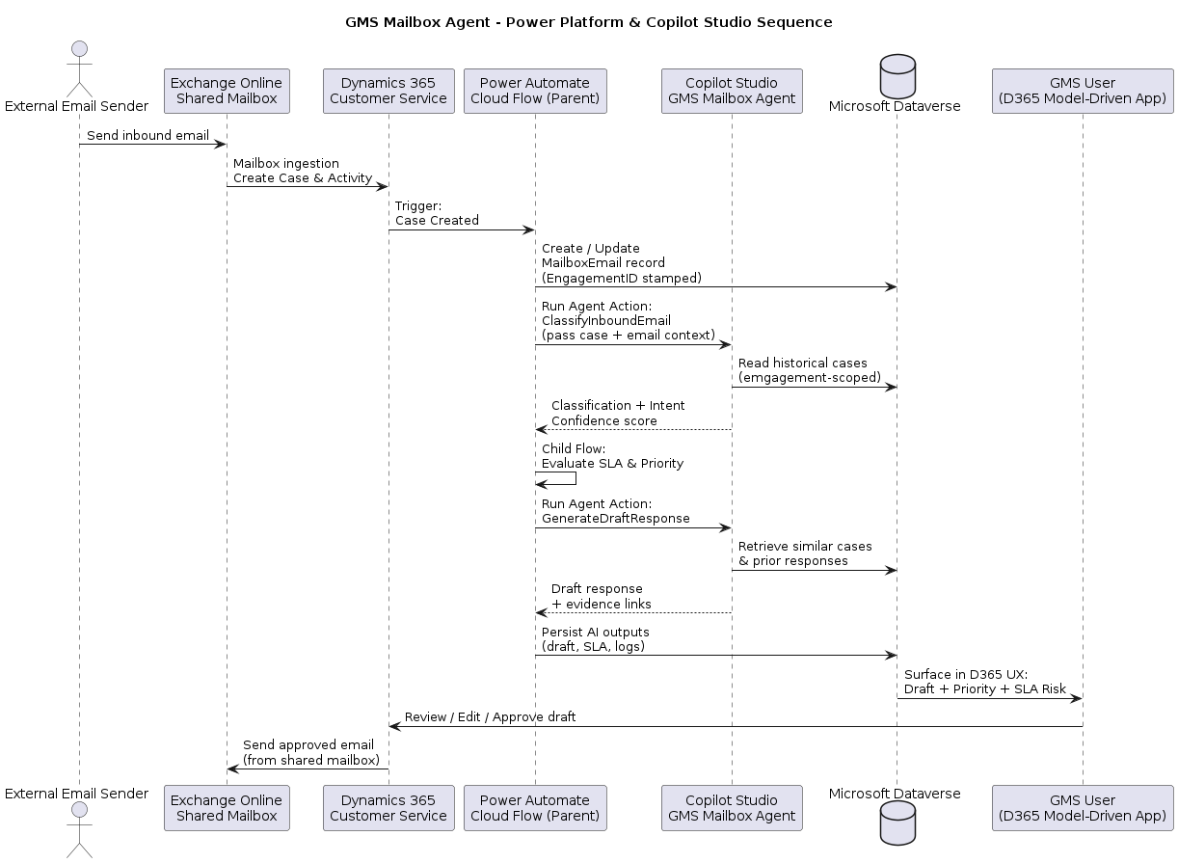
SEQUENCE FLOW
The sequence diagram explains the runtime behavior and order of execution. An external sender submits an email to the shared mailbox, after which D365 Customer Service ingests the message and creates a case. A Power Automate parent flow triggers on the case creation event, stamps/derives the engagement context, and stores the email record (and any extracted content) into Dataverse for traceability. The flow then calls a Copilot Studio agent action to perform email classification and intent detection, returning a category recommendation, confidence score, and routing/prioritization signals. Next, SLA logic is applied (commonly via a child flow) to compute SLA risk and update priority/escalation flags. If a response is required, the orchestration calls a second Copilot Studio action to generate a draft response using engagement-scoped history (similar cases/prior replies/templates), and stores the draft plus evidence references in Dataverse. The user then reviews the draft inside D365 (Model‑Driven App), edits if needed, and explicitly approves before sending. No email is ever sent autonomously by the agent; the final send and case status update are user‑driven, and all key actions are logged for audit.

Slide 3
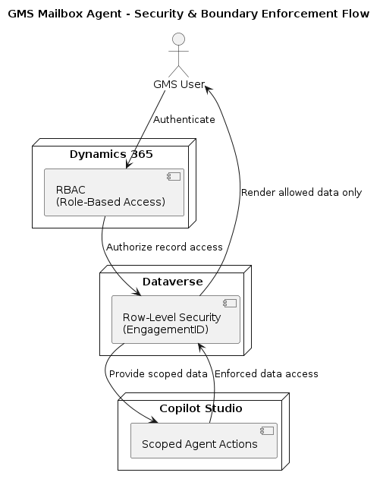
SECURITY BOUNDARIES
The security flow highlights how access is enforced end‑to‑end. Users authenticate into D365 and are authorized via role‑based access control (RBAC) to access mailbox cases and related records. Data access is further constrained using Dataverse row‑level security, ensuring users and services can only read/write records associated with their permitted engagement boundary (typically enforced through EngagementID and security roles/teams). Copilot Studio does not bypass these controls; instead, it accesses data only through scoped actions that query Dataverse under enforced permissions and engagement filters. As a result, the agent can only retrieve and reason over engagement‑scoped content, and all generated outputs (classification decisions, drafts, confidence scores, overrides) are written back into Dataverse under the same security constraints. This provides defense‑in‑depth: D365 RBAC governs who can access the experience, Dataverse row security governs what data can be accessed, and Copilot actions remain constrained to the same boundary, supporting compliance and audit expectations.

Slide 4
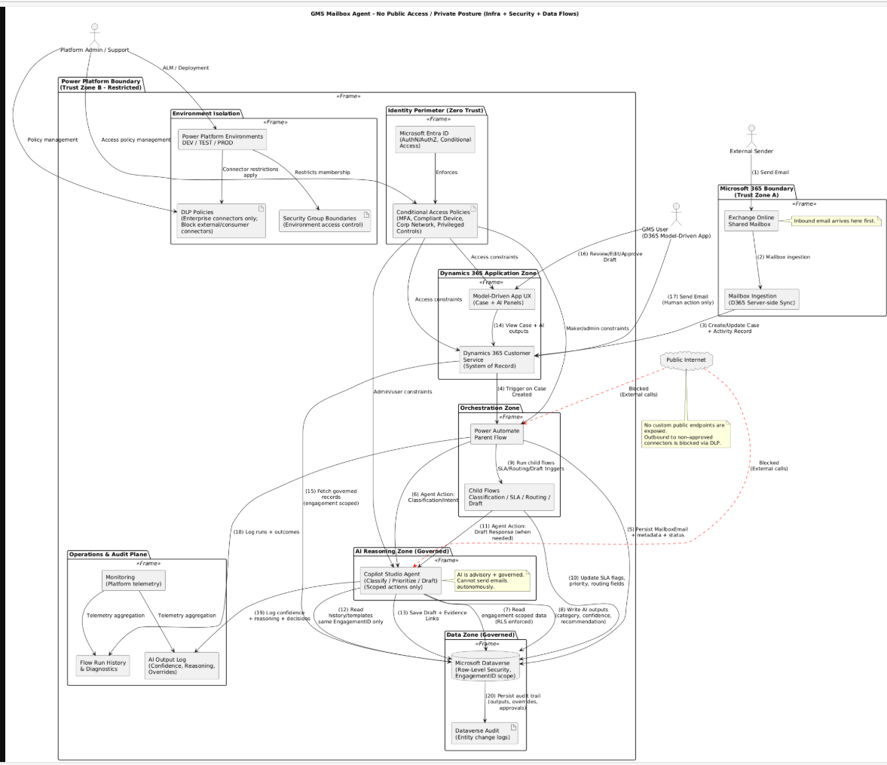
NETWORK AND INFRASTRUCTURE COMPONENTS
Inbound & Case Creation
External sender sends an email to the Exchange Online shared mailbox.
Dynamics 365 Customer Service ingests the mailbox email and creates a Case (system of record).
Automation & Persistence
A Power Automate cloud flow triggers on case creation.
The flow stamps the EngagementID and persists email content and metadata into Dataverse with row-level security.
AI Classification & SLA Processing
Power Automate invokes a Copilot Studio agent action for classification and intent detection.
Copilot Studio reads only engagement-scoped records from Dataverse (RLS enforced).
AI outputs (category, intent, confidence) are written back to Dataverse.
Child flows compute SLA risk, priority, and routing recommendations.
Draft Response Generation
When a response is required, Power Automate invokes a Draft Response agent action.
Copilot retrieves historical cases, emails, and templates within the same EngagementID only.
Draft response and evidence references are stored in Dataverse.
User Review & Approval
The D365 Model-Driven App renders AI outputs and drafts.
Dataverse ensures users see only permitted engagement data.
GMS users review, edit, and approve drafts.
Email sending is executed only by the user, never by AI.
Security, Identity & Audit
Power Automate logs execution, overrides, and outcomes.
Copilot Studio logs confidence scores and reasoning.
Power Platform monitoring provides operational telemetry.
Microsoft Entra ID governs authentication and authorization for all services.

Slide 5
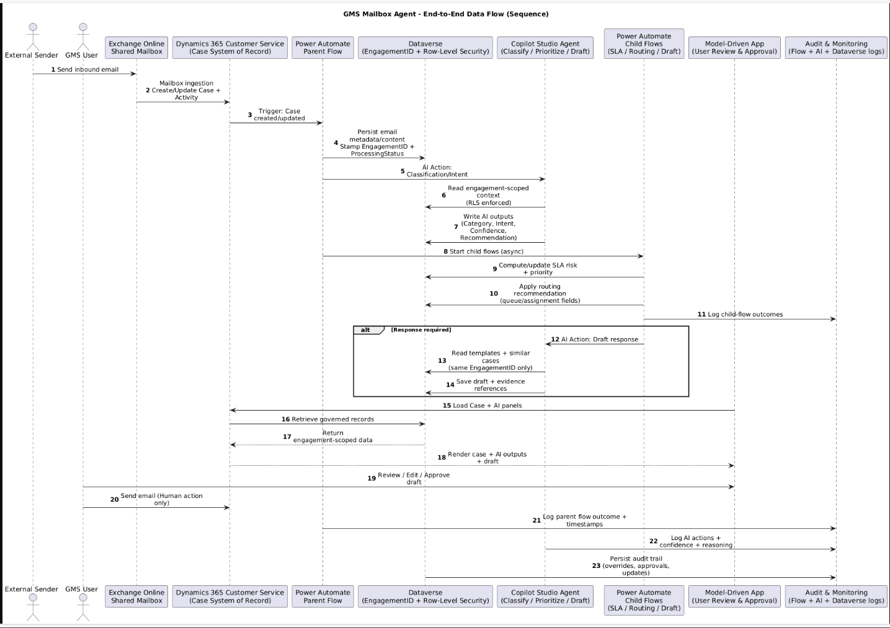
DATA FLOWS
The GMS Mailbox Agent data flow begins when an external sender submits an email to the GMS shared mailbox hosted in Exchange Online. Dynamics 365 Customer Service ingests the mailbox email using standard mailbox processing and creates or updates a Case, with the email stored as a related activity record. Dynamics 365 acts as the system of record for all mailbox interactions and case lifecycle management.
Case creation triggers a Power Automate parent orchestration flow. The flow reads the case and email content, derives the EngagementID, and persists normalized email metadata and extracted content into Microsoft Dataverse. Dataverse serves as the secure, auditable data layer, enforcing row‑level security to ensure all downstream processing is strictly scoped to the relevant engagement.
The orchestration then invokes a Copilot Studio agent action to perform AI‑assisted classification and intent detection. The agent reads only engagement‑scoped records from Dataverse and returns structured outputs such as recommended category, intent, confidence score, and prioritization signals. These results are written back to Dataverse under the same security boundary. Additional child flows execute asynchronously to evaluate SLA risk, determine priority, and apply routing recommendations, updating the case record accordingly.
When a response is required, a child flow invokes a second Copilot Studio action to generate a draft response. The agent retrieves only engagement‑specific historical cases, prior emails, and approved templates, and stores the drafted response along with evidence references in Dataverse. The AI does not send emails or take external actions.
GMS users review AI outputs and draft responses in the Dynamics 365 model‑driven app. Users can edit or override recommendations and must explicitly approve before sending any email. Throughout the lifecycle, Power Automate, Copilot Studio, and Dataverse generate comprehensive logs capturing AI decisions, confidence scores, overrides, approvals, and timestamps, ensuring full auditability and governance.

