Slide 1
FrameworkController (FC)
- General-Purpose Kubernetes Pod Controller
Yuqi Wang
Microsoft STCA
Home Page:
https://github.com/microsoft/frameworkcontroller

Slide 2
Session
Overview
Example - DL Training
How it Works
Advanced Features

Slide 3
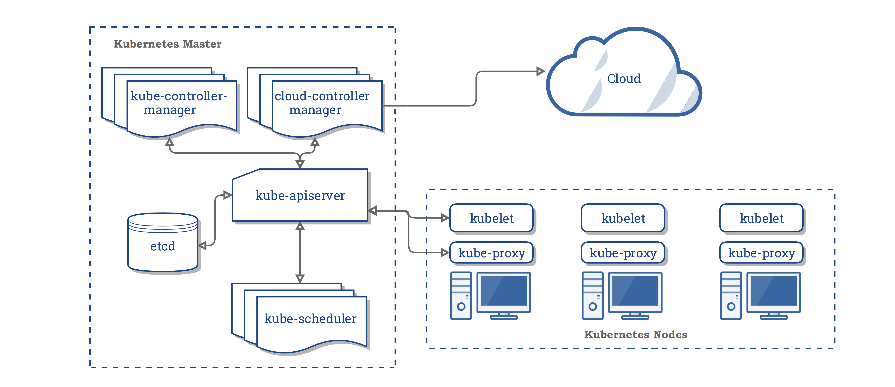
Background: K8S The Modern Cluster Manager inspired by Google’s Borg
https://kubernetes.io/docs/concepts/overview/components/

Slide 4
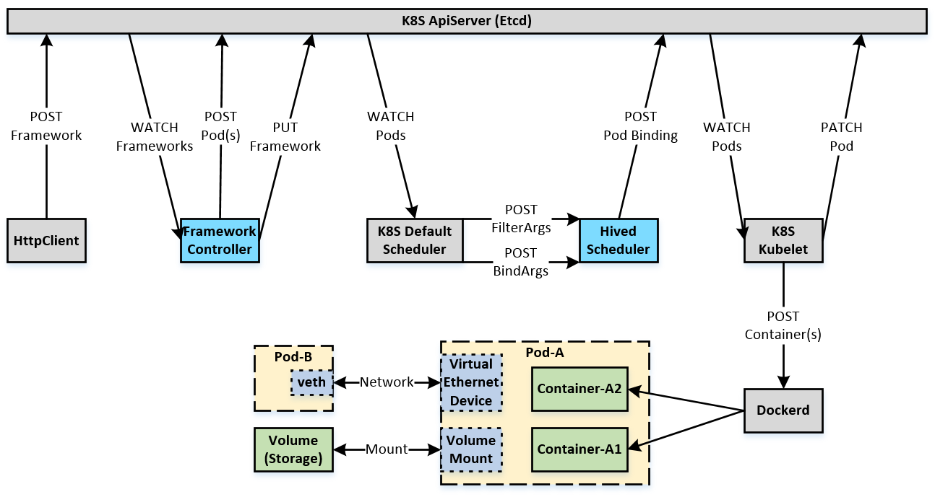
Background: Pod The Orchestration and Scheduling Unit in K8S

Slide 5
Why FC?
Key Problem
OSS only has specialized Pod controllers
Kubernetes StatefulSet Controller
Kubernetes Job Controller
KubeFlow TFJob Operator
KubeFlow PyTorch Operator
KubeFlow MPI Operator
etc
Limitation: Still cannot support some applications
Overhead: Have to learn, use, develop, deploy and maintain so many different controllers

Slide 6
Why FC?
Our Solution
Build a General-Purpose K8S Pod Controller for:
Stateless and Stateful Service (DL Serving, Nginx, HBase, AP Service, etc)
Stateless and Stateful Batch (DL MultiWorkerMirrored Training, Batch Data Processing, etc)
Any combination of above applications (DL PS Training, DL Elastic Training, Stream Data Processing, etc)
Key Benefits
Support many Kubernetes official unsupported applications
Only need to learn, use, develop, deploy and maintain a single controller
All kinds of applications can be orchestrated through the same interface with a unified experience
If really required, only need to build specialized Controller Wrappers on top of it, instead of building from scratch
Microsoft MagneTar and OpenPAI (Open Platform for AI)
Microsoft ITP (Integrated Training Platform / AzureML Kubernetes Compute)
Microsoft DLWorkspace (Deep Learning Workspace)
Microsoft NNI (Neural Network Intelligence)
Additional Benefits: Advanced Features
Tolerate Platform maintenances, failures and even Human faults, etc
Multi-TaskRoles, ExecutionType, Fine grained RetryPolicy, CompletionPolicy and Status
Scale Up/Down, Able to tune Consistency vs Availability
Well-defined Fine-grained State Machine and Failure Model
Framework Barrier, History, Error Classification, etc

Slide 7
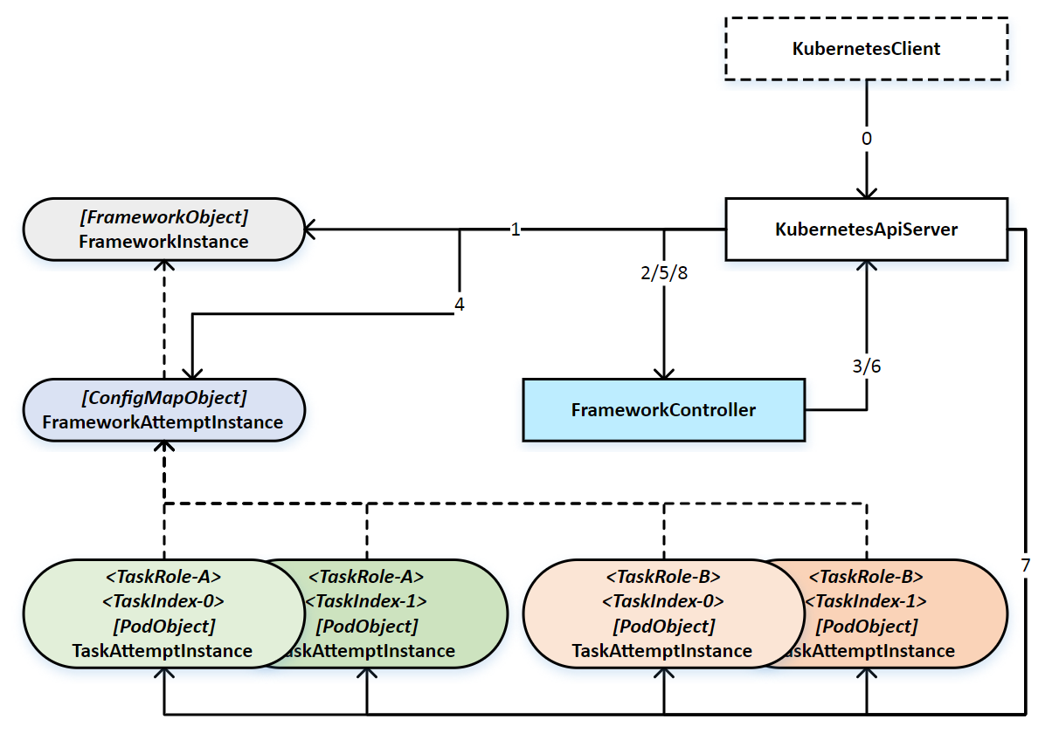
Architecture

Slide 8
Example - TF PS Training
- name: ps taskNumber: 2 frameworkAttemptCompletionPolicy: minFailedTaskCount: 1 minSucceededTaskCount: -1 task: retryPolicy: fancyRetryPolicy: false maxRetryCount: 0 pod: spec: restartPolicy: Never hostNetwork: true containers: - name: tensorflow image: frameworkcontroller/tensorflow-examples:gpu workingDir: "/tensorflow/benchmarks/scripts/tf_cnn_benchmarks" command: - sh - "-c" - FB_PS_PORT=4001 FB_WORKER_PORT=5001 . /mnt/frameworkbarrier/injector.sh && python tf_cnn_benchmarks.py --job_name=ps --task_index=${FC_TASK_INDEX} --ps_hosts=${FB_PS_ADDRESSES} --worker_hosts=${FB_WORKER_ADDRESSES} --variable_update=parameter_server --cross_replica_sync=false --model=alexnet --batch_size=8 --num_batches=10 --device=gpu --local_parameter_device=gpu --num_gpus=1 --data_format=NCHW --data_name=cifar10 --data_dir=/mnt/data/cifar-10-batches-py --train_dir=/mnt/data/${FC_FRAMEWORK_NAME}/output ports: - containerPort: 4001 resources: limits: nvidia.com/gpu: 1 volumeMounts: - name: frameworkbarrier-volume mountPath: "/mnt/frameworkbarrier" - name: data-volume mountPath: "/mnt/data" initContainers: - name: frameworkbarrier image: frameworkcontroller/frameworkbarrier env: - name: KUBE_APISERVER_ADDRESS value: http://10.151.41.16:8080 volumeMounts: - name: frameworkbarrier-volume mountPath: "/mnt/frameworkbarrier" volumes: - name: frameworkbarrier-volume emptyDir: {} - name: data-volume nfs: server: 10.169.8.232 path: "/home/yqwang/nfs"
apiVersion: frameworkcontroller.microsoft.com/v1 kind: Framework metadata: name: tensorflowdistributedtrainingwithdefaultscheduledgpu spec: executionType: Start retryPolicy: fancyRetryPolicy: true maxRetryCount: 2 taskRoles:
http://{ApiServer}:8080/apis/frameworkcontroller.microsoft.com/v1/namespaces/default/frameworks/tensorflowdistributedtrainingwithdefaultscheduledgpu

Slide 9
Example - TF PS Training
- name: worker taskNumber: 3 frameworkAttemptCompletionPolicy: minFailedTaskCount: 1 minSucceededTaskCount: 3 task: retryPolicy: fancyRetryPolicy: false maxRetryCount: 0 pod: spec: restartPolicy: Never hostNetwork: true containers: - name: tensorflow image: frameworkcontroller/tensorflow-examples:gpu workingDir: "/tensorflow/benchmarks/scripts/tf_cnn_benchmarks" command: - sh - "-c" - FB_PS_PORT=4001 FB_WORKER_PORT=5001 . /mnt/frameworkbarrier/injector.sh && python tf_cnn_benchmarks.py --job_name=worker --task_index=${FC_TASK_INDEX} --ps_hosts=${FB_PS_ADDRESSES} --worker_hosts=${FB_WORKER_ADDRESSES} --variable_update=parameter_server --cross_replica_sync=false --model=alexnet --batch_size=8 --num_batches=10 --device=gpu --local_parameter_device=gpu --num_gpus=1 --data_format=NCHW --data_name=cifar10 --data_dir=/mnt/data/cifar-10-batches-py --train_dir=/mnt/data/${FC_FRAMEWORK_NAME}/output ports: - containerPort: 5001 resources: limits: nvidia.com/gpu: 1 volumeMounts: - name: frameworkbarrier-volume mountPath: "/mnt/frameworkbarrier" - name: data-volume mountPath: "/mnt/data" initContainers: - name: frameworkbarrier image: frameworkcontroller/frameworkbarrier env: - name: KUBE_APISERVER_ADDRESS value: http://10.151.41.16:8080 volumeMounts: - name: frameworkbarrier-volume mountPath: "/mnt/frameworkbarrier" volumes: - name: frameworkbarrier-volume emptyDir: {} - name: data-volume nfs: server: 10.169.8.232 path: "/home/yqwang/nfs"

Slide 10
Example - TF PS Training
- name: worker taskStatuses: - index: 0 state: Completed startTime: '2019-11-20T06:48:43Z' transitionTime: '2019-11-20T06:52:33Z' completionTime: '2019-11-20T06:52:33Z' retryPolicyStatus: accountableRetriedCount: 0 retryDelaySec: totalRetriedCount: 0 attemptStatus: id: 0 startTime: '2019-11-20T06:48:43Z' runTime: '2019-11-20T06:48:53Z' completionTime: '2019-11-20T06:52:33Z' podName: tensorflowdistributedtrainingwithdefaultscheduledgpu-worker-0 podUID: cae0f7a1-0b61-11ea-a441-000d3ab408a6 instanceUID: 0_cae0f7a1-0b61-11ea-a441-000d3ab408a6 podNodeName: 10.151.41.24 podHostIP: 10.151.41.24 podIP: 10.151.41.24 completionStatus: code: 0 diagnostics: Pod succeeded phrase: Succeeded type: attributes: [] name: Succeeded pod: containers: - code: 0 name: frameworkbarrier reason: Completed - code: 0 name: tensorflow reason: Completed
status: state: Completed startTime: '2019-11-20T06:48:43Z' transitionTime: '2019-11-20T06:53:12Z' completionTime: '2019-11-20T06:53:12Z' retryPolicyStatus: accountableRetriedCount: 0 retryDelaySec: totalRetriedCount: 0 attemptStatus: id: 0 startTime: '2019-11-20T06:48:43Z' runTime: '2019-11-20T06:48:51Z' completionTime: '2019-11-20T06:53:12Z' configMapName: tensorflowdistributedtrainingwithdefaultscheduledgpu-attempt configMapUID: cacb23a4-0b61-11ea-a441-000d3ab408a6 instanceUID: 0_cacb23a4-0b61-11ea-a441-000d3ab408a6 completionStatus: code: 0 diagnostics: Pod succeeded phrase: Succeeded trigger: message: SucceededTaskCount 3 has reached MinSucceededTaskCount 3 in the TaskRole taskIndex: 0 taskRoleName: worker type: attributes: [] name: Succeeded taskRoleStatuses:

Slide 11
Example - TF PS Training
- name: ps taskStatuses: - index: 0 state: Completed startTime: '2019-11-20T06:48:43Z' transitionTime: '2019-11-20T06:53:06Z' completionTime: '2019-11-20T06:53:06Z' retryPolicyStatus: accountableRetriedCount: 0 retryDelaySec: totalRetriedCount: 0 attemptStatus: id: 0 startTime: '2019-11-20T06:48:43Z' runTime: '2019-11-20T06:48:52Z' completionTime: '2019-11-20T06:53:06Z' podName: tensorflowdistributedtrainingwithdefaultscheduledgpu-ps-0 podUID: cad52924-0b61-11ea-a441-000d3ab408a6 instanceUID: 0_cad52924-0b61-11ea-a441-000d3ab408a6 podNodeName: 10.151.41.26 podHostIP: 10.151.41.26 podIP: 10.151.41.26 completionStatus: code: -220 diagnostics: Stop to complete current FrameworkAttempt phrase: FrameworkAttemptCompletion type: attributes: - Permanent name: Failed

Slide 12

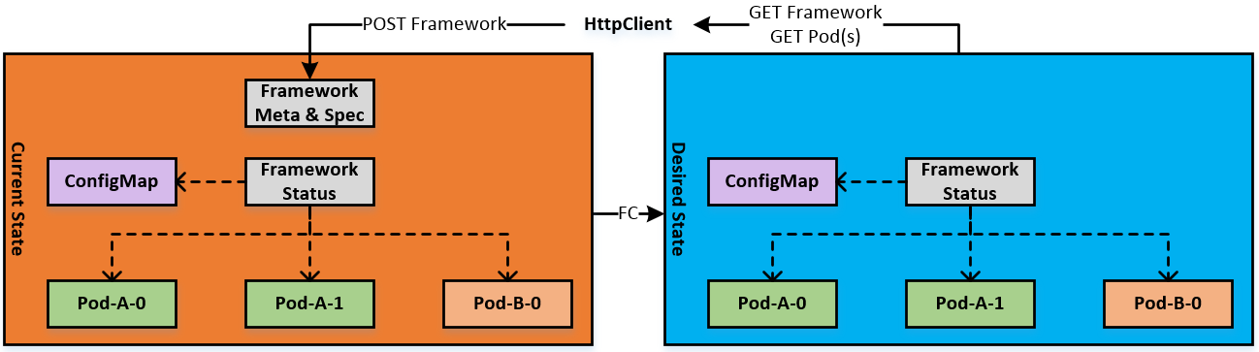
How FC Works: Goal
General Reconciliation Process
Framework Reconciliation Process (SyncFramework)
for {
desired := getDesiredState()
current := getCurrentState()
makeChanges(desired, current)
}

Slide 13
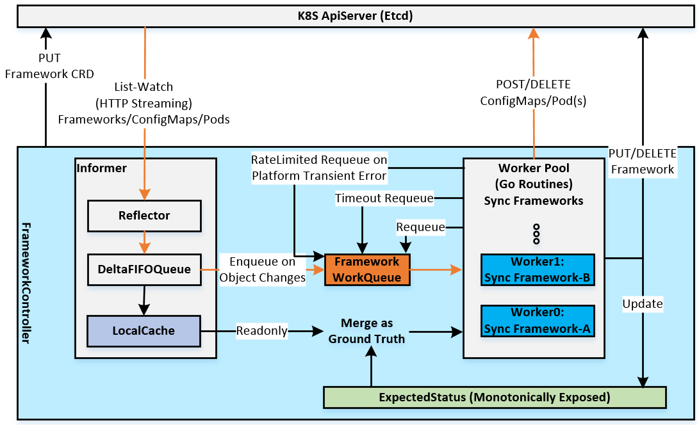
How FC Works: Drive Goal
High Perf and Scalability:
Framework Operation Latency: < 1s (e.g., from Create Framework to K8s run its Pods)
Framework Operation Throughput: = Concurrent Workers / Latency
Framework/Pod Scalability: Bound on ApiServer and Mem

Slide 14
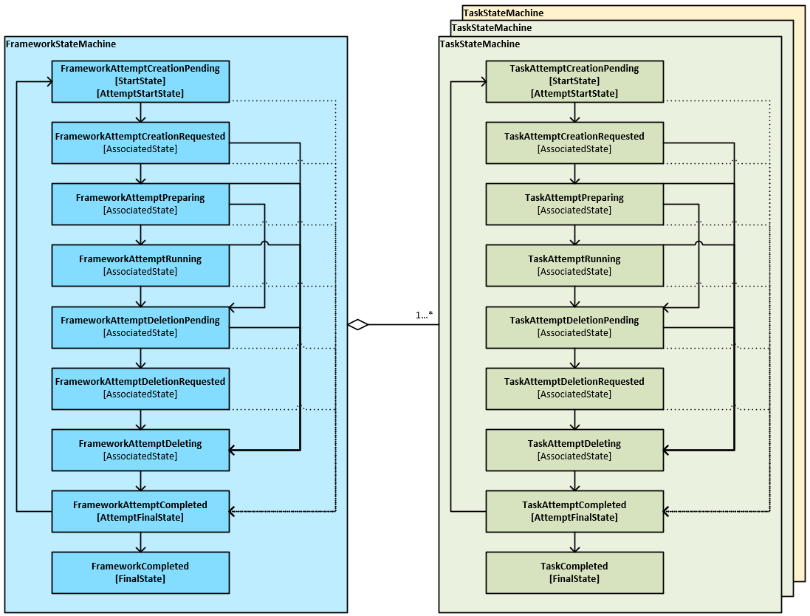
How FC Works: StateMachine

Slide 15
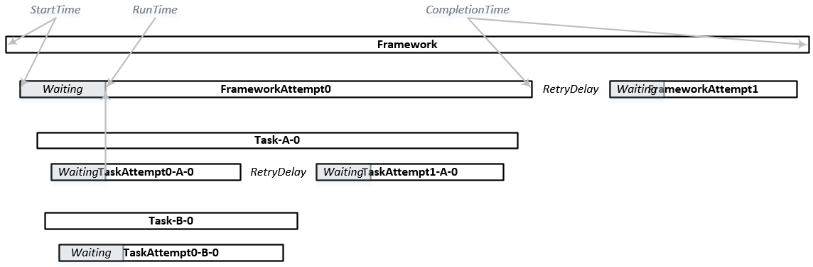
How FC Works: LifeCycle

Slide 16
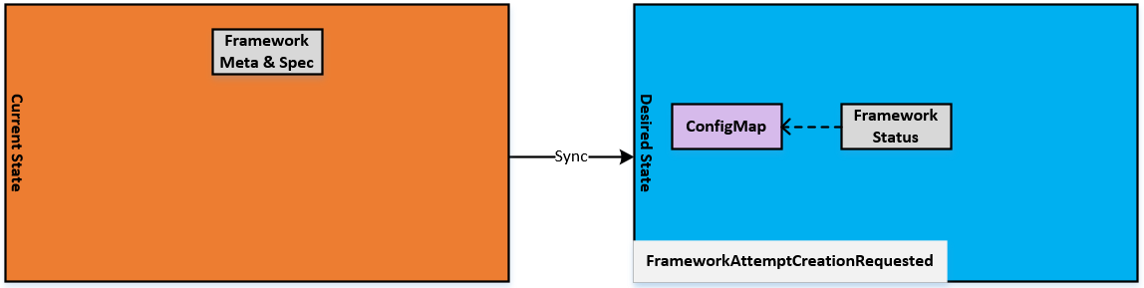
How FC Works: SyncFramework Example

Slide 17
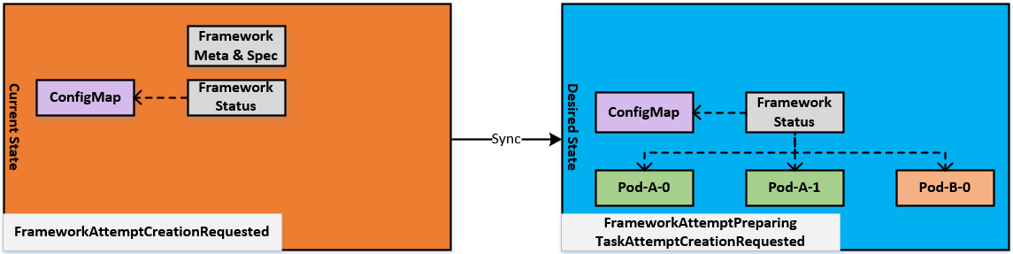
How FC Works: SyncFramework Example

Slide 18
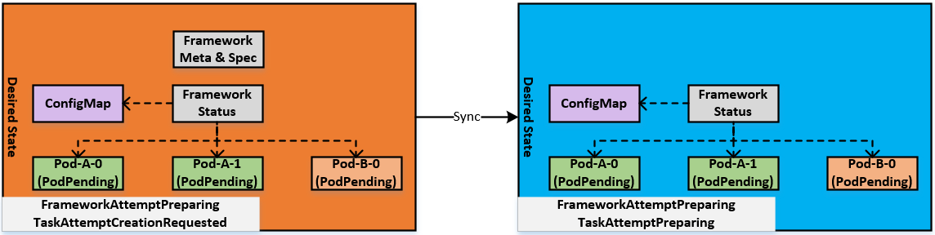
How FC Works: SyncFramework Example

Slide 19
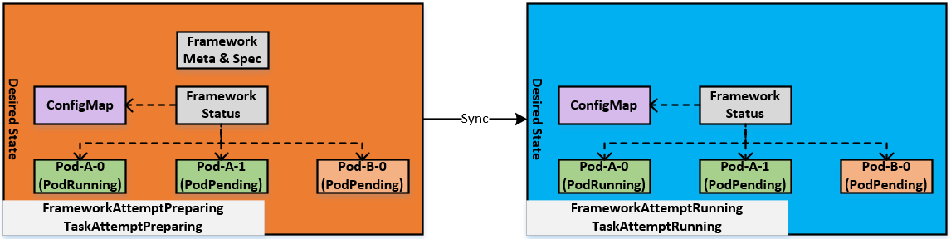
How FC Works: SyncFramework Example

Slide 20
How FC Works: SyncFramework Demo
Pod-A-0 and Pod-A-1 failed and retried 2 times
Persisted Task CompletionStatus
Deleted Pod-A-0 and Pod-A-1
Completed Task-A-0 and Task-A-1
Completing whole FrameworkAttempt
Persisted FrameworkAttempt CompletionStatus
Deleting ConfigMap
Deleting Pod-B-0 (Graceful Shutdown)
May Force Delete Pod-B-0
Deleted Pod-B-0
Completed Task-B-0
Deleted ConfigMap
Completed current FrameworkAttempt
Retried next FrameworkAttempt
Running Framework
Stopping Framework
Similar to 4.
Framework
ConfigMap
Pod-A-0
Pod-A-1
Pod-B-0

Slide 21
Advanced Features: Tune Consistency vs Availability
Pod-A-0 and Pod-A-1 failed and retried 2 times
Persisted Task CompletionStatus
Deleted Pod-A-0 and Pod-A-1
Completed Task-A-0 and Task-A-1
Completing whole FrameworkAttempt
Persisted FrameworkAttempt CompletionStatus
Deleting ConfigMap
Deleting Pod-B-0 (Graceful Shutdown)
May Force Delete Pod-B-0
Deleted Pod-B-0
Completed Task-B-0
Deleted ConfigMap
Completed current FrameworkAttempt
Retried next FrameworkAttempt
Running Framework
Stopping Framework
Similar to 4.
Framework
ConfigMap
Pod-B-0
(PodUnknown)

Slide 22
Advanced Features: Framework Barrier
Light-weight Gang Execution
Light-weight and Reliable Service Discovery
Ensure user app is started only after its Pod is managed
Compatible with HiveD Gang Scheduling/Preemption
Framework
ConfigMap
Cont-A-0-Init
Cont-A-1-Init
Cont-B-0-Init
Barrier
Cont-A-0-App
Cont-A-1-App
Cont-B-0-App

Slide 23
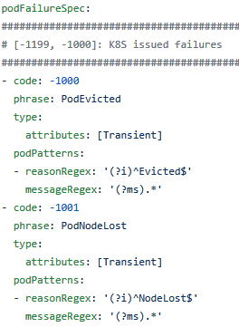
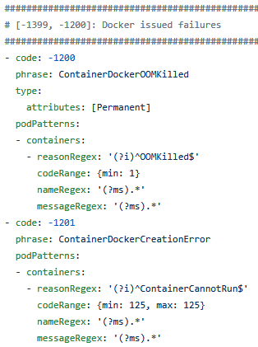
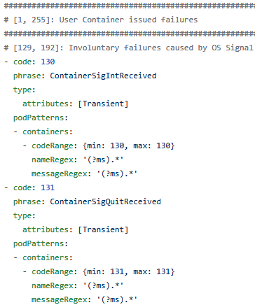
Advanced Features: Error Spec Classify and Summarize Pod failures

Slide 24
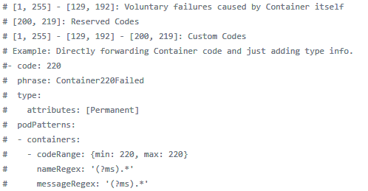
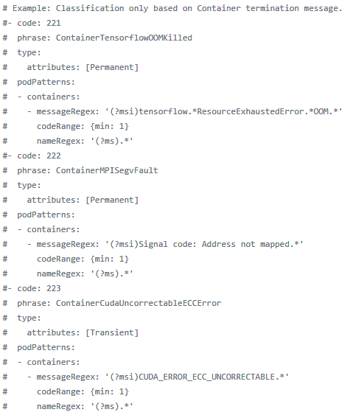
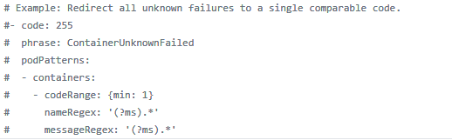
Advanced Features: Error Spec Classify and Summarize Pod failures

Slide 25
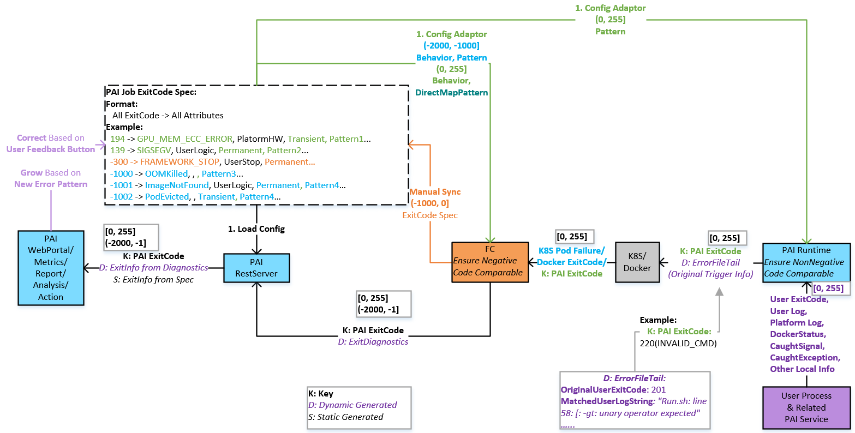
Advanced Features: Error Spec

Slide 26
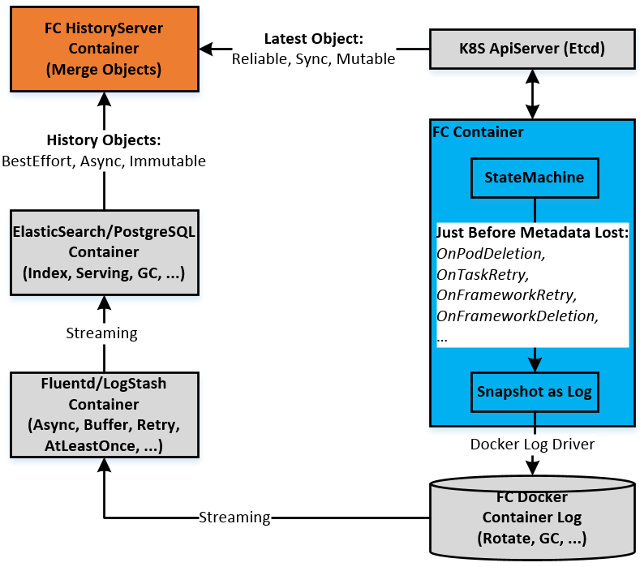
Advanced Features: Framework History

Slide 27
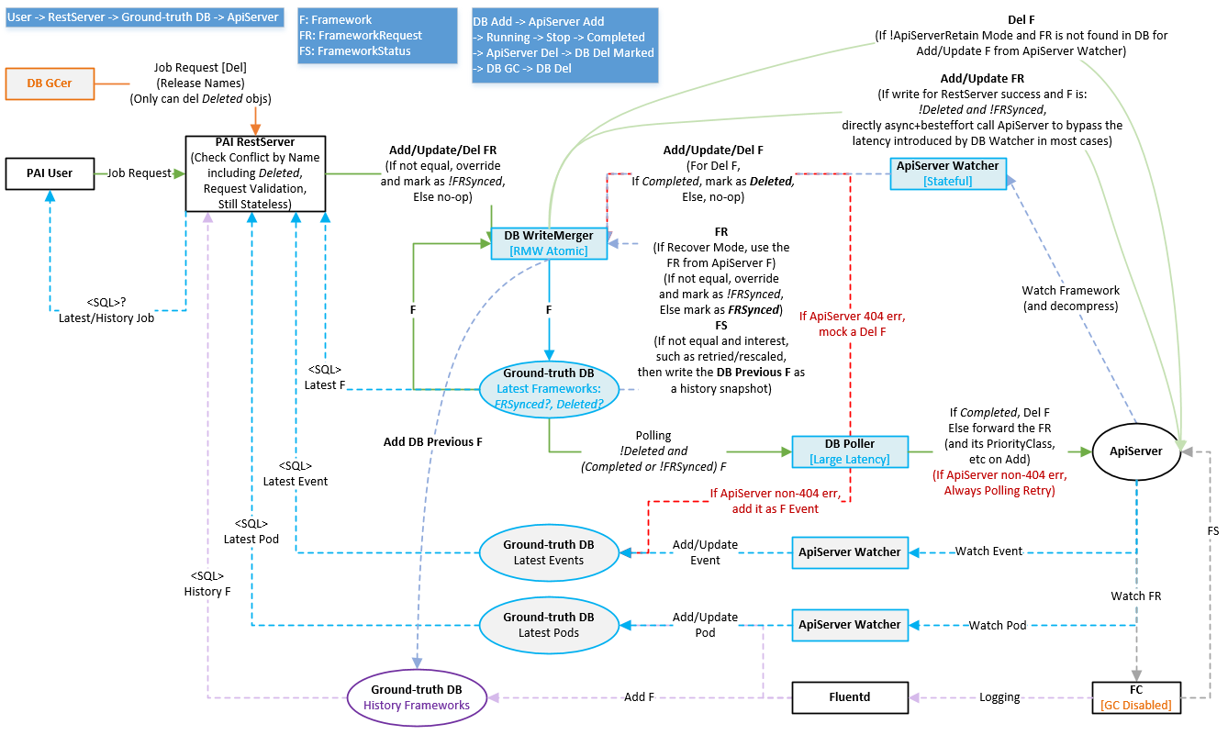
Advanced Features: Framework History

Slide 28
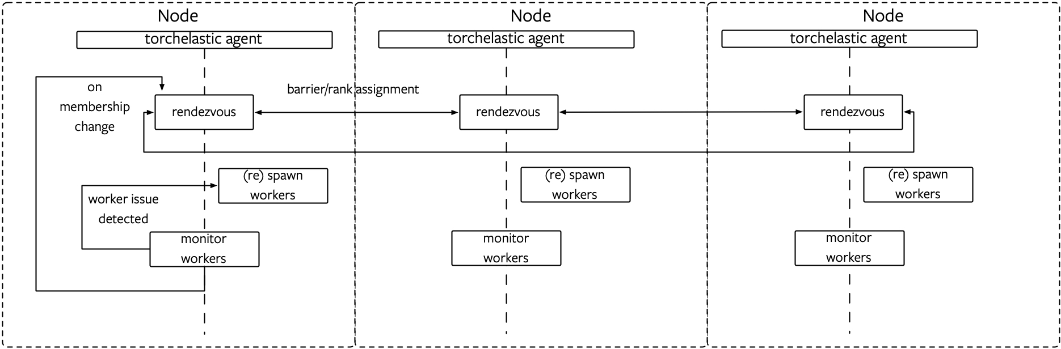
Advanced Features: Re-Scale & Elastic Training
PyTorch Elastic Training On FC
Support Fault Tolerant
Single Task failure does not fail the whole Framework
Support ScaleUp/ScaleDown with Strong Safety Guarantee
Introduced Task DeletionPending state, to let user know if re-scale committed
Able to update CompletionPolicy at the same time according to the new scale
Support whole cluster shared etcd or per-application dedicated etcd

Slide 29
Resource
https://github.com/microsoft/frameworkcontroller
https://github.com/microsoft/hivedscheduler
https://github.com/microsoft/pai

Slide 30
Q & A

