Slide 1

Microsoft Fabric Workspace Governance
PR-Based Workspace Provisioning — Architecture Diagrams
✅ Paid Capacity (F-SKU / P-SKU)
🧪 Fabric Trial Capacity (60 days)
Slide 2 Visual Architecture — Paid Capacity
Slide 3 Visual Architecture — Fabric Trial
Slide 4 Mermaid Diagram — Paid Capacity
Slide 5 Mermaid Diagram — Fabric Trial
Orange 🧪 slides highlight Trial-specific differences from paid F-SKU capacity.

Slide 2
Paid Capacity Architecture — F-SKU / P-SKU
✅ F-SKU / P-SKU
GitHub
Azure Entra ID
👤 Dev
GitHub PR
YAML manifest
Actions: Validate
Policy + schema
Actions: Provision
Fabric REST API
App Registration
gh-fabric-workspace-provisioner
Service Principal
SPN object ID
opens
triggers
on merge
approved
🔒 Prot.
Branch + CODEOWNERS
Approve & Merge
PR review gate
🖥 Runner
Self-hosted macOS
Prod Env Gate
Required reviewer
OIDC Creds × 3
PR · main · production
Security Group
sg-fabric-workspace-provisioner
OIDC auth
🔑 OIDC Federated Auth — No secrets stored in GitHub
GitHub Actions exchanges a short-lived OIDC token for an Entra ID JWT at runtime (3 credentials: PR · main · production)
Fabric Administrator Role (Entra ID)
Assigned to the Service Principal → enables Fabric admin API calls (workspace, domain, capacity assignment)
REST API → creates workspace
scopes tenant
Microsoft Fabric
Azure ARM (Paid only)
🔧 Admin Portal
Tenant settings UI
Tenant Settings
4 SPN API settings
⬡ Capacity
F-SKU / P-SKU
ARM API
az resource patch
Subscription
Azure resource mgmt
enables admin API
adds SPN as admin
assigned to
✅ New Workspace Provisioned
Owner assigned · Capacity assigned · Tenant policy applied via Security Group scoping
az resource patch → capacity.administration.members[]
Adds SPN GUID as Capacity Admin. Also available via Fabric Admin Portal (works for Trial too).

Slide 3
Trial Capacity Architecture — 🧪 Fabric Trial (60 days free)
🧪 Fabric Trial
GitHub
Azure Entra ID
👤 Dev
GitHub PR
YAML manifest
Actions: Validate
Policy + schema
Actions: Provision
Fabric REST API
App Registration
gh-fabric-workspace-provisioner
Service Principal
SPN object ID
opens
triggers
on merge
approved
🔒 Prot.
Branch + CODEOWNERS
Approve & Merge
PR review gate
🖥 Runner
Self-hosted macOS
Prod Env Gate
Required reviewer
OIDC Creds × 3
PR · main · production
Security Group
sg-fabric-workspace-provisioner
OIDC auth
🔑 OIDC Federated Auth — No secrets stored in GitHub
GitHub Actions exchanges a short-lived OIDC token for an Entra ID JWT at runtime (3 credentials: PR · main · production)
Fabric Administrator Role (Entra ID)
Assigned to the Service Principal → enables Fabric admin API calls (workspace, domain, capacity assignment)
REST API → creates workspace
scopes tenant
Microsoft Fabric
❌ No Azure ARM API available
✅ Add SPN as Capacity Admin via:
Fabric Admin Portal → Capacities
⚠️ Trial expires after 60 days
Update FABRIC_CAPACITY_ID var
when switching to paid capacity
💡 All other steps are identical
🧪 Trial Capacity — Key Differences
🔧 Admin Portal
Tenant settings UI
Tenant Settings
4 SPN API settings
⬡ Capacity
🧪 Trial (60d)
enables admin API
assigned to
✅ New Workspace Provisioned
Owner assigned · Capacity assigned · Tenant policy applied via Security Group scoping

Slide 4
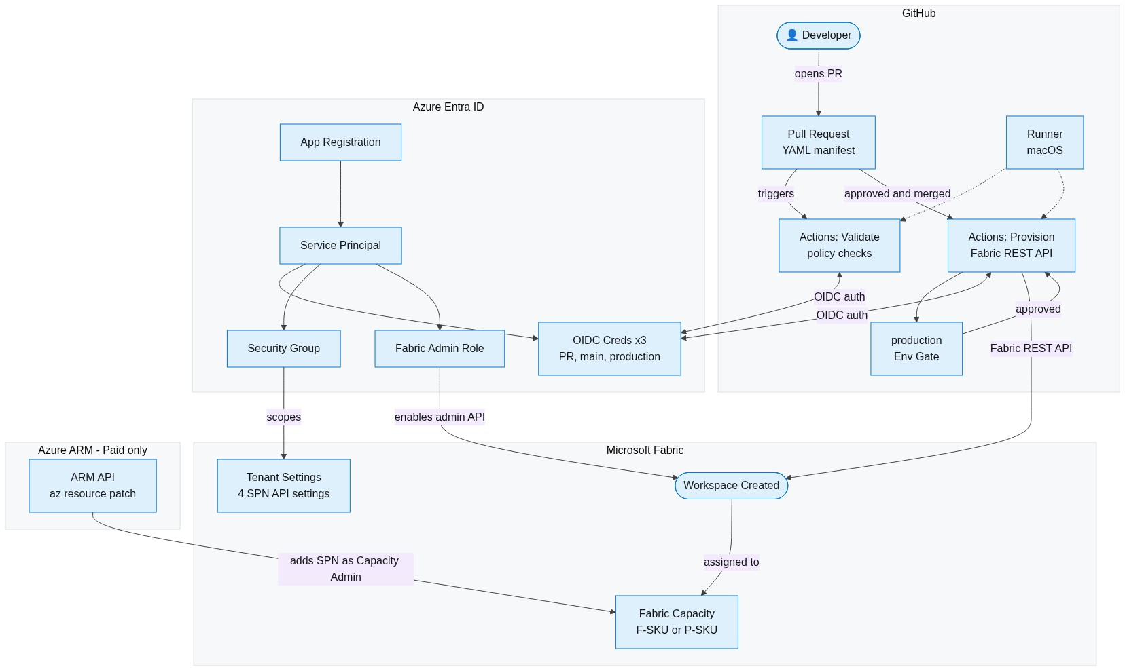
Mermaid Diagram — Paid Capacity F-SKU / P-SKU

Slide 5
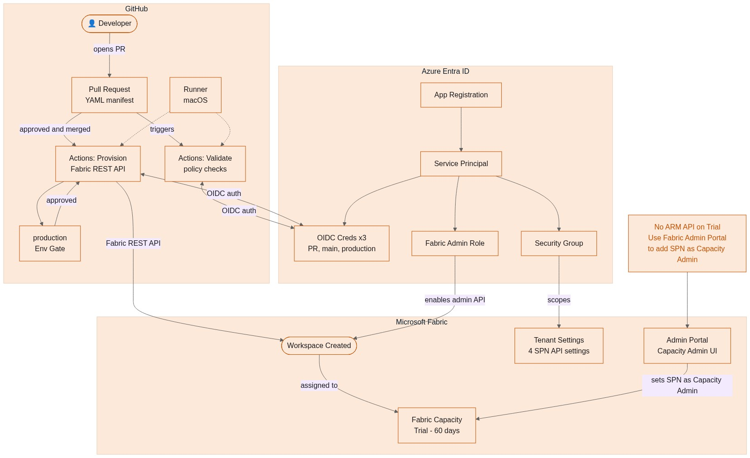
Mermaid Diagram — Fabric Trial 60-day free trial

