Slide 1
HVE-Core and the RPI Framework
Turning AI from a Code Generator into a Research Partner
A constraint-based framework for AI-assisted engineering
30-Minute Overview • Two Parts
Proven at AVEVA • BMW • Michelin • Hexagon • Kubota • Nvidia
Notes:
Welcome. Over the next 30 minutes I'll show you why the way most teams use AI coding assistants is fundamentally broken — and how a constraint-based framework called RPI fixes it. We'll cover the problem, the framework, a live demo, and how different roles use it today.
HVE-Core has been industry-proven at companies like AVEVA, BMW, Michelin, Hexagon, Kubota, and Nvidia to improve coding accuracy, automate repetitive tasks, and personalize solutions.

Slide 2
The Problem
You: "Build me a Terraform module for Azure IoT"
AI: *immediately generates 2,000 lines of code*
Reality:
• Missing provider dependencies
• Wrong variable naming conventions
• Patterns from 3 years ago
• Broke two downstream services
• Used modules that don't exist in your registry
It looked right. It compiled. Then you deployed.
The Cost
15–20 hrs/week
lost to repetitive tasks and
relearning context
40% productivity loss
from unstructured AI interactions
and context-switching
Raise your hand if this has happened to you.
Notes:
Raise your hand if this has happened to you. The AI generates something that looks right. It compiles. Then you deploy and discover it used patterns from 3 years ago, missed your naming conventions, and broke two downstream services. This is the universal failure mode of AI-assisted development.
The pain is quantifiable: developers lose 15 to 20 hours per week dealing with repetitive tasks and relearning context. Unstructured AI interactions and constant context-switching cost about 40% of productivity.

Slide 3
Why It Happens
Investigate?
🔍
Search • Analyze • Understand
Implement!
⌨️
Generate • Write • Ship
AI Writes First and Thinks Never
"Plausible" and "correct" aren't the same thing
Notes:
The root cause: AI treats every request as an implementation request. It never separates investigation from implementation. It pattern-matches from training data instead of searching your actual codebase. The output looks plausible — but plausible and correct aren't the same thing.

Slide 4
The Counterintuitive Insight
"The solution isn't teaching AI to be smarter.
It's preventing AI from doing certain things
at certain times."
Optimizing for plausible code
Optimizing for verified truth
Constraints are features, not limitations
Notes:
This is the philosophical foundation of HVE-Core. We don't try to make AI smarter. We constrain what it can do at each stage. A researcher that cannot write code will search instead of inventing. A planner that cannot implement will sequence instead of coding. Constraints force better behavior.

Slide 5
What is HVE-Core?
An enterprise-ready prompt engineering framework that transforms GitHub Copilot from a code-completion tool into a structured engineering partner.
Agents
22
Prompts
27
Instructions
24
Skills
1
Collections
10
Delegation Flow
User
Prompt
Agent
Instructions
Agents define behavior and constraints. Instructions encode standards.
Prompts are user entry points. Skills package domain knowledge.
Collections bundle everything for specific roles.
Industry-proven at AVEVA, BMW, Michelin, Hexagon, Kubota, and Nvidia
Notes:
HVE-Core is an enterprise-ready prompt engineering framework. 22 custom agents, 27 prompts, 24 instruction files, 1 skill, and 10 collections. Agents define what AI can and cannot do. Instructions encode coding standards. Prompts are how users interact. Collections bundle artifacts for specific roles.
This isn't just theory. HVE-Core has been used by industry leaders like AVEVA, BMW, Michelin, Hexagon, Kubota, and Nvidia.

Slide 6
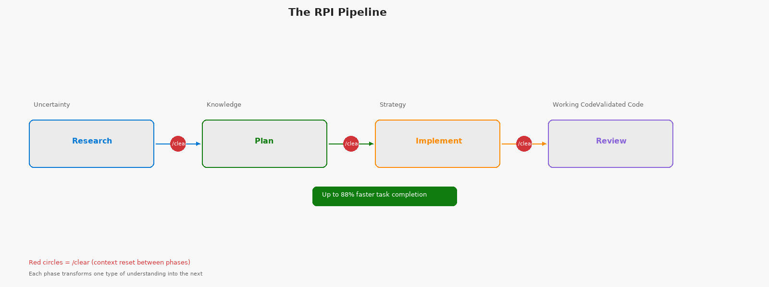
The RPI Pipeline
Notes:
Each phase converts one form of understanding into the next. Internal trials show up to 88% faster task completion using RPI compared to unstructured AI prompting.

Slide 7
Deep Dive: Each Phase
Research
Plan
Implement
Review
Purpose
Discover what exists
Core Constraint
CANNOT implement or modify code
Key Output
research.md with citations
Invocation
/task-research
Purpose
Sequence the work
Core Constraint
CANNOT implement or modify code
Key Output
plan.instructions.md + details.md
Invocation
/task-plan
Purpose
Execute the plan
Core Constraint
MUST follow plan — no creative decisions
Key Output
Working code matching plan
Invocation
/task-implement
Purpose
Validate the output
Core Constraint
CANNOT modify code — only report findings
Key Output
8-dimension review report
Invocation
/task-review
Best practice: Keep implementation to ~3 files per RPI cycle for manageable scope
Notes:
The constraints row is the key architectural element. Each constraint forces the AI into its correct mode of operation. Keep each RPI cycle scoped to about 3 files.

Slide 8
Quality Comparison + The /clear Rule
Traditional AI
Dimension
RPI Approach
Invents plausible patterns
Pattern matching
Finds actual codebase patterns
No audit trail
Traceability
Research → Plan → Code
Lost between sessions
Knowledge transfer
Preserved in artifacts
30-50% discarded
Rework
< 10% rework
Manual review only
Validation
8-dimension structured review
The /clear Rule: Context Reset Between Phases
Research
/clear
Plan
/clear
Implement
/clear
Review
Stop asking AI: "Write this code."
Start asking: "Help me research, plan, then implement with evidence."
Context clearing prevents mode contamination — each phase gets a clean start.
Notes:
The traceability row is the strongest argument for RPI adoption. The /clear rule sounds counterintuitive — why throw away context? Because context contamination causes mode confusion.
The paradigm shift: stop asking AI to write code. Start asking it to help you research, plan, and then implement with evidence.

Slide 9
Six Custom Chat Modes
RPI Cycle
Complementary
Task Researcher
/task-research
Prompt Builder
/prompt-build
Constraint: Cannot implement
Constraint: Orchestrates subagents
Task Planner
/task-plan
Constraint: Cannot implement
PR Review
Agent picker
Constraint: Never modifies code
Task Implementor
/task-implement
Constraint: Follows plan only
Task Reviewer
/task-review
Constraint: Cannot modify code
Every mode enforces specific constraints — AI cannot bypass its designated role
Advanced: rpi-agent orchestrates all 4 phases in a single session for familiar tasks
Notes:
Four modes form the RPI cycle. Two additional modes serve specialized functions. For familiar tasks, the rpi-agent can orchestrate all four phases in one session.

Slide 10
Let's See It in Action
Live Demo: RPI Workflow — Researching and Planning a Feature
Watch for:
1.
How the researcher finds existing patterns (not invents code)
2.
How it cites specific files and line numbers
3.
How the plan references the research artifacts
4.
How /clear resets context between phases
5.
How the implementor follows the plan step by step
Demo: ~5 minutes in VS Code • Research → /clear → Plan → /clear → Implement
Notes:
Watch for five things: how the researcher searches rather than invents, how it cites files and line numbers, how the plan references research artifacts, how /clear resets context, and how the implementor follows the plan.

Slide 11
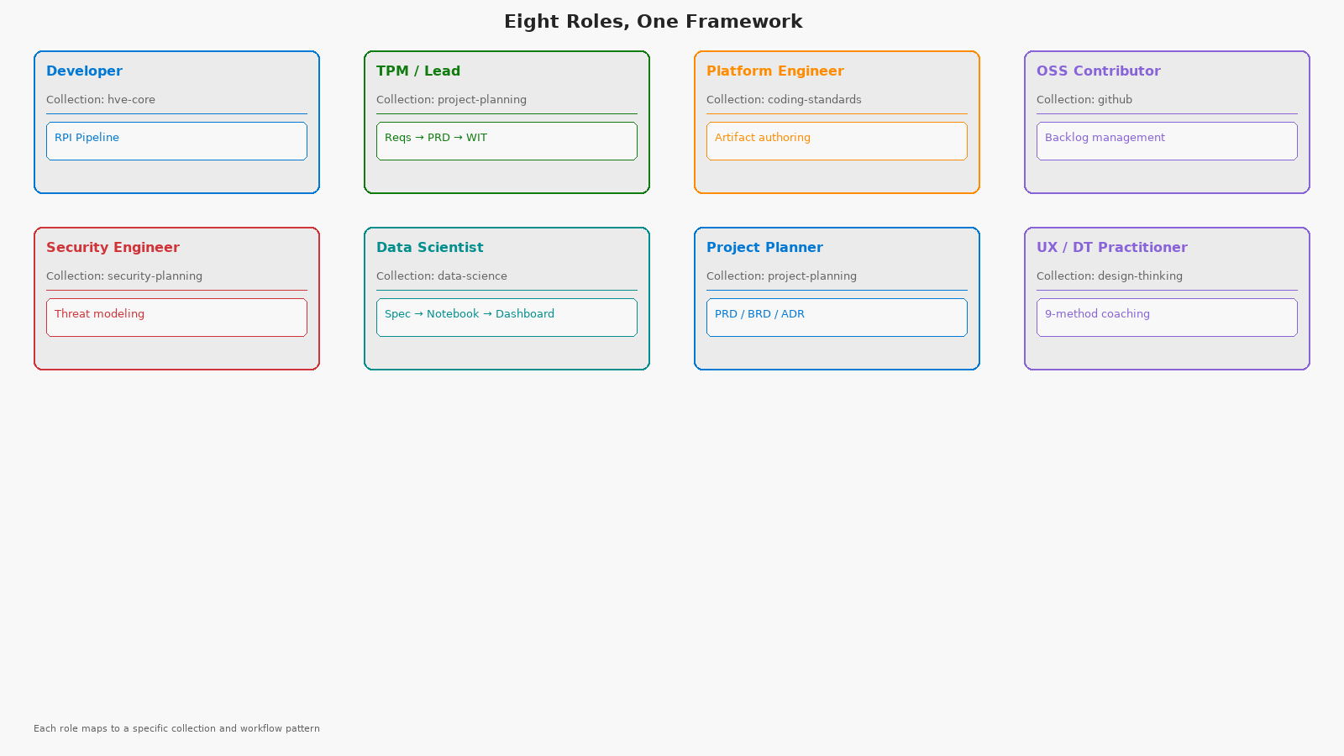
Eight Roles, One Framework
Notes:
HVE-Core isn't just for developers. Eight distinct roles, each with a dedicated collection that filters the right tools for their job.

Slide 12
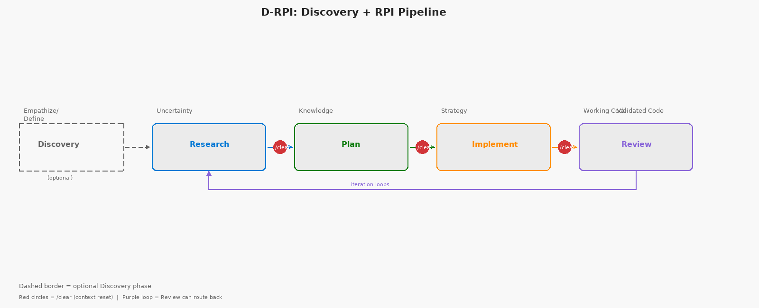
Beyond RPI: Discovery + Design Thinking
Design Thinking Alignment
Discovery
→ Empathize / Define
Implement
→ Build / Test
Research
→ Ideate (evidence-constrained)
Review
→ Validate / Feedback
Plan
→ Prototype (on paper)
D-RPI and Design Thinking integration are forward-looking extensions. Core four-phase RPI is the production workflow today.
Notes:
For complex or ambiguous projects, add a Discovery phase before Research — D-RPI. Discovery mirrors Empathize and Define stages of Design Thinking. D-RPI and Design Thinking integration are forward-looking extensions.

Slide 13
Real Results with HVE-Core
50%
90%
2 Days
Quality
Dev
Experience
Faster
Deployments
Faster
Docs
vs 8 Weeks
Improved
Better
Global telecom:
AI-driven IaC
Architecture docs
and security plans:
days → hours
Internal hackathon:
RPI + Copilot
prototype
AI PR reviews
catch subtle bugs
pre-merge
Less rework,
less context-switching,
higher satisfaction
Real teams. Real metrics. Real improvements.
Internal trials: up to 88% faster task completion with RPI
Notes:
These aren't hypothetical — a global telecom cut deployment times by 50%. Architecture and security docs went from days to hours. A hackathon team delivered a prototype in 2 days instead of 8 weeks. Developers are happier.

Slide 14
Built by HVE-Core, Validated by HVE-Core
Self-Referential Credibility
• This presentation was planned using RPI
• Every agent was built by the Prompt Builder agent
• Instructions files follow their own rules
• Collection manifests are validated by their own CI
• Documentation is generated from the same artifacts
If HVE-Core doesn't work on itself,
why would it work on your project?
Validation Pipeline
Linting (7 jobs)
Markdown, YAML, frontmatter, links,
tables, collections metadata, version consistency
Analysis (2 jobs)
PowerShell PSScriptAnalyzer, skill validation
Security (3 jobs)
Dependency pinning, SHA staleness, copyright
Schema Validation
Collection YAML → plugin generation → extension packaging
Notes:
HVE-Core uses its own tools to build itself. This presentation was planned using the RPI workflow. The validation pipeline runs 12+ automated checks on every PR.

Slide 15
Extension Ecosystem
Extension
Agents
Prompts
Instructions
Focus
hve-core
21
23
18
Core RPI + all foundations
hve-ado
9
19
10
Azure DevOps integration
hve-github
9
19
10
GitHub backlog management
hve-project-planning
13
15
5
PRD / BRD / ADR workflows
hve-security-planning
9
16
5
Threat modeling
hve-rpi
8
14
5
Standalone RPI cycle
hve-prompt-engineering
8
14
5
Artifact authoring
hve-data-science
1
1
0
Data science workflows
Common base: 8 core agents + 5 core instructions shared across all extensions
Notes:
8 VS Code extensions organized by role. All share a common base of 8 core agents and 5 core instructions. Pick the extension that matches your role.

Slide 16
Learning Curve & Compounding Value
The Honest Truth
The Payoff
Your first RPI workflow will feel slower.
You'll wonder why you can't just ask AI to code it.
You'll feel like the constraints are slowing you down.
You'll want to skip the research phase.
That's normal. Stay with it.
By your third feature, the workflow
feels natural.
Research artifacts compound across features.
Plans reference previous research findings.
Rework drops below 10%.
The framework pays for itself.
Research documents accumulate into institutional memory.
New team members can read how past decisions were made. You're not just solving
today's problem — you're building the knowledge base that accelerates tomorrow's.
Evolution Timeline
v1.1.0
Jan 19 — Initial release
v2.0.0
Jan 28 — Breaking: agent restructure
v2.3.4
Feb 13 — Stable + extensions
Notes:
Be honest with your team: the first RPI workflow feels slower. By the third feature, the workflow feels natural. Research documents accumulate into institutional memory.

Slide 17
Three Paths to Start + Learn More
VS Code Extension ⭐ • 10 seconds
Peer Clone • 2 minutes
Codespaces • 1 click
Individual users, TPMs,
immediate access
Developers needing
customization
Contributors wanting
zero-config
Learning Resources
•
HVE-Learning Repository
Self-paced modules on prompt engineering, RPI, backlog management
•
First Workflow Tutorial
15-minute guided RPI exercise
•
Customer Zero Katas
Hands-on practice exercises for real-world scenarios
•
Documentation
aka.ms/hve-core — install, usage, FAQs
microsoft/hve-learning • aka.ms/cz-repo-katas • aka.ms/hve-core
Start with one RPI workflow. The research artifacts compound from there.
Notes:
Three paths to get started. The VS Code Extension is the fastest — 10 seconds. The HVE-Learning repository has self-paced modules. Customer Zero Katas provide hands-on practice exercises.

Slide 18
Join the Community
Bi-Weekly Syncs
Teams Channels
HVE Community Syncs — live demos,
Q&A, roadmap updates,
and best practice sharing
#Hypervelocity and #SeasonOfHVE
— real-time discussions,
tips, troubleshooting
Good First Issues
Contribution Types
Look for "good first issue" tags
on HVE-Core and accelerator
repos (Edge AI, Robotics)
Code • Prompts • Instructions
• Skills • Docs • Bug reports
• Feature requests
Find Issue
Use RPI to Research
Submit PR
Get Review
Use RPI to learn the repo and make your first PR — the agents keep you on track
Notes:
Bi-weekly community syncs, Teams channels, and curated good-first-issue tags. Contributions aren't limited to code — prompts, instructions, documentation, and bug reports are all valuable.

Slide 19
Getting Started
1
Install HVE-Core extension from VS Code Marketplace (10 seconds)
2
Open Copilot Chat and select a chat mode (e.g., Task Researcher)
3
Run /task-research on your next feature or bug
4
Experience the difference — then try the full RPI cycle
github.com/microsoft/hve-core
Try /task-research on your next feature
Notes:
Four steps to get started. Install the extension — 10 seconds. Open Copilot Chat. Select Task Researcher. Ask it about your next feature.

Slide 20
Key Takeaways
1
Accelerate delivery and quality
HVE-Core combines AI tools with structured practices — tasks up to 88% faster without sacrificing quality or security
2
RPI is the game-changer
Research → Plan → Implement → Review turns Copilot from a nifty helper into a reliable partner. Structured phases kill the AI rework loop
3
Empower every role
Not just for coders — PMs, TPMs, security engineers, data scientists, and OSS contributors each have dedicated workflows
4
Start your hypervelocity journey
It only takes 10 seconds to install. Pick a small task, run it through RPI, and see the difference
"The code comes last, after the hard work of understanding is complete."
Install
Try RPI
Join Community
Questions?
Notes:
Four takeaways: accelerate delivery and quality, RPI is the game-changer, empower every role, and start your hypervelocity journey. The code comes last, after the hard work of understanding is complete. Questions?

