Slide 1
HVE-Core and the RPI Framework
Turning AI from a Code Generator into a Research Partner
A constraint-based framework for AI-assisted engineering
30-Minute Overview • Two Parts
Proven at AVEVA • BMW • Michelin • Hexagon • Kubota • Nvidia
Notes:
Welcome. Over the next 30 minutes I'll show you why the way most teams use AI coding assistants is fundamentally broken — and how a constraint-based framework called RPI fixes it. We'll cover the problem, the framework, a live demo, and how different roles use it today.
HVE-Core has been industry-proven at companies like AVEVA, BMW, Michelin, Hexagon, Kubota, and Nvidia to improve coding accuracy, automate repetitive tasks, and personalize solutions.

Slide 2
The Problem
You: "Build me a Terraform module for Azure IoT"
AI: *immediately generates 2,000 lines of code*
Reality:
• Missing provider dependencies
• Wrong variable naming conventions
• Patterns from 3 years ago
• Broke two downstream services
• Used modules that don't exist in your registry
It looked right. It compiled. Then you deployed.
The Cost
15–20 hrs/week
lost to repetitive tasks and
relearning context
40% productivity loss
from unstructured AI interactions
and context-switching
Raise your hand if this has happened to you.
Notes:
Raise your hand if this has happened to you. The AI generates something that looks right. It compiles. Then you deploy and discover it used patterns from 3 years ago, missed your naming conventions, and broke two downstream services. This is the universal failure mode of AI-assisted development.
The pain is quantifiable: developers lose 15 to 20 hours per week dealing with repetitive tasks and relearning context. Unstructured AI interactions and constant context-switching cost about 40% of productivity. Those aren't hypothetical numbers — they come from real engineering teams.

Slide 3
Why It Happens
Investigate?
🔍
Search • Analyze • Understand
Implement!
⌨️
Generate • Write • Ship
AI Writes First and Thinks Never
"Plausible" and "correct" aren't the same thing
Notes:
The root cause: AI treats every request as an implementation request. It never separates investigation from implementation. It pattern-matches from training data instead of searching your actual codebase. The output looks plausible — but plausible and correct aren't the same thing.

Slide 4
The Counterintuitive Insight
"The solution isn't teaching AI to be smarter.
It's preventing AI from doing certain things
at certain times."
Optimizing for plausible code
Optimizing for verified truth
Constraints are features, not limitations
Notes:
This is the philosophical foundation of HVE-Core. We don't try to make AI smarter. We constrain what it can do at each stage. A researcher that cannot write code will search instead of inventing. A planner that cannot implement will sequence instead of coding. Constraints force better behavior.

Slide 5
What is HVE-Core?
An enterprise-ready prompt engineering framework that transforms GitHub Copilot from a code-completion tool into a structured engineering partner.
Agents
22
Prompts
27
Instructions
24
Skills
1
Collections
10
Delegation Flow
User
Prompt
Agent
Instructions
Agents define behavior and constraints. Instructions encode standards.
Prompts are user entry points. Skills package domain knowledge.
Collections bundle everything for specific roles.
Industry-proven at AVEVA, BMW, Michelin, Hexagon, Kubota, and Nvidia
Notes:
HVE-Core is an enterprise-ready prompt engineering framework. 22 custom agents, 27 prompts, 24 instruction files, 1 skill, and 10 collections. Agents define what AI can and cannot do. Instructions encode coding standards. Prompts are how users interact. Collections bundle artifacts for specific roles — a developer gets different tools than a TPM.
This isn't just theory. HVE-Core has been used by industry leaders like AVEVA, BMW, Michelin, Hexagon, Kubota, and Nvidia to boost productivity and improve coding accuracy in real production environments.

Slide 6
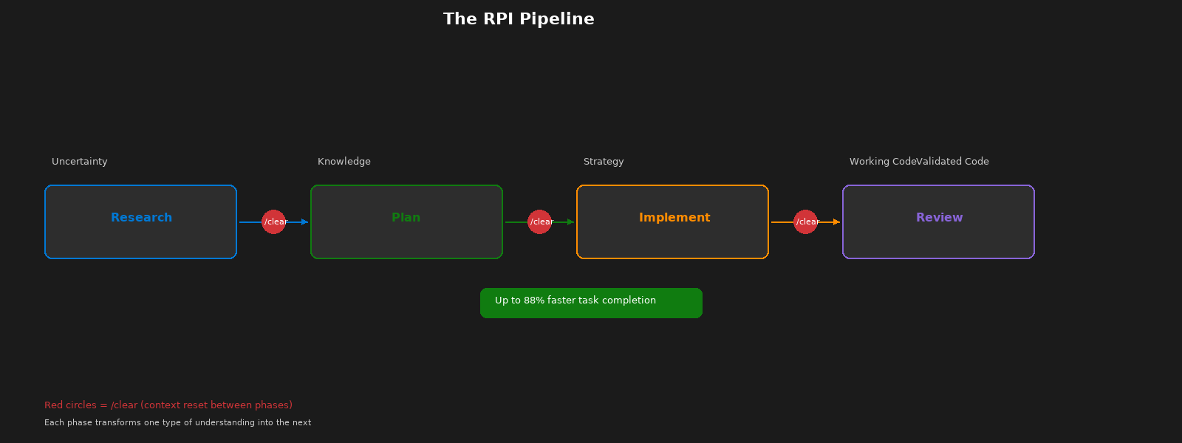
The RPI Pipeline
Notes:
Each phase converts one form of understanding into the next. Uncertainty becomes knowledge. Knowledge becomes strategy. Strategy becomes working code. Working code becomes validated code. The /clear markers between phases prevent context contamination — the researcher's reasoning must not leak into the implementor.
Internal trials show up to 88% faster task completion using RPI compared to unstructured AI prompting. That means what used to take a week might take one day.

Slide 7
Deep Dive: Each Phase
Research
Plan
Implement
Review
Purpose
Discover what exists
Core Constraint
CANNOT implement or modify code
Key Output
research.md with citations
Invocation
/task-research
Purpose
Sequence the work
Core Constraint
CANNOT implement or modify code
Key Output
plan.instructions.md + details.md
Invocation
/task-plan
Purpose
Execute the plan
Core Constraint
MUST follow plan — no creative decisions
Key Output
Working code matching plan
Invocation
/task-implement
Purpose
Validate the output
Core Constraint
CANNOT modify code — only report findings
Key Output
8-dimension review report
Invocation
/task-review
Best practice: Keep implementation to ~3 files per RPI cycle for manageable scope
Notes:
The constraints row is the key architectural element. The researcher cannot implement — so it searches instead of inventing. The planner cannot implement — so it sequences instead of coding. The implementor follows the plan — no creative decisions. The reviewer cannot modify code — only validate. Each constraint forces the AI into its correct mode of operation.
Best practice: keep each RPI cycle scoped to about 3 files. If the plan is larger, split into multiple cycles. This keeps tasks manageable and prevents context overload.

Slide 8
Quality Comparison + The /clear Rule
Traditional AI
Dimension
RPI Approach
Invents plausible patterns
Pattern matching
Finds actual codebase patterns
No audit trail
Traceability
Research → Plan → Code
Lost between sessions
Knowledge transfer
Preserved in artifacts
30-50% discarded
Rework
< 10% rework
Manual review only
Validation
8-dimension structured review
The /clear Rule: Context Reset Between Phases
Research
/clear
Plan
/clear
Implement
/clear
Review
Stop asking AI: "Write this code."
Start asking: "Help me research, plan, then implement with evidence."
Context clearing prevents mode contamination — each phase gets a clean start.
Notes:
For TPMs: the traceability row is your strongest argument for RPI adoption. Every line of code traces back through a plan to a research finding. For everyone: the /clear rule sounds counterintuitive — why throw away context? Because context contamination causes the researcher's reasoning patterns to leak into the implementor, creating mode confusion. Each phase needs a clean start with only its designated inputs.
The paradigm shift is real: stop asking AI to write code. Start asking it to help you research, plan, and then implement with evidence. That single change transforms AI from a code generator into a research partner.

Slide 9
Six Custom Chat Modes
RPI Cycle
Complementary
Task Researcher
/task-research
Prompt Builder
/prompt-build
Constraint: Cannot implement
Constraint: Orchestrates subagents
Task Planner
/task-plan
Constraint: Cannot implement
PR Review
Agent picker
Constraint: Never modifies code
Task Implementor
/task-implement
Constraint: Follows plan only
Task Reviewer
/task-review
Constraint: Cannot modify code
Every mode enforces specific constraints — AI cannot bypass its designated role
Advanced: rpi-agent orchestrates all 4 phases in a single session for familiar tasks
Notes:
Four modes form the RPI cycle. Two additional modes serve specialized functions. Prompt Builder creates the artifacts that configure the agents — it's meta-level. PR Review is an 8-dimension quality gate that complements Task Reviewer. Every mode has a constraint that prevents the AI from doing something specific.
Advanced tip: for familiar tasks where you know the codebase well, the rpi-agent can orchestrate all four phases in a single session. But for anything complex or unfamiliar, running phases separately with /clear gives much better results.

Slide 10
Let's See It in Action
Live Demo: RPI Workflow — Researching and Planning a Feature
Watch for:
1.
How the researcher finds existing patterns (not invents code)
2.
How it cites specific files and line numbers
3.
How the plan references the research artifacts
4.
How /clear resets context between phases
5.
How the implementor follows the plan step by step
Demo: ~5 minutes in VS Code • Research → /clear → Plan → /clear → Implement
Notes:
I'm going to run through the RPI workflow live. Watch for five things: how the researcher searches rather than invents, how it cites files and line numbers, how the plan references research artifacts, how /clear resets context, and how the implementor follows the plan step by step.
Demo flow: open VS Code, run /task-research, show output, /clear, run /task-plan with research file, show plan and details output, /clear, run /task-implement with plan.
Fallback: if live demo fails, switch to pre-captured screenshots or terminal output.

Slide 11
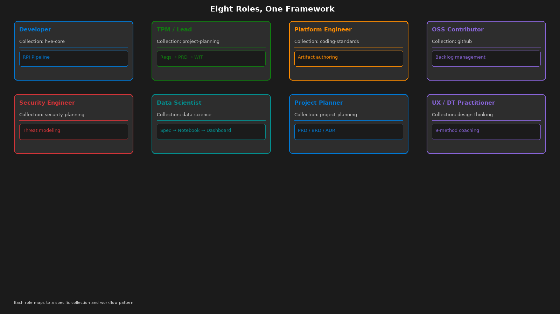
Eight Roles, One Framework
Notes:
HVE-Core isn't just for developers. Eight distinct roles, each with a dedicated collection that filters the right tools for their job.
For developers: the RPI pipeline. For TPMs and leads: requirements discovery → PRD authoring → ADO work item creation. For PMs and non-coding roles: use Researcher to gather data for status reports, Planner to structure narratives, Prompt Builder to formulate user stories. For OSS contributors: RPI as a self-service mentor — pick a 'good first issue,' research the codebase, plan your approach, implement with guidance.
Notice that roles don't share workflows — a TPM's tooling is different from a developer's. Collections make that separation automatic.

Slide 12
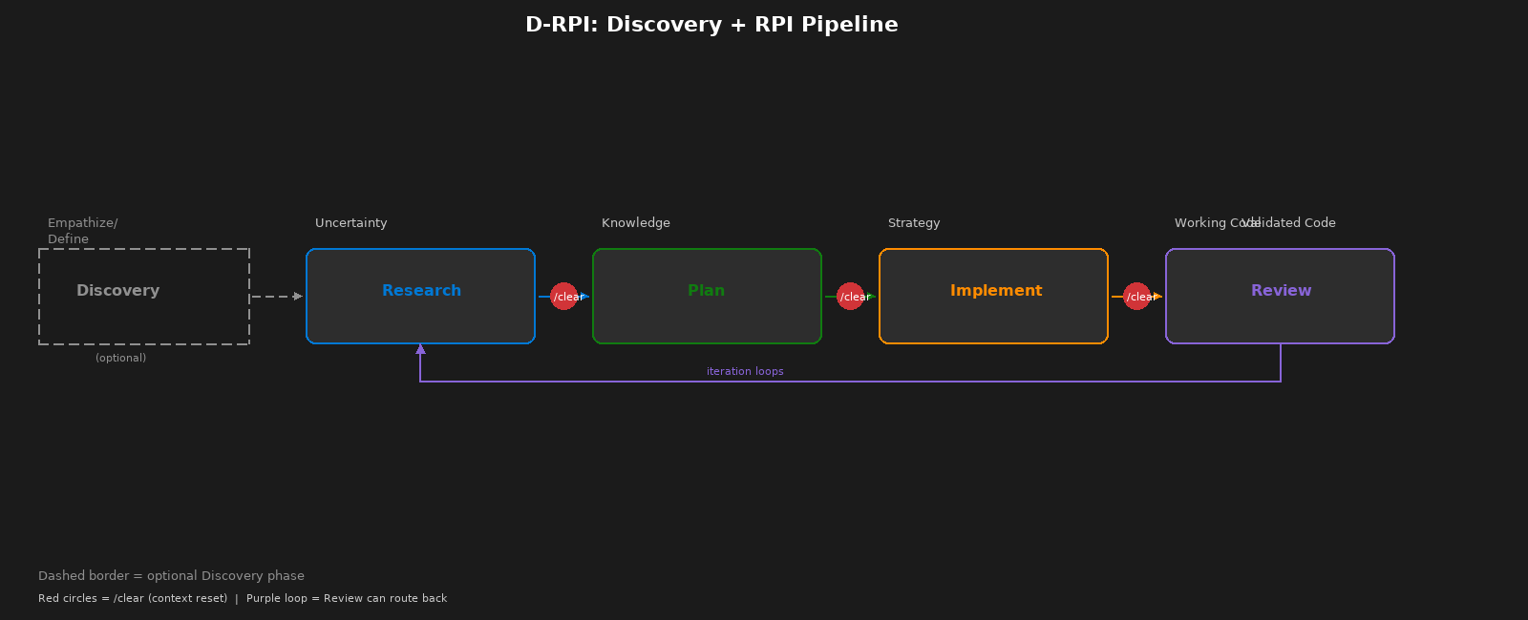
Beyond RPI: Discovery + Design Thinking
Design Thinking Alignment
Discovery
→ Empathize / Define
Implement
→ Build / Test
Research
→ Ideate (evidence-constrained)
Review
→ Validate / Feedback
Plan
→ Prototype (on paper)
D-RPI and Design Thinking integration are forward-looking extensions. Core four-phase RPI is the production workflow today.
Notes:
RPI adapts to different situations. For complex or ambiguous projects where requirements are unclear, you can add a Discovery phase before Research — we call this D-RPI. Discovery is a brainstorming session with the AI in Ask Mode: 'Who is the audience? What do they care about? What do they already know?' It mirrors the Empathize and Define stages of Design Thinking.
This alignment isn't a coincidence. RPI maps naturally to Design Thinking — Research parallels Ideation, Plan parallels Prototyping, Implement parallels Building, Review parallels Testing with feedback loops. Context from Discovery pre-seeds the Research phase, so the AI already understands the high-level intent.
Note that D-RPI and Design Thinking integration are forward-looking extensions. The core four-phase RPI is the production workflow today. And RPI is cyclical, not linear — the Review phase can route back to Research for knowledge gaps, back to Plan for scope changes, or back to Implement for fixes.

Slide 13
Real Results with HVE-Core
50%
90%
2 Days
Quality
Dev
Experience
Faster
Deployments
Faster
Docs
vs 8 Weeks
Improved
Better
Global telecom:
AI-driven IaC
Architecture docs
and security plans:
days → hours
Internal hackathon:
RPI + Copilot
prototype
AI PR reviews
catch subtle bugs
pre-merge
Less rework,
less context-switching,
higher satisfaction
Real teams. Real metrics. Real improvements.
Internal trials: up to 88% faster task completion with RPI
Notes:
These aren't hypothetical — real teams have seen dramatic improvements with HVE-Core. A global telecom rolled out an HVE approach in their cloud deployment process and cut deployment times by 50%. Another team saw architecture documents and security plans go from taking several days to just a few hours — a 90% reduction.
At an internal hackathon, a team delivered a working prototype in only 2 days using RPI and Copilot — something that traditionally would have taken 6 to 8 weeks. Quality improved too: the AI-driven PR Review agent helped developers catch subtle bugs and security issues before code was merged.
And developers are happier. By eliminating tedious tasks and reducing context-switching, HVE-Core frees engineers to focus on creative problem-solving. Teams report significantly less frustration and higher morale.

Slide 14
Built by HVE-Core, Validated by HVE-Core
Self-Referential Credibility
• This presentation was planned using RPI
• Every agent was built by the Prompt Builder agent
• Instructions files follow their own rules
• Collection manifests are validated by their own CI
• Documentation is generated from the same artifacts
If HVE-Core doesn't work on itself,
why would it work on your project?
Validation Pipeline
Linting (7 jobs)
Markdown, YAML, frontmatter, links,
tables, collections metadata, version consistency
Analysis (2 jobs)
PowerShell PSScriptAnalyzer, skill validation
Security (3 jobs)
Dependency pinning, SHA staleness, copyright
Schema Validation
Collection YAML → plugin generation → extension packaging
Notes:
HVE-Core uses its own tools to build itself. This presentation was planned using the RPI workflow. Every agent was built by the Prompt Builder agent. The validation pipeline runs 12+ automated checks on every PR. If it doesn't work on itself, why would it work on your project? Self-referential credibility is the strongest argument for adoption.

Slide 15
Extension Ecosystem
Extension
Agents
Prompts
Instructions
Focus
hve-core
21
23
18
Core RPI + all foundations
hve-ado
9
19
10
Azure DevOps integration
hve-github
9
19
10
GitHub backlog management
hve-project-planning
13
15
5
PRD / BRD / ADR workflows
hve-security-planning
9
16
5
Threat modeling
hve-rpi
8
14
5
Standalone RPI cycle
hve-prompt-engineering
8
14
5
Artifact authoring
hve-data-science
1
1
0
Data science workflows
Common base: 8 core agents + 5 core instructions shared across all extensions
Notes:
8 VS Code extensions organized by role. hve-core is the full package with 21 agents, 23 prompts, and 18 instruction files. Specialized extensions like hve-ado and hve-github focus on specific workflows. All share a common base of 8 core agents and 5 core instructions. Pick the extension that matches your role.

Slide 16
Learning Curve & Compounding Value
The Honest Truth
The Payoff
Your first RPI workflow will feel slower.
You'll wonder why you can't just ask AI to code it.
You'll feel like the constraints are slowing you down.
You'll want to skip the research phase.
That's normal. Stay with it.
By your third feature, the workflow
feels natural.
Research artifacts compound across features.
Plans reference previous research findings.
Rework drops below 10%.
The framework pays for itself.
Research documents accumulate into institutional memory.
New team members can read how past decisions were made. You're not just solving
today's problem — you're building the knowledge base that accelerates tomorrow's.
Evolution Timeline
v1.1.0
Jan 19 — Initial release
v2.0.0
Jan 28 — Breaking: agent restructure
v2.3.4
Feb 13 — Stable + extensions
Notes:
Be honest with your team: the first RPI workflow feels slower. That's by design. You're building research artifacts that compound across features. By the third feature, the workflow feels natural and you'll wonder how you worked without it.
The real value isn't the current task — it's what compounds. Research documents accumulate into institutional memory. New team members can read how past decisions were made. You're not just solving today's problem; you're building the knowledge base that accelerates tomorrow's.

Slide 17
Three Paths to Start + Learn More
VS Code Extension ⭐ • 10 seconds
Peer Clone • 2 minutes
Codespaces • 1 click
Individual users, TPMs,
immediate access
Developers needing
customization
Contributors wanting
zero-config
Learning Resources
•
HVE-Learning Repository
Self-paced modules on prompt engineering, RPI, backlog management
•
First Workflow Tutorial
15-minute guided RPI exercise
•
Customer Zero Katas
Hands-on practice exercises for real-world scenarios
•
Documentation
aka.ms/hve-core — install, usage, FAQs
microsoft/hve-learning • aka.ms/cz-repo-katas • aka.ms/hve-core
Start with one RPI workflow. The research artifacts compound from there.
Notes:
Three paths to get started, based on your role. The VS Code Extension is the fastest — literally 10 seconds from the Marketplace. Search 'HVE Core,' install, and you have all six chat modes immediately. If you need to customize artifacts, clone the repo. For zero-config, use GitHub Codespaces — one click.
For learning, the first-workflow tutorial takes 15 minutes — it's a guided RPI exercise. The HVE-Learning repository has full self-paced modules on prompt engineering, RPI, and backlog management. Customer Zero Katas provide hands-on practice exercises for real-world scenarios.
All documentation lives at aka.ms/hve-core — installation steps, usage examples, FAQs, and deep-dive guides.

Slide 18
Join the Community
Bi-Weekly Syncs
Teams Channels
HVE Community Syncs — live demos,
Q&A, roadmap updates,
and best practice sharing
#Hypervelocity and #SeasonOfHVE
— real-time discussions,
tips, troubleshooting
Good First Issues
Contribution Types
Look for "good first issue" tags
on HVE-Core and accelerator
repos (Edge AI, Robotics)
Code • Prompts • Instructions
• Skills • Docs • Bug reports
• Feature requests
Find Issue
Use RPI to Research
Submit PR
Get Review
Use RPI to learn the repo and make your first PR — the agents keep you on track
Notes:
We'd love to have you be part of the HVE community. Bi-weekly community syncs are the best way to see what's new — live demos of new features, Q&A with the core team, and roadmap discussions. These are open to everyone.
For day-to-day collaboration, join the #Hypervelocity and #SeasonOfHVE Teams channels. You'll find tips, troubleshooting help, and discussions about best practices.
Contributing is straightforward. Issues labeled 'good first issue' are curated for newcomers. And here's the meta play: use RPI itself to make your first contribution. Run Task Researcher to understand the codebase, Task Planner to outline your approach, then implement. Contributions aren't limited to code — prompts, instructions, documentation, and bug reports are all valuable.

Slide 19
Getting Started
1
Install HVE-Core extension from VS Code Marketplace (10 seconds)
2
Open Copilot Chat and select a chat mode (e.g., Task Researcher)
3
Run /task-research on your next feature or bug
4
Experience the difference — then try the full RPI cycle
github.com/microsoft/hve-core
Try /task-research on your next feature
Notes:
Four steps to get started. Install the extension — 10 seconds. Open Copilot Chat. Select Task Researcher. Ask it about your next feature. That's it.
Don't change your whole workflow — just use the researcher once and see what happens. When you see how it searches the codebase instead of inventing code, you'll understand why constraints are features.

Slide 20
Key Takeaways
1
Accelerate delivery and quality
HVE-Core combines AI tools with structured practices — tasks up to 88% faster without sacrificing quality or security
2
RPI is the game-changer
Research → Plan → Implement → Review turns Copilot from a nifty helper into a reliable partner. Structured phases kill the AI rework loop
3
Empower every role
Not just for coders — PMs, TPMs, security engineers, data scientists, and OSS contributors each have dedicated workflows
4
Start your hypervelocity journey
It only takes 10 seconds to install. Pick a small task, run it through RPI, and see the difference
"The code comes last, after the hard work of understanding is complete."
Install
Try RPI
Join Community
Questions?
Notes:
To wrap up: Hypervelocity Engineering is about making your whole team dramatically faster and better. First, HVE-Core delivers real results — some teams have seen nearly a tenfold speed-up on certain tasks, while also catching quality issues that could have slipped through.
Second, RPI is the heart of this approach. It might feel counterintuitive at first to slow down and do separate research and planning steps, but that structure is exactly what unlocks the speed later. Structured phases kill the AI rework loop.
Third, HVE-Core empowers everyone, not just developers. PMs create PRDs. TPMs build backlog hierarchies. Security engineers generate threat models. Our call to action: try HVE-Core on one task this week. The setup is trivial — 10 seconds. 'The code comes last, after the hard work of understanding is complete.' Thank you — let's go forth and build at hypervelocity. Questions?

