Slide 1
HVE-Core and the RPI Framework
Turning AI from a Code Generator into a Research Partner
A constraint-based framework for AI-assisted engineering
30-Minute Overview • Two Parts
Notes:
Welcome. Over the next 30 minutes I'll show you why the way most teams use AI coding assistants is fundamentally broken — and how a constraint-based framework called RPI fixes it. We'll cover the problem, the framework, a live demo, and how different roles use it today.

Slide 2
The Problem
You: "Build me a Terraform module for Azure IoT"
AI: *immediately generates 2,000 lines of code*
Reality:
• Missing provider dependencies
• Wrong variable naming conventions
• Patterns from 3 years ago
• Broke two downstream services
• Used modules that don't exist in your registry
It looked right. It compiled. Then you deployed.
Raise your hand if this has happened to you.
Notes:
Raise your hand if this has happened to you. The AI generates something that looks right. It compiles. Then you deploy and discover it used patterns from 3 years ago, missed your naming conventions, and broke two downstream services. This is the universal failure mode of AI-assisted development.

Slide 3
Why It Happens
Investigate?
🔍
Search • Analyze • Understand
Implement!
⌨️
Generate • Write • Ship
AI Writes First and Thinks Never
"Plausible" and "correct" aren't the same thing
Notes:
The root cause: AI treats every request as an implementation request. It never separates investigation from implementation. It pattern-matches from training data instead of searching your actual codebase. The output looks plausible — but plausible and correct aren't the same thing.

Slide 4
The Counterintuitive Insight
"The solution isn't teaching AI to be smarter.
It's preventing AI from doing certain things
at certain times."
Optimizing for plausible code
Optimizing for verified truth
Constraints are features, not limitations
Notes:
This is the philosophical foundation of HVE-Core. We don't try to make AI smarter. We constrain what it can do at each stage. A researcher that cannot write code will search instead of inventing. A planner that cannot implement will sequence instead of coding. Constraints force better behavior.

Slide 5
What is HVE-Core?
An enterprise-ready prompt engineering framework that transforms GitHub Copilot from a code-completion tool into a structured engineering partner.
Agents
22
Prompts
27
Instructions
24
Skills
1
Collections
10
Delegation Flow
User
Prompt
Agent
Instructions
Agents define behavior and constraints. Instructions encode standards.
Prompts are user entry points. Skills package domain knowledge.
Collections bundle everything for specific roles.
Notes:
HVE-Core is an enterprise-ready prompt engineering framework. 22 custom agents, 27 prompts, 24 instruction files, 1 skill, and 10 collections. Agents define what AI can and cannot do. Instructions encode coding standards. Prompts are how users interact. Collections bundle artifacts for specific roles — a developer gets different tools than a TPM.

Slide 6
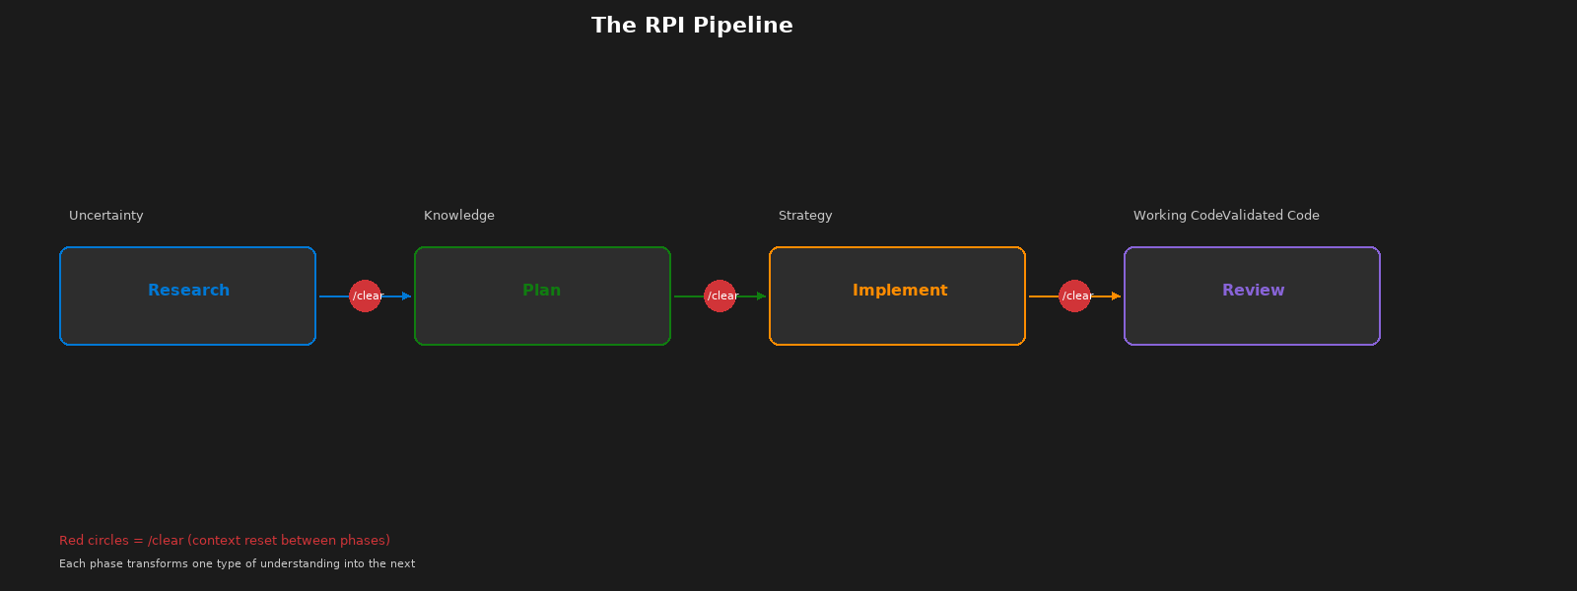
The RPI Pipeline
Notes:
Each phase converts one form of understanding into the next. Uncertainty becomes knowledge. Knowledge becomes strategy. Strategy becomes working code. Working code becomes validated code. The /clear markers between phases prevent context contamination — the researcher's reasoning must not leak into the implementor.

Slide 7
Deep Dive: Each Phase
Research
Plan
Implement
Review
Purpose
Discover what exists
Core Constraint
CANNOT implement or modify code
Key Output
research.md with citations
Invocation
/task-research
Purpose
Sequence the work
Core Constraint
CANNOT implement or modify code
Key Output
plan.instructions.md + details.md
Invocation
/task-plan
Purpose
Execute the plan
Core Constraint
MUST follow plan — no creative decisions
Key Output
Working code matching plan
Invocation
/task-implement
Purpose
Validate the output
Core Constraint
CANNOT modify code — only report findings
Key Output
8-dimension review report
Invocation
/task-review
Notes:
The constraints row is the key architectural element. The researcher cannot implement — so it searches instead of inventing. The planner cannot implement — so it sequences instead of coding. The implementor follows the plan — no creative decisions. The reviewer cannot modify code — only validate. Each constraint forces the AI into its correct mode of operation.

Slide 8
Quality Comparison + The /clear Rule
Traditional AI
Dimension
RPI Approach
Invents plausible patterns
Pattern matching
Finds actual codebase patterns
No audit trail
Traceability
Research → Plan → Code
Lost between sessions
Knowledge transfer
Preserved in artifacts
30-50% discarded
Rework
< 10% rework
Manual review only
Validation
8-dimension structured review
The /clear Rule: Context Reset Between Phases
Research
/clear
Plan
/clear
Implement
/clear
Review
Context clearing prevents mode contamination — the researcher's reasoning must not leak into the implementor's execution context.
Notes:
For TPMs: the traceability row is your strongest argument for RPI adoption. Every line of code traces back through a plan to a research finding. For everyone: the /clear rule sounds counterintuitive — why throw away context? Because context contamination causes the researcher's reasoning patterns to leak into the implementor, creating mode confusion. Each phase needs a clean start with only its designated inputs.

Slide 9
Six Custom Chat Modes
RPI Cycle
Complementary
Task Researcher
/task-research
Prompt Builder
/prompt-build
Constraint: Cannot implement
Constraint: Orchestrates subagents
Task Planner
/task-plan
Constraint: Cannot implement
PR Review
Agent picker
Constraint: Never modifies code
Task Implementor
/task-implement
Constraint: Follows plan only
Task Reviewer
/task-review
Constraint: Cannot modify code
Every mode enforces specific constraints — AI cannot bypass its designated role
Notes:
Four modes form the RPI cycle. Two additional modes serve specialized functions. Prompt Builder creates the artifacts that configure the agents — it's meta-level. PR Review is an 8-dimension quality gate that complements Task Reviewer. Every mode has a constraint that prevents the AI from doing something specific. That's what makes the framework reliable.

Slide 10
Let's See It in Action
Live Demo: RPI Workflow — Researching and Planning a Feature
Watch for:
1.
How the researcher finds existing patterns (not invents code)
2.
How it cites specific files and line numbers
3.
How the plan references the research artifacts
Demo: ~5 minutes in VS Code • Research → /clear → Plan
Notes:
I'm going to run through Research and Plan live. Watch for three things: First, how the researcher searches the codebase instead of inventing code. Second, how it cites specific files and line numbers. Third, how the plan references the research artifacts. Demo flow: open VS Code, run /task-research, show output, /clear, run /task-plan with research file, show plan and details output.

Slide 11
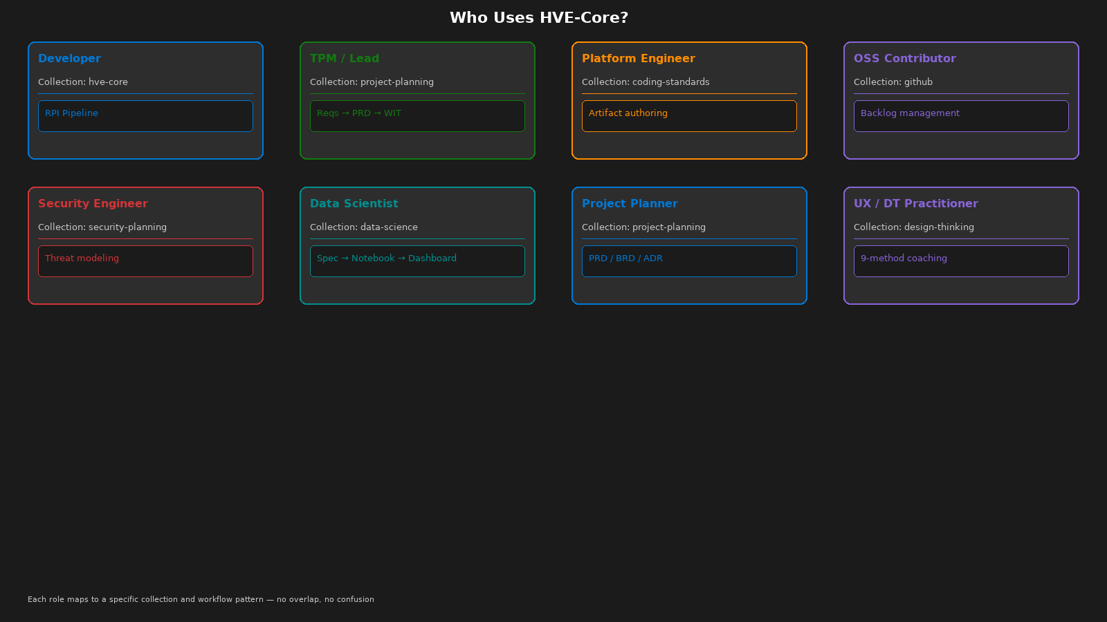
Who Uses HVE-Core?
Notes:
HVE-Core isn't just for developers. TPMs use project-planning for Requirements → PRD → ADO work items. Platform engineers use coding-standards for artifact authoring. Security engineers use security-planning for threat models. Data scientists have their own Spec → Notebook → Dashboard workflow. Roles don't share workflows — collections make that separation automatic.

Slide 12
Dogfooding + Enterprise Validation
Self-Referential Credibility
• This presentation was planned using RPI
• Every agent was built by the Prompt Builder agent
• Instructions files follow their own rules
• Collection manifests are validated by their own CI
• Documentation is generated from the same artifacts
If HVE-Core doesn't work on itself,
why would it work on your project?
Validation Pipeline
Linting (7 jobs)
Markdown, YAML, frontmatter, links,
tables, collections metadata, version consistency
Analysis (2 jobs)
PowerShell PSScriptAnalyzer, skill validation
Security (3 jobs)
Dependency pinning, SHA staleness, copyright
Schema Validation
Collection YAML → plugin generation → extension packaging
Notes:
HVE-Core uses its own tools to build itself. This presentation was planned using the RPI workflow. Every agent was built by the Prompt Builder agent. The validation pipeline runs 12+ automated checks on every PR. If it doesn't work on itself, why would it work on your project? Self-referential credibility is the strongest argument for adoption.

Slide 13
Extension Ecosystem
Extension
Agents
Prompts
Instructions
Focus
hve-core
21
23
18
Core RPI + all foundations
hve-ado
9
19
10
Azure DevOps integration
hve-github
9
19
10
GitHub backlog management
hve-project-planning
13
15
5
PRD / BRD / ADR workflows
hve-security-planning
9
16
5
Threat modeling
hve-rpi
8
14
5
Standalone RPI cycle
hve-prompt-engineering
8
14
5
Artifact authoring
hve-data-science
1
1
0
Data science workflows
Common base: 8 core agents + 5 core instructions shared across all extensions
Notes:
8 VS Code extensions organized by role. hve-core is the full package with 21 agents, 23 prompts, and 18 instruction files. Specialized extensions like hve-ado and hve-github focus on specific workflows. All share a common base of 8 core agents and 5 core instructions. Pick the extension that matches your role.

Slide 14
Learning Curve & Compounding Value
The Honest Truth
The Payoff
Your first RPI workflow will feel slower.
You'll wonder why you can't just ask AI to code it.
You'll feel like the constraints are slowing you down.
You'll want to skip the research phase.
That's normal. Stay with it.
By your third feature, the workflow
feels natural.
Research artifacts compound across features.
Plans reference previous research findings.
Rework drops below 10%.
The framework pays for itself.
Evolution Timeline
v1.1.0
Jan 19 — Initial release
v2.0.0
Jan 28 — Breaking: agent restructure
v2.3.4
Feb 13 — Stable + extensions
Notes:
Be honest with your team: the first RPI workflow feels slower. That's by design. You're building research artifacts that compound across features. By the third feature, the workflow feels natural and you'll wonder how you worked without it. The version timeline shows rapid iteration — v1.1.0 in January, breaking restructure at v2.0.0 nine days later, stable at v2.3.4 two weeks after that.

Slide 15
Getting Started
VS Code Extension • 10 seconds
Peer Clone • 2 minutes
Codespaces • 1 click
Zero-config
Install from marketplace
Recommended for most users
Customizable
Clone .github/ into your repo
For teams with custom needs
Zero-config
Pre-built dev environment
For quick exploration
github.com/microsoft/hve-core
Try /task-research on your next feature
Questions?
Notes:
Three ways to get started. VS Code Extension is fastest — 10 seconds, zero config. Peer Clone gives you customization — clone our .github/ folder into your repo. Codespaces gives you a full pre-built environment in one click. The call to action: try /task-research on your next feature. Don't change your whole workflow — just use the researcher once and see what happens. Resources: getting-started guide, first-workflow tutorial, docs/rpi/ documentation.

